Slide 1
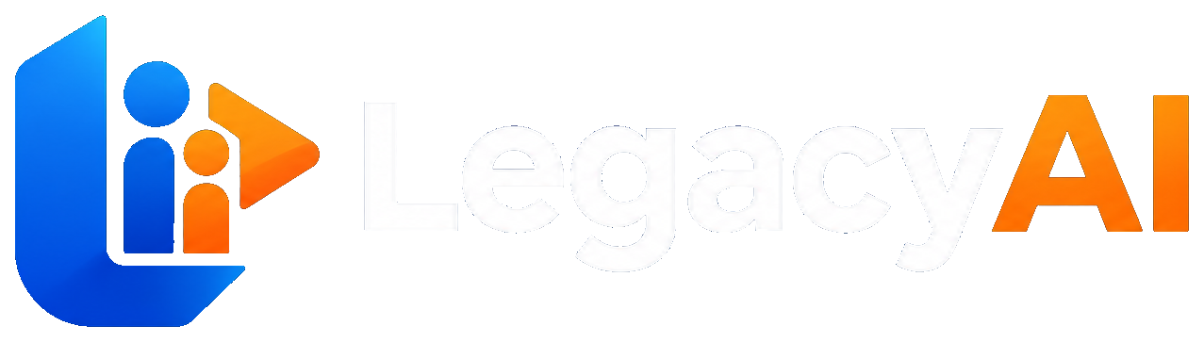
LegacyAI
AI-Assisted Wealth Transition & Emergency-Fund Diversification
Bridging Generational Trust: AI for Asset & Family Transitions
Central Michigan University
Vrutant Vyas · Rishita Arora · Prosper Mapepa · Riya Gurung
Built for PNC Private Bank · Scenario: Inheritance & Intergenerational Wealth Transfer
Live prototype → scan QR on final slide

Slide 2
Banks keep parents. They lose the kids.
The retention cliff at intergenerational transfer
97%
20–45%
81%
Parent retention
Heir retention
Heirs plan to switch
Schwab — clients stay
Cerulli / Natixis
Capgemini — stated intent
Our thesis
Heirs don’t leave because families are unhappy — they leave because no trust exists with the bank before the money moves. LegacyAI earns that trust early: consent-first family continuity + advisor intelligence that turns idle cash into a calm, advisor-approved plan.
LegacyAI · Central Michigan University · 2026 CSL Case Competition

Slide 3
Market opportunity — and what is at risk
Inheritance scenario: capture net-new assets and retain relationships at transfer
$105T
~$4.8T/yr
Expected to pass to heirs by 2048
Average annual transfer, 2026–2048
Cerulli Associates, 2024
Team calc. from Cerulli
$2.6–$3.8T/yr
$26–$38B
Addressable transfer flow we bridge
1% of that flow — annual upside scale
Market opportunity band
Illustrative capture band
LegacyAI · Central Michigan University · 2026 CSL Case Competition

Slide 4
Customer discovery → product decisions
Friction themes from published research + dual-persona journey testing on the prototype
Friction
What we heard / read
How LegacyAI responds
No bank relationship before transfer
Heirs meet the institution after the money moves.
Family Hub: invite next-gen years earlier; heirs see a plan while Principal is present.
Cold outreach breaks trust
Advisors need warm introductions, not surprise calls.
Consent gate: Outreach stays locked until Principal taps Allow call.
Idle cash vs. emergency fear
Families keep excess cash liquid because crises feel sudden.
AI sizes a 3-month reserve, then suggests risk-aware growth — advisor + customer approve.
Privacy is the deal-breaker
Families will not share if answers feel exposed.
Role-based desks; lesson answers private; no inferred external-bank activity.
Sources: Cerulli, Capgemini, Natixis, Schwab, BlackRock (account sharing). Primary journey validation via working prototype.

Slide 5
One family. Four roles. One path.
Dual-sided journey: Advisor Intelligence Workbench ↔ Client / Family Experience
1
2
3
4
5
6
ADVISOR
ADVISOR
PRINCIPAL
ADVISOR
HEIR
ADVISOR
AI Analysis
Book
Hub
Outreach
Intake & Plan
Report
Rank the book
Prepare the brief
Invite + Allow call
Warm intro only
Guided + private
Full decision trail
Nothing moves without Principal consent and advisor judgment. AI calculates. Humans decide.
LegacyAI · Central Michigan University · 2026 CSL Case Competition

Slide 6
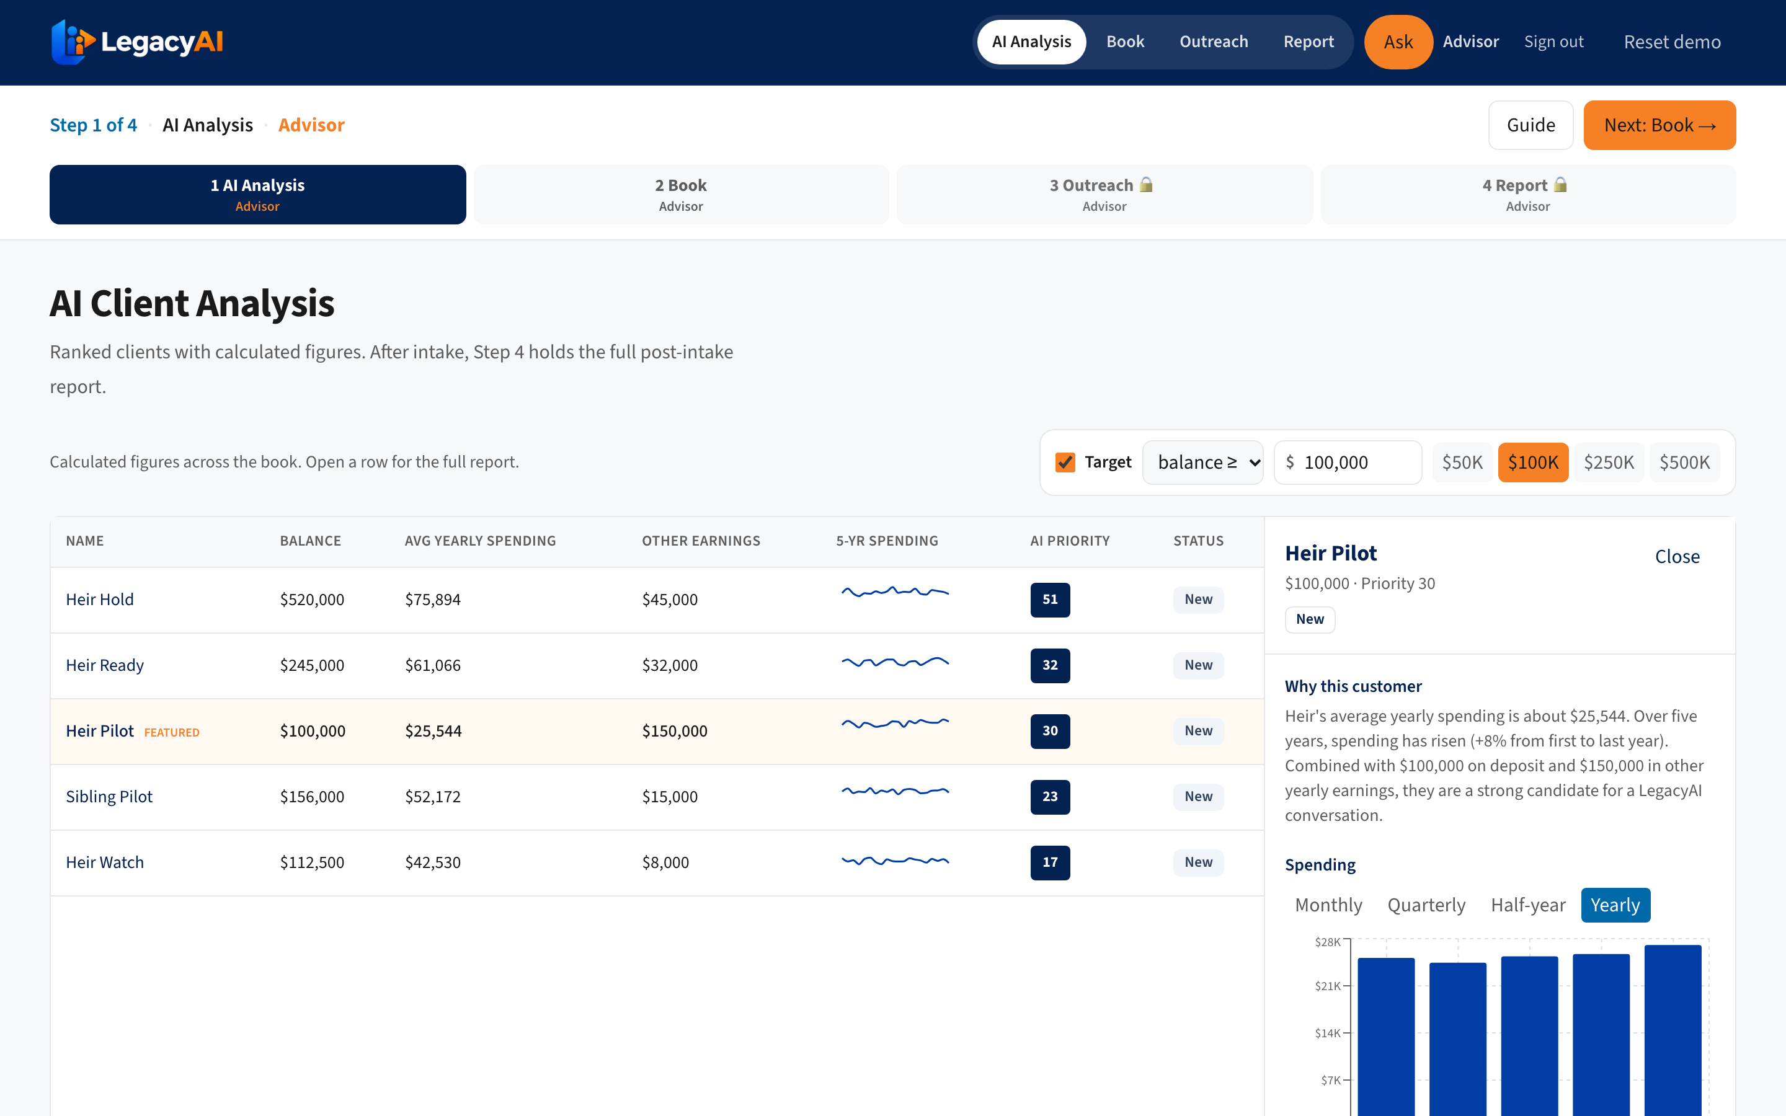
Advisor Intelligence Workbench
AI Client Analysis ranks who needs a conversation — with explainable priority, not a black box
Where AI works
Ranks clients by idle cash, spending trend, and earnings context
Surfaces an AI Priority score + “why this customer”
Where humans decide
Advisor opens the family desk and owns the brief
Outreach stays locked until Principal allows the call
Specific, not vague
Rules + figures on the bank record — never inferred external activity
LegacyAI · Central Michigan University · 2026 CSL Case Competition

Slide 7
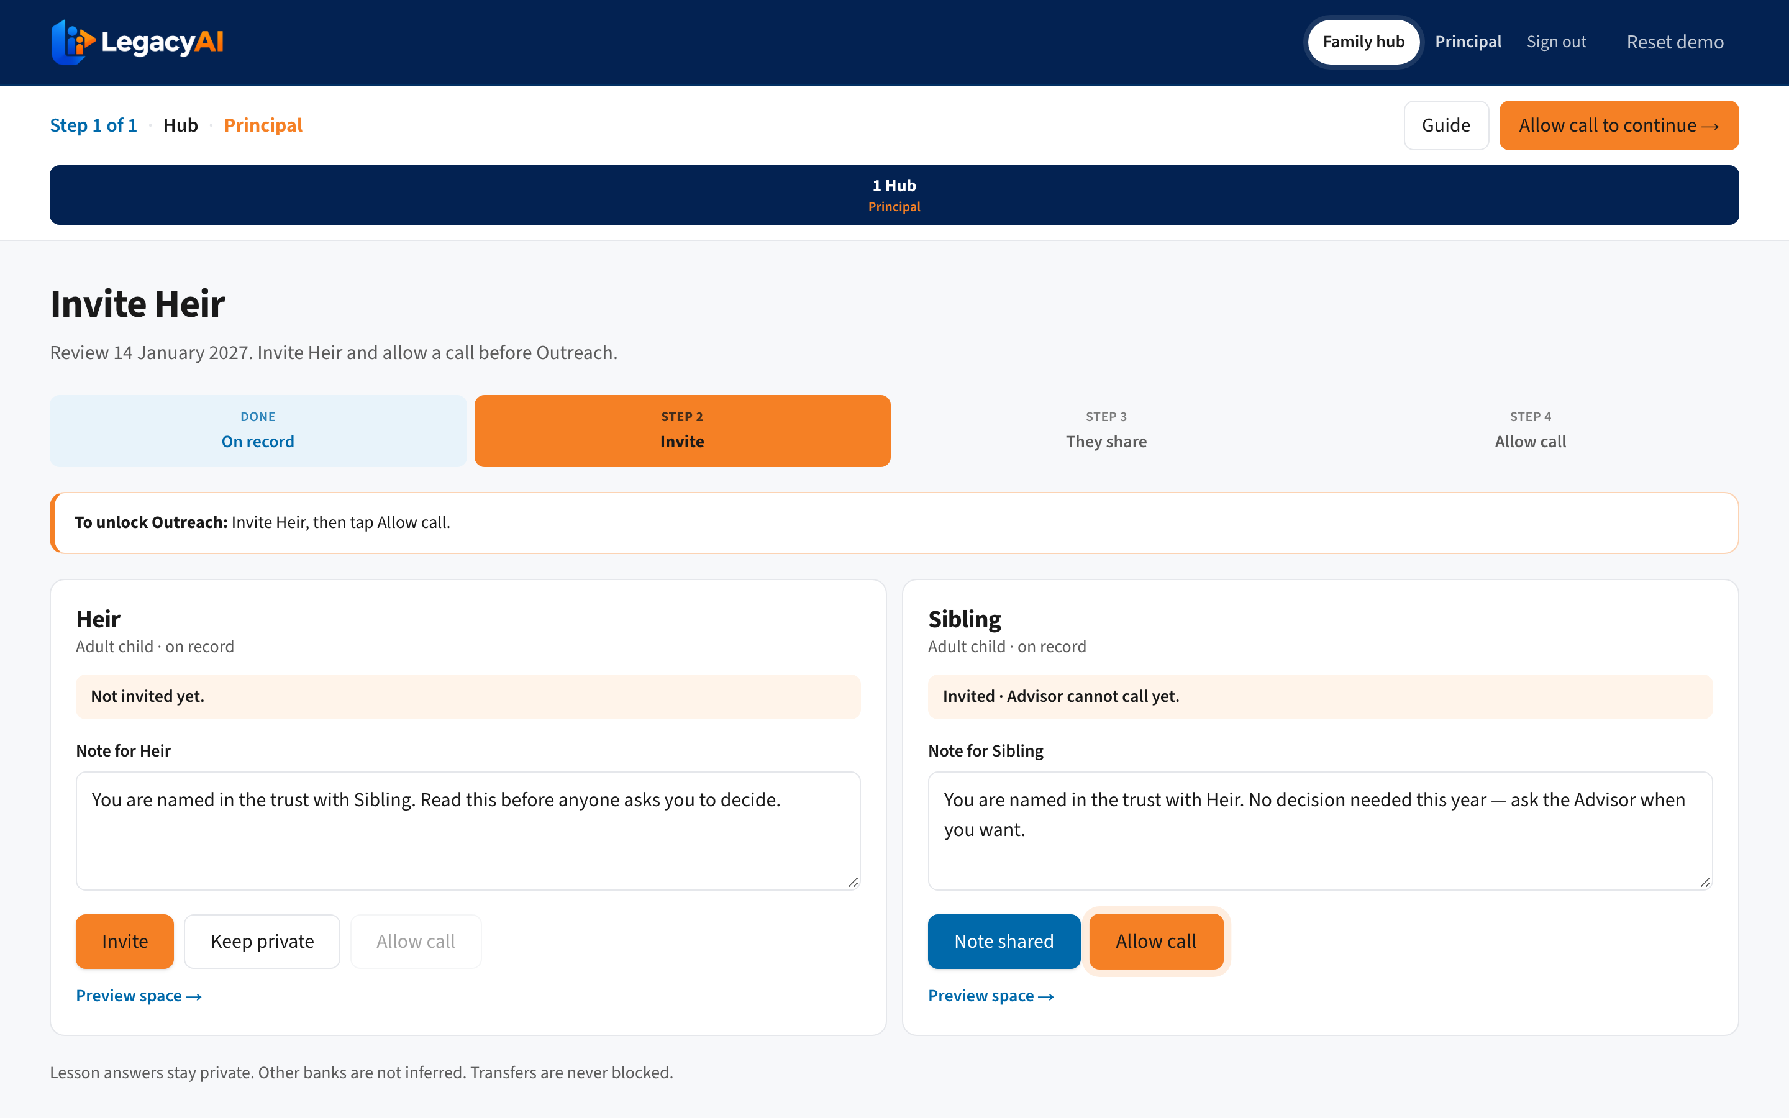
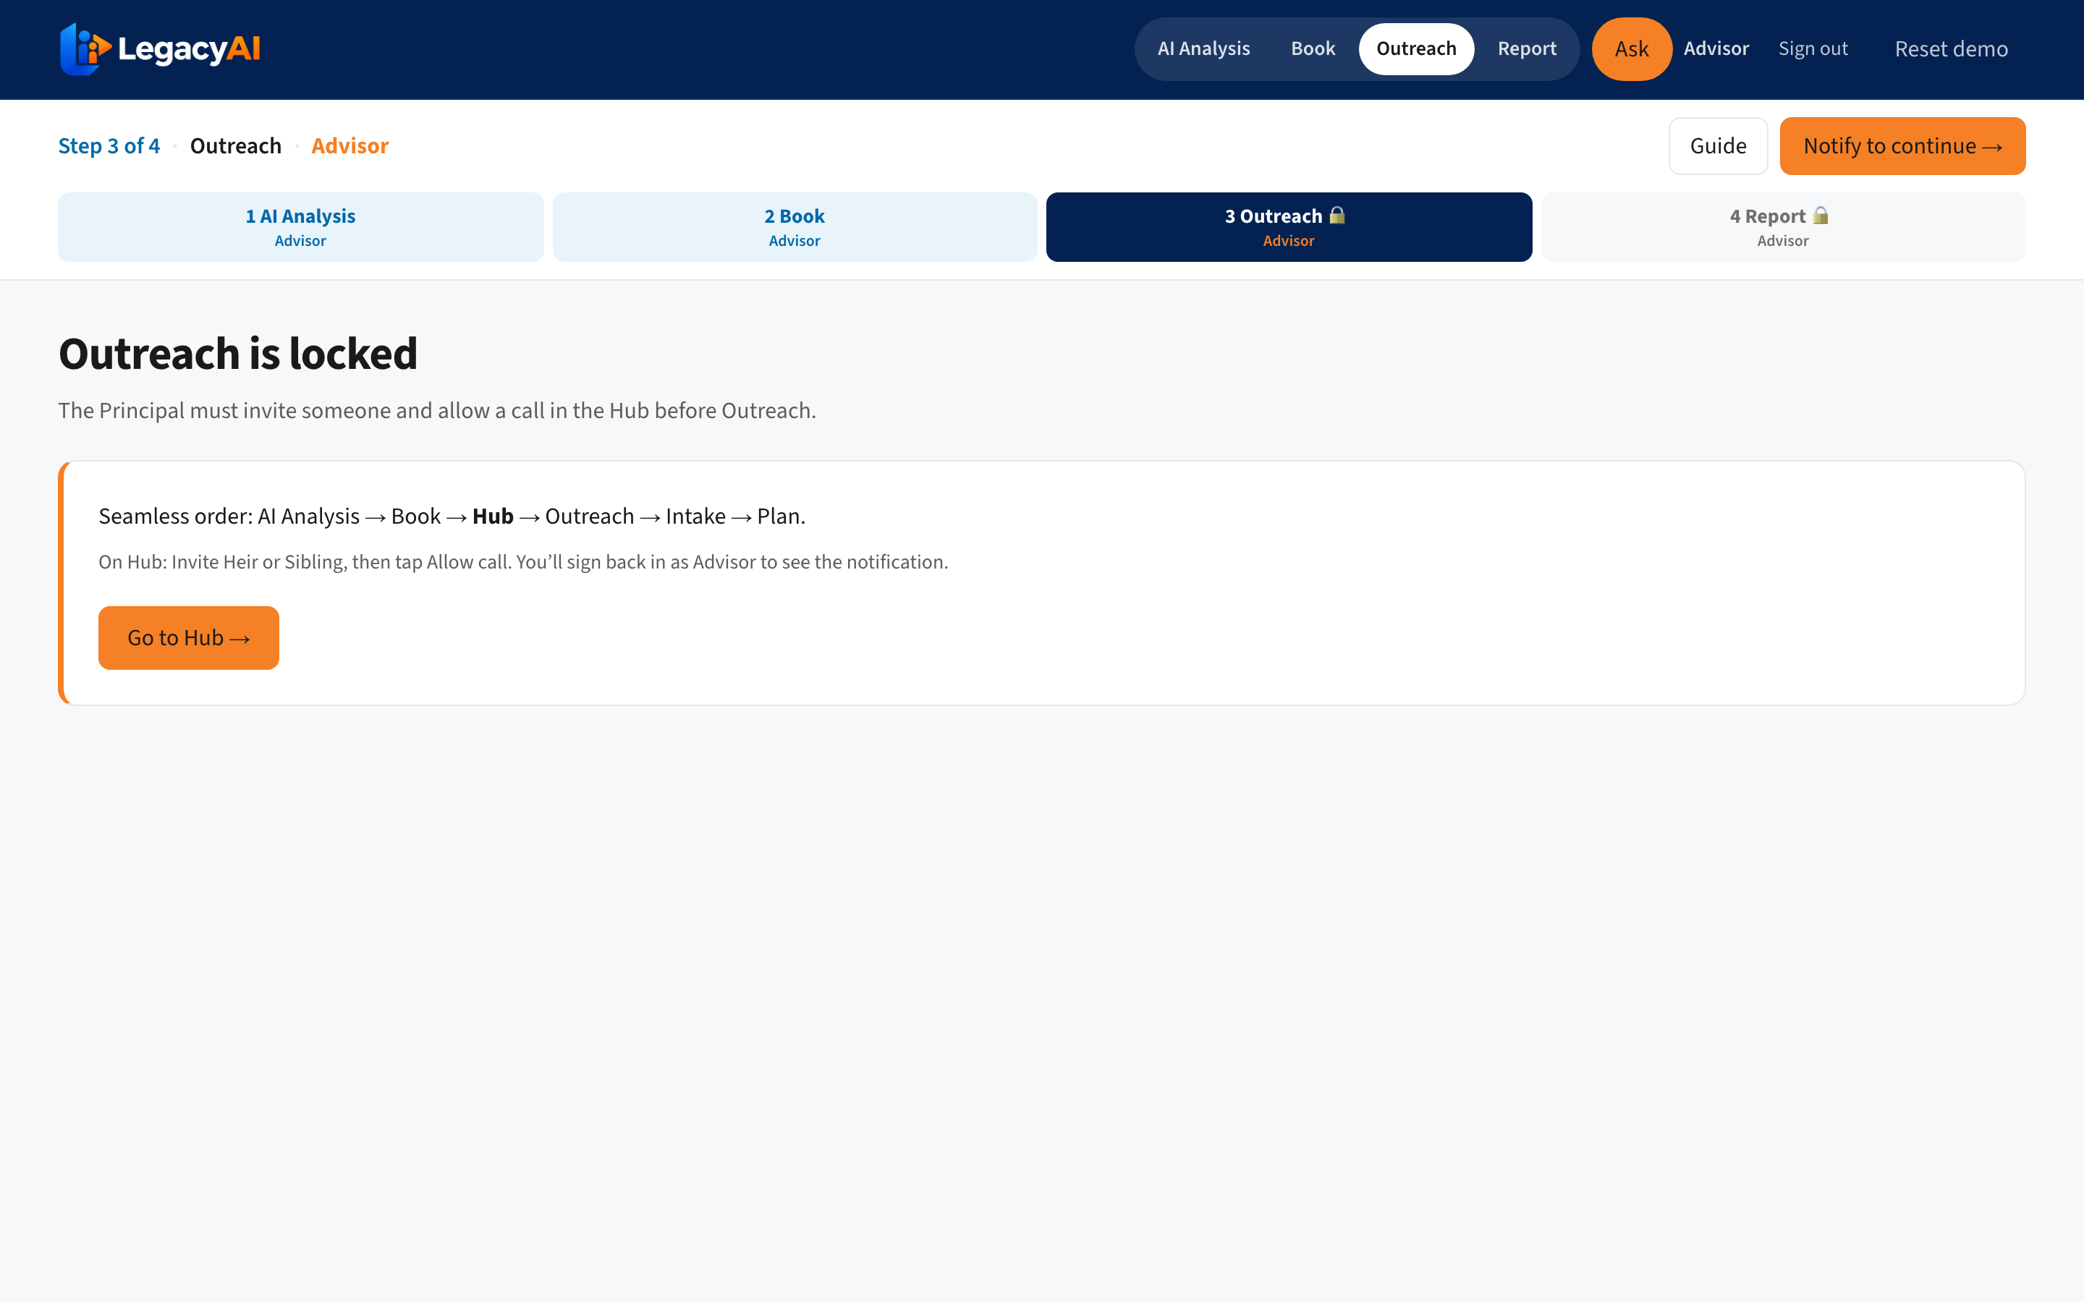
Client & Family Experience
Principal controls the invitation. Heirs get clarity without pressure.
Family Hub — Invite Heir, then Allow call
Outreach locked until consent — trust by design
LegacyAI · Central Michigan University · 2026 CSL Case Competition

Slide 8
Secret sauce — consent-gated continuity OS
Generative AI is common. A hard consent workflow on the bank record is not.
Consent as infrastructure
Multi-role truth model
Outreach cannot start without Principal Allow call. That single gate is our unfair workflow advantage.
Advisor, Principal, Heir, Sibling see different desks from the same household record — role ACL, not one shared inbox.
AI calculates / humans approve
Hard to copy
90-day emergency reserve, risk-aware split, care-cost set-aside. Advisor sets the final plan; customer confirms. Nothing moves alone.
Competitors can add chatbots. Copying a bank-integrated, consent-first, dual-sided operating path requires product + compliance + culture change.
LegacyAI · Central Michigan University · 2026 CSL Case Competition

Slide 9
Business thesis & adoption hypotheses
How LegacyAI creates ROI — and what we must prove next
Value creation
• Retain inherited PNC deposits that would otherwise leave at transfer
• Capture net-new assets via heir onboarding + idle-cash plans
• Increase advisor capacity with ranked book + ready briefs
• Grow deposit margin and advisory fees on plan assets
Hypotheses to validate
H1: Consent-first outreach lifts heir meeting conversion vs. cold call
H2: Advisors adopt ranking if briefs save ≥15 min / household
H3: 3-month reserve + growth split increases plan acceptance
H4: Pilot vs. control shows 6–12 mo retention lift on inherited assets
LegacyAI · Central Michigan University · 2026 CSL Case Competition

Slide 10

Finalist roadmap — and try the live prototype
Iterate with deeper discovery, GTM, and measured pilot design
Now
If Finalists
Pilot
Scale
Working dual-sided prototype
Consent-gated demo path
More advisor & family interviews
Harden AI explainability
Pittsburgh book + control group
KPIs: engagement, retention, NNA
$100K+ idle cash → broader book
Advisor rollout playbook
Scan to open live demo
legacy-ai-phi.vercel.app
Start full demo → Advisor seat
Find the money. Protect the family. Keep the relationship.
Landing also: legacayai.vercel.app · Demo password: LegacyAI1
LegacyAI · Central Michigan University · 2026 CSL Case Competition

