Slide 1
AWS Managed Blockchain QuickStart
Kirk Kalvar
Senior Software Engineer/Principal
KAL Technology
kirk.kalvar@kal.technology
@kskalvar

Slide 2
Introduction
Blockchain, more than cryptocurrency
IBM (IBM) has 1,500 employees working on more than 500 blockchain projects in industries like shipping, banking, healthcare and food safety

Slide 3
Why AWS Managed Blockchain?
AWS Managed Services enable you to quickly and easily deploy your blockchain infrastructure
Amazon Managed Blockchain runs up-to-date versions of Hyperledger Fabric. Currently 1.2
Ethereum is included on their Roadmap
On Demand

Slide 4
Requirements
AWS Account (root)
An EC2 Instance in which to install AWS CLI Version 1.16.x or greater
Installation time ~30 minutes

Slide 5
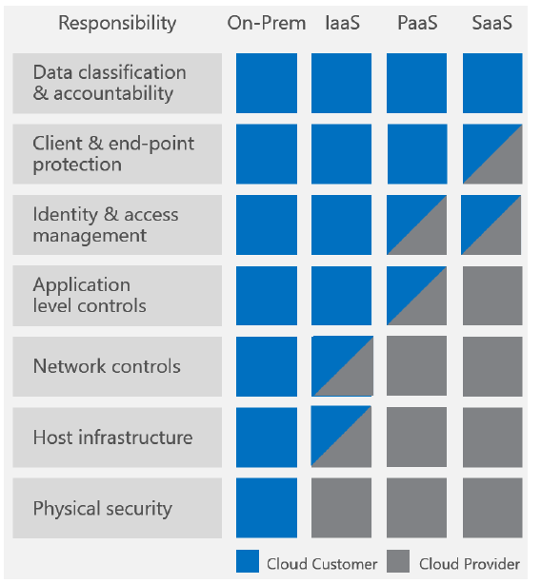
AWS Shared Responsibility Model

Slide 6
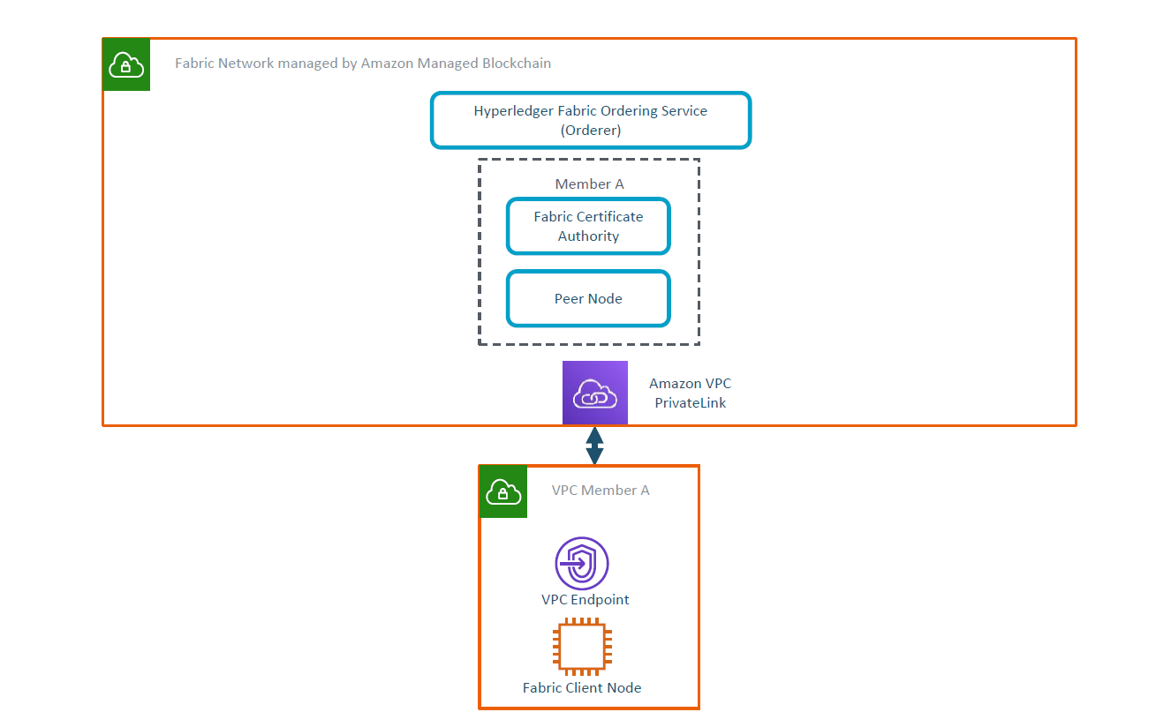

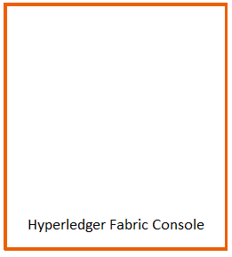
Architecture
AWS Responsibility
Customer Responsibility

Slide 7
Installation Steps
Create Amazon Managed Hyperledger
Create Amazon Managed Hyperledger Fabric Peer Node
Create AWS EC2 Hyperledger Console Instance
Create AWS EC2 Hyperledger Fabric Client Node
Configure AWS EC2 Hyperledger Fabric Client Node and Enroll Identity
Using the AWS EC2 Hyperledger Fabric Client Node
Notes:
Send a simple text message
Use representative website
Use phone dialer
Use web browser

Slide 8
Quick Demo
To save time an AWS Managed Blockchain has already been configured using AWS Management Console, EC2 cloud-init, AWS CloudFormation, and scripts.
I’ve already:
Created a Fabric Channel
Joined the Peer Node to the Channel
Installed Chaincode
Instantiated the Chaincode on the Channel
We should be able to perform basic operations using the Chaincode:
Query the Chaincode
Invoke a Transaction
Notes:
Send a simple text message
Use representative website
Use phone dialer
Use web browser

Slide 9
Conclusions
Cons
Unfortunately this is still a pretty manual effort right now, not what I would expect for a AWS Managed Service
Need for bash scripts, CloudFormation, and EC2 cloud-init scripts to speed setup process
Pros
Quickly provide Blockchain Infrastructure
On Demand
Notes:
Send a simple text message
Use representative website
Use phone dialer
Use web browser

Slide 10
Questions?

Slide 11
References
AWS Managed Hyperledger Fabric QuickStart
https://github.com/kskalvar/aws-blockchain-fabric-quickstart
Article: IBM is betting big on blockchain technology. Is it worth the risk?
https://money.cnn.com/2018/09/06/technology/ibm-blockchain-gamble

