Slide 1
🎬 Movie Recommendation System
A Hybrid Recommendation Engine with Interactive Visualizations
React + Vite
FastAPI
Scikit-learn
D3.js
Tailwind CSS
Group Project • April 2026

Slide 2
📑 Table of Contents
01
Project Overview
06
API Endpoints
Introduction and objectives
RESTful API design with FastAPI
02
System Architecture
07
Evaluation Metrics
Full-stack design and data flow
RMSE, MAE, Precision@K, Recall@K
03
Recommendation Algorithms
08
Results & Analysis
Collaborative, SVD, and content-based methods
Performance charts and findings
04
Tech Stack
09
Key Features
Frontend, backend, and ML libraries
Search, graph, posters, and explanations
05
Frontend Components
10
Conclusion & Future Work
React pages and interactive components
Summary and next steps

Slide 3
01 Project Overview
🎯 Problem Statement
🚀 Objectives
With thousands of movies available, users face choice overload. Traditional browsing is inefficient. This project builds an intelligent recommendation system that helps users discover movies they'll love, powered by hybrid machine learning algorithms and interactive visualizations.
• Build a hybrid recommendation engine (Collaborative + SVD + Content)
• Create an interactive React-based frontend with Tailwind CSS
• Implement explainable AI – show WHY movies are recommended
• Visualize movie similarity networks using D3.js force graphs
🎬
⭐
🤖
📊
🌐
9,700+
100K+
3
4
6
Movies in Dataset
User Ratings
ML Algorithms
Evaluation Metrics
API Endpoints

Slide 4
02 System Architecture
👤
⚛️
🔗
🧠
📦
User
React Frontend
REST API
ML Engine
Data Layer
→
→
→
→
Browser Interaction
Vite + Tailwind D3 Graph Viz
FastAPI Endpoints
Hybrid Recommender
CSV Datasets Pandas + Sklearn
Data Flow
User searches a movie → React sends GET/POST request to FastAPI → Backend loads pre-computed similarity matrices → Hybrid scoring combines Collaborative (50%) + SVD (30%) + Content (20%) → Ranked results returned with explanations → React renders cards, posters (via Wikipedia API), and D3 force graph.

Slide 5
03 Recommendation Algorithms
👥
🧮
🎭
Collaborative Filtering
SVD (Matrix Factorization)
Content-Based Filtering
Weight: 50%
Weight: 30%
Weight: 20%
Computes movie-movie cosine similarity from the user-movie rating matrix. Movies liked by similar users are recommended.
Uses TruncatedSVD to extract 50 latent features, then computes cosine similarity on the compressed embeddings.
Multi-label binarizes movie genres and computes cosine similarity on genre vectors. Recommends movies with similar genres.
How it works:
How it works:
How it works:
1. Build user×movie rating matrix
2. Transpose to get movie vectors over users
3. Compute cosine similarity between all movies
1. Transpose user-movie matrix (rows=movies)
2. Apply TruncatedSVD (n_components=50)
3. Cosine similarity on movie embeddings
1. Parse genres into multi-label sets
2. Binarize with MultiLabelBinarizer
3. Cosine similarity on genre vectors
Hybrid Score = 0.5 × Collaborative + 0.3 × SVD + 0.2 × Content

Slide 6
04 Tech Stack
⚛️ Frontend
🐍 Backend & ML
▸ React (Vite)
Fast dev server, HMR, optimized builds
▸ FastAPI
High-performance async Python web framework
▸ Tailwind CSS
Utility-first responsive styling
▸ Pandas
Data manipulation and analysis
▸ react-force-graph-2d
D3-powered interactive similarity graphs
▸ Scikit-learn
Cosine similarity, SVD, ML binarizers
▸ Axios
HTTP client for API communication
▸ httpx
Async HTTP client for Wikipedia poster API
▸ React Router
Client-side routing for SPA navigation
▸ Pydantic
Data validation and API schemas

Slide 7
05 Frontend Components
🏠 Home.jsx
🎯 Recommendations.jsx
💡 PersonalizedPage.jsx
🔥 Popular.jsx
Page
Page
Page
Page
Landing page with search bar, featured movies, and navigation to all sections.
Displays top-10 recommended movies for a selected title with similarity scores & explanations.
Multi-movie input for personalized recommendations. Users select multiple liked movies.
Top-20 highest-rated movies with minimum 50 ratings. Shows average scores and genres.
🎬 MovieCard.jsx
🕸️ MovieGraph.jsx
🔍 SearchBar.jsx
📌 Navbar.jsx
Component
Component
Component
Component
Reusable card with poster (Wikipedia API), title, genre tags, score badge & explanations.
Interactive D3 force-directed graph showing movie similarity network with weighted edges.
Auto-completing search with debounced API calls. Filters movies as the user types.
Responsive navigation bar with links to Home, Popular, and Personalized pages.

Slide 8
06 API Endpoints
Method
Endpoint
Purpose
Description
GET
/movies?q=...
Search & list movies
Returns up to 50 matching movies with title, genres, and movieId
GET
/recommend/{title}
Get recommendations
Top-10 similar movies with hybrid scores and explanations
GET
/popular
Popular movies
Top-20 highest-rated movies (min 50 ratings)
POST
/personalized-recommendations
Personalized picks
Recommendations based on multiple liked movies
GET
/graph/{title}
Similarity graph
Nodes & weighted links for D3 force-graph visualization
GET
/poster/{title}
Movie poster
Wikipedia thumbnail URL for movie card display
GET
/metrics
Evaluation metrics
RMSE, MAE, Precision@10, Recall@10 performance data

Slide 9
07 Evaluation Metrics
📐 Methodology
The system uses an 80/20 train-test split on user ratings. TruncatedSVD (50 components) creates a low-rank approximation of the user-movie matrix as predicted ratings. A "relevant" item is defined as a movie the user rated ≥ 4.0 in the test set.
RMSE
MAE
P@10
R@10
Root Mean Squared Error
Mean Absolute Error
Precision at 10
Recall at 10
√(mean((pred - actual)²))
mean(|pred - actual|)
|relevant ∩ top-10| / 10
|relevant ∩ top-10| / |relevant|
Penalizes larger errors more heavily
Average magnitude of prediction errors
Fraction of top-10 that are relevant
How many relevant items are captured

Slide 10
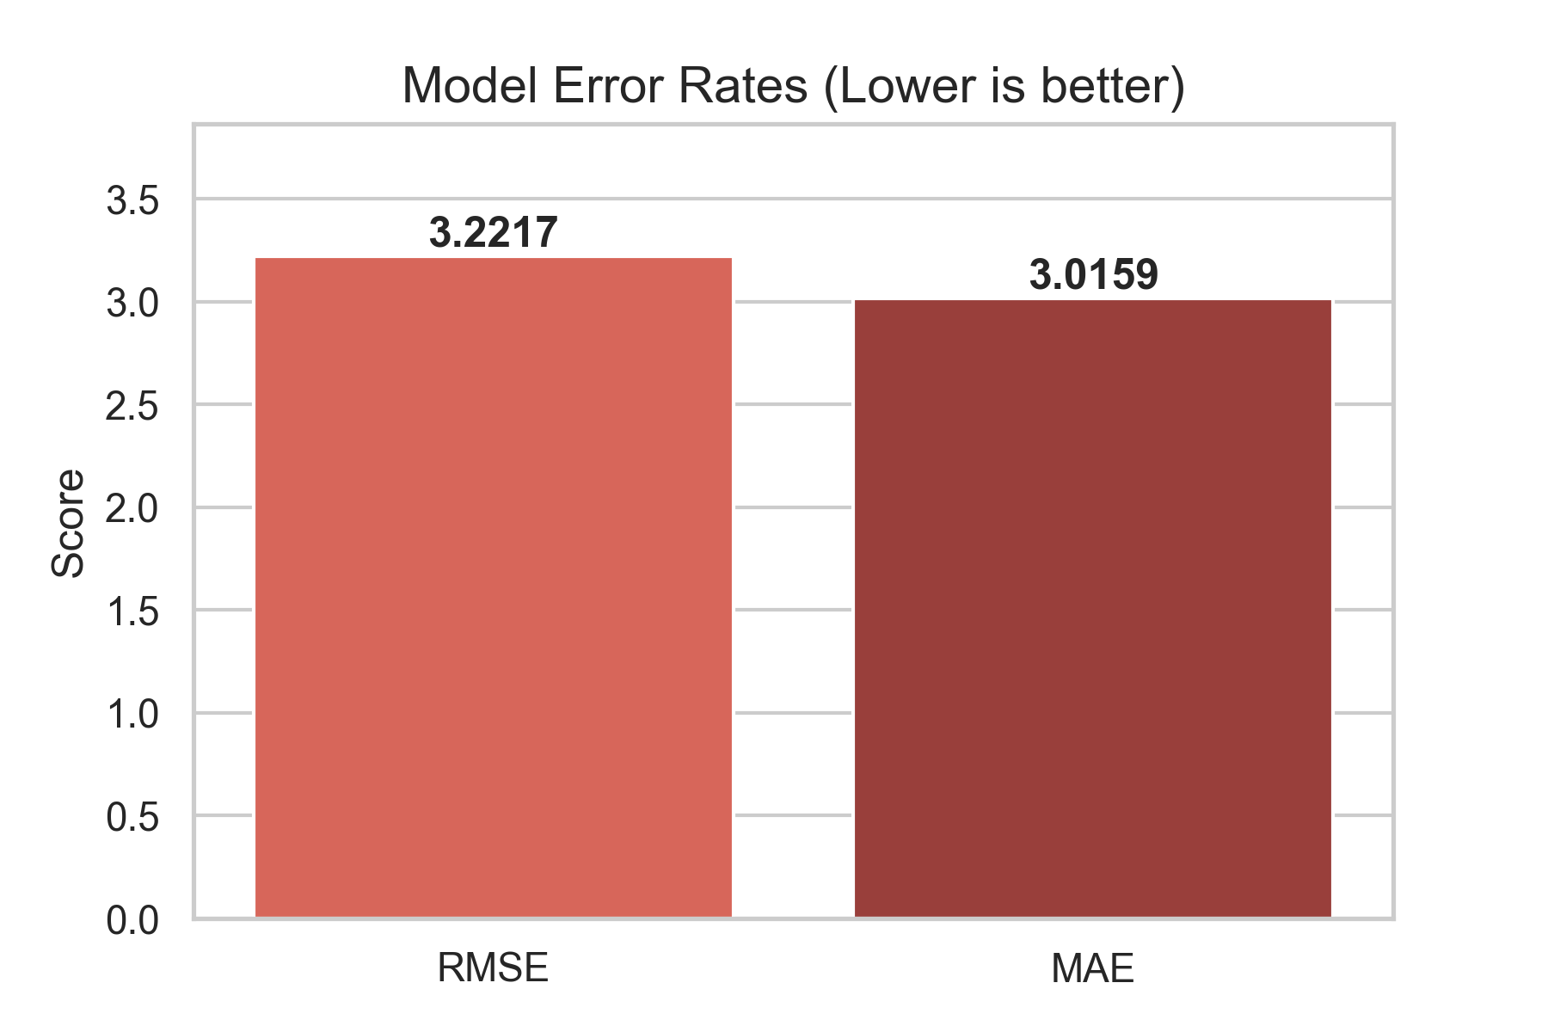
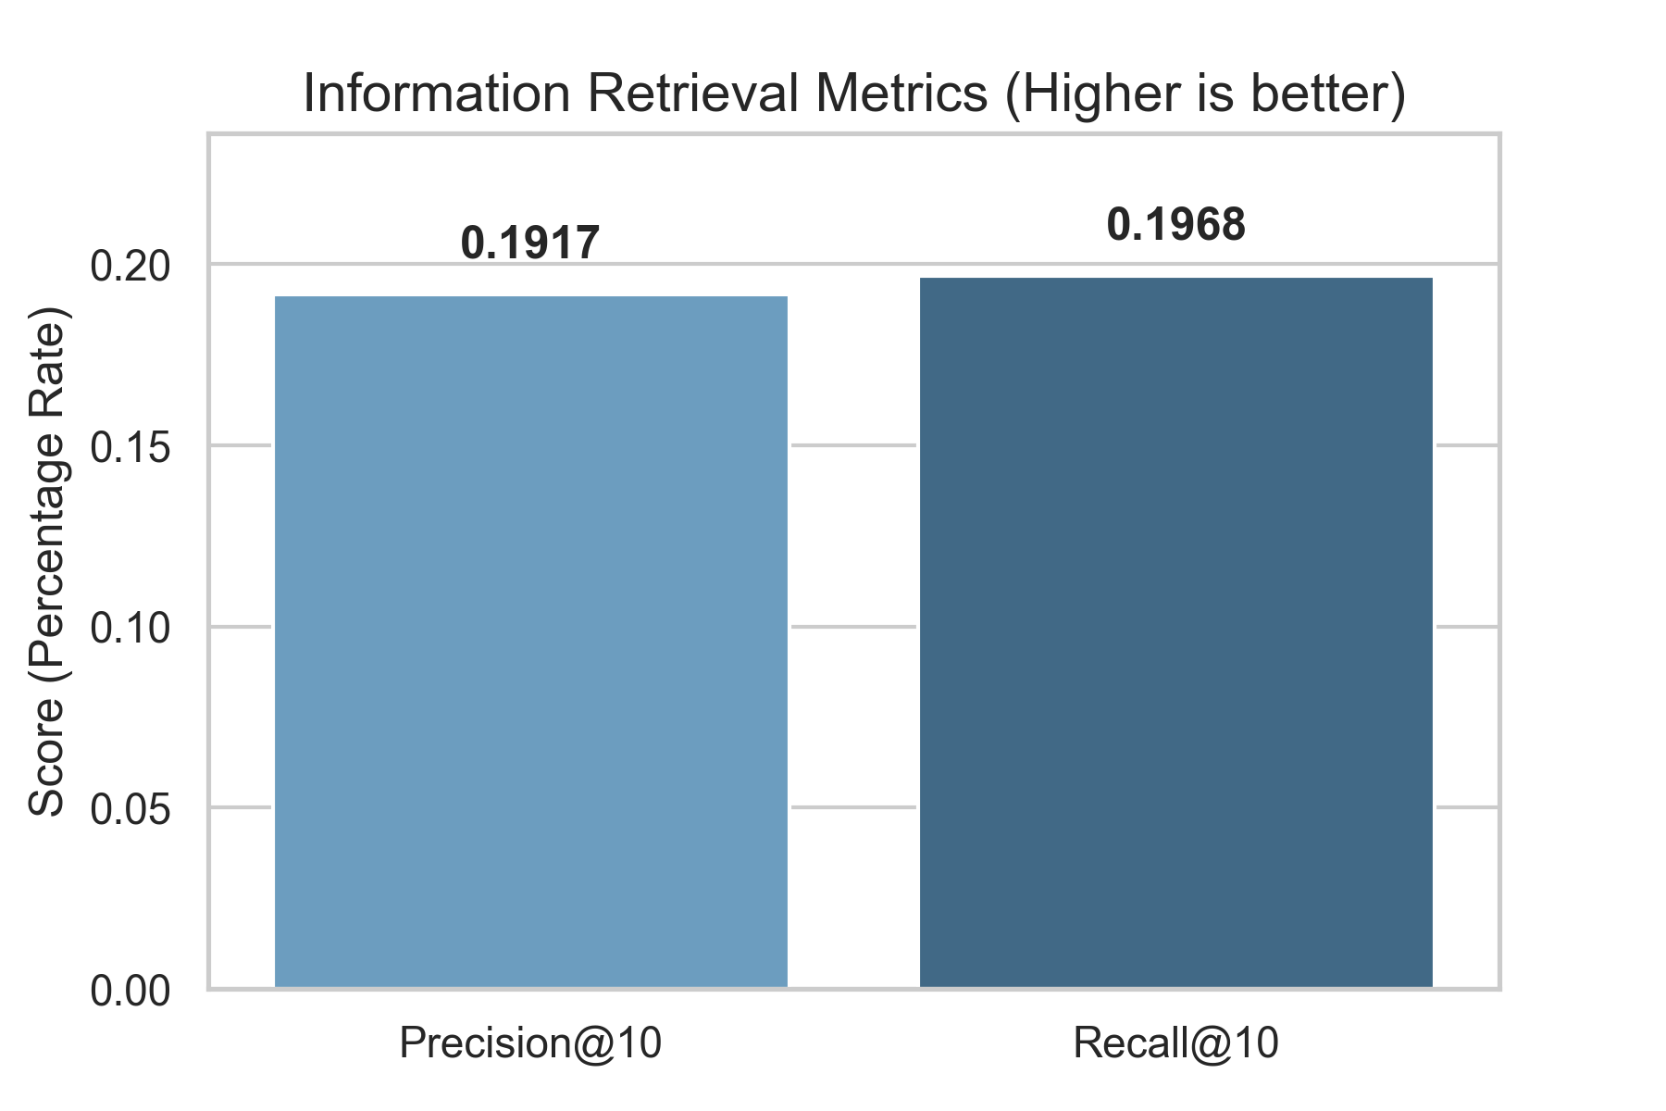
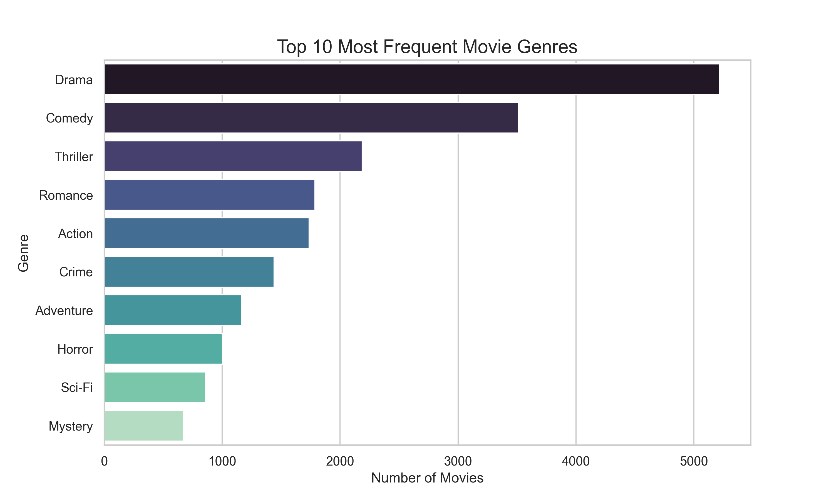
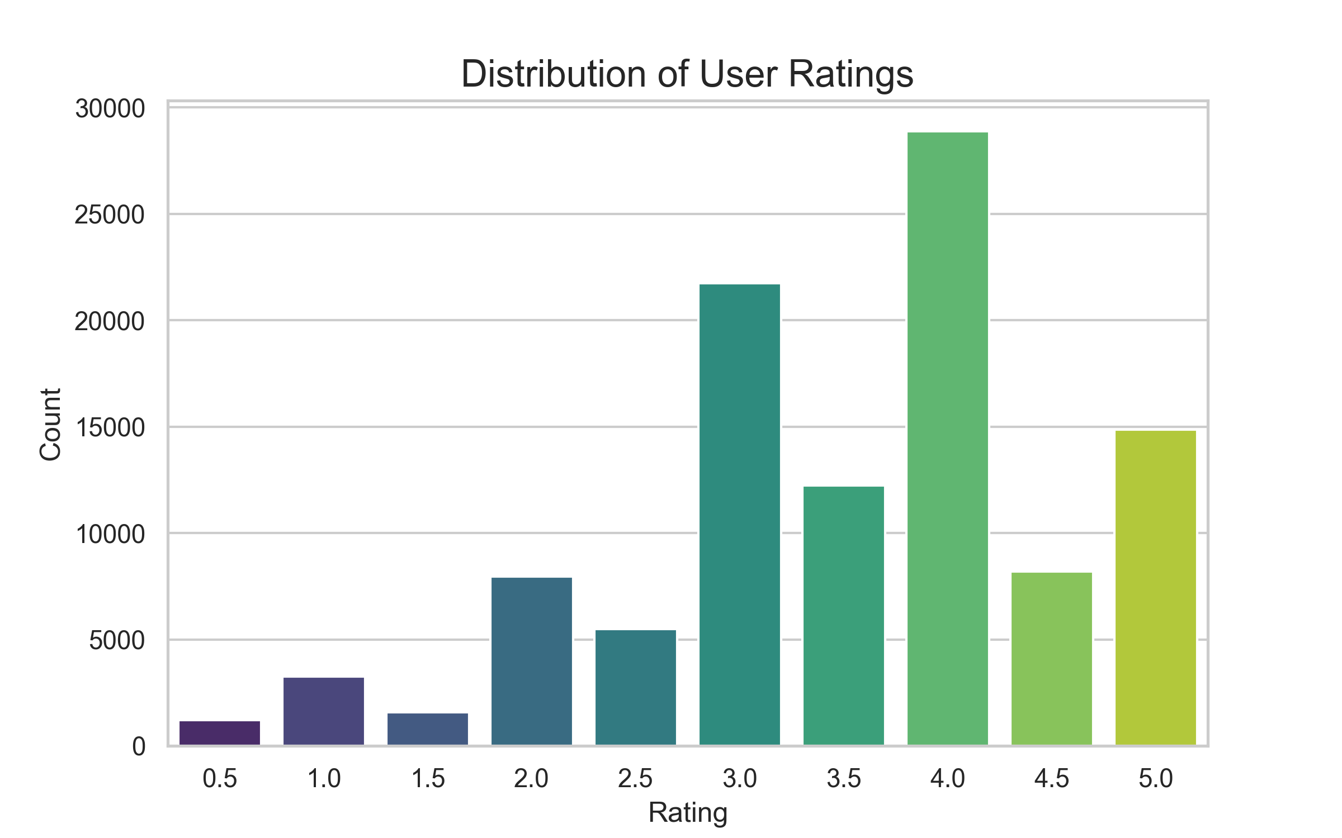
08 Results & Analysis
Error Metrics (RMSE & MAE)
Retrieval Metrics (P@10 & R@10)
Top Genre Distribution
Rating Distribution

Slide 11
09 Key Features
🔍
Smart Search
🤖
Explainable AI
🕸️
Similarity Graph
Auto-completing search with debounced API calls. Filters movies as users type, returning up to 50 results.
Each recommendation includes human-readable explanations: shared genres, collaborative signals, and latent feature patterns.
Interactive D3 force-directed network visualization. Nodes represent movies, edges show similarity weights.
🖼️
Auto Posters
💡
Personalized Picks
📊
Metrics Dashboard
Movie posters are fetched automatically from Wikipedia's REST API. No API key needed. Results are LRU-cached (2000 entries).
Input multiple favorite movies to get a tailored recommendation list based on averaged hybrid similarity vectors.
View real-time evaluation metrics: RMSE, MAE, Precision@10, and Recall@10 from an 80/20 train-test split.

Slide 12
10 Conclusion & Future Work
✅ Conclusion
🔮 Future Work
• Successfully built a hybrid recommendation engine combining three ML approaches
• Collaborative Filtering captures user preference patterns
• SVD extracts meaningful latent features from sparse rating data
• Content-Based Filtering ensures genre relevance
• Full-stack application with polished, responsive UI
• Explainable AI enhances user trust and transparency
• Integrate deep learning models (Neural Collaborative Filtering)
• Add user authentication and persistent watch history
• Implement real-time rating feedback loop
• Use TMDB API for richer metadata (cast, directors, trailers)
• Deploy to cloud (AWS / Vercel) for production use
• Add A/B testing framework for algorithm comparison
Thank You! 🎬
Questions & Discussion

