Slide 1

ZeroVM and ZVM Runtime (ZRT)
Ryan McKinney
Senior Software Engineer, Rackspace

Slide 2
Agenda
ZeroVM
What is ZeroVM?
Architecture
Guest Memory Layout
Anatomy of a Syscall
ZeroVM Runtime (ZRT)
Syscall handling (zcalls)
Code Review
ZeroVM
ZRT/ZVM-toolchain/ZeroVM interrelation

Slide 3
“Left as an exercise for the reader.”
ZeroVM
Manifests
https://github.com/zerovm/zerovm/blob/master/doc/manifest.txt
Channels
https://github.com/zerovm/zerovm/blob/master/doc/channels.txt
ZRT full library review
There’s a lot! (think glibc)
In-depth ZVM GCC toolchain architecture
It’s complicated, and I don’t want to
Native Client (NaCl) assembly
http://www.chromium.org/nativeclient/how-tos/how-to-write-assembler-for-x86-nacl-platform
GOOD LUCK!

Slide 4
ZeroVM
What is it?

Slide 5
The (sort of) Plain English Description
ZeroVM creates a secure isolated execution environment that allows users to run a single application or program.
Notes:
specifically x86_64 segmentation
Adapting Software Fault Isolation to Contemporary CPU Architectures
https://www.usenix.org/legacy/event/sec10/tech/full_papers/Sehr.pdf

Slide 6
Some Technical Details
Based on the Chromium Native Client (NaCl) project
Leverages ZeroMQ ZBroker (networked named pipes)
Includes a full compiler toolchain
ZRT provides a subset of the POSIX API
ZRT also includes a port of the CPython interpreter
Notes:
Software Fault Isolation (SFI) sandbox
segment addressing

Slide 7
ZeroVM
Architecture

Slide 8
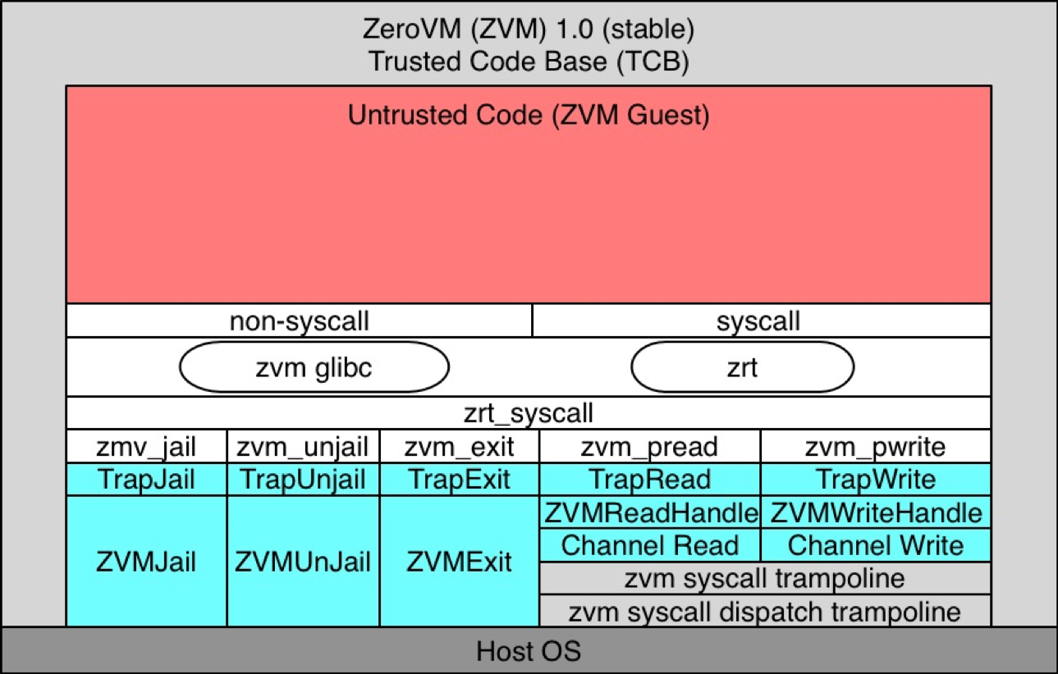
ZeroVM Architecture Overview

Slide 9
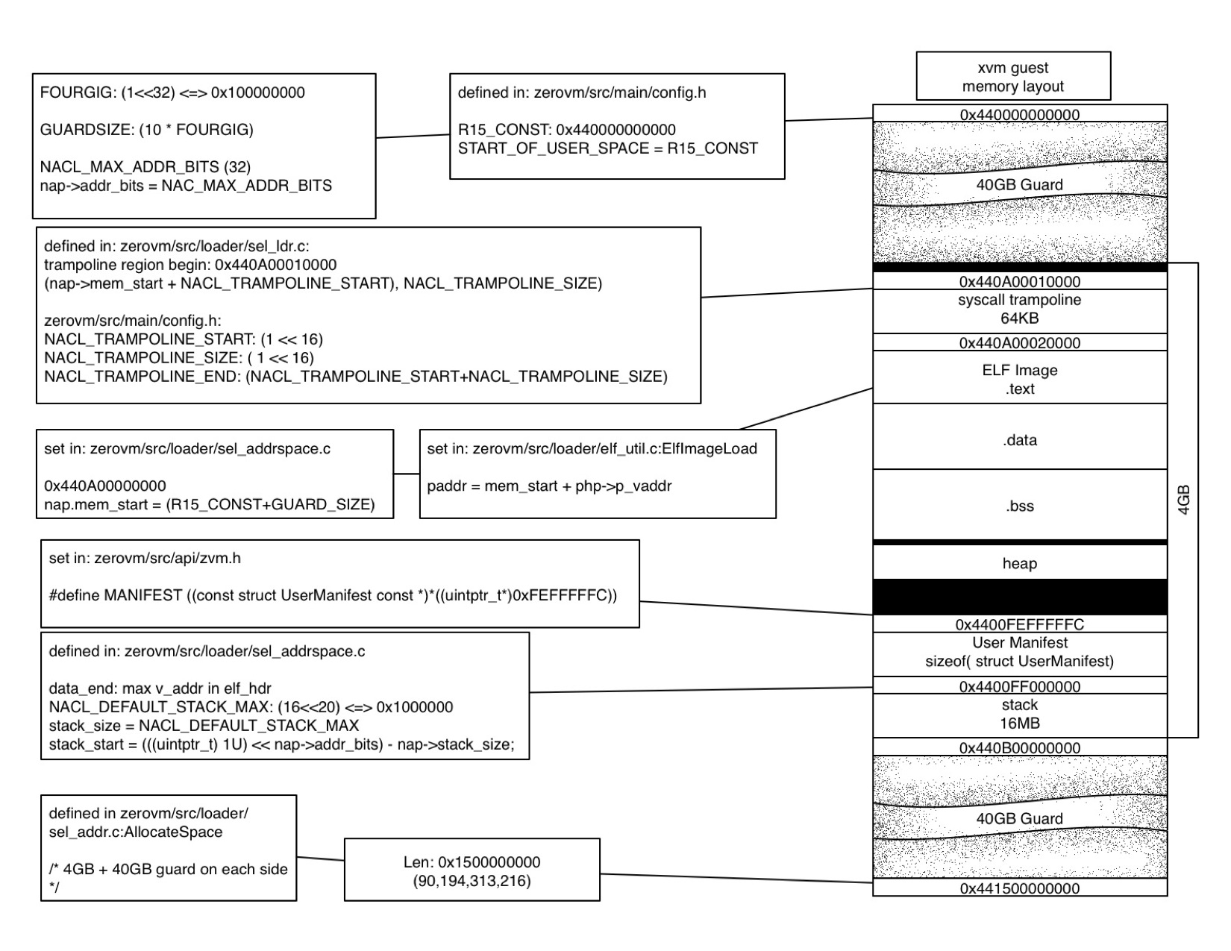
ZeroVM Guest Memory Layout

Slide 10
ZeroVM
Anatomy of a Syscall

Slide 11
ZeroVM - Traps and Trampolines
Syscalls
are the interface between untrusted and trusted codebase allowing limited and verified code execution outside of the sandbox
start as a call from untrusted code to a trampoline (TrapHandler)
ZeroVM owns a trusted context as well as an untrusted context
untrusted code cannot read the trusted stack, and trusted code can’t use the untrusted stack
nothing can use the stack unless the appropriate context switch takes place
Dispatcher does the following:
Determine which syscall was called
Look up the syscall implementation in the dispatch table
Call the syscall
Initiate the context switch back to untrusted code

Slide 12
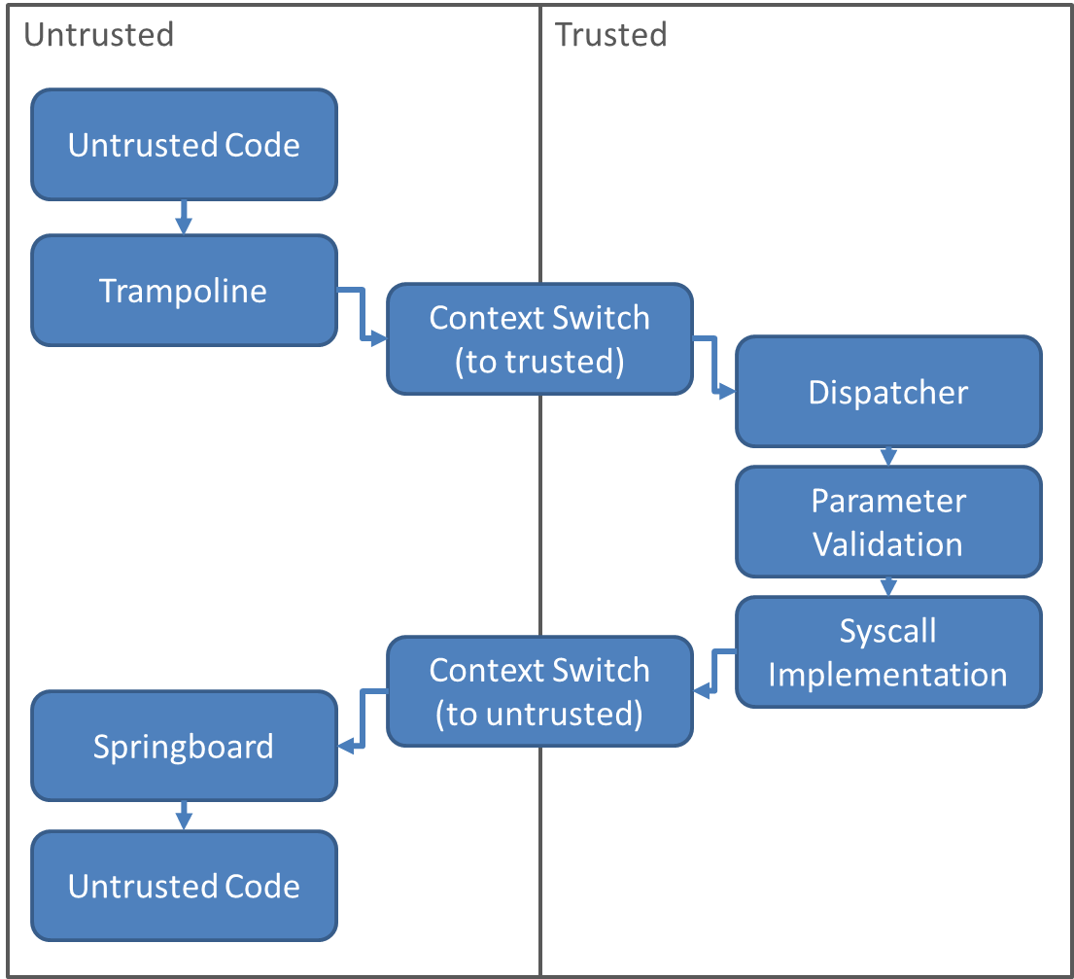
ZeroVM – Anatomy of a Syscall
Notes:
Blatantly ripped from Google Native Clients – Anatomy of a Syscall
http://www.chromium.org/nativeclient/reference/anatomy-of-a-sys

Slide 13
ZeroVM - Traps and Trampolines
Defined in: zerovm/api/zvm.h
ZVM API – (i.e. Trap functions)
TrapRead – read from channel
TrapWrite – write to channel
TrapExit – terminate the guest program
TrapJail – validation of the memory block.
if validation is successful the memory block will be marked as “read only” and “executable”
TrapUnjail – memory block will be marked as “read/write”
TrapFork – convert running zerovm to “daemon” mode.
spawn new sessions via unix socket request
new sessions will start from the address next after zvm_fork() call

Slide 14
ZeroVM Runtime (ZRT)
syscall handling (zcalls)

Slide 15
ZRT - syscalls
Syscalls
read ⬄ zmv_pread
write ⬄ zmv_pwrite
Non-Syscall Syscalls
open ⬄ handled internally by ZRT within untrusted code
close ⬄ handled internally by ZRT within untrusted code

Slide 16
Exposes ZVM API by replacing the appropriate syscalls in glibc
open
close
read
write
ZeroVM Runtime (ZRT)
Syscall handling (zcalls)
ZVM-toolchain/ZRT/ZeroVM interrelation

Slide 17
Questions?
Website: www.zerovm.org
Github: https://github.com/zerovm/
User Mailing List: zerovm@googlegroups.com
Development Mailing List: zerovm-devel@googlegroups.com
IRC: #zerovm on Freenode
Notes:
http://www.chromium.org/nativeclient/reference/research-papers

