Slide 1
Protein-small molecule interactions Protein-ligand interactions in drug action and design
Allegra Via

Slide 2
Session materials
This presentation (a video of the lecture: Protein-small molecule interactions: Protein-ligand interactions in drug action and design)
The pptx of the lecture (in presentations)
Tutorial on searching DrugBank and ChEMBL (in practicals)
A video on “Using AutoDock 4 and Autodock VINA with AutoDock Tools” by David S Goodsell
The pptx of the video (in presentations)
A video on “Introduction to Virtual Screening” by Stefano Forli
The pptx of the video (in presentations)

Slide 3
Learning outcomes
By the end of the session, learners will be able to:
provide a definition of “drug” and “drug target”
tell the main mechanisms of drug action
list the steps of the drug development process
explain what is drug repositioning and why it is important
describe the principles underlying rational drug design
describe the content of Drug Bank and ChEMBL
make queries in Drug Bank and in ChEMBL
describe how Autodock 4 and VINA do work
tell what is virtual screening and what it is useful for

Slide 4
Drug
A substance intended for use in the diagnosis, cure, mitigation, treatment, or prevention of disease
A drug can be a small-molecular-weight chemical compound or a biological macromolecule, such as an antibody or a recombinant protein

Slide 5
Biological target
Anything within a living organism to which some other entity, like an endogenous ligand or a drug is directed and/or binds.

Slide 6
“Druggable” targets
A nucleic acid or a protein (e.g. an enzyme, a receptor) known or predicted to bind with high affinity to a drug AND whose activity is modified by the drug with a therapeutic benefit to the patient
Proteins constitute ~80% of all drug targets
Other targets include mainly DNA and RNA

Slide 7
Involvement of proteins in diseases
Invading pathogens attacking the host cells or secreting toxins
Notes:
The initial attachment of the virion to the host cell is initiated by interactions between the S protein and its receptor. The sites of receptor binding domains (RBD) within the S1 region of a coronavirus S protein vary depending on the virus, with some having the RBD at the N-terminus of S1 (MHV) while others (SARS-CoV) have the RBD at the C-terminus of S1 [29,30]. The S-protein/receptor interaction is the primary determinant for a coronavirus to infect a host species and also governs the tissue tropism of the virus. Many coronaviruses utilize peptidases as their cellular receptor. It is unclear why peptidases are used, as entry occurs even in the absence of the enzymatic domain of these proteins.

Slide 8
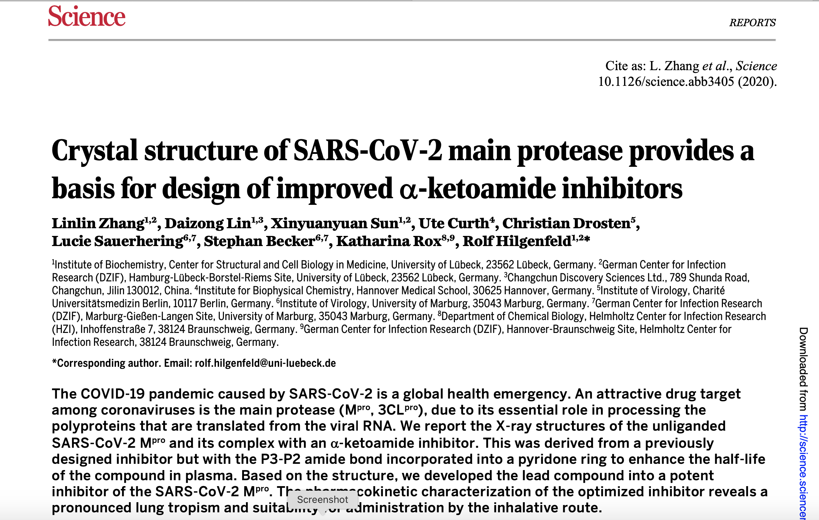

Slide 9
Involvement of proteins in diseases
External toxic compounds entering the body via air, water, food or injury
Mad cow disease
Prion protein

Slide 10
Involvement of proteins in diseases
Malfunctioning of endogenous components as a result of genetic, environmental, or age-related causes (cancer, metabolic disorders, autoimmune diseases, etc)
Protein misfolding diseases
Alzhaimer’s disease
Parkinson’s disease
Huntington’s disease
Amyloid-beta peptide; phosphorylated tau protein
Alpha-synuclein
Mutated huntingtin

Slide 11
Involvement of proteins in diseases
Loss of enzymatic activity
Receptor overstimulation
Toxins
Misfolding and aggregation
Autoimmune response

Slide 12
How drugs work
Directly: inhibiting the malfunctioning protein
Indirectly: modulating the activity of a different protein, so as to compensate for the abnormal activity of the malfunctioning protein

Slide 13

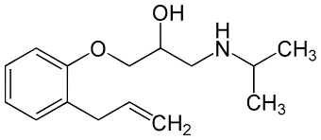
Drug effects on cell-surface receptors
Agonist: activating drug
Antagonist: inhibiting drug
In most cases, both act by "molecular mimicry" (i.e. they resemble the endogenous molecule acting on the receptor)
The chemical structure difference between agonists and antagonists may not be large
Alprenolol
Activator of the β₂ adrenergic receptor
Inhibitor of the β₂ adrenergic receptor

Slide 14
Allostery
Some drugs acting on hormone-activated receptors use allostery (non-competitive mode of action)
Example: benzodiazepines (Valium, Xanax) act as allosteric activators of GABA receptors
They stabilise GABA_{A} in a conformation that has higher affinity to the natural agonist → upregulation of the receptor's activity

Slide 15
Drug effects on enzymes
Competitive inhibition with the natural substrate
Reversible binding:
relatively easy to design but overmatched by the natural substrate →
need for high concentrations →
side effects

Slide 16
Drug effects on enzymes
Competitive inhibition with the natural substrate
Strong interactions:
Covalent bond → irreversible inhibition
Non-covalent binding but with high affinity → de facto irreversible inhibitors
Suicide inhibitors (or mechanism based inhibitors) → are modified substrates that bind to the enzyme reversibly but are converted by the normal catalytic process into irreversible inhibitors

Slide 17
Selectivity and side effects
Endogenous compounds often act on several targets
Drugs resemble endogenous compounds
Side effects are the result of low selective drugs (e.g. aspirin, COX and COX-1)

Slide 18
Drug development process

Slide 19
It takes on average 12 years and over $350 million to get a new drug from the laboratory onto the pharmacy shelf

Slide 20
Drug development process
Purification and isolation of the active ingredient of each substance/synthesis of chemical substances
Testing substance activity, selectivity and toxicity on cell cultures and isolated tissues
Repeating the tests in animal models to address systemic effects as well as drug stability, delivery, selectivity, degradation, clearance, etc.
Repeating the test on human volunteers (clinical trials)
Pre-clinical trials

Slide 21
Market attainment for a new drug
> $ 100 million
up to ~$1 billion
10-15 year process
<10% overall probability of success (typically one in a few thousands)
See: Development of New Therapeutic Drugs and Biologics for Rare Diseases
Notes:
Once a potential therapeutic drug or biologic has been discovered, the process of developing the therapeutic for a particular disease, whether rare or not, begins with preclinical development and continues through increasingly complex and demanding phases of clinical testing to support approval for marketing. Much of what is done throughout the process of drug development is driven by necessary regulations that require the sponsor of a new drug to demonstrate its safety and efficacy. (Figure 5-1 depicts the process, in simplified form, from the earliest basic investigations through studies undertaken after a product has been approved for marketing.) Although public and nonprofit organizations have sometimes taken a product through this process, this work, which is expensive and risky, has traditionally been done within pharmaceutical and biotechnology companies. Approximately 10 percent of potential therapeutics that effectively pass preclinical development reach the market, and the cost for each is estimated to average from $100 million to more than $1 billion, depending on the disease and other factors and taking the cost of failed drugs into account (see, e.g., DiMasi et al., 2003; PhRMA, 2007; Gassman et al., 2008). According to one study of the 50 largest pharmaceutical firms, about one in six new drugs that entered clinical testing eventually received approval for marketing, but this rate varied widely by therapeutic class and was slightly higher for drugs licensed into a company than for drugs originated by the company (27 percent versus 16 percent) (DiMasi et al., 2010). The proportion of orphan drug approvals accounted for by large pharmaceutical companies has grown in recent years (Tufts Center, 2010), but the committee found no analysis of the success rate specific to orphan drugs.
Given the relatively low odds of success and the high costs of drug development, pharmaceutical and biotechnology companies usually focus on potential therapies with the highest likelihood of generating a good financial return—as is the case with virtually all companies in any field. This has meant that potential therapies for rare diseases, including therapies for life-threatening conditions, have often languished in the early development pipeline. Moreover, conventional approaches to drug development are often not feasible for rare diseases, which offer not only small markets but also small populations for participation in clinical trials. To paraphrase the adage of Confucius, to achieve the goals of developing effective treatments for rare diseases calls for an adjustment of the action steps.

Slide 22
Drug repurposing and repositioning: novel drug development strategies
It involves the investigation of existing drugs for new therapeutic purposes
use of de-risked compounds
potentially lower overall development costs and
shorter development timelines
Rare diseases
Neglected diseases
Notes:
Drug repurposing: progress, challenges and recommendations
Sudeep Pushpakom et al.
Nature Reviews Drug Discovery volume 18, pages 41–58(2019)
Abstract
Given the high attrition rates, substantial costs and slow pace of new drug discovery and development, repurposing of 'old' drugs to treat both common and rare diseases is increasingly becoming an attractive proposition because it involves the use of de-risked compounds, with potentially lower overall development costs and shorter development timelines. Various data-driven and experimental approaches have been suggested for the identification of repurposable drug candidates; however, there are also major technological and regulatory challenges that need to be addressed. In this Review, we present approaches used for drug repurposing (also known as drug repositioning), discuss the challenges faced by the repurposing community and recommend innovative ways by which these challenges could be addressed to help realize the full potential of drug repurposing.

Slide 23
Only a few candidate molecules (5-10000) enter the drug development process
The number of chemically feasible molecules that could (in principle) serve as drugs has been estimated to be 10⁶⁰-10¹⁰⁰ [chemical space]
BUT

Slide 24
Computer-aided drug design
Allows the reduction of the nearly infinite number of candidate molecules into a defined group of prototypical molecules (lead compounds)
A lead compound is generally defined as a new chemical entity that could potentially be developed into a new drug by optimizing its beneficial effects and minimizing its side effects

Slide 25
Computer-aided drug design
the huge chemical space is reduced to manageable size
makes the drug development process more time-efficient (= cheaper)
helpful mainly in the first stages of the process

Slide 26
Computational methods: identification and optimization of lead compounds
Predict the physiological compatibility (QSAR)
Predict the relative binding affinity and specificity to a target protein (rational drug design or reverse pharmacology)

Slide 27
Prediction of physiological compatibility
QSAR (Quantitative Structure-Activity Relationship)
Regression models relating a set of "predictor" variables (X) to the potency of the response variable (Y)
Classification models relate the predictor variables to a categorical value of the response variable.
Predictors consist of physico-chemical properties or theoretical molecular descriptors of chemicals; the QSAR response-variable could be a biological activity of the chemicals
E.g. the potency may be found to depend on the surface area and on the dipole moment
Disadvantage: input data are limited

Slide 28
Predict the relative binding affinity and specificity to a target protein: rational drug design
The process of finding new drugs based on the knowledge of a biological target
Identify a suitable (druggable) target
Clone, produce, purify target
Determine three-dimensional structure of the target
Sistematically search for small, drug-like molecules that bind to the target
This is done through constraints that embody all the knowledge the scientist has about the specific interactions between a molecule and a target protein

Slide 29
Structure-based drug design: identification of lead compounds
Ligand-based approach
if known ligands exist that share the same binding mode → pharmacophore
Receptor-based approach (or structure-guided drug design)
if the target is a protein and its structure and the location of the binding site are known → property map of the binding site
If the binding site is not known, first locate the binding site and THEN build a property map
If the structure is not known → homology modelling + energy-based optimisation

Slide 30
Ligand-based approach
A pharmacophore is a reduced representation (template or scaffold) of the drug including only those properties that are important for the desirable effect on the target protein
A pharmacophore is built by aligning known ligands that share the same binding mode, thus identifying regions of common chemical properties
Common regions should complement the binding site on the target protein
Can be done computationally or manually

Slide 31
Receptor-based approach
Rule-based algorithms identify discrete chemical groups in the target protein that are capable of participating in meaningful atom-atom interactions

Slide 32
Receptor-based approach
Once the constraints are assigned, the missing parts (chemical groups) can be added
Synthesis of derivatives → Combinatorial chemistry → large number of molecules
Assay of derivatives → High-throughput methods for screening chemical libraries
Use of reduced libraries (e.g. only including molecules known to act on the same target or target family)
Computational search of the chemical space (virtual screening)

Slide 33
Computational search of the chemical space and lead design
Virtual scan of huge db of molecules/fragments/atoms in search of the right combination of chemical groups , i.e. molecules translating constraints into a real, viable lead
Binding affinity to the target protein is assessed using scoring functions
Goal of lead design: rank the relative affinity to the target molecule
→ Simplified, knowledge-based scoring functions

Slide 34
Molecular docking
Conformational flexibility
Different orientations of the lead
Molecular docking: sampling of conformations and orientation
Docking scoring functions rely on either energy calculations or statistical tendencies of groups to appear in certain molecular contexts

Slide 35
Lead optimisation
Drugs → nM binding affinities
Leads → mM binding affinities
Lead optimisation: energy-based methods combined with a sampling algorithm generating systematic changes in the chemical composition and conformation of the lead
Optimization of affinity and selectivity
This can be combined with docking procedures
QSAR → Optimisation of physicochemical, pharmaceutical, ADMET, and pharmacokinetic properties
ADMET: Absorption, distribution, metabolism, excretion, toxicity

