Slide 1

Dependency Parsing for Bangla Text
Course No: CSE 4000
Supervised by:
Dr. K. M. Azharul Hasan
Professor
Computer Science and Engineering
Khulna University of Engineering & Technology
Presented by:
Shaikh Prothomaa Binte Minhaz
Roll: 1807010
Computer Science and Engineering
Khulna University of Engineering & Technology

Slide 2
Outline
Introduction
Related works
Objectives
Parser generation
Dataset
Algorithm execution
Edge labeling
Input and output
Result analysis
Interface
Challenges
Conclusion
Future work
References

Slide 3
Introduction
Dependency parsing refers to the process of examining dependencies between the phrases of a sentence to determine its grammatical structure
The process is based on the assumption that there is a direct relationship between each linguistic unit in a sentence
the relationships between each linguistic unit, or phrase, in the sentence are expressed by directed arcs from parent to child node

Slide 4
Related works
Arnab Dhar et al. “A Hybrid Dependency Parser for Bangla” In Proceedings of the 10th Workshop on Asian Language Resources. A two-stage dependency parser for Bangla
In the first stage, build a model using a Bangla dependency Treebank and then build a data-driven Bangla parser using this model
In the second stage, constraint-based parsing has been used to modify the output of the data-driven parser.

Slide 5
Related works (Cont’d…)
Das et al. “Evaluation of two Bengali dependency parsers” Proceedings of the Workshop on Machine Translation and Parsing in Indian Languages. 2012.
Grammar-based parser outperforms the Maltparser ICON data based on which the demand frames of the Bengali verbs were developed but its performance degrades while dealing with an unknown dataset

Slide 6
Objectives
The goal is to build a dependency parse tree for the Bangla language
To find out the syntactic relationships between words in Bangla sentences
To create the annotated corpus and linguistic resources for Bangla
To generate a parsing tree of Bangla input text

Slide 7
Parser generation for Bangla text
Accuracy
Provide transition and emission probability
Annotated corpus
Train
Evaluate corpus
Separate into sentences
Create fully connected graph
Execute Proposed algorithm
Tokenization
Identify POS
Assign weights
Accuracy calculation
Provide dependencies
Input paragraph
Output
Figure 1: Proposed methodology

Slide 8
Parser generation for Bangla text
Create Bangla annotated dataset
Calculate transition and emission probabilities from the dataset
the transition probability refers to the probability of transitioning from one hidden state to another
the emission probability refers to the probability of observing a particular output (emission) symbol from a given hidden state.

Slide 9
Parser generation for Bangla text (Cont’d…)
Paragraph user input and separate into sentences
Tokenize and identify the POS of each word in a sentence using BNLP
Create a fully connected directed graph using tokens with a root node that has only outgoing edges to the tokens
Assign weights using transition and emission probabilities while considering POS

Slide 10
Dataset
The dataset specifications,
Table 1: dataset specification
Name of criteria | Number
Accuracy | 0.7692307692307693
Size of vocabulary | 61
Transition parameters | 144
Emission parameters | 98
Unique states | 33

Slide 11
Algorithm execution
The proposed algorithm is the Edmonds algorithm. It takes a fully connected weighted directed graph and a root node
Choose only max weighted edges
Check if there is any cycle exists or not. If yes then make a compact node with the nodes of the cycle and recursively call the function again
It returns a maximum spanning tree and the weights indicate dependencies

Slide 12
Algorithm execution
Break the compacted node and replace with original node
Reverse the graph and return
no
Input Graph and root
Reverse the graph
Select max incoming edges of all nodes (except root)
Check if a cycle exit
Create a compacted node using nodes in the cycle
yes
Calculate incoming and outgoing edge weights of that compacted node
Figure 2: Proposed algorithm

Slide 13
Edge labeling
Edge-weight calculation:
(source, destination) = p * [transition probability(source, destination) +
emission probability(destination)]
p is the priority value. It varies for different POS as a destination
p for Coordinating Particle (CCD) > p for Verb (VM or VAUX)> p for Pronominals (PPR) > p for Common Noun (NC) > p for Absolute Demonstrative (DAB) > p for Proper Noun (NP)

Slide 14
Input and output
Input paragraph: পদ্মা বাংলাদেশের একটি প্রধান নদী। এটি হিমালয়ে উৎপন্ন গঙ্গানদীর প্রধান শাখা এবং বাংলাদেশের ২য় দীর্ঘতম নদী।
Separate into sentences:
Sentence 1: পদ্মা বাংলাদেশের একটি প্রধান নদী।
Sentence 2: এটি হিমালয়ে উৎপন্ন গঙ্গানদীর প্রধান শাখা এবং বাংলাদেশের ২য় দীর্ঘতম নদী।

Slide 15
Input and output (Cont’d…)
Tokenization and POS tagging:
('পদ্মা', 'NP'), ('বাংলাদেশের', 'NP'), ('একটি', 'JQ'), ('প্রধান', 'JJ'), ('নদী', 'NC'), ('।', 'PU’)
('এটি', 'PPR'), ('হিমালয়ে', 'VM'), ('উৎপন্ন', 'JJ'), ('গঙ্গানদীর', 'NC'), ('প্রধান', 'JJ'), ('শাখা', 'NC'), ('এবং', 'CCD'), ('বাংলাদেশের', 'NP'), ('২য়', 'NP'), ('দীর্ঘতম', 'JJ'), ('নদী', 'NC'), ('।', 'PU’)

Slide 16
Input and output (Cont’d…)
Like this, each node has weighted edges to other edges but there is no incoming edge to root node
Table 2: edge label for root node in sentence 1
From | To | Label
root | পদ্মা | 0.0784313725490196
root | বাংলাদেশের | 1e-07
root | একটি | 0.2400001
root | প্রধান | 0.28
root | নদী | 0.7209302325581395
root | । | 0.6377171215880894

Slide 17
Input and output (Cont’d…)
Output dependencies:
Sentence 1: [('root', 'একটি'), ('একটি', 'বাংলাদেশের'), ('নদী', '।'), ('পদ্মা', 'প্রধান'), ('পদ্মা', 'নদী'), ('বাংলাদেশের', 'পদ্মা')]
Sentence 2: [('root', 'এটি'), ('root', 'হিমালয়ে'), ('root', 'এবং'), ('।', 'উৎপন্ন'), ('।', 'প্রধান'), ('।', 'দীর্ঘতম'), ('এটি', 'গঙ্গানদীর'), ('এটি', 'শাখা'), ('এটি', 'বাংলাদেশের'), ('এটি', '২য়'), ('এটি', 'নদী'), ('নদী', '।’)]

Slide 18
Input and output (Cont’d…)
root
একটি
বাংলাদেশের
পদ্মা
প্রধান
নদী
।
Figure 3: graphical representation of sentence 1

Slide 19
Result Analysis
Method 1,
Take parent of each edge and sort the transition probabilities that have same parent node in descending order
Accuracy decreases proportionally for that edge if transition probability is from further length and accuracy for the sentence is sum of all edges
Method 2,
Accuracy is the ratio of the no of edges that has an entry in transition probability dictionary and no of total edges

Slide 20
Result Analysis (Cont’d…)
The estimated accuracy in method 1: [0.42032176973353447, 0.8045771059006352]
The estimated accuracy in method 2: [0.6666666666666666, 0.8333333333333334]

Slide 21
Result Analysis (Cont’d…)
From figure 3, ('বাংলাদেশের', 'পদ্মা’), ('পদ্মা', 'প্রধান’), ('নদী', '।’) these 3 edges are correct according to grammar but ('একটি', 'বাংলাদেশের’), ('পদ্মা', 'প্রধান’), ('root', 'একটি’) these 3 edges are incorrect.
So method 1 (0.42032176973353447) accuracy calculation gives a closer result than method 2 (0.6666666666666666)

Slide 22
Result Analysis (Cont’d…)
From the output of sentence 2, ('root', 'এটি'), ('root', 'এবং’), ('এটি', 'গঙ্গানদীর'), ('এটি', 'শাখা'), ('এটি', 'বাংলাদেশের'), ('এটি', '২য়'), ('এটি', 'নদী'), ('নদী', ‘।’) edges are correct and ('root', 'হিমালয়ে’), ('।', 'উৎপন্ন'), ('।', 'প্রধান'), ('।', 'দীর্ঘতম’) edges are incorrect
So method 1 (0.8045771059006352) accuracy calculation gives a closer result than method 2 (0.8333333333333334)

Slide 23
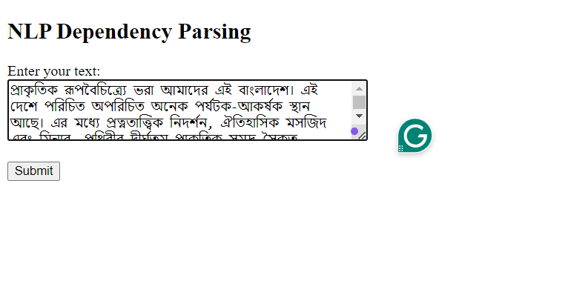
Interface
Figure 4: Input page (using Flask)

Slide 24
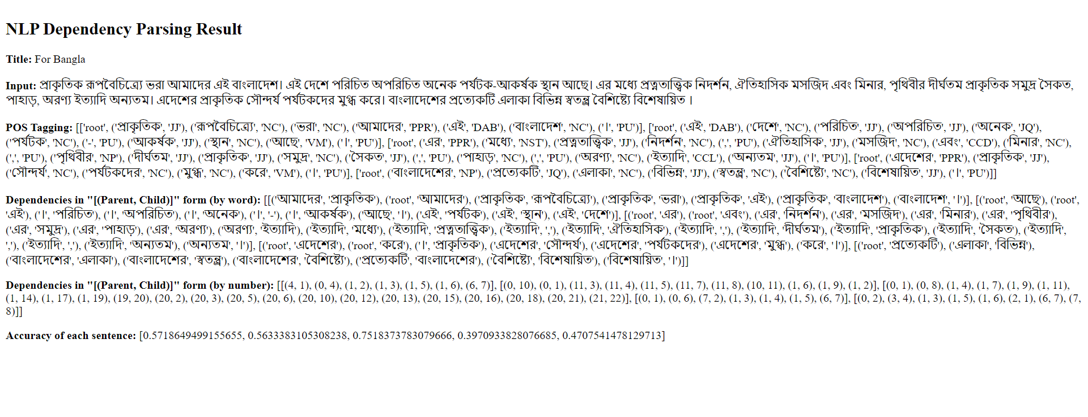
Interface (Cont’d…)
Figure 5: Output page (using Flask)

Slide 25
Challenges
Bangla has fewer linguistic resources than English
Bangla is rich in morphological features and flexible in word order
The Bangla language is more complex and ambiguous which causes parser errors
Need a significant amount of memory and computing power

Slide 26
Future work
This work can be expanded by detecting appropriate parts of speech of words in a sentence, assigning weights by considering more linguistic features
Consider the free word order in Bangla language
Use this mechanism to enrich knowledge-base of computer
Generate automated human-like Bangla text

Slide 27
Conclusion
Grammars for the Bangla language are often complex, ambiguous, spelling variations and specified by collections of examples rather than formal rules.
It can verify whether a Bangla sentence is syntactically correct or not
This work can help Bangla language to be used globally
Enrich linguistic resources and annotated corpora of the Bangla language

Slide 28
References
G. K. Saha, “Parsing Bengali text: An intelligent approach,” ACM Ubiquity, 7(13), pp. 1–5, 2006.
Arnab Dhar, Sanjay Chatterji, Sudeshna Sarkar, Anupam Basu, “A Hybrid Dependency Parser for Bangla” In Proceedings of the 10th Workshop on Asian Language Resources, pp.55–64, COLING 2012, 2012.

Slide 29
References (Cont’d…)
McDonald, Ryan et al. "Non-projective dependency parsing using spanning tree algorithms." Proceedings of human language technology conference and conference on empirical methods in natural language processing. 2005.
Abu Zaher Md. Faridee, Francis M. Tyers, “Development of a morphological analyzer for Bengali”, Free/Open-Source Rule-Based Machine Translation, p. 43-50, 2009.

Slide 30
Thank you!

Slide 31
Any Question?

