Slide 1
CSE 216
ERD Submission
Supervised by
Madhusudan Basak
Presented by
Nirob Arefin(1505050)
Protik Dey (1505051)

Slide 2
Project Name
Art Gallery Management System

Slide 3
Entities (with attributes)
Customer: Customer_id, Customer_name, Sex, Address, Phone_no, Email_id, Favourite_Genre.
Arts: Art_id, Art_title, Art_genre, Date_of_creation, Price, Status(Sold/Unsold), Artist_id.
Artist: Artist_id, Artist_name, Address, Phone_no, Email_id, Main_Genre, Date_of_birth, Sex.
Employee: Employee_id, Employee_name,Manager_id, Sex, Date_of_birth, Salary, Address, Phone_no, Email_id, Hire_date, End_date.

Slide 4
Entities (with attributes)
Manager: Manager_id, Manager_name, Date_of_birth, Salary, Address, Phone_no, Email_id, Join_date, End_date, Sex.
Exhibition: Exhibition_id, Exhibition_name, Start_date, End_date.
Hallroom: Hall_id, Hall_name.
Bill: Bill_id, Customer_id, Art_id, Date, Amount.
Payslip: Payslip_id, artist_id, Amount, date, Art_id,Bill_id.

Slide 5
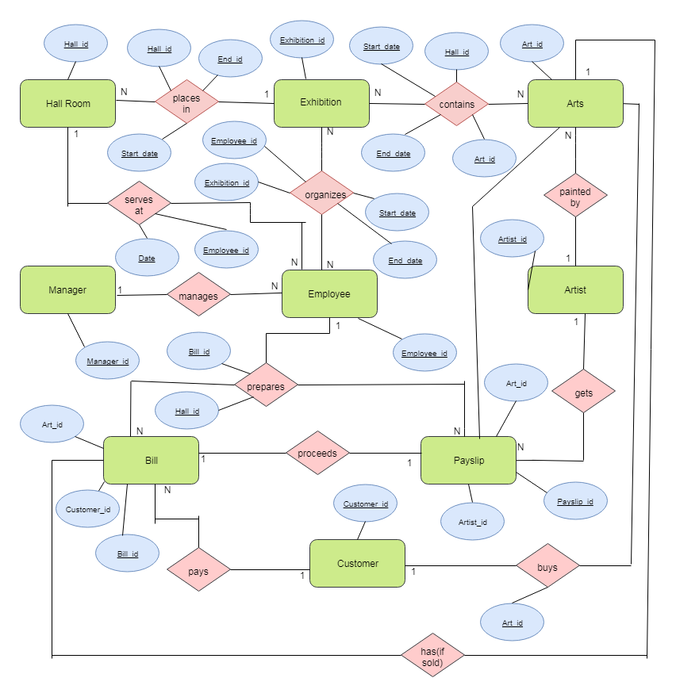
ER Diagram

Slide 6
Relational Schema
Customer: Customer_id(pk), Customer_name, Sex, Address, Phone_no, Email_id, Favourite_Genre.
Arts: Art_id(pk), Art_title, Art_genre, Date_of_creation, Price, Status(Sold/Unsold), Artist_id(fk).
Artist: Artist_id(pk), Artist_name, Address, Phone_no, Email_id, Main_Genre, Date_of_birth, Sex.
Employee: Employee_id(pk), Employee_name, Sex, Salary, Manager_id(fk), Date_of_birth, Address, Phone_no, Email_id, Hire_date, End_date.

Slide 7
Relational Schema
Manager: Manager_id(pk), Manager_name, Date_of_birth, Salary, Address, Phone_no, Email_id, Join_date, End_date, Sex.
Exhibition: Exhibition_id(pk), Exhibition_name, Start_date, End_date.
Hallroom: Hall_id(pk), Hall_name.
Bill: Bill_id(pk), Customer_id(fk), Art_id(fk), Date, Amount.
Payslip: Payslip_id(pk), artist_id(fk), Amount, date, Art_id(fk),Bill_id(fk).

Slide 8
Relational Schema
Contains: Exhibition_id(pk), Art_id(pk), Start_date(pk), End_date(pk).
Places_in: Exhibition_id(fk), Start_date(pk), End_date(pk), Hall_id.
Serves_at: Employee_id(pk), Date(pk), Hall_id(fk).
Organizes: Employee_id(pk), Exhibition_id(pk), Start_date(pk), End_date(pk).

Slide 9
Relational Schema
Prepares: Employee_id(fk), Bill_id(pk), Payslip_id(pk).
Buys: Customer_id(fk), Art_id(pk).

Slide 10
Thank You

