Slide 1
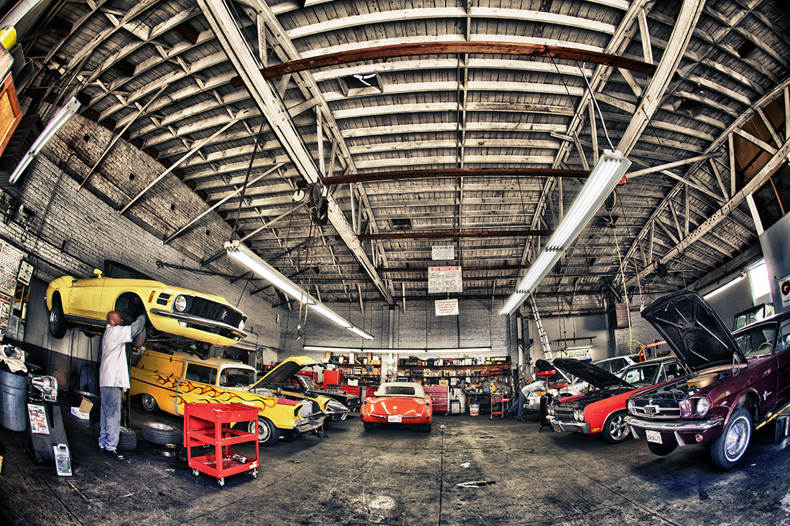
Car Shop management system submitted by: 1.protiva arafin 18201011

Slide 2
Introduction:
Car Shop Management System is a system for managing sales of cars. It contains all the information and establishes relation between different modules such as,
Manager
Salesperson
Customers and car details
Manufacturer

Slide 3
Objective & GOAL OF THE PROJECT :
The main objective of the Car Sales System is to manage the details of inventory, customer, car Models, salesperson. The goal of the project is to build an application program to reduce the manual work for managing the inventory, customer, cars, car Models. The data retrieval process is much easier than that of paperworks.

Slide 4
Tables and Attributes:
Manager | Salespersons | Customers | Cars | Car details | Manufacturer
man_id | salesper_id | cus_no | car_no | Car_type | Manu_country_code
man_name | salesper_name | cus_name | car_vin | Car_brand | Manu_country_name
man_salary | salesper_salary | cus_mail |  | Car_model
 |  | cus_mobile |  | Car_color
 |  |  |  | Car_price

Slide 5
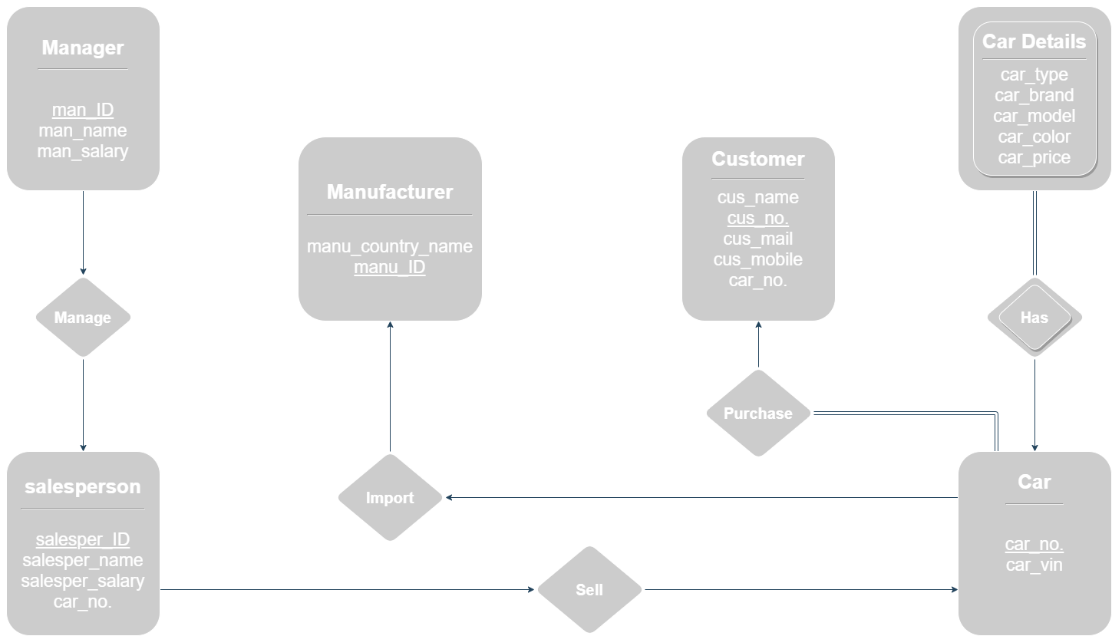
ER DIAGRAM:

Slide 6
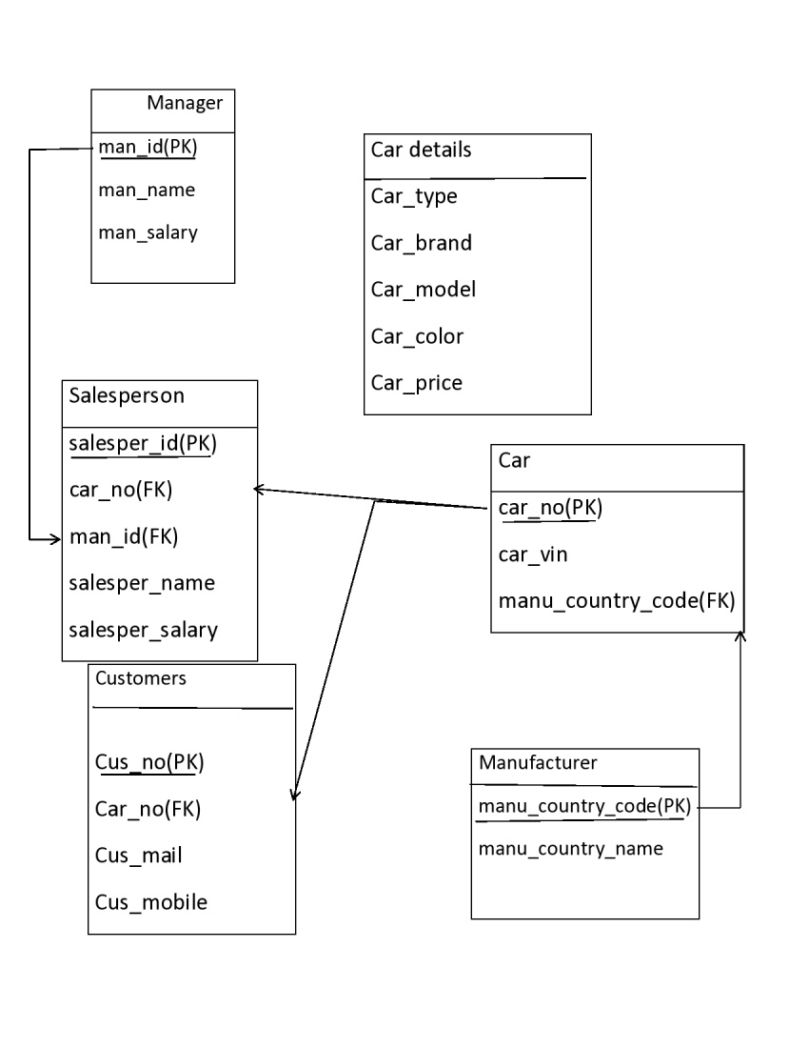
SCHEMA DIAGRAM:

Slide 7


