Slide 1
ONLINE FOOD ORDERING
SYSTEM ANALYSIS

Slide 2
Objective of Project
Online Food Ordering System (FOS) analysis aims to explore and analyze
the orders given by customers. This analysis focuses on extracting insights
from an Online FOS dataset.
The dataset contains information about Customer, Restaurants, MenuItems,
Orders, OrderDetails and Reviews from a fictional Online FOS.
By analyzing this data, we can find trends, patterns, and insights that
can be used to improve business operations and decision-making.

Slide 3
Database Schema
Reviews
Field | Type
ReviewID | (INT, Primary Key)
RestaurantID | (INT, Foreign Key)
CustomerID | (INT, Foreign Key)
ReviewDate | (DATE)
Rating | (DECIMAL)
Comments | (TEXT)
Restaurants
Field | Type
RestaurantID | (INT, Primary Key)
RestaurantName | (VARCHAR)
Address | (VARCHAR)
CuisineType | (VARCHAR)
Customers
Field | Type
CustomerID | (INT, Primary Key)
FirstName | (VARCHAR)
LastName | (VARCHAR)
Email | (VARCHAR)
Phone | (VARCHAR)
RegistrationDate | (DATE)
Orders
Field | Type
OrderID | (INT, Primary Key)
CustomerID | (INT, Foreign Key)
RestaurantID | (INT, Foreign Key)
OrderDate | (DATE)
TotalAmount | (DECIMAL)
MenuItems
Field | Type
MenuItemID | (INT, Primary Key)
RestaurantID | (INT, Foreign Key)
ItemName | (VARCHAR)
Price | (DECIMAL)
Description | (TEXT)
OrderDetails
Field | Type
OrderDetailID | (INT, Primary Key)
OrderID | (INT, Foreign Key)
MenuItemID | (INT, Foreign Key)
Quantity | (INT)
ItemPrice | (DECIMAL)

Slide 4
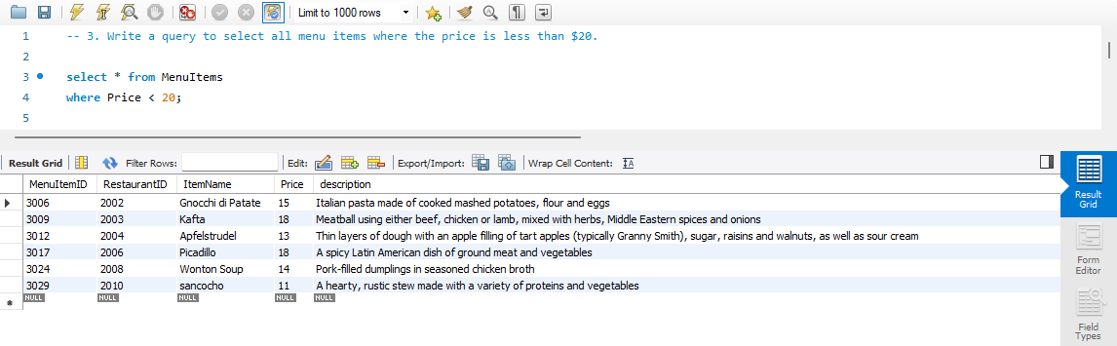

Slide 5
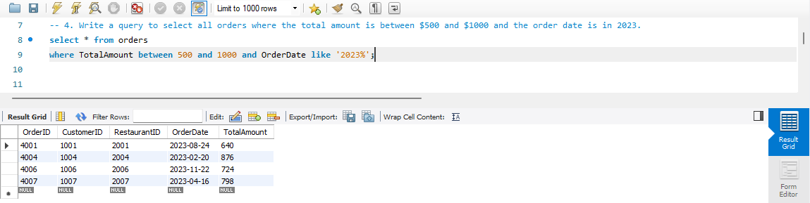

Slide 6
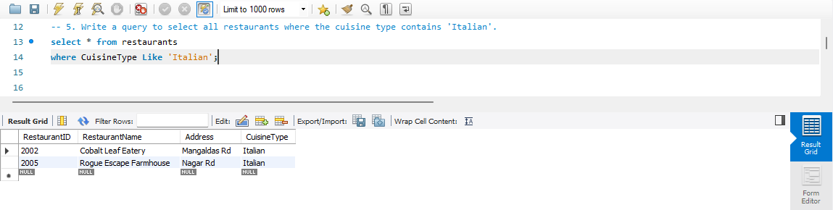

Slide 7
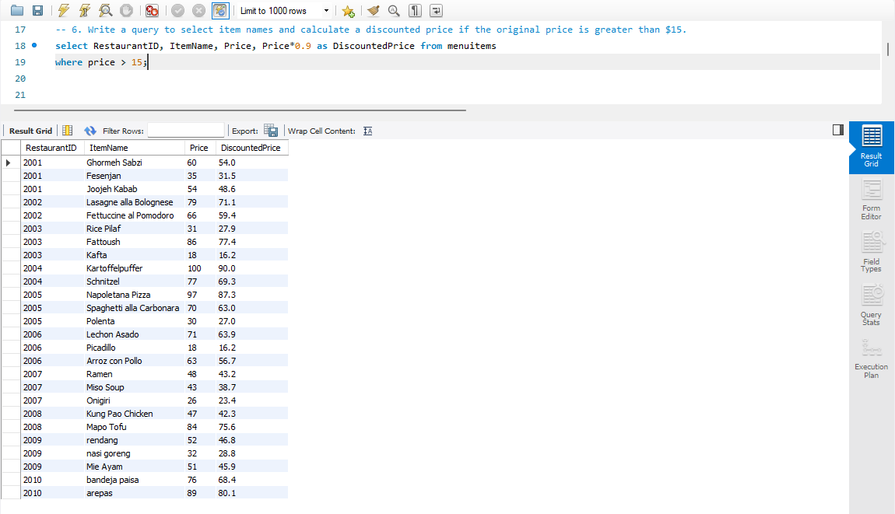

Slide 8
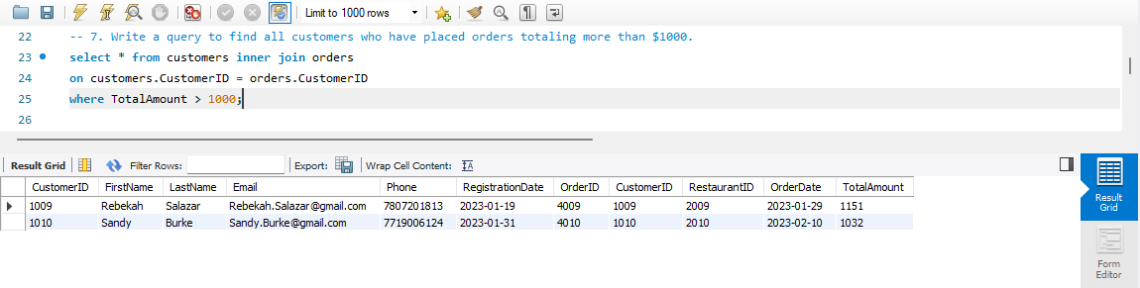

Slide 9
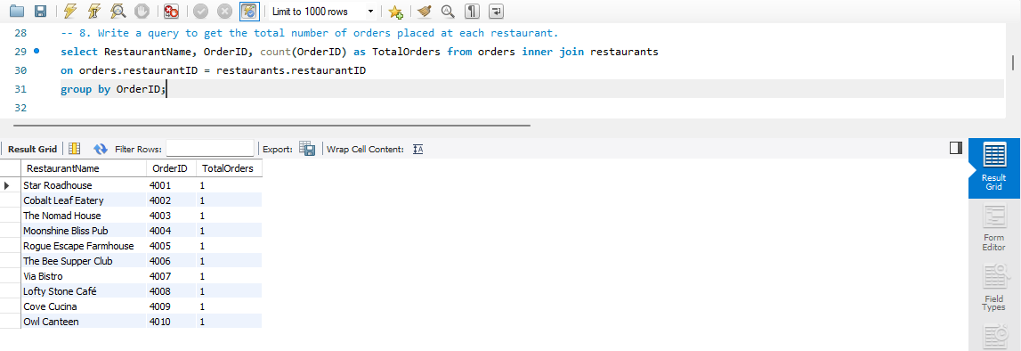

Slide 10
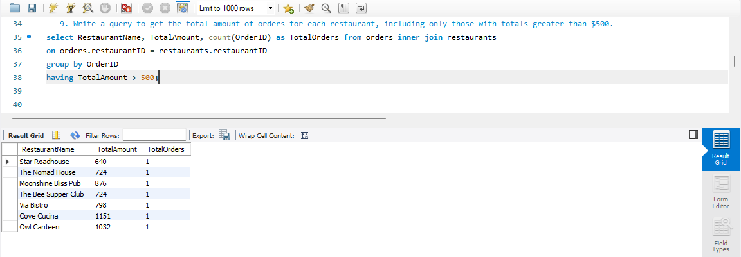

Slide 11
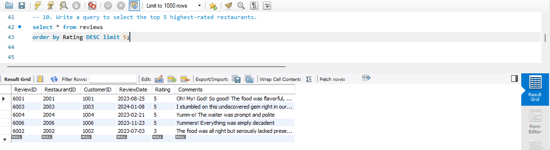

Slide 12
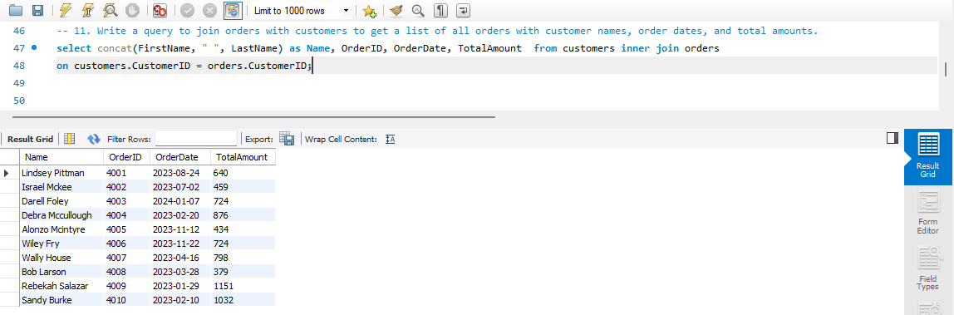

Slide 13
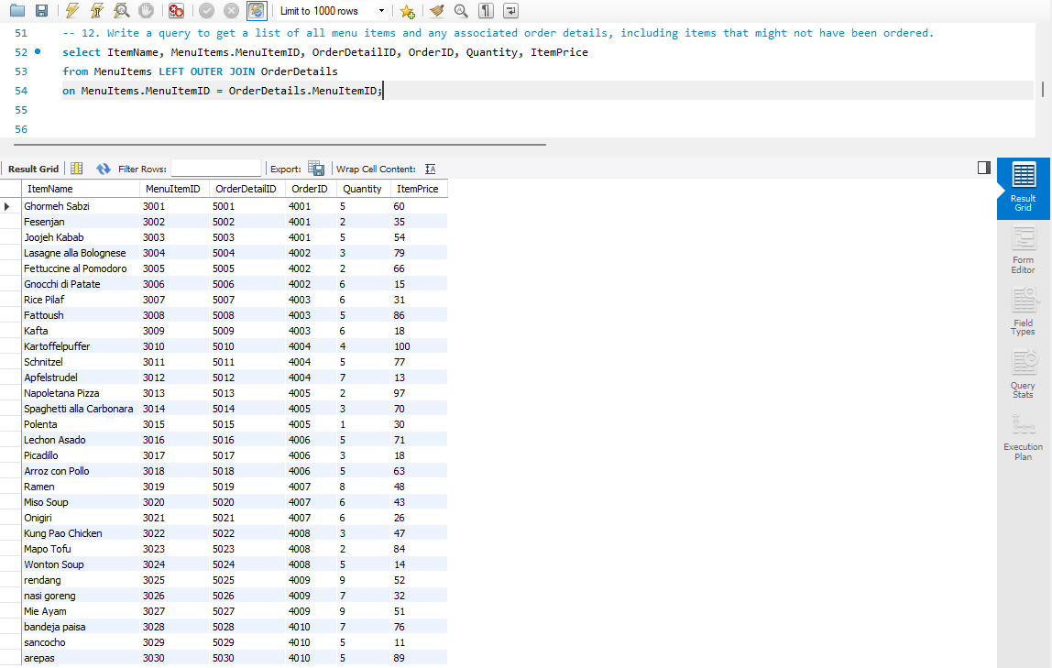

Slide 14
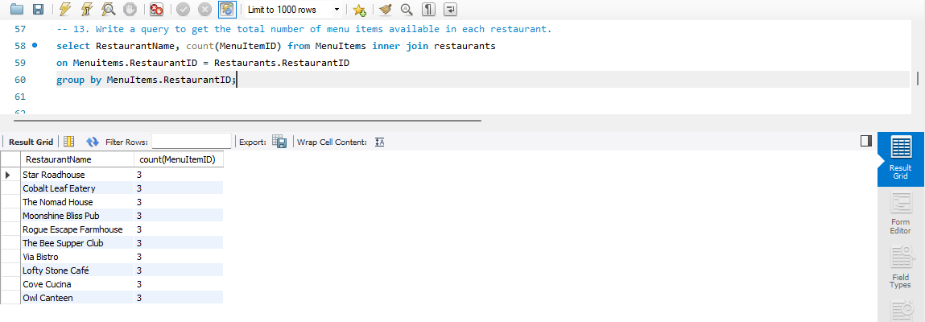

Slide 15
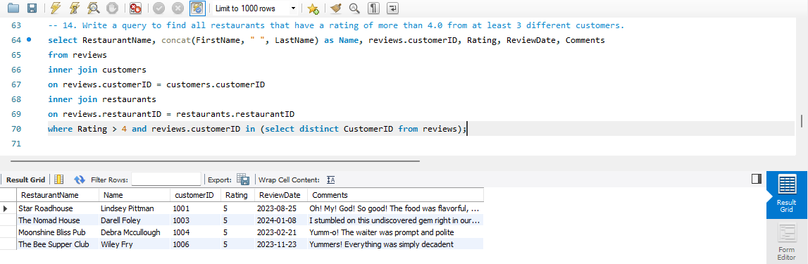

Slide 16
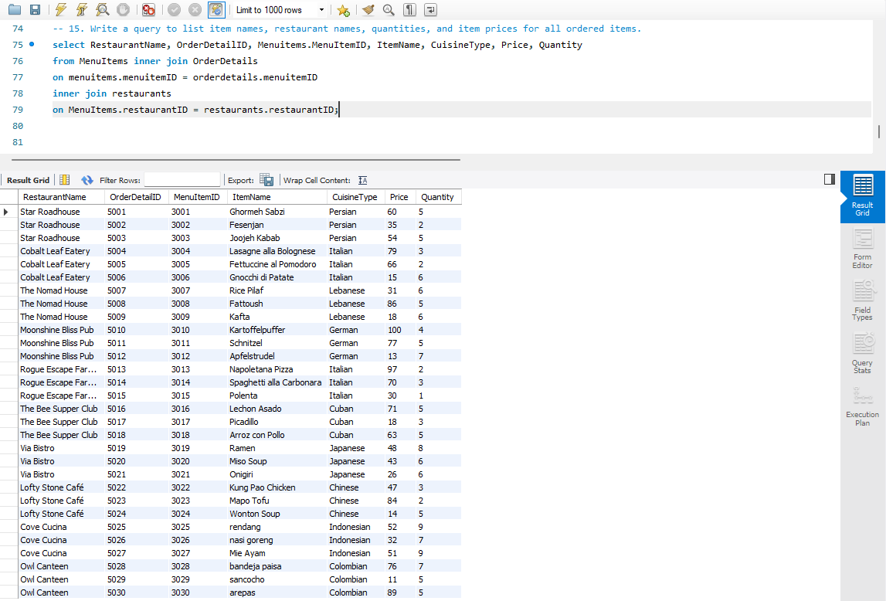

Slide 17
THANK YOU

