Slide 1
A
B
C
D

Slide 3
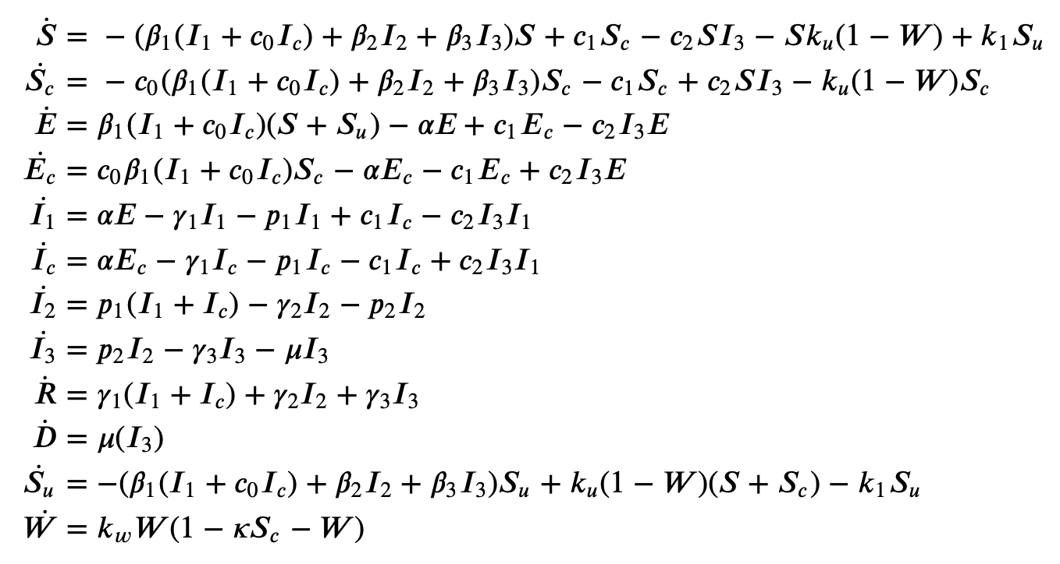
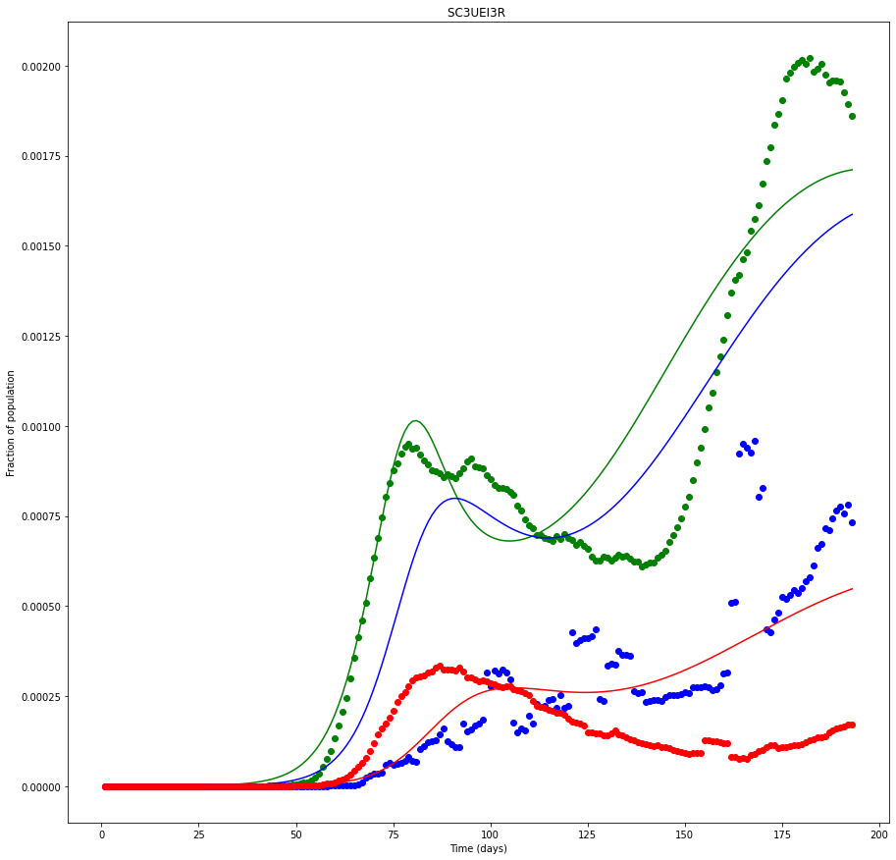
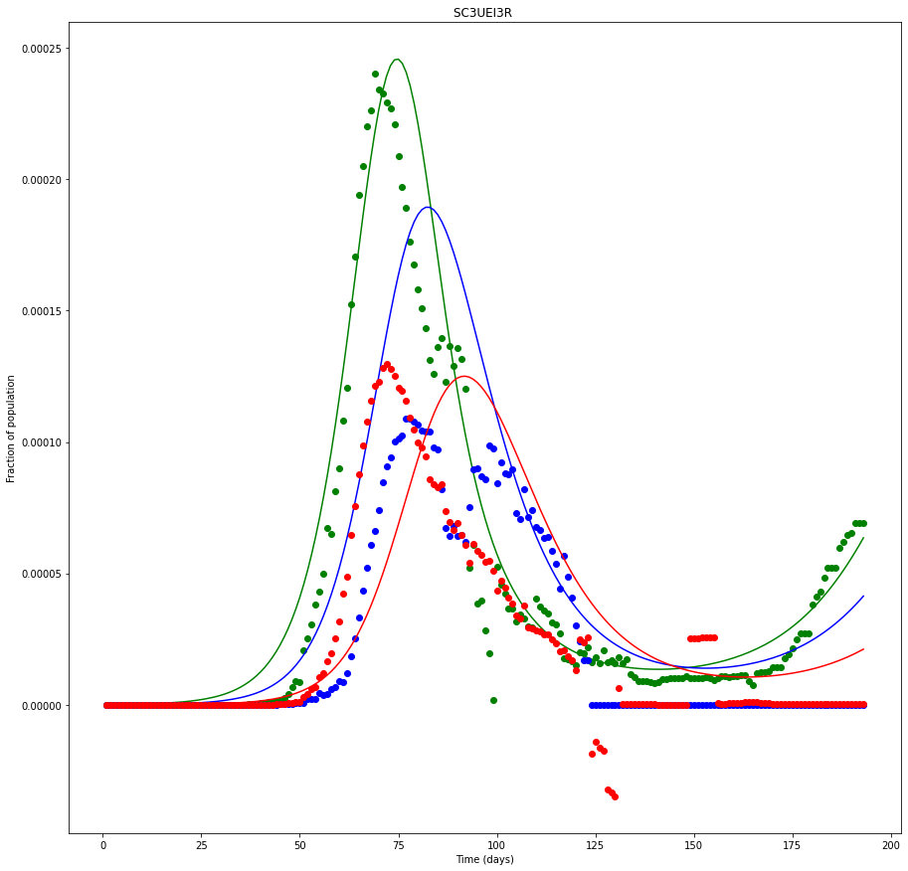
A
B
C
D
Notes:
{'beta_1': 0.44, 'alpha': 0.25, 'mu': 0.026, 'c_0': 0.38, 'c_1': 0.009, 'c_2': 348.0, 'logI_0': -6.5, 'k_u': 0.241, 'k_1': 0.009, 'k_w': 0.021, 'kappa': 0.367} USA

Slide 4
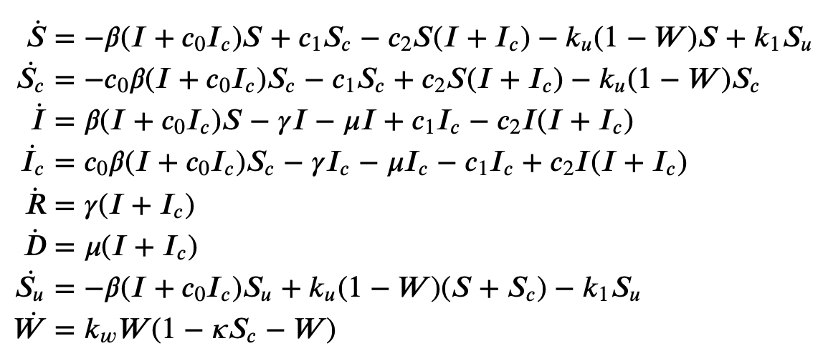
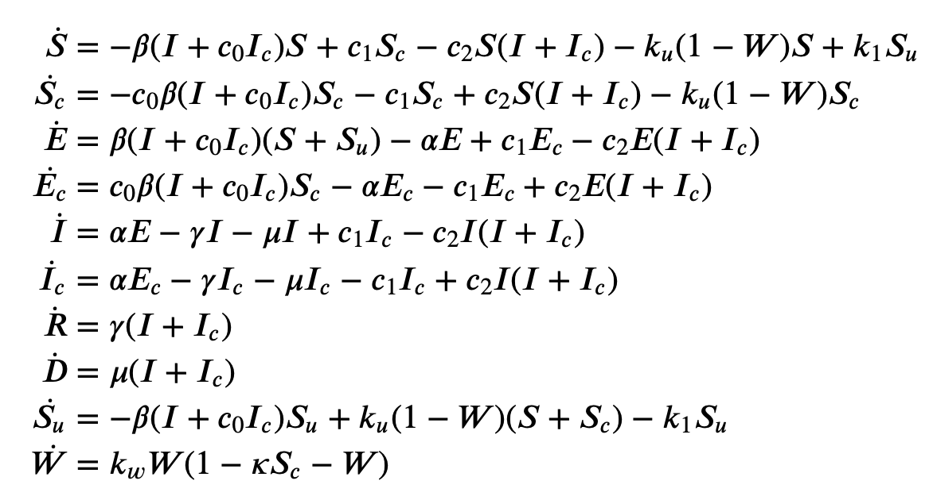

Slide 5


Slide 8
Notes:
CautionFactor= 0.2 # Fractional reduction of exposure rate for cautioned individuals
CautionRetention= 60. # Duration of cautionary state of susceptibles (4 weeks)
CautionICUFrac= 0.3 # Fraction of ICUs occupied leading to transition to caution @ 1/day
ICUFrac= 0.002 # Fraction of ICUs relative to population size N

