Slide 1
A
B
C
D

Slide 3
A
B
C
D
Notes:
{'beta_1': 0.44, 'alpha': 0.25, 'mu': 0.026, 'c_0': 0.38, 'c_1': 0.009, 'c_2': 348.0, 'logI_0': -6.5, 'k_u': 0.241, 'k_1': 0.009, 'k_w': 0.021, 'kappa': 0.367} USA

Slide 8
Notes:
CautionFactor= 0.2 # Fractional reduction of exposure rate for cautioned individuals
CautionRetention= 60. # Duration of cautionary state of susceptibles (4 weeks)
CautionICUFrac= 0.3 # Fraction of ICUs occupied leading to transition to caution @ 1/day
ICUFrac= 0.002 # Fraction of ICUs relative to population size N

Slide 9
B
A

Slide 11
A
B
C

Slide 12
A
B
D
C
Unclustered

Slide 13
Fractions (0 to 1) | Round 1 | Round 2 | Round 3
FracMild | 0.7 | 0.6 to 0.85 | 0.6 to 0.9
FracCritical | 0.1 | 0.05 to 0.15 | 0.02 to 0.2
CFR (CaseFatalityRatio) | 0.05 | 0.03 to 0.1 | 0.03 to 0.1
ICUFrac’ (per 1000) | 1 | Fixed Country | Fixed Country
CautionFactor | 0.05 to 0.5 | 0.1 to 0.3 | 0.05 to 0.5
EconomicCostOfCaution | 0.5 | 0.5 | 0.1 to 0.9
FracConfirmedDet | 0.2 to 1 | 0.1 to 1 | 0.1 to 1
FracDeathsDet | 1 | 0.3 to 1 | 0.25 to 1
Time constants (days)
IncubPeriod | 5 | 5 | 3 to 8
DurMildInf | 10 | 6 to 12 | 3 to 14
DurHosp | 4 | 3 to 6 | 2 to 8
TimeICUDeath | 5 | 3 to 7 | 3 to 10
CautionRetention | 15 to 90 | 15 to 90 | 15 to 150
EconomicStriction | 30 | 30 | 15 to 90
EconomicRetention | 60 | 15 to 90 | 15 to 90
EconomyRelaxation | 60 | 60 | 30 to 90
2nd order rates
Exposure (per day per individual) | 0.2 to 0.5 | 0.2 to 0.5 | 0.2 to 0.5
CautionExposure (per day per indiv./ICU) | 0.1 to 1. | 0.05 to 2 | 0.1 to 2
Initial conditions
logI_0 | -10 to -6 | -10 to -6 | -10 to -6

Slide 14
method of scoring clusterings
1
2
3
4
deaths
cases
linear
ramp
testing corrected cases
linear
pwlfit
nonlin
rawtest
nonlin
pwlfit
Notes:
foo.plot_outliers() from Consensus.ipynb

Slide 16
Stage 1
Stage 2
Stage 3
Stage 4
Notes:
Wht satthresh value of 0.75 in stage 4

Slide 17
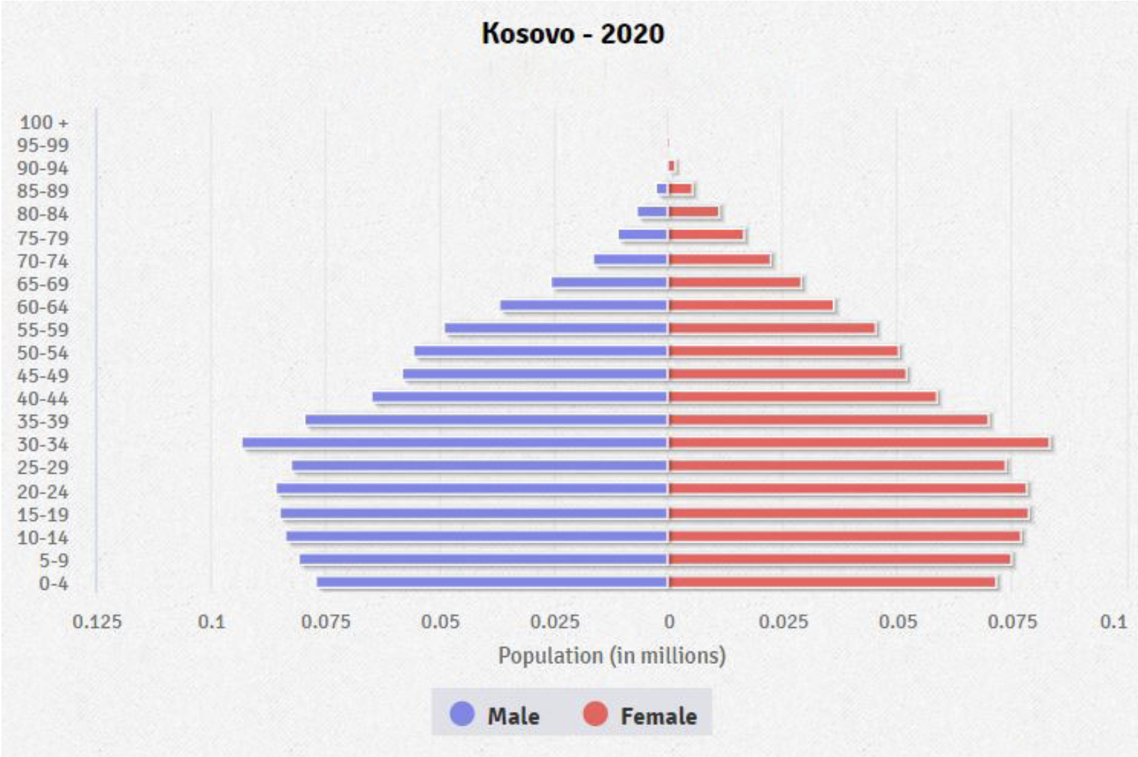
Kosovo age structure

