Slide 1
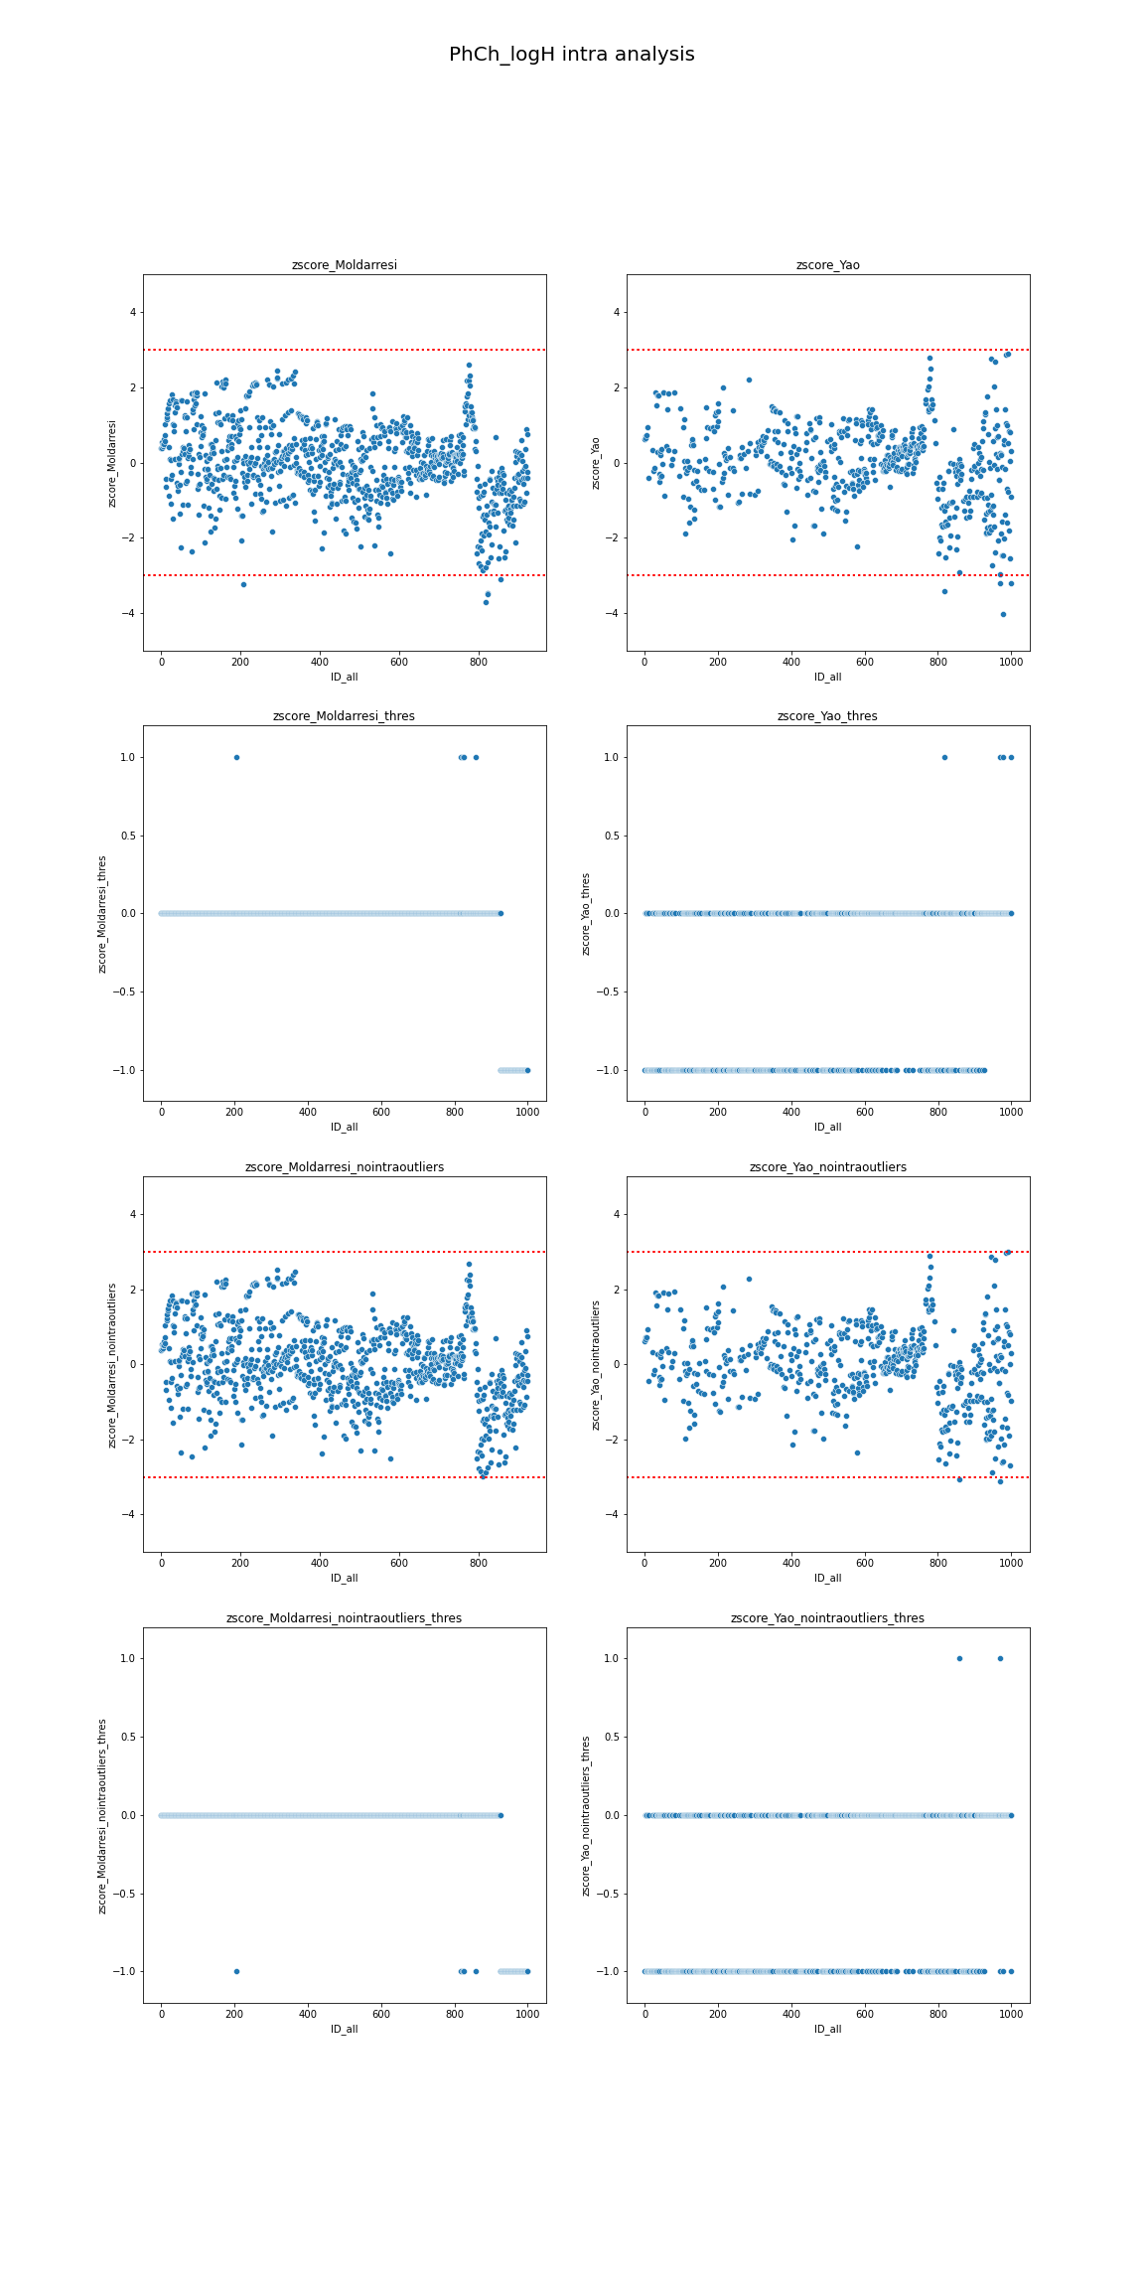
In this analysis, each column of the graph correspond to individual dataset
This is z-score analysis for individual dataset, were red lines are z-score = +/-3, so, all molecules over or below this line, are “outliers” inside each dataset (intraoutliers)
This is a more simple visualization of z-score analysis from above. Dots at values =1 are “intraoutliers”, dots at 0 are correct molecules and dots with value = (-1) are just nans (it means that molecule with this ID is not in this dataset, but I preferred to maintain same ID for all representations).
This is the same of the first panel, but eliminating those molecules over the threshold
This is the same of the second panel, but eliminating those molecules over the threshold

