Slide 1
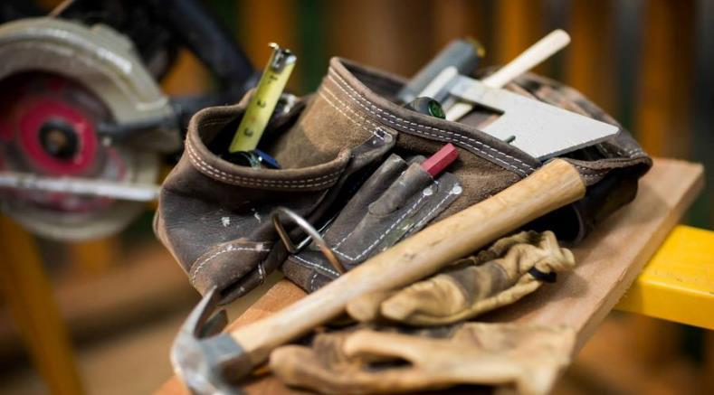

ProtoXCode
Kiosk Rotation Engine
Converting .pptx files into a temporary PDF file using LibreOffice before the PDF renderer process it further into an image and adds a timer based upon the text content.

Slide 2
More info about the supported formats
Images
Direct display:
- PNG
- JPG
- JPEG
- WEBP
Preprocessed:
- HEIC
- HEIF
Video
Directly plays MP4 and WEBP videos. Mutable in config, plays entire video.
PDF
Converts PDF into multiple slides as image before rendering. Estimates display time based upon word count.
HTML
Displays both direct HTML files or URL links
(Must support being built in).
Display time estimated based upon word count.
Office
PowerPoint:
Converts to a PDF file using LibreOffice before it’s processed again with the PDF renderer.

