Slide 1
Dreamcast and Crayon

Slide 2
What is Crayon?
To first explain Crayon, we need to look at the Dreamcast since it was originally based around it.

Slide 3
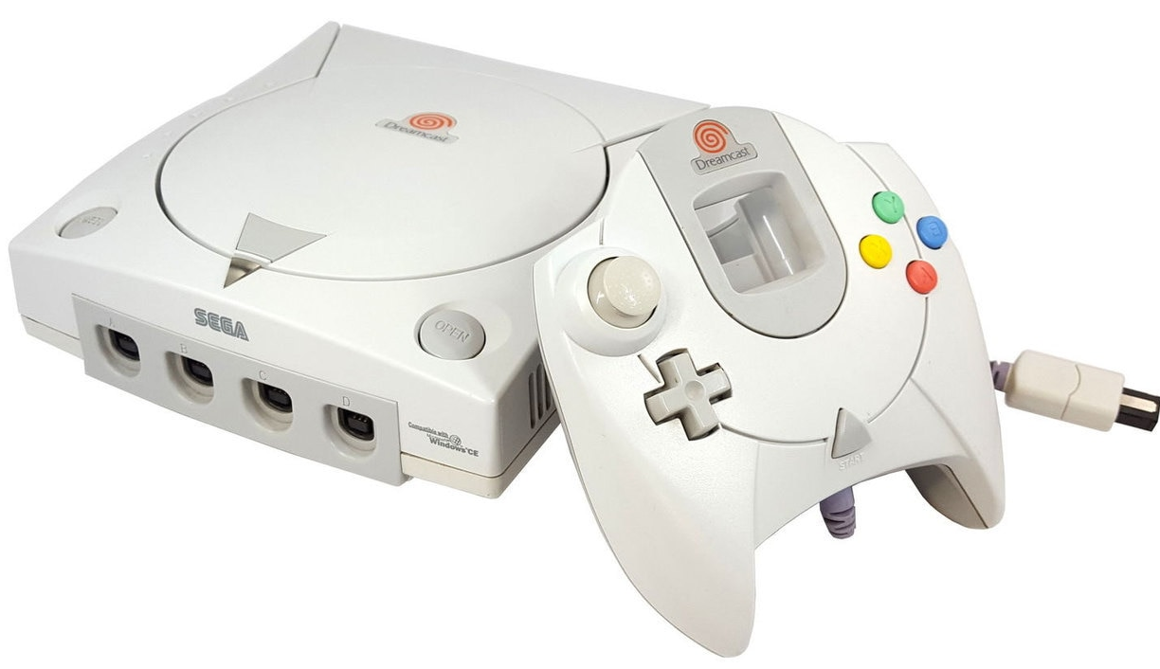
What is the Dreamcast/DC?
It came out in 1998 and has similar performance to the PS2. These days its comparable to an older PC
The controller is similar to modern controllers, except its missing the shoulder buttons, the second thumbstick and they can’t be pressed in
Specs wise it has 16MB of main RAM, 8MB of VRAM, 2MB of SRAM, 200MHz CPU, 100MHz GPU and 67MHz SPU
It mostly uses CD-ROMs for playing games
Has 4 controllers with upto 8 memory cards with 100KB of storage space each
Also comes with either a modem or ethernet adapter

Slide 4
Why use the Dreamcast/DC?
It has an active homebrew community. Lots of programming/development support considering it’s a dead console
On top of that, its one of the few “newish” consoles that still has a decent homebrew community (The next newest homebrew console would be the Megadrive/SNES)
People still release retail games on the system and there’s a niche market for them. Plus a DC port can bring attention to a PC port.
I started programming for it because I thought it was cool writing code for a console

Slide 5
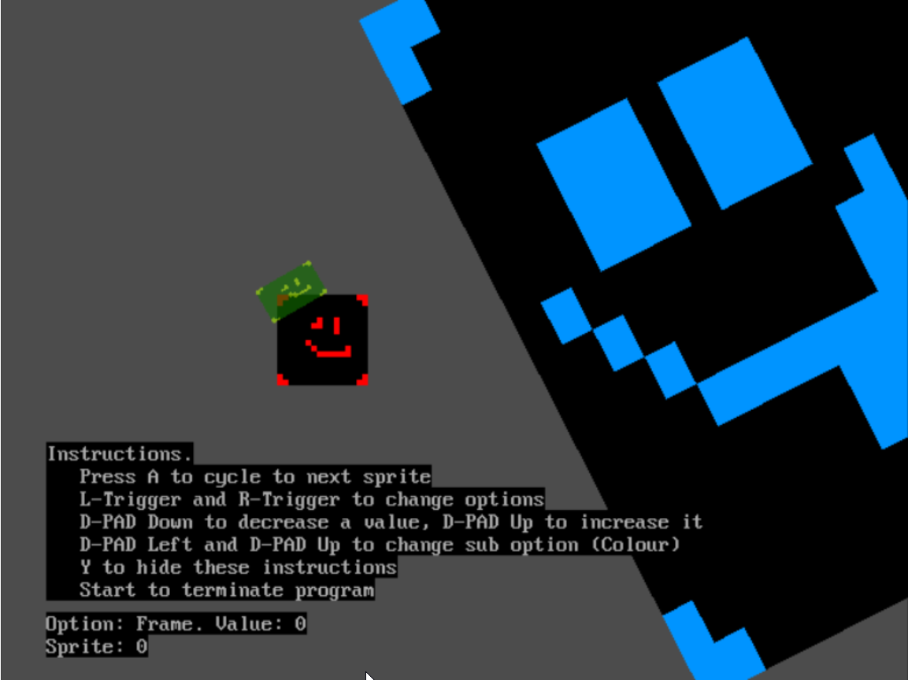
That said, what is Crayon?
It’s a 2D game-framework made in C by Protofall
Designed to be fast and simple
Currently only works on Dreamcast, but later it will work on computers and possibly other systems
Dreamcast version uses “KallistiOS” to interface with the console
Computers will use either OpenGL or Vulkan
Still a WIP, some features like most of the Cameras and Fontstyles aren’t implemented yet
Can use it to make new projects
Doesn’t support traditional lighting

Slide 6
How does a Crayon project work?
All projects have a code, assets folder and build script
When building a project it converts the assets directory into a processed form called "cdfs“.
For example you can specify your PNG textures to be converted into the Dreamcast format, make “Romdisks” from folders or build spritesheets
Crayon requires always uses Spritesheets, these are made from “crayon_anim”s which are made up of individual sprites. The textures must be 2^m wide and 2^n high (texels), this is a Dreamcast limitation

Slide 7

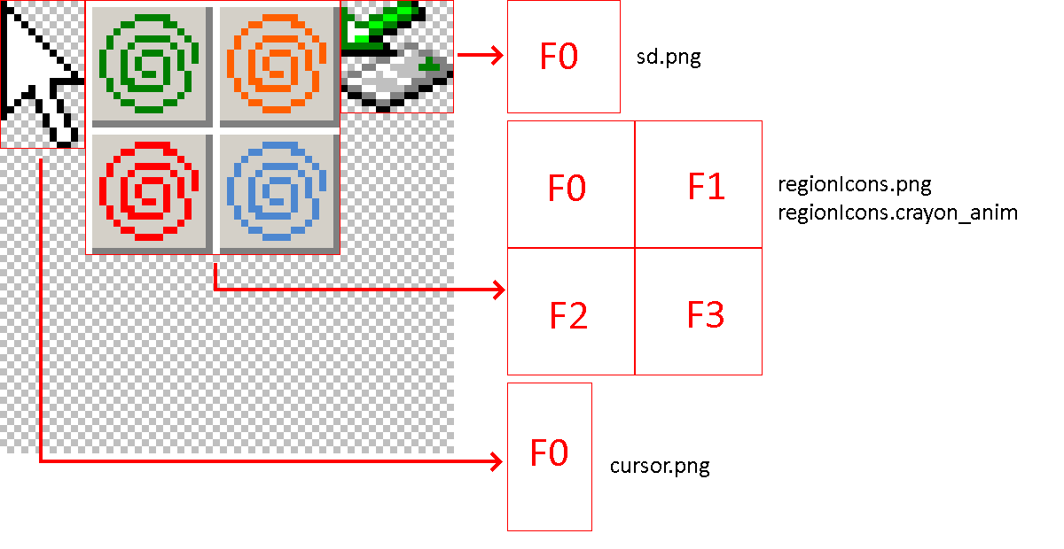
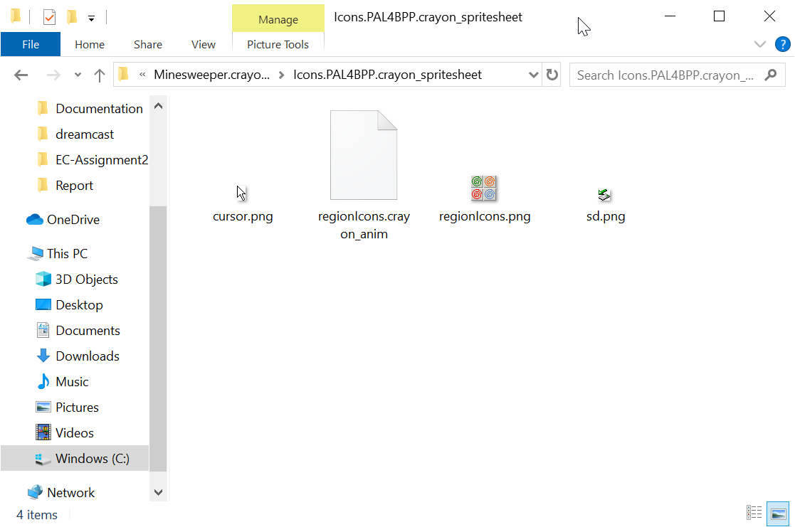
This is what a Crayon Spritesheet process looks like

Slide 8
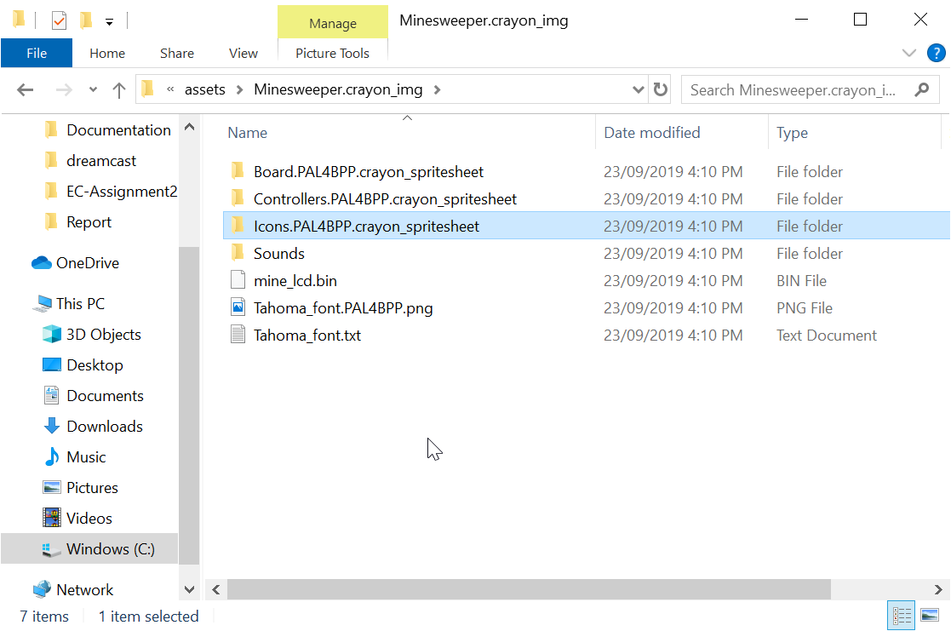
How to tell Crayon to make a Spritesheet

Slide 9
The texture formats
The DC has a few texture formats. Note ARGB = Alpha (Transparency), Red, Green and Blue. The numbers say how many bits per channel.
RGB565 is the best non-transparency output mode
ARGB1555 is good if you want punchthrough mode
ARGB4444 allows for different levels of transparency
PAL4BPP and PAL8BPP are paletted texture with 16 and 256 colours respectively. The palette itself is in the ARGB8888 format
We can have at most 1024 palette entries per frame. That’s 4 PAL8BPP palettes, 64 PAL4BPP palettes or some mix of the two
The DC has a native compression format that *can* be loss-less. (It’s a little complicated to understand, but if you’re curious I can explain it later)
Most PNGs are in the RGBA8888 format, so some info is always lost

Slide 10
Video output for Dreamcast
The main video output is 640x480 (4:3) via VGA (Progressive Scan) or RCA/RGB (Interlaced) at 50/60Hz (Always 60 for VGA)
As for game base resolutions, these are the main options
640x480. Uses whole screen, but doesn’t scale well to modern displays
320x240. Can be scaled nicely to DC and modern displays, but not a big area
640x360 letterboxed. Is basically 16:9 and scales well to modern displays. IMO this is the best choice.
320x180 letterboxed. Can scale up to previous resolution, but less detail

Slide 11
Sound capabilities
Yamaha AICA with 32-bit ARM7 RISC CPU core, 64 channels/voices/”piano-key-notes-at-once”
For music, it can load OGG songs (Whole file loaded into RAM) or use CDDA music (This is the format music CDs are in)
A side effect of using CDDA is that the game disc can double as a music CD
For sound, all files must be 16-bit uncompressed or in the ADPCM format (4-bit compressed).
Depending on what format is chosen, sound effects have a max length (*)
OpenAL looks like a good method of handling sound for us

Slide 12
Controllers
As mentioned before, the Dreamcast has a normal joypad controller, there are some other kinds of controllers too
Keyboard and Mouse, they work like PC ones, but aren’t as common
There are other peripherals, but KallistiOS doesn’t support them

Slide 13
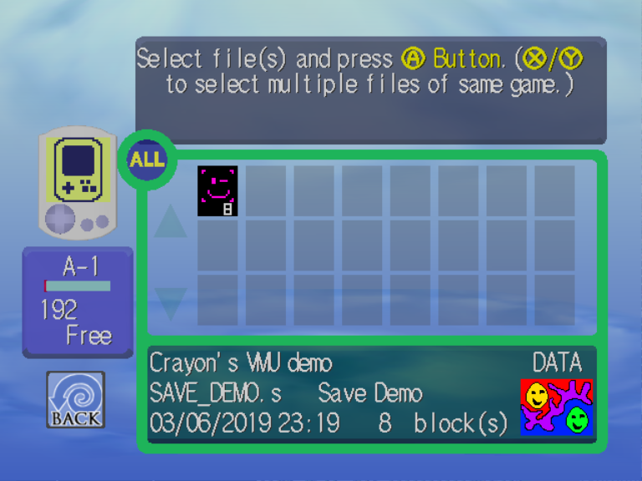
Memory Cards/Savefiles
The DC’s Memory Cards are called VMUs. They hold 100KB total or 200 Blocks (1 Block = 512B) with up to 8 VMUs at once
A DC Savefile has an icon with up to 3 frames of animation (1 frame = 1 Block), an optional “Eyecatcher” (Bottom right) and the save data.
Savefiles can be as small as 2 Blocks

Slide 14
Ways of running games/programs
Emulation: For Windows I recommend DEMUL since its nearly perfect, otherwise Redream is alright.
Burn CDs: This is basically the way the final game will be played at retail, but for dev we have to burn a new CD per change
Serial/SD port: With a special boot disc we can tell the DC to load from the Serial/SD port on the back. This means we only burn 1 disc, but it is very slow
Ethernet Adapter: Like the SD method we only burn one disc, but we load stuff from our PC over the network and it is faster than the CD-Drive

Slide 15
Distribution and Piracy
DC’s are too common, only 11 million sold worldwide which is half as much as the OG XBOX. But DC has an active homebrew market
Games usually released on professionally made CD-ROMs. There are producers out there who handle this such as JoshProd
Some people are setting their game’s ISO online for a cheaper price
Our code can run on any region DC for all the major revisions
We can also put the Windows/Mac/Linux executables on the disc for a “Multi-Platform CD-ROM” release
Anti-Piracy is practically non-existent on the DC for Homebrew games due to our code using an Anti-Piracy loophole to run

Slide 16
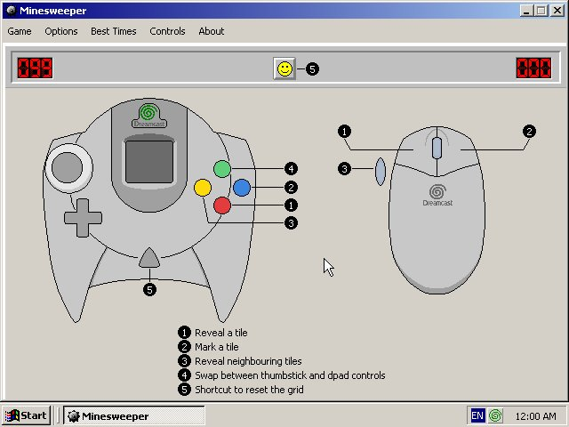
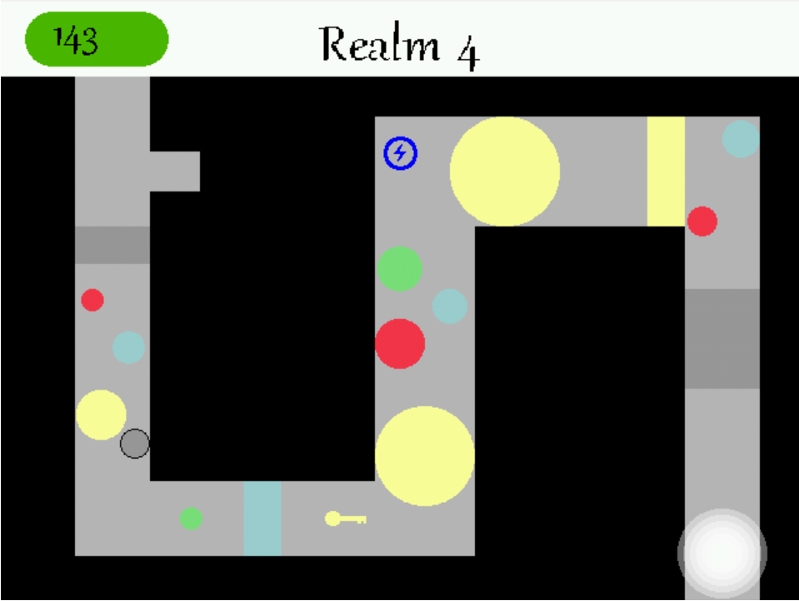
Examples of Crayon in Action

Slide 17
Pros and Cons of Crayon/Dreamcast
 | Modern Systems/Modern Engines (OpenGL, Vulcan, Gamemaker) | Dreamcast/Crayon
Has 2D support | ✔️ | ✔️
Has 3D support | ✔️ | ❌
Can support 16:9 | ✔️ | ✔️*
Can use Physical Media | ✔️ | ✔️
Camera/Perspective Support | ✔️ | ➖
Internet Capabilities | ✔️ | ✔️
We are experience with the engine | ❌ | ✔️(As Crayon’s creator, I know it)
Retro Appeal | ❌ | ✔️
Creatively flexible | ✔️ | ✔️* (Is only missing a few nice features)
Easy of getting code to run | ❌ | ✔️

