Slide 1
Dreamcast and Crayon

Slide 2
What is Crayon?
To first explain Crayon, we need to look at the Dreamcast since it was originally based around it.

Slide 3
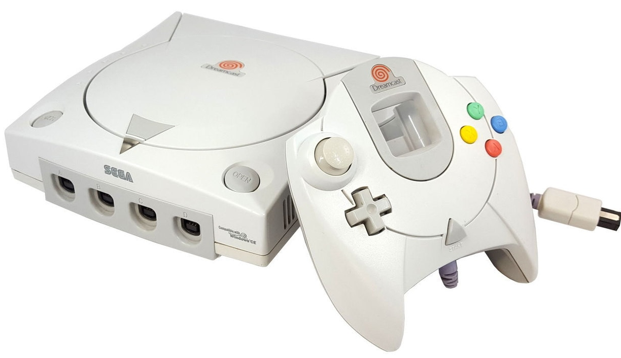
What is the Dreamcast/DC?
It came out in 1998 and has similar performance to the PS2. These days its comparable to an older PC
The controller is similar to modern controllers, except its missing the shoulder buttons, the second thumbstick and they can’t be pressed in
Specs wise it has 16MB of main RAM, 8MB of VRAM, 2MB of SRAM, 200MHz CPU, 100MHz GPU and 67MHz SPU
It mostly uses CD-ROMs for playing games
Has 4 controllers with upto 8 memory cards with 512KB of storage space each
Also comes with either a modem or ethernet adapter

Slide 4
Why use the Dreamcast/DC?
It has an active homebrew community. Lots of programming/development support considering it’s a dead console
On top of that, its one of the few “newish” consoles that still has a decent homebrew community (The next newest homebrew console would be the Megadrive/SNES)
People still release retail games on the system and there’s a niche market for them. Plus a DC port can bring attention to a PC port.
I started programming for it because I thought it was cool writing code for a console

Slide 5
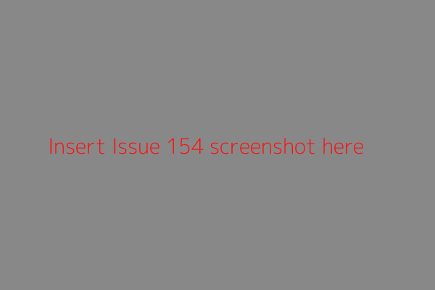
That said, what is Crayon?
It’s a 2D game-framework made in C by Protofall
Designed to be fast and simple
Currently only works on Dreamcast, but later it will work on computers and possibly other systems
Dreamcast version uses “KallistiOS” to interface with the console
Computers will use either OpenGL or Vulcan
Still a WIP, some features like the “Camera” aren’t implemented yet
Can use it to make new projects

Slide 6
How does a Crayon project work?
All projects have a code, assets folder and build script
When building a project it converts the assets directory into a processed form called "cdfs“.
For example you can specify your PNG textures to be converted into the Dreamcast format, make “Romdisks” from folders or build spritesheets
Crayon requires always uses Spritesheets, these are made from “crayon_anim”s which are made up of individual sprites. The textures must be 2^m wide and 2^n high (texels), this is a Dreamcast limitation

Slide 7

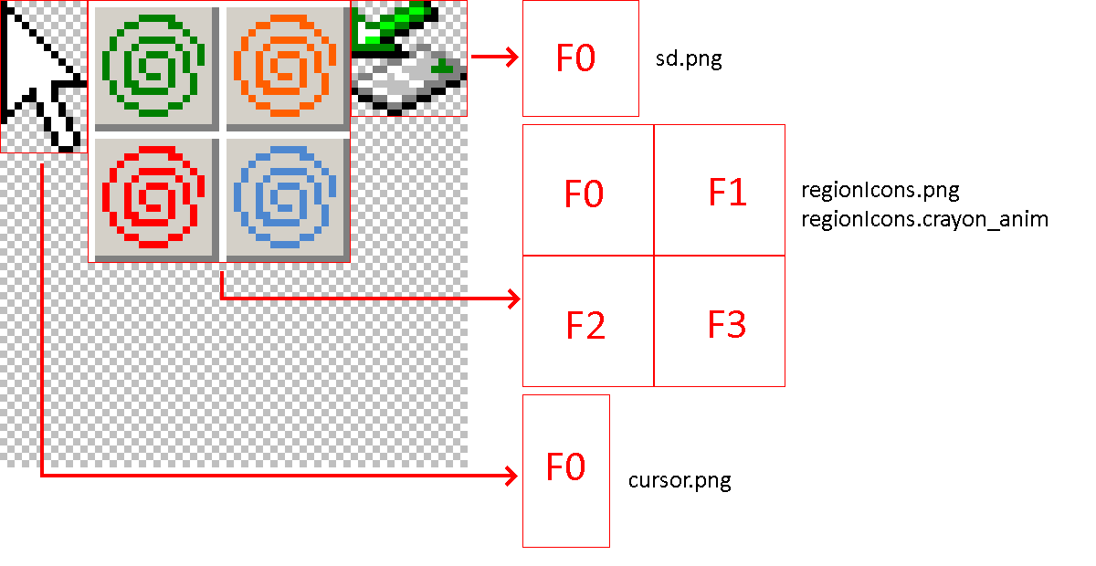
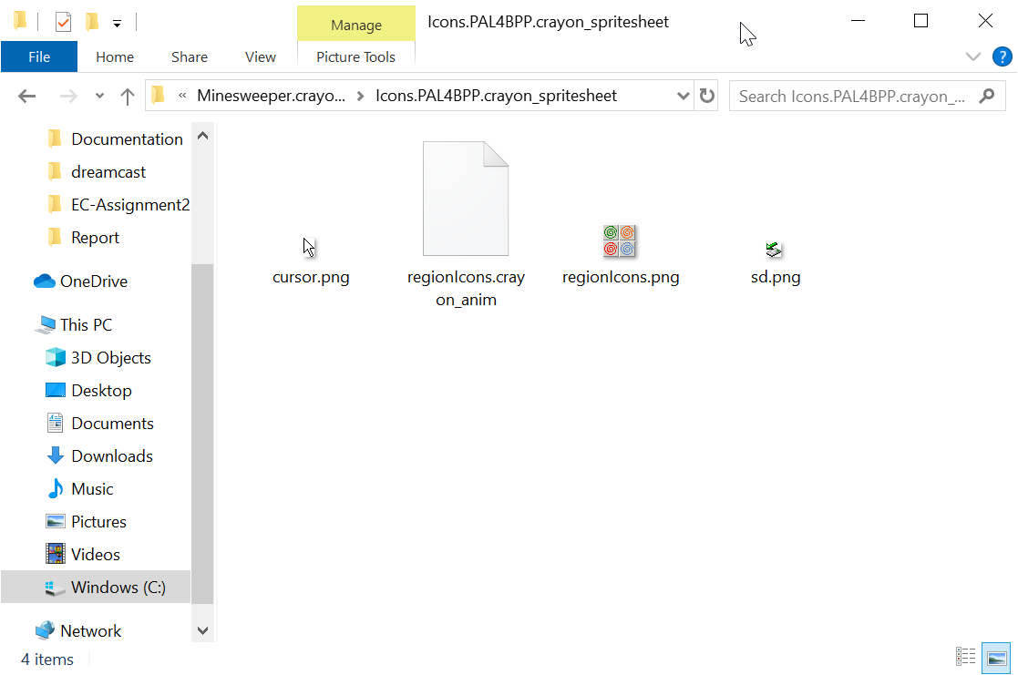
This is what a Crayon Spritesheet process looks like

