Slide 1
Asso. Prof. Dong Yabo
dongyb@zju.edu.cn
College of Computer Science and Technology, Zhejiang University

Slide 2
Overview
Digital Systems, Computers, and Beyond
Information Representation
Number Systems [binary, octal and hexadecimal]
Arithmetic Operations
Base Conversion
Decimal Codes [BCD (binary coded decimal)]
Alphanumeric Codes
Parity Bit
Gray Codes
Chapter 1 <number>

Slide 3
DIGITAL & COMPUTER SYSTEMS - Digital System
Takes a set of discrete information inputs and discrete internal information (system state) and generates a set of discrete information outputs.
Discrete
Discrete
Inputs
Information
Discrete
Processing
Outputs
System
System State
Chapter 1 <number>

Slide 4
Types of Digital Systems
No state present
  Combinational Logic System
  Output = Function(Input)
State present
  State updated at discrete times
  => Synchronous Sequential System
  State updated at any time
  =>Asynchronous Sequential System
  State = Function (State, Input)
  Output = Function (State)
  or Function (State, Input)
Chapter 1 <number>
Notes:
1. Moore型的输出只与当前状态有关，而Mealy型的输出还与输入相关。
2. 在实现相同功能的情况下,Mealy型状态机所需要的状态数比Moore型少，Moore需要待状态稳定才输出。
3.输出时序上，Moore状态机同步输出，Mealy状态机异步输出；
4.输出变化上，Mealy状态机比Moore状态机领先一个时钟周期；

Slide 5
Digital System Example:
A Digital Counter (e. g., odometer):
Count Up
0
0
1
3
5
6
4
Reset
Inputs:
Count Up, Reset
Outputs:
Visual Display
State:
"Value" of stored digits
Synchronous or Asynchronous?
Chapter 1 <number>
Notes:
里程表 非同步，看你走了多少路，任意时刻都有可能更新

Slide 6
Digital Computer Example
Memory
Control
CPU
unit
Datapath
Inputs: keyboard, mouse, wireless, microphone
Outputs: LCD screen, wireless, speakers
Input/Output
Synchronous or Asynchronous?
Chapter 1 <number>
Notes:
Answer: Part of specification for a PC is in MHz. What does that imply? A clock which defines the discrete times for update of state for a synchronous system. Not all of the computer may be synchronous, however. PC 的部分规格以 MHz 为单位。 这意味着什么？ 定义同步系统状态更新离散时间的时钟。 然而，并非所有计算机都是同步的。

Slide 7
And Beyond – Embedded Systems
Computers as integral parts of other products
Examples of embedded computers
  Microcomputers
  Microcontrollers
  Digital signal processors
Chapter 1 <number>
Notes:
嵌入式系统：嵌入机械或电气系统内部、具有专一功能和实时计算性能的计算机系统

Slide 8
Embedded Systems
Examples of Embedded Systems Applications
  Smart phones
  Video games
  Copiers
  Printers
  Dishwashers
  Flat Panel TVs
  Global Positioning Systems
Chapter 1 <number>

Slide 9
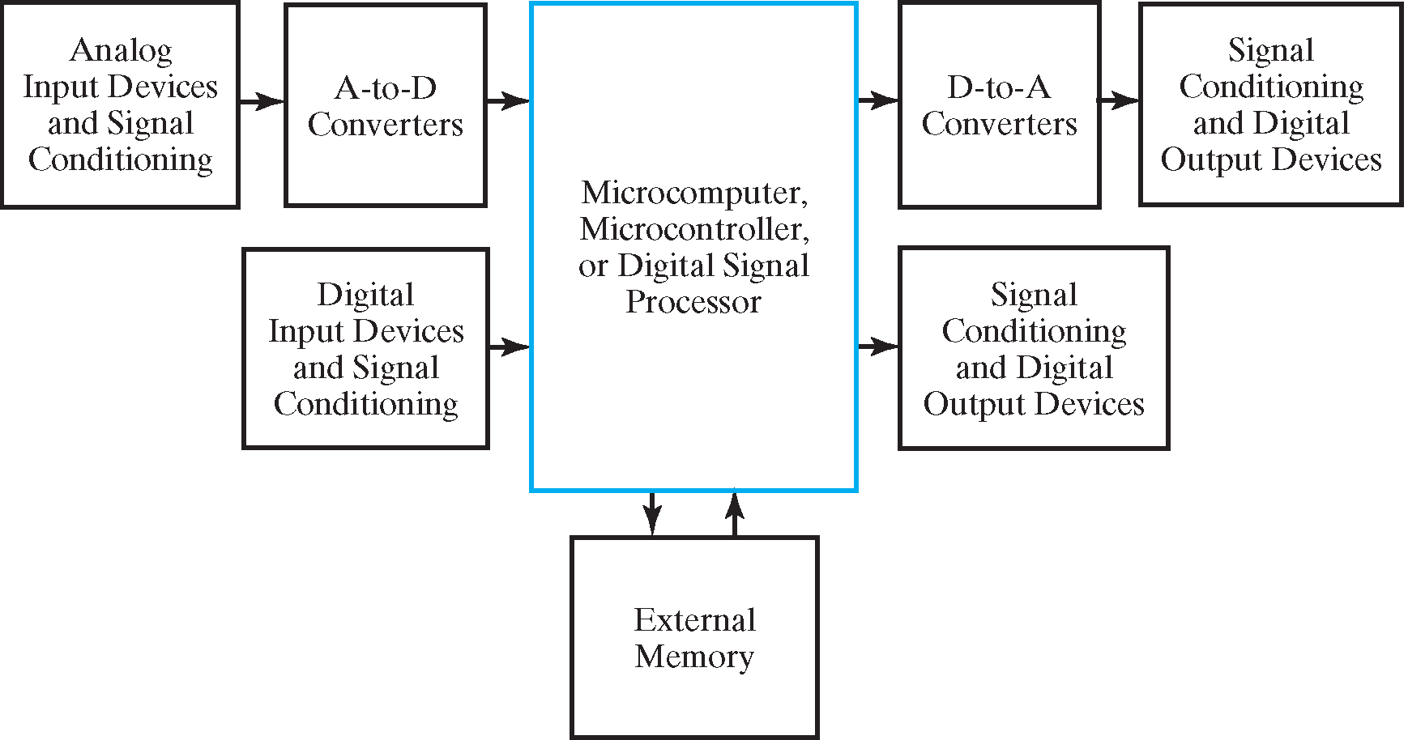
Embedded Systems
Block Diagram of Embedded Systems
Chapter 1 <number>
Notes:
A是模拟信号，D是数字信号

Slide 10
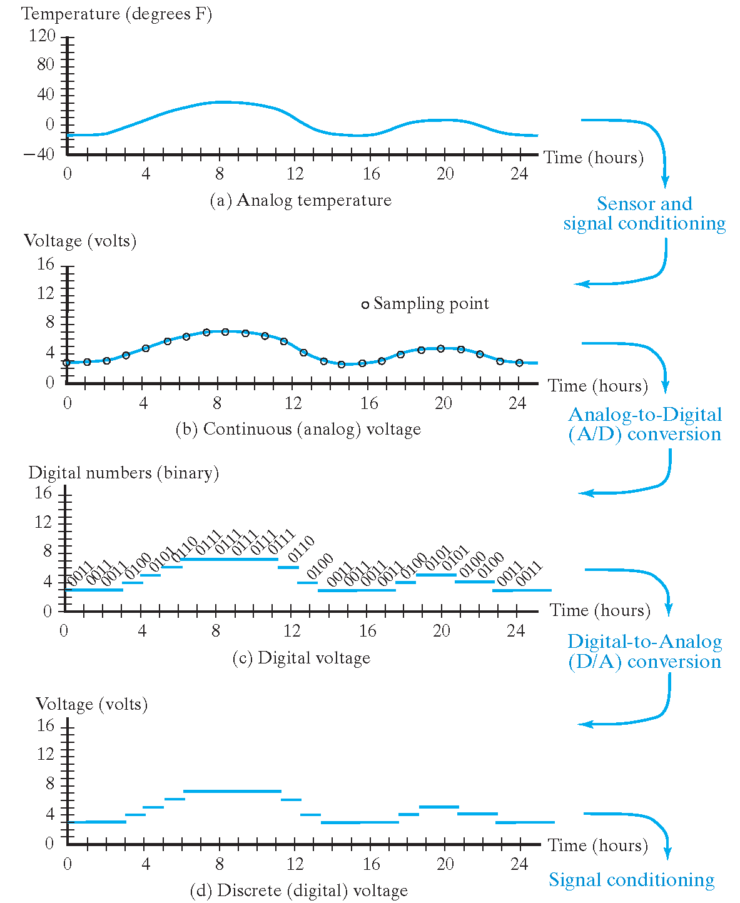
Example: Temperature Measurement and Display
Temperature Measurement
Chapter 1 <number>
Notes:
香农采样定理，当采样频率高于2倍信号最高频率，就能完整的将信号采样。
采样过后在时间上将信号离散化，为了在数值上也离散化，需要对信号二进制转化进行分段，几位采样位数就是2的几次方段
对音质的影响：采样频率，最低音质48k，16位采样位数，人耳最高听20k，定为2倍多一点48k。无损音质24位采样位数。

Slide 11
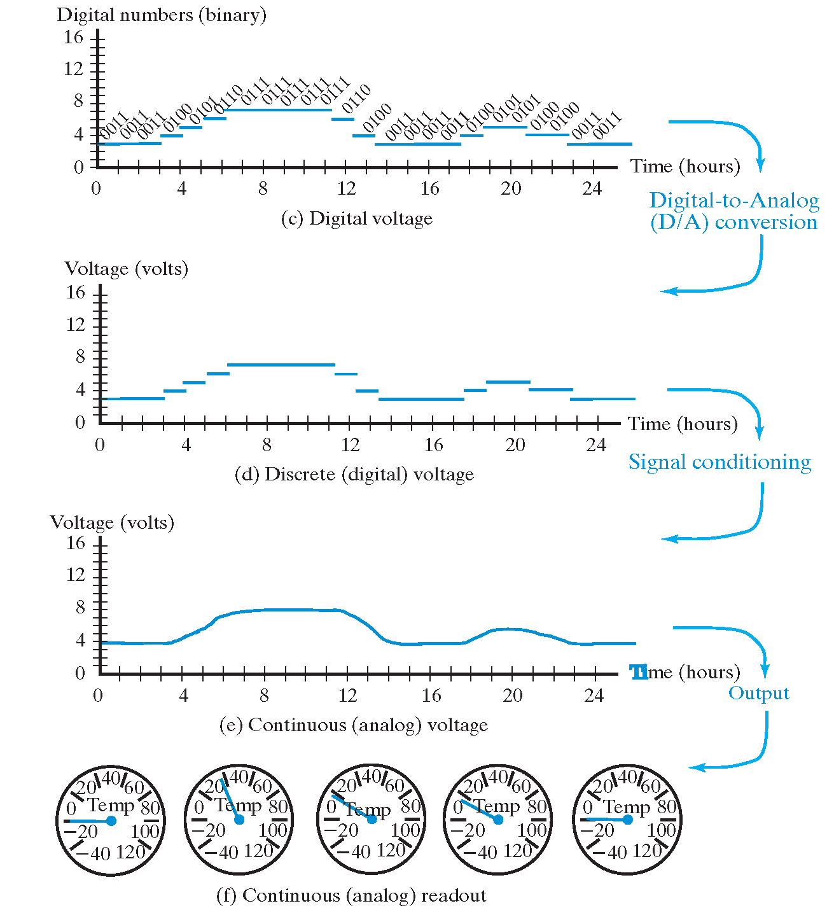
Example: Temperature Measurement and Display
Temperature Display
Chapter 1 <number>
Notes:
从Signao conditioning到 output需要滤波器LF

Slide 12
INFORMATION REPRESENTATION - Signals
Information variables represented by physical quantities.
For digital systems, the variables take on discrete values.
Two level, or binary values are the most prevalent values in digital systems.
Binary values are represented abstractly by:
  digits 0 and 1
  words (symbols) False (F) and True (T)
  words (symbols) Low (L) and High (H)
  and words On and Off.
Binary values are represented by values or ranges of values of physical quantities
Chapter 1 <number>

Slide 13
Signal Examples Over Time
Time
Continuous in value & time
Analog
Digital
Discrete in value & continuous in time
Asynchronous
Synchronous
Discrete in value & time
Chapter 1 <number>
Notes:
模拟信号：时间和数值变化都是连续的
数字信号：时间连续，数值离散
同步信号：时间和数值都是离散，要变化只能在固定的时间点变化

Slide 14
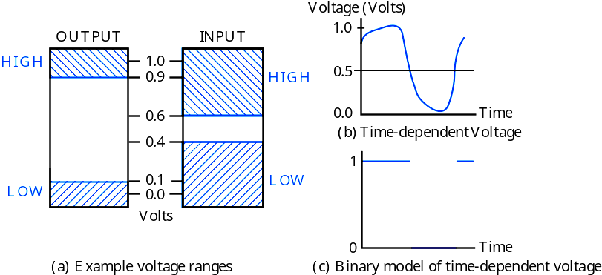
Signal Example – Physical Quantity: Voltage
Threshold Region
Why binary is most prevalent in digital systems?
Chapter 1 <number>
Notes:
The HIGH range typically corresponds to binary 1 and LOW range to binary 0. The threshold region is a range of voltages for which the input voltage value cannot be interpreted reliably as either a 0 or a 1.
输入电压范围较大，为了在外界干扰的情况下仍能正常工作。
二进制的抗干扰能力较强，数字信号比模拟信号更可靠

Slide 15
Binary Values: Other Physical Quantities
What are other physical quantities represent 0 and 1?
  CPU Voltage
  Disk
  CD
  Dynamic RAM
Magnetic Field Direction
Surface Pits/Light
Capacitor Charge
Chapter 1 <number>
Notes:
CPU利用电压
磁盘利用磁系方向
光盘利用表面的凹坑对光的反射不一样
内存利用电容的充放电

Slide 16
NUMBER SYSTEMS – Representation
Positive radix, positional number systems
A number with radix r is represented by a string of digits:
A_{n - 1}A_{n - 2} … A₁A₀ . A₋ ₁ A₋ ₂ … A_{- m + 1} A_{- m}
in which 0 ≤ A_{i} < r and . is the radix point.
The string of digits represents the power series:
(
)
(
)
i = n - 1
j = - 1
(Number)_{r}
=
∑
i
+
∑
j
A
r
A
r
i
j
i = 0
j = - m
(Integer Portion)
(Fraction Portion)
+
Chapter 1 <number>

Slide 17
Number Systems – Examples
 | General | Decimal | Binary
Radix (Base) | r | 10 | 2
Digits | 0 => r - 1 | 0 => 9 | 0 => 1
0 1 2 3 Powers of 4 Radix 5 -1 -2 -3 -4 -5 | r⁰ r¹ r² r³ r⁴ r⁵ r ⁻¹ r ⁻² r ⁻³ r ⁻⁴ r ⁻⁵ | 1 10 100 1000 10,000 100,000 0.1 0.01 0.001 0.0001 0.00001 | 1 2 4 8 16 32 0.5 0.25 0.125 0.0625 0.03125
Chapter 1 <number>

Slide 18
Special Powers of 2
2¹⁰ (1024) is Kilo, denoted "K"
2²⁰ (1,048,576) is Mega, denoted "M"
2³⁰ (1,073, 741,824)is Giga, denoted "G"
2⁴⁰ (1,099,511,627,776 ) is Tera, denoted “T"
Chapter 1 <number>
Notes:
50次方为P

Slide 19
ARITHMETIC OPERATIONS - Binary Arithmetic
Single Bit Addition with Carry
Multiple Bit Addition
Single Bit Subtraction with Borrow
Multiple Bit Subtraction
Multiplication
BCD Addition
Chapter 1 <number>

Slide 20
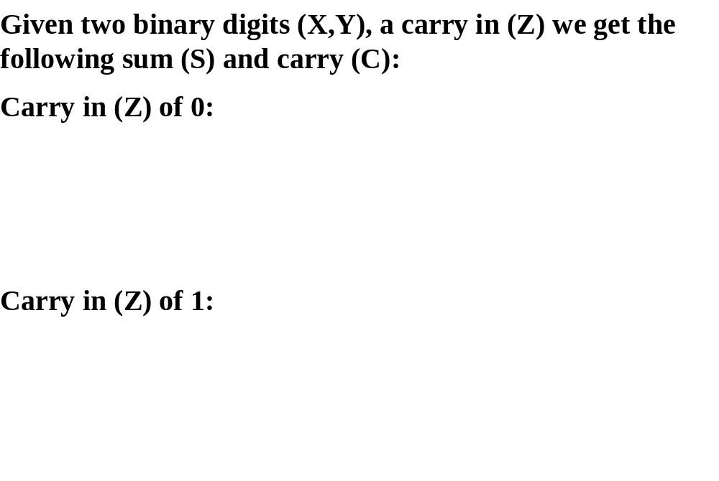
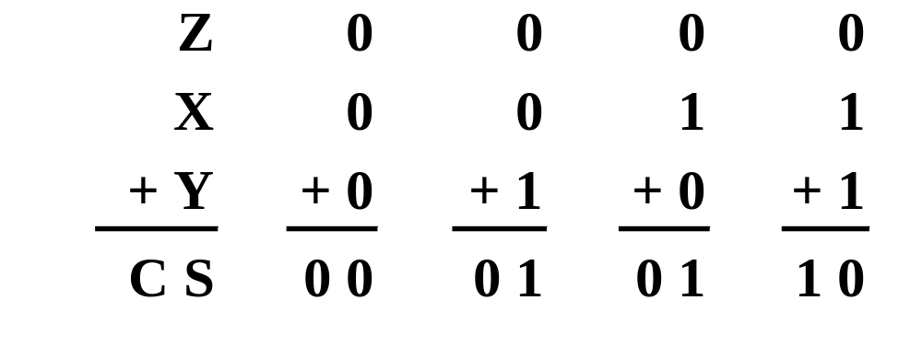
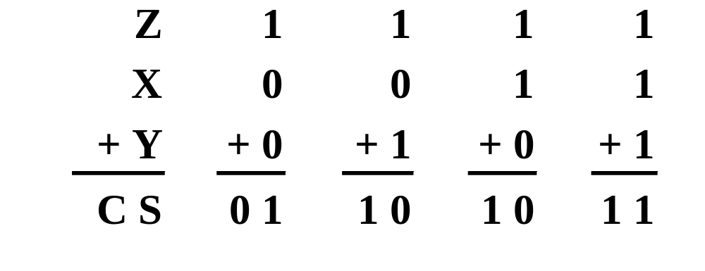
Single Bit Binary Addition with Carry
Chapter 1 <number>
Notes:
C是进位输出
S是和

Slide 21
Multiple Bit Binary Addition
Extending this to two multiple bit examples:
Carries 0 0
Augend 01100 10110
Addend +10001 +10111
Sum
Note: The 0 is the default Carry-In to the least significant bit.
Chapter 1 <number>
Notes:
Carries 00000 01100
Augend 01100 10110
Addend +10001 +10111
Sum 11101 101101
Carries Augend Addend进位 被加数 加数

Slide 22
Single Bit Binary Subtraction with Borrow
Given two binary digits (X,Y), a borrow in (Z) we get the following difference (S) and borrow (B):
Borrow in (Z) of 0:
Borrow in (Z) of 1:
Z
0
0
0
0
X
0
0
1
1
- Y
-0
-1
-0
-1
BS
0 0
1 1
0 1
0 0
Z
1
1
1
1
X
0
0
1
1
- Y
-0
-1
-0
-1
BS
11
1 0
0 0
1 1
Chapter 1 <number>

Slide 23
Multiple Bit Binary Subtraction
Extending this to two multiple bit examples:
Borrows 0 0
Minuend 10110 10110
Subtrahend - 10010 - 10011
Difference
Notes: The 0 is a Borrow-In to the least significant bit. If the Subtrahend > the Minuend, interchange and append a – to the result.
Chapter 1 <number>
Notes:
Borrows 00000 00110
Minuend 10110 10110
Subtrahend –10010 –10011
Difference 00100 00011

Slide 24
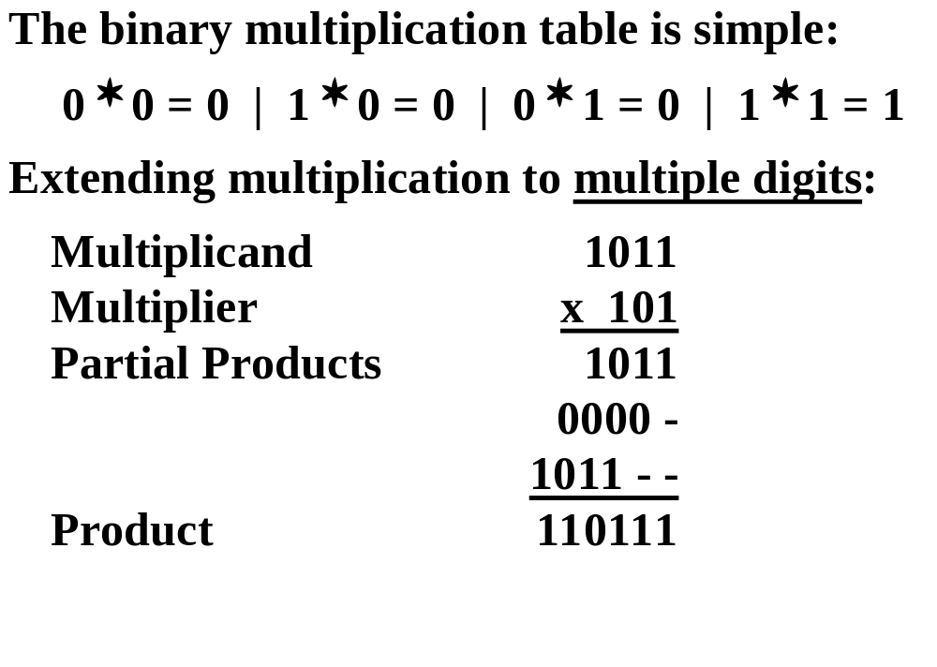
Binary Multiplication
Chapter 1 <number>

Slide 25
BASE CONVERSION - Positive Powers of 2
Useful for Base Conversion
Exponent
Value
Exponent
Value
0
1
11
2,048
1
2
12
4,096
2
4
13
8,192
3
8
14
16,384
4
16
15
32,768
5
32
16
65,536
6
64
17
131,072
7
128
18
262,144
8
256
19
524,288
9
512
20
1,048,576
10
1024
21
2,097,152
Chapter 1 <number>

Slide 26
Commonly Occurring Bases
Name
Radix
Digits
Binary
2
0,1
Octal
8
0,1,2,3,4,5,6,7
Decimal
10
0,1,2,3,4,5,6,7,8,9
Hexadecimal
16
0,1,2,3,4,5,6,7,8,9,A,B,C,D,E,F
The six letters (in addition to the 10
integers) in hexadecimal represent:
Chapter 1 <number>
Notes:
Answer: The six letters A, B, C, D, E, and F represent the digits for values
10, 11, 12, 13, 14, 15 (given in decimal), respectively, in hexadecimal.
Alternatively, a, b, c, d, e, f are used.

Slide 27
Numbers in Different Bases
Good idea to memorize!
Decimal
Binary
Octal
Hexa
decimal
(Base 10)
(Base 2)
(Base 8)
(Base 16)
00
00000
00
00
01
00001
01
01
02
00010
02
02
03
00011
03
03
04
00100
04
04
05
00101
05
05
06
00110
06
06
07
00111
07
07
08
01000
10
08
09
01001
11
09
10
01010
12
0A
11
0101
1
13
0B
12
01100
14
0C
13
01101
15
0D
14
01110
16
0E
15
01111
17
0F
16
10000
20
10
Chapter 1 <number>

Slide 28
Conversion Between Bases
To convert from one base to another:
1) Convert the Integer Part
2) Convert the Fraction Part
3) Join the two results with a radix point
Chapter 1 <number>

Slide 29
Conversion Details
To Convert the Integral Part:
  Repeatedly divide the number by the new radix and save the remainders. The digits for the new radix are the remainders in reverse order of their computation. If the new radix is > 10, then convert all remainders > 10 to digits A, B, …
To Convert the Fractional Part:
  Repeatedly multiply the fraction by the new radix and save the integer digits that result. The digits for the new radix are the integer digits in order of their computation. If the new radix is > 10, then convert all integers > 10 to digits A, B, …
Chapter 1 <number>

Slide 30
Converting Binary to Decimal
To convert to decimal, use decimal arithmetic to form Σ (digit × respective power of 2).
Example: Convert 11010₂ to N₁₀:
Chapter 1 <number>
Notes:
Powers of 2: 43210
11010₂ =>
1 X 2⁴ = 16
+ 1 X 2³ = 8
+ 0 X 2² = 0
+ 1 X 2¹ = 2
+ 0 X 2⁰ = 0
26₁₀

Slide 31
Example: Convert 725₁₀ To Base 2
2 7 2 5
(725)₁₀ = (10 1101 0101)₂
2 3 6 2…………1
2 1 8 1…………0
2 9 0…………1
2 4 5…………0
2 2 2…………1
2 1 1…………0
2 5…………1
2 2…………1
2 1…………0
2 0…………1
Chapter 1 <number>

Slide 32
Example: Convert 0.678₁₀ To Base 2
(0.678)₁₀ = (0.1010 1101 1001)₂
2× 0.678………… = 1.356
2× 0.356………… = 0.712
2× 0.712………… = 1.424
2× 0.424………… = 0.848
2× 0.848………… = 1.696
2× 0.696………… = 1.392
2× 0.392………… = 0.784
2× 0.784………… = 1.568
2× 0.568………… = 1.136
2× 0.136………… = 0.272
2× 0.272………… = 0.544
2× 0.544………… = 1.088
Notes:
乘2取整

Slide 33
Example: Convert 46.6875₁₀ To Base 2
Convert 46 to Base 2
Convert 0.6875 to Base 2:
Join the results together with the radix point:
Chapter 1 <number>
Notes:
Answer 1: Converting 46 as integral part: Answer 2: Converting 0.6875 as fractional part:
46/2 = 23 rem = 0 0.6875 * 2 = 1.3750 int = 1
23/2 = 11 rem = 1 0.3750 * 2 = 0.7500 int = 0
11/2 = 5 remainder = 1 0.7500 * 2 = 1.5000 int = 1
5/2 = 2 remainder = 1 0.5000 * 2 = 1.0000 int = 1
2/2 = 1 remainder = 0 0.0000
1/2 = 0 remainder = 1 Reading off in the forward direction: 0.1011₂
Reading off in the reverse direction: 101110₂
Answer 3: Combining Integral and Fractional Parts:
101110. 1011₂

Slide 34
Additional Issue - Fractional Part
Note that in this conversion, the fractional part can become 0 as a result of the repeated multiplications.
In general, it may take many bits to get this to happen or it may never happen.
Example Problem: Convert 0.65₁₀ to N₂
  0.65 = 0.1010011001001 …
  The fractional part begins repeating every 4 steps yielding repeating 1001 forever!
Solution: Specify number of bits to right of radix point and round or truncate to this number.
Chapter 1 <number>

Slide 35
Checking the Conversion
To convert back, sum the digits times their respective powers of r.
From the prior conversion of 46.6875₁₀
101110₂ = 1·32 + 0·16 +1·8 +1·4 + 1·2 +0·1
= 32 + 8 + 4 + 2
= 46
0.1011₂ = 1/2 + 1/8 + 1/16
= 0.5000 + 0.1250 + 0.0625
= 0.6875
Chapter 1 <number>

Slide 36
Why Do Repeated Division and Multiplication Work?
Divide the integer portion of the power series on slide 11 by radix r. The remainder of this division is A₀, represented by the term A₀/r.
Discard the remainder and repeat, obtaining remainders A₁, …
Multiply the fractional portion of the power series on slide 11 by radix r. The integer part of the product is A₋₁.
Discard the integer part and repeat, obtaining integer parts A₋₂, …
This demonstrates the algorithm for any radix r >1.
Chapter 1 <number>
Notes:
Divide integral part equation on slide 21 by r. Note that the powers of r decline by 1 in the quotient and that a fraction a₀/r results, giving a₀ as the remainder.
The next time, fraction a₁/r results giving a₁ as the remainder.
In general, the remainder will be a_{i} for the ith step.
At the nth step, a_{n}/r will result with the quotient = 0.
Similarly, for multiply, a_{–1} will emerge as the integral part first since r x r ^{–1} = 1.

Slide 37
Octal (Hexadecimal) to Binary and Back
Octal (Hexadecimal) to Binary:
  Restate the octal (hexadecimal) as three (four) binary digits starting at the radix point and going both ways.
Binary to Octal (Hexadecimal):
  Group the binary digits into three (four) bit groups starting at the radix point and going both ways, padding with zeros as needed in the fractional part.
  Convert each group of three bits to an octal (hexadecimal) digit.
Chapter 1 <number>
Notes:
2转8 三位
2转16 四位

Slide 38
Octal (Hexadecimal) to Binary and Back
Example:
(67.731) ₈ ＝（110 111 .111 011 001)₂
(312.64)₈＝(011 001 010 . 110 1)₂
(11 111 101 . 010 011 11)₂＝(375.236)₈
(10 110.11)₂＝(26.6)₈
(3AB4.1) ₁₆ ＝（0011 1010 1011 0100 .0001)₂
(21A.5)₁₆＝(0010 0001 1010 . 0101)₂
(1001101.01101)₂= ( 0100 1101. 0110 1000 )₂=(4D.68)₁₆
(110 0101.101)₂＝(65.A)₁₆
Chapter 1 <number>

Slide 39
Octal to Hexadecimal via Binary
Convert octal to binary.
Use groups of four bits and convert as above to hexadecimal digits.
Example: Octal to Binary to Hexadecimal
6 3 5 . 1 7 7 ₈
Why do these conversions work?
Chapter 1 <number>
Notes:
Answer 1:
6 3 5 . 1 7 7 ₈
110|011|101 . 001|111|111 ₂
Regroup:
1|1001|1101 . 0011|1111|1(000)₂
Convert:
1 9 D . 3 F 8₁₆
Answer 2: Marking off in groups of three (four) bits corresponds to dividing or multiplying by 2³ = 8 (2⁴ = 16) in the binary system.

Slide 40
A Final Conversion Note
You can use arithmetic in other bases if you are careful:
Example: Convert 101110₂ to Base 10 using binary arithmetic:
  Step 1 101110 / 1010 = 100 r 0110
  Step 2 100 / 1010 = 0 r 0100
  Converted Digits are 0100₂ | 0110₂
  or 4 6 ₁₀
Chapter 1 <number>

Slide 41
Binary Numbers and Binary Coding
Flexibility of representation
  Within constraints below, can assign any binary combination (called a code word) to any data as long as data is uniquely encoded.
Information Types
  Numeric 有特定的数值意义 数值编码
    Must represent range of data needed
    Very desirable to represent data such that simple, straightforward computation for common arithmetic operations permitted
    Tight relation to binary numbers
  Non-numeric 非数值编码
    Greater flexibility since arithmetic operations not applied.
    Not tied to binary numbers
Chapter 1 <number>

Slide 42
Non-numeric Binary Codes
Given n binary digits (called bits), a binary code is a mapping from a set of represented elements to a subset of the 2^{n} binary numbers.
Example: A
binary code
for the seven
colors of the
rainbow
Code 100 is
not used
Color
Binary Number
Red
000
Orange
001
Yellow
010
Green
011
Blue
101
Indigo
110
Violet
111
Chapter 1 <number>
Notes:
无特定数值含义（符号编码）

Slide 43
Number of Bits Required
Given M elements to be represented by a binary code, the minimum number of bits, n, needed, satisfies the following relationships:
    2^{n} ≥ M > 2^{(n – 1)}
    n = log₂ M where x , called the ceiling
    function, is the integer greater than or equal to x.
Example: How many bits are required to represent decimal digits with a binary code?
Chapter 1 <number>
Notes:
M = 10
Therefore n = 4 since:
2⁴ =16 is ≥ 10 > 2³ = 8
and the ceiling function for log₂ 10 is 4.

Slide 44
Number of Elements Represented
Given n digits in radix r, there are r^{n} distinct elements that can be represented.
But, you can represent m elements, m < r^{n}
Examples:
  You can represent 4 elements in radix r = 2 with n = 2 digits: (00, 01, 10, 11).
  You can represent 4 elements in radix r = 2 with n = 4 digits: (0001, 0010, 0100, 1000).
  This second code is called a "one hot" code.
Chapter 1 <number>
Notes:
Onehot 有几个element就有几个二进制位，每一位的1代表一个符号

Slide 45
DECIMAL CODES - Binary Codes for Decimal Digits
There are over 8,000 ways that you can chose 10 elements from the 16 binary numbers of 4 bits. A few are useful:
Decimal
8,4,2,1
Excess3
8,4,
-
2,
-
1
Gray
0
0000
0011
0000
0000
1
0001
0100
0111
0100
2
0010
0101
0110
0101
3
0011
0110
0101
0111
4
0100
0111
0100
0110
5
0101
1000
1011
0010
6
0110
1001
1010
0011
7
0111
1010
1001
0001
8
1000
1011
1000
1001
9
1001
1
100
1111
1000
Chapter 1 <number>

Slide 46
Excess 3 Code and 8, 4, –2, –1 Code
Decimal | Excess 3 | 8, 4, –2, –1
0 | 0011 | 0000
1 | 0100 | 0111
2 | 0101 | 0110
3 | 0110 | 0101
4 | 0111 | 0100
5 | 1000 | 1011
6 | 1001 | 1010
7 | 1010 | 1001
8 | 1011 | 1000
9 | 1100 | 1111
What interesting property is common to these two codes?
Chapter 1 <number>
Notes:
Answer: Both of these codes have the property that the codes for 0 and 9, 1 and 8, etc. can be obtained from each other by replacing the 0’s with the 1’s and vice-versa in the code words. Such a code is sometimes called a complement code.
余3码
将对应数字的二进制值加三所得
最高位代表8，第二位4，第三位-2第四位-1，将四位代表的数字相加
0和9，1和8，2和7互为反码

Slide 47
Binary Coded Decimal (BCD)
The BCD code is the 8,4,2,1 code.
8, 4, 2, and 1 are weights
BCD is a weighted code
This code is the simplest, most intuitive binary code for decimal digits and uses the same powers of 2 as a binary number, but only encodes the first ten values from 0 to 9.
Example: 1001 (9) = 1000 (8) + 0001 (1)
How many “invalid” code words are there?
What are the “invalid” code words?
Chapter 1 <number>
Notes:
Answer 1: 6
Answer 2: 1010, 1011, 1100, 1101, 1110, 1111

Slide 48
Warning: Conversion or Coding?
Do NOT mix up conversion of a decimal number to a binary number with coding a decimal number with a BINARY CODE.
13₁₀ = 1101₂ (This is conversion)
13 ⇔ 0001|0011 (This is coding)
Chapter 1 <number>
Notes:
用编码的方式表示十进制数而不直接用十进制数的二进制：
和人交互的设备一般用BCD码表示，在嵌入式系统中存储BCD码更方便。如果直接用二进制数，要进行计算才能转化为十进制数（人能看懂），较为麻烦
如何在BCD上进行加减法操作？

Slide 49
BCD Arithmetic
Given a BCD code, we use binary arithmetic to add the digits:
8
1000
Eight
+5
+0101
Plus 5
13
1101
is 13 (> 9)
Note that the result is MORE THAN 9, so must be
represented by two digits!
To correct the digit, subtract 10 by adding 6 modulo 16.
8
1000
Eight
+5
+0101
Plus 5
13
1101
is 13 (> 9)
+0110
so add 6
carry = 1
0011
leaving 3 + cy
0001 | 0011
Final answer (two digits)
If the digit sum is > 9, add one to the next significant digit
Chapter 1 <number>
Notes:
如果转换后的结果大于9，加6即可

Slide 50
BCD Addition Example
Add 2905_{BCD} to 1897_{BCD} showing carries and digit corrections.
0
1 1 1
0001 1000 1001 0111
+ 0010 1001 0000 0101
0100 10010 1010 1100
+ 0000 + 0110 + 0110 + 0110
0100 1000 0000 0010
Chapter 1 <number>
Notes:
1 1 1 0
0001 1000 1001 0111
+ 0010 1001 0000 0101
0100 10010 1010 1100
+ 0000+ 0110+ 0110+ 0110
0100 1000 0000 0010

Slide 51
ALPHANUMERIC CODES - ASCII Character Codes
American Standard Code for Information Interchange
This code is a popular code used to represent information sent as character-based data. It uses 7-bits to represent:
  94 Graphic printing characters.
  34 Non-printing characters
Some non-printing characters are used for text format (e.g. BS = Backspace, CR = carriage return)
Other non-printing characters are used for record marking and flow control (e.g. STX and ETX start and end text areas).
(Refer to Table 1
-4 in the text)
Chapter 1 <number>

Slide 52
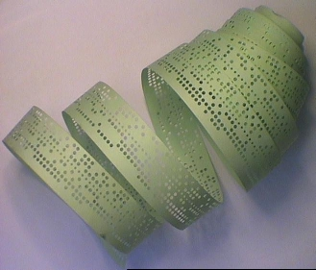
ASCII Properties
ASCII has some interesting properties:
Digits 0 to 9 span Hexadecimal values 30₁₆
to 39₁₆
.
Upper case A
-
Z span 41₁₆
to 5A₁₆
.
Lower case a
-
z span 61₁₆
to 7A₁₆
.
Lower to upper case translation (and vice versa)
occurs by
flipping bit 6.
Delete (DEL) is all bits set,
a carryover from when
punched paper tape was used to store messages.
Punching all holes in a row erased a mistake!
Chapter 1 <number>
Notes:
删除符号位全为1

Slide 53
7 BIT ASCII CODE TABLE
b6b5b4 b3b2b1b0 | 000 | 001 | 010 | 011 | 100 | 101 | 110 | 111
0000 | NUL | DLE | SP | 0 | @ | P | ， | p
0001 | SOM | DC | ! | 1 | A | Q | a | q
0010 | STX | DC | “ | 2 | B | R | b | r
0011 | ETX | DC | # | 3 | C | S | c | s
0100 | EOT | DC | $ | 4 | D | T | d | t
0101 | ENQ | NAA | % | 5 | E | U | e | u
0110 | ACA | SYN | & | 6 | F | V | f | v
0111 | BEL | ETB | ， | 7 | G | W | g | w
1000 | BS | CAN | ( | 8 | H | X | h | x
1001 | HT | EM | ) | 9 | I | Y | i | y
1010 | LF | SUB | * | : | J | Z | j | z
1011 | VT | ESC | + | ; | A | [ | k
1100 | FF | FS | ， | < | L | \ | l | |
1101 | CR | GS | － | = | M | ] | m
1110 | SO | RS | ． | > | N |  | n | ~
1111 | SI | US | / | ? | O | ← | o | DEL
Chapter 1 <number>

Slide 54
PARITY BIT Error-Detection Codes
Redundancy (e.g. extra information), in the form of extra bits, can be incorporated into binary code words to detect and correct errors.
A simple form of redundancy is parity, an extra bit appended onto the code word to make the number of 1’s odd or even. Parity can detect all single-bit errors and some multiple-bit errors.
A code word has even parity if the number of 1’s in the code word is even.
A code word has odd parity if the number of 1’s in the code word is odd.
Chapter 1 <number>
Notes:
冗余（例如额外信息）以额外位的形式可以合并到二进制码字中以检测和纠正错误。 冗余的一种简单形式是奇偶校验，即在码字上附加一个额外的位来确定 1 的数量为奇数或偶数。 奇偶校验可以检测所有单位错误和一些多位错误。 如果码字中 1 的个数是偶数，则该码字具有偶奇偶校验。 如果码字中 1 的数量是奇数，则该码字具有奇奇偶校验。

Slide 55
4-Bit Parity Code Example
Fill in the even and odd parity bits:
The codeword "1111" has even parity and the codeword "1110" has odd parity. Both can be used to represent 3-bit data.
Even Parity
Odd Parity
Message
-
Parity
Message
-
Parity
000
-
000
-
001
-
001
-
010
-
010
-
011
-
011
-
100
-
100
-
101
-
101
-
110
-
110
-
111
-
111
-
Chapter 1 <number>
Notes:
Even Parity Bits: 0, 1, 1, 0, 1, 0, 0, 1
Odd Parity Bits: 1, 0, 0, 1, 0, 1, 1, 0
加一个数字，里面的1的个数是偶数，就是偶检验码，是奇数就是奇检验码
检查的时候校验位和数据位一起检查
只能检查一个位置的错误，如果有两个就不行，只能检验出错概率不高的情况

Slide 56
GRAY CODE – Decimal
What special property does the Gray code have in relation to adjacent decimal digits?
Decimal
8,4,2,1
Gray
0
0000
0000
1
0001
0100
2
0010
0101
3
0011
0111
4
0100
0110
5
0101
0010
6
0110
0011
7
0111
0001
8
1000
1001
9
1001
1000
Chapter 1 <number>
Notes:
Answer: As we “counts” up or down in decimal, the code word for the Gray code changes in only one bit position as we go from decimal digit to digit including from 9 to 0.
相邻两个码位之间有一位是不一样的，有多种Gray Code
用来记录系统中的状态：

Slide 57
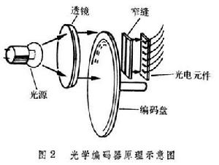
Optical Shaft Encoder
Does this special Gray code property have any value?
An Example: Optical Shaft Encoder
111
000
100
000
B
0
B
1
110
001
101
001
B
2
G
2
G
1
010
111
G
0
101
011
100
011
110
010
(a) Binary Code for Positions 0 through 7
(b) Gray Code for Positions 0 through 7
Chapter 1 <number>
Notes:
Yes, as illustrated by the that followed.
旋转编码器，在电机上用来记录电机转动角度。
能收到光为1，收不到为0，记录相同角度上的各位数字，判断角度
用gray码的原因是，传感器不可能完全在一条线上，可能从000到100到110最后到111，会出现中间结果，出现错误。用gray码，每次只能有一个位改变，
状态码进可能用gray码表示

Slide 58
Shaft Encoder (Continued)
How does the shaft encoder work?
For the binary code, what codes may be produced if the shaft position lies between codes for 3 and 4 (011 and 100)?
Is this a problem?
Chapter 1 <number>
Notes:
Answer 1: The encoder disk contains opaque and clear areas.
Opaque represents a 0 and clear a 1. Light shining through each ring of the encoder corresponding to a bit of the code strikes a sensor to produce a 0 or a 1.
Answer 2: In addition to the correct code, either 011 or 100, the codes 000, 010, 001, 110, 101, or 111 can be produced.
Answer 3: Yes, the shaft position can be completely UNKNOWN!

Slide 59
Shaft Encoder (Continued)
For the Gray code, what codes may be produced if the shaft position lies between codes for 3 and 4 (010 and 110)?
Is this a problem?
Does the Gray code function correctly for these borderline shaft positions for all cases encountered in octal counting?
Chapter 1 <number>
Notes:
Answer 1: Only the correct codes, either 010 or 110
Answer 2: No, the shaft position is known to be either 3 or 4 which is OK since it is halfway in between.
Answer 3: Yes, since an erroneous code cannot arise. This includes between 0 and 7 (000 and 100).

Slide 60
UNICODE
UNICODE extends ASCII to 65,536 universal characters codes
  For encoding characters in world languages
  Available in many modern applications
  2 byte (16-bit) code words
  See Reading Supplement – Unicode on the Companion Website http://www.prenhall.com/mano
Chapter 1 <number>

Slide 61
Assignment
1-3, 1-9, 1-12, 1-13, 1-16, 1-18, 1-19, 1-28
Chapter 1 <number>

