Slide 2
Overview
Part 1 – Design Procedure
  Steps
    Specification
    Formulation
    Optimization
    Technology Mapping
  Beginning Hierarchical Design
  Technology Mapping - AND, OR, and NOT to NAND or NOR
  Verification
    Manual
    Simulation
Chapter 3 - Part 1 <number>

Slide 3
Overview (continued)
Part 2 – Combinational Logic
  Functions and functional blocks
  Rudimentary logic functions
  Decoding using Decoders
    Implementing Combinational Functions with Decoders
  Encoding using Encoders
  Selecting using Multiplexers
    Implementing Combinational Functions with Multiplexers
Chapter 3 - Part 1 <number>

Slide 4
Combinational Circuits
A combinational logic circuit has:
  A set of m Boolean inputs,
  A set of n Boolean outputs, and
  n switching functions, each mapping the 2^{m} input combinations to an output such that the current output depends only on the current input values
A block diagram:
Combinatorial
Logic
Circuit
m Boolean Inputs
n Boolean Outputs
Chapter 3 - Part 1 <number>

Slide 5
Beginning Hierarchical Design
To control the complexity of the function mapping inputs to outputs:
  Decompose the function into smaller pieces called blocks
  Decompose each block’s function into smaller blocks, repeating as necessary until all blocks are small enough
  Any block not decomposed is called a primitive block
  The collection of all blocks including the decomposed ones is a hierarchy
Example: 9-input parity tree (see next slide)
  Top Level: 9 inputs, one output
  2nd Level: Four 3-bit odd parity trees in two levels
  3rd Level: Two 2-bit exclusive-OR functions
  Primitives: Four 2-input NAND gates
  Design requires 4 X 2 X 4 = 32 2-input NAND gates
Chapter 3 - Part 1 <number>

Slide 6
Hierarchy for Parity Tree Example
X
0
X
1
X
2
9-Input
X
3
odd
X
4
Z
O
X
5
function
X
X
6
0
A
0
3-Input
X
7
A
odd
X
8
X
1
1
function
B
O
(a) Symbol for circuit
X
2
A
2
X
3
A
0
3-Input
A
0
3-Input
X
4
A
1
odd
B
O
A
1
odd
B
O
Z
O
X
A
function
A
function
5
2
2
X
6
A
0
3-Input
X
7
A
1
odd
B
O
X
A
function
8
2
(b) Circuit as interconnected 3-input odd
function blocks
A
0
A
1
B
O
A
2
(c) 3-input odd function circuit as
interconnected exclusive-OR
blocks
(d) Exclusive-OR block as interconnected
Chapter 3 - Part 1 <number>
NANDs

Slide 7
Reusable Functions
Whenever possible, we try to decompose a complex design into common, reusable function blocks
These blocks are
  verified and well-documented
  placed in libraries for future use
Chapter 3 - Part 1 <number>

Slide 8
Top-Down versus Bottom-Up
A top-down design proceeds from an abstract, high-level specification to a more and more detailed design by decomposition and successive refinement
A bottom-up design starts with detailed primitive blocks and combines them into larger and more complex functional blocks
Design usually proceeds top-down to known building blocks ranging from complete CPUs to primitive logic gates or electronic components.
Much of the material in this chapter is devoted to learning about combinational blocks used in top-down design.
Chapter 3 - Part 1 <number>

Slide 9
Design Procedure
Specification
  Write a specification for the circuit if one is not already available
Formulation
  Derive a truth table or initial Boolean equations that define the required relationships between the inputs and outputs, if not in the specification
  Apply hierarchical design if appropriate
Optimization
  Apply 2-level and multiple-level optimization
  Draw a logic diagram or provide a netlist for the resulting circuit using ANDs, ORs, and inverters
Chapter 3 - Part 1 <number>

Slide 10
Design Procedure
Technology Mapping
  Map the logic diagram or netlist to the implementation technology selected
Verification
  Verify the correctness of the final design manually or using simulation
Chapter 3 - Part 1 <number>

Slide 11
Design Example
Specification
  BCD to Excess-3 code converter
  Transforms BCD code for the decimal digits to Excess-3 code for the decimal digits
  BCD code words for digits 0 through 9: 4-bit patterns 0000 to 1001, respectively
  Excess-3 code words for digits 0 through 9: 4-bit patterns consisting of 3 (binary 0011) added to each BCD code word
  Implementation:
    multiple-level circuit
    NAND gates (including inverters)
Chapter 3 - Part 1 <number>

Slide 12
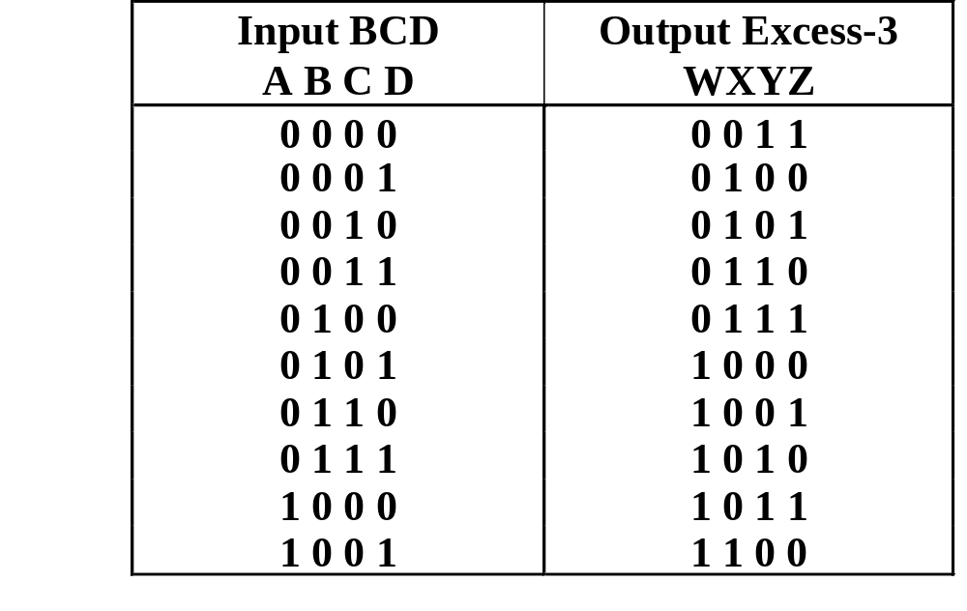
Design Example (continued)
Formulation
  Conversion of 4-bit codes can be most easily formulated by a truth table
  Variables
  - BCD:
  A,B,C,D
  Variables
  - Excess-3
  W,X,Y,Z
  Don’t Cares
  - BCD 1010
  to 1111
Chapter 3 - Part 1 <number>

Slide 13
Design Example (continued)
C
C
Optimization
  2-level using
  K-maps
W = A + BC + BD
X = C + D + B
Y = CD +
Z =
z
y
1
1
1
1
0
1
3
2
0
1
3
2
1
1
1
1
4
5
7
6
B
4
5
7
6
B
X
X
X
X
X
X
X
X
A
12
13
15
14
A
12
13
15
14
1
X
X
1
X
X
B
B
C
D
8
9
11
10
8
9
11
10
D
D
C
D
D
x
C
C
w
1
1
1
0
1
3
2
0
1
3
2
1
1
1
1
4
5
7
6
B
4
5
7
6
B
X
X
X
X
X
X
X
X
A
12
13
15
14
A
12
13
15
14
1
X
X
1
1
X
X
8
9
11
10
8
9
11
10
D
D
Chapter 3 - Part 1 <number>

Slide 14
Design Example (continued)
Optimization (continued)
  Multiple-level using transformations
  W = A + BC + BD
  X = C + D + B
  Y = CD +
  Z = G = 7 + 10 + 6 + 0 = 23
  Perform extraction, finding factor:
  T₁ = C + D
  W = A + BT₁
  X = T₁ + B
  Y = CD +
  Z =
B
B
C
D
C
D
D
B
C
D
C
D
D
  G = 2 + 4 + 7 + 6 + 0 = 19
Chapter 3 - Part 1 <number>

Slide 15
Design Example (continued)
Optimization (continued)
  Multiple-level using transformations
  T₁ = C + D
  W = A + BT₁
  X = T₁ + B
  Y = CD +
  Z = G = 19
  An additional extraction not shown in the text since it uses a Boolean transformation: ( = C + D = ):
  W = A + BT₁
  X = T₁ + B
  Y = CD +
  Z =
B
C
D
C
D
D
C
D
T₁
B
T₁
How many levels in the circuit?
T₁
D
  G = 2 +1 + 4 + 6 + 4 + 0 = 17!
Chapter 3 - Part 1 <number>

Slide 16
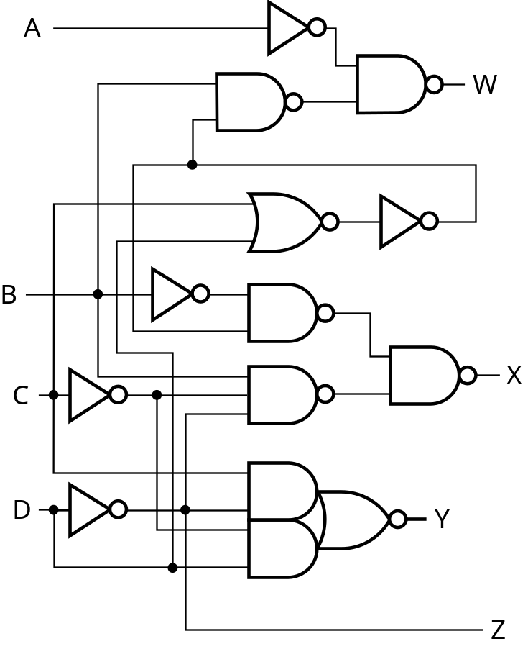
Design Example (continued)
Technology Mapping
  Mapping with a library containing inverters and 2-input NAND, 2-input NOR, and 2-2 AOI gates
A
W
B
X
C
Y
D
Z
Chapter 3 - Part 1 <number>

Slide 17
Technology Mapping
Mapping Procedures
  To NAND gates
  To NOR gates
  Mapping to multiple types of logic blocks in covered in the reading supplement: Advanced Technology Mapping.
Chapter 3 - Part 1 <number>

Slide 18
Chip Design Styles
Full custom - the entire design of the chip down to the smallest detail of the layout is performed
  Expensive
  Justifiable only for dense, fast chips with high sales volume
Standard cell - blocks have been design ahead of time or as part of previous designs
  Intermediate cost
  Less density and speed compared to full custom
Gate array - regular patterns of gate transistors that can be used in many designs built into chip - only the interconnections between gates are specific to a design
  Lowest cost
  Less density compared to full custom and standard cell
Chapter 2 - Part 1 <number>

Slide 19
Cell Libraries
Cell - a pre-designed primitive block
Cell library - a collection of cells available for design using a particular implementation technology
Cell characterization - a detailed specification of a cell for use by a designer - often based on actual cell design and fabrication and measured values
Cells are used for gate array, standard cell, and in some cases, full custom chip design
Chapter 2 - Part 1 <number>

Slide 20
Typical Cell Characterization Components
Schematic or logic diagram
Area of cell
  Often normalized to the area of a common, small cell such as an inverter
Input loading (in standard loads) presented to outputs driving each of the inputs
Delays from each input to each output
One or more cell templates for technology mapping
One or more hardware description language models
If automatic layout is to be used:
  Physical layout of the cell circuit
  A floorplan layout providing the location of inputs, outputs, power and ground connections on the cell
Chapter 2 - Part 1 <number>

Slide 21
Example Cell Library
Typical
Typical
Input-to-
Basic
Cell
Cell
Normalized
Input
Output
Function
Name
Schematic
Area
Load
Delay
Templates
Inverter
1.00
1.00
0.04
＋
0.012
*
SL
2NAND
1.25
1.00
0.05
＋
0.014
*
SL
2NOR
1.25
1.00
0.06
＋
0.018
*
SL
2-2 AOI
2.25
0.95
0.07
＋
0.019
*
SL
Chapter 2 - Part 1 <number>

Slide 22
Mapping to NAND gates
Assumptions:
  Gate loading and delay are ignored
  Cell library contains an inverter and n-input NAND gates, n = 2, 3, …
  An AND, OR, inverter schematic for the circuit is available
The mapping is accomplished by:
  Replacing AND and OR symbols,
  Pushing inverters through circuit fan-out points, and
  Canceling inverter pairs
Chapter 3 - Part 1 <number>

Slide 23
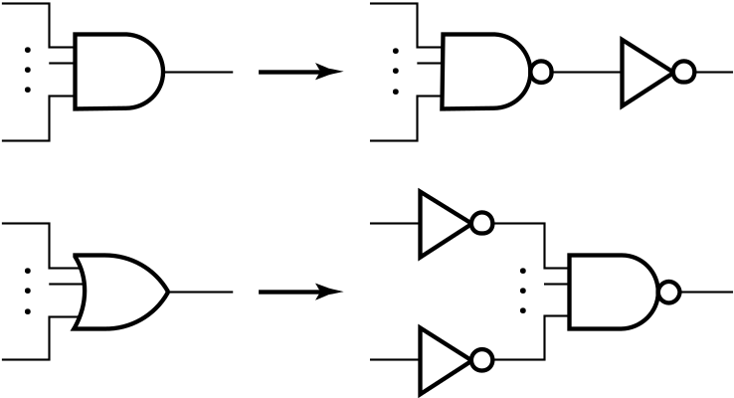
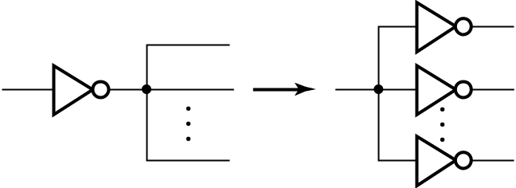

NAND Mapping Algorithm
Replace ANDs and ORs:
Repeat the following pair of actions until there is at most one inverter between :
  A circuit input or driving NAND gate output, and
  The attached NAND gate inputs.
Chapter 3 - Part 1 <number>

Slide 24
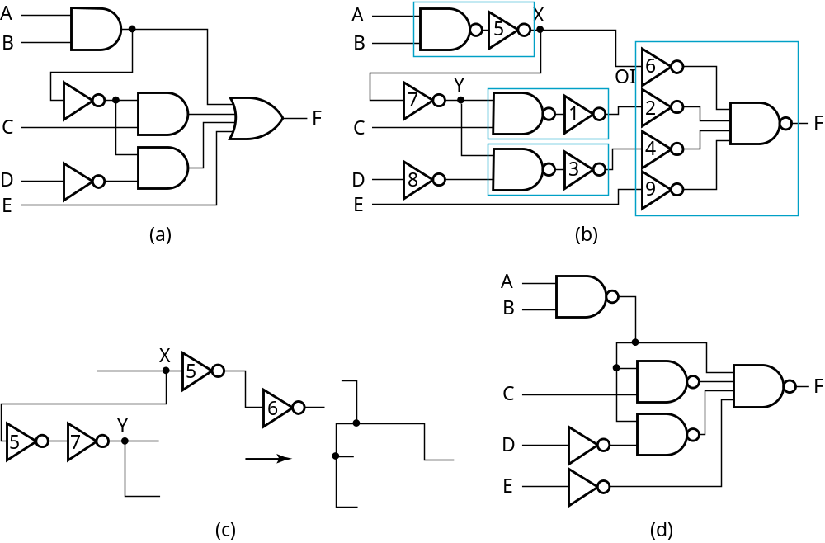
NAND Mapping Example
Chapter 3 - Part 1 <number>

Slide 25
Mapping to NOR gates
Assumptions:
  Gate loading and delay are ignored
  Cell library contains an inverter and n-input NOR gates, n = 2, 3, …
  An AND, OR, inverter schematic for the circuit is available
The mapping is accomplished by:
  Replacing AND and OR symbols,
  Pushing inverters through circuit fan-out points, and
  Canceling inverter pairs
Chapter 3 - Part 1 <number>

Slide 26
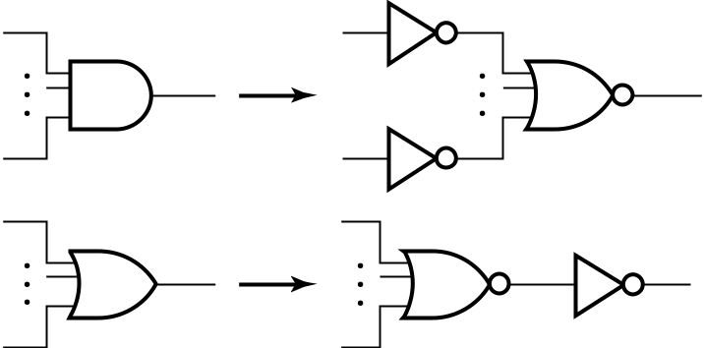
NOR Mapping Algorithm
Replace ANDs and ORs:
Repeat the following pair of actions until there is at most one inverter between :
  A circuit input or driving NAND gate output, and
  The attached NAND gate inputs.
Chapter 3 - Part 1 <number>

Slide 27
NOR Mapping Example
A
A
B
B
2
1
X
C
F
C
3
F
D
D
E
E
(a)
A
(b)
B
C
F
D
E
(c)
Chapter 3 - Part 1 <number>

Slide 28
Verification
Verification - show that the final circuit designed implements the original specification
Simple specifications are:
  truth tables
  Boolean equations
  HDL code
If the above result from formulation and are not the original specification, it is critical that the formulation process be flawless for the verification to be valid!
Chapter 3 - Part 1 <number>

Slide 29
Basic Verification Methods
Manual Logic Analysis
  Find the truth table or Boolean equations for the final circuit
  Compare the final circuit truth table with the specified truth table, or
  Show that the Boolean equations for the final circuit are equal to the specified Boolean equations
Simulation
  Simulate the final circuit (or its netlist, possibly written as an HDL) and the specified truth table, equations, or HDL description using test input values that fully validate correctness.
  The obvious test for a combinational circuit is application of all possible “care” input combinations from the specification
Chapter 3 - Part 1 <number>

Slide 30
Verification Example: Manual Analysis
BCD-to-Excess 3 Code Converter
  Find the SOP Boolean equations from the final circuit.
  Find the truth table from these equations
  Compare to the formulation truth table
Finding the Boolean Equations:
T₁ = C + D = C + D
W = A (T₁ B) = A + B T₁
X = (T₁ B) (B ) = T₁ + B
Y = C + D = CD +
C
D
B
C
D
D
C
C
D
Chapter 3 - Part 1 <number>

Slide 31
Verification Example: Manual Analysis
Find the circuit truth table from the equations and compare to specification truth table:
Input BCD
Output Excess
-
3
Input BCD
Output Excess
-
3
A B C D
WXYZ
A B C D
WXYZ
0 0 0 0
0 0 1 1
0 0 0 0
0 0 1 1
0 0 0 1
0 1 0 0
0 0 0 1
0 1 0 0
0 0 1 0
0 1 0 1
0 0 1 0
0 1 0 1
0 0 1 1
0 1 1 0
0 0 1 1
0 1 1 0
0 1 0 0
0 1 1 1
0 1 0 0
0 1 1 1
0 1 0 1
1 0 0 0
0 1 0 1
1 0 0 0
0 1 1 0
1 0 0 1
0 1 1 0
1 0 0 1
0 1 1 1
1 0 1 0
0 1 1 1
1 0 1 0
1 0 0 0
1 0 1 1
1 0 0 0
1 0 1 1
1 0 0 1
1 0 1 1
1 0 0 1
1 0 1 1
The tables match!
Chapter 3 - Part 1 <number>
Notes:
Since the outputs are not specified for the don’t cares, no analysis for correctness is needed.

Slide 32
Verification Example: Simulation
Simulation procedure:
  Use a schematic editor or text editor to enter a gate level representation of the final circuit
  Use a waveform editor or text editor to enter a test consisting of a sequence of input combinations to be applied to the circuit
    This test should guarantee the correctness of the circuit if the simulated responses to it are correct
    Short of applying all possible “care” input combinations, generation of such a test can be difficult
Chapter 3 - Part 1 <number>

Slide 33
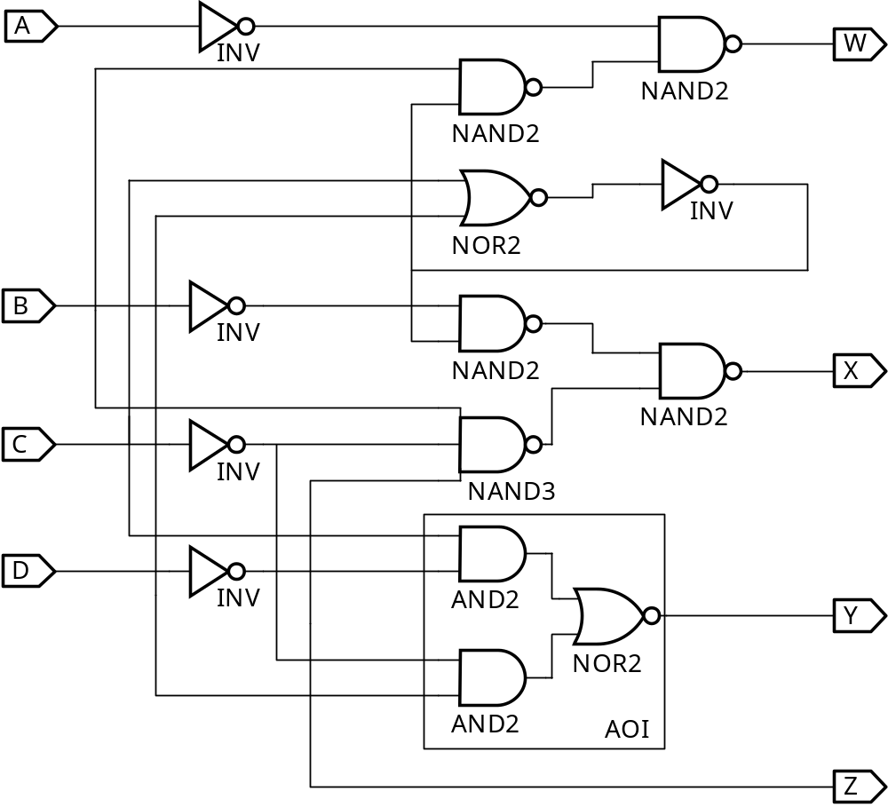
Verification Example: Simulation
Enter BCD-to-Excess-3 Code Converter Circuit Schematic
AOI symbol
not available
Chapter 3 - Part 1 <number>

Slide 34
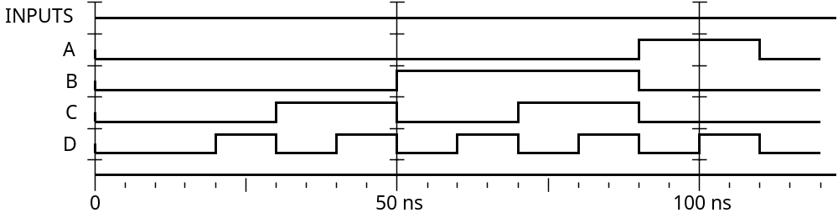
Verification Example: Simulation
Enter waveform that applies all possible input combinations:
Are all BCD input combinations present? (Low is a 0 and high is a one)
Chapter 3 - Part 1 <number>
Notes:
Yes, 0000 through 1001 are present.

Slide 35
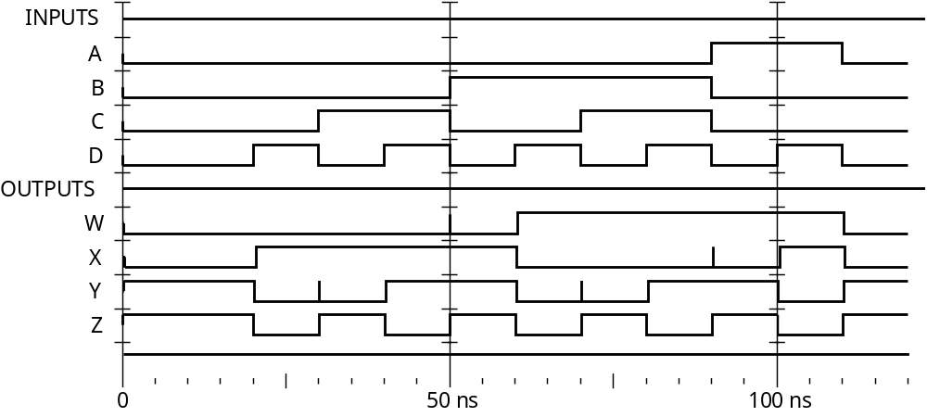
Verification Example: Simulation
Run the simulation of the circuit for 120 ns
Do the simulation output combinations match the original truth table?
Chapter 3 - Part 1 <number>
Notes:
Yes, the output combinations 0011 through 1100 occur in response to 0000 through 1001, respectively.

Slide 36
Assignment
3-7, 3-8, 3-11, 3-13, 3-14, 3-16, 3-27
Chapter 3 - Part 1 <number>

