Slide 1
Asso. Prof. Dong Yabo
dongyb@zju.edu.cn
College of Computer Science and Technology, Zhejiang University

Slide 2
Overview
Part 2 – Combinational Logic
Functions and functional blocks
Rudimentary logic functions
Decoding using Decoders
Implementing Combinational Functions with Decoders
Encoding using Encoders
Selecting using Multiplexers
Implementing Combinational Functions with Multiplexers

Slide 3
Functions and Functional Blocks
The functions considered are those found to be very useful in design
Corresponding to each of the functions is a combinational circuit implementation called a functional block.
In the past, functional blocks were packaged as small-scale-integrated (SSI), medium-scale integrated (MSI), and large-scale-integrated (LSI) circuits.
Today, they are often simply implemented within a very-large-scale-integrated (VLSI) circuit.

Slide 4
Rudimentary Logic Functions
Functions of a single variable X
Can be used on the inputs to functional blocks to implement other than the block’s intended function
T
A
BLE 4-1
Functions of
One
V
a
ria
b
le
X
F
= 0
F
= X
F
=
X
F = 1
0
0
0
1
1
1
0
1
0
1
=
=
=
=
=
=

Slide 5
Multiple-bit Rudimentary Functions
Multi-bit Examples:
A wide line is used to represent a bus which is a vector signal
In (b) of the example, F = (F₃, F₂, F₁, F₀) is a bus.
The bus can be split into individual bits as shown in (b)
Sets of bits can be split from the bus as shown in (c) for bits 2 and 1 of F.
The sets of bits need not be continuous as shown in (d) for bits 3, 1, and 0 of F.
A
F
A
3
3
2
1
F
1
2
4
4
2:1
F(2:1)
2
F
0
F
0
F
1
1
A
0
(c)
F
0
A
(a)
(b)
3
4
3,1:0
F(3), F(1:0)
F
(d)

Slide 6
Enabling Function
Enabling permits an input signal to pass through to an output
Disabling blocks an input signal from passing through to an output, replacing it with a fixed value
The value on the output when it is disable can be Hi-Z (as for three-state buffers and transmission gates), 0 , or 1
When disabled, 0 output
When disabled, 1 output
See Enabling App in text

Slide 7
Decoding
Decoding - the conversion of an n-bit input code to an m-bit output code with n ≤ m ≤ 2^{n} such that each valid code word produces a unique output code
Circuits that perform decoding are called decoders
Here, functional blocks for decoding are
called n-to-m line decoders, where m ≤ 2^{n}, and
generate 2^{n} (or fewer) minterms for the n input variables

Slide 8
Decoder
？
Bus width?
Controller
0
1
2
3
4
5
6
7

Slide 9
Decoder
A | B | C | Y₀ | Y₁ | Y₂ | Y₃ | Y₄ | Y₅ | Y₆ | Y₇
0 | 0 | 0 | 1 | 0 | 0 | 0 | 0 | 0 | 0 | 0
0 | 0 | 1 | 0 | 1 | 0 | 0 | 0 | 0 | 0 | 0
0 | 1 | 0 | 0 | 0 | 1 | 0 | 0 | 0 | 0 | 0
0 | 1 | 1 | 0 | 0 | 0 | 1 | 0 | 0 | 0 | 0
1 | 0 | 0 | 0 | 0 | 0 | 0 | 1 | 0 | 0 | 0
1 | 0 | 1 | 0 | 0 | 0 | 0 | 0 | 1 | 0 | 0
1 | 1 | 0 | 0 | 0 | 0 | 0 | 0 | 0 | 1 | 0
1 | 1 | 1 | 0 | 0 | 0 | 0 | 0 | 0 | 0 | 1

Slide 10
Decoder Examples
1-to-2-Line Decoder
2-to-4-Line Decoder
A
D
D
0
1
D
0
=
A
0
1
0
1
0
1
A
D
=
A
1
(a)
(b)
A
0
A
1
A
0
D
0
D
1
D
2
D
3
A
1
0
0
1
0
0
0
D
=
A
A
0
1
0
1
0
0
0
1
0
1
0
0
0
1
0
1
1
0
0
0
1
D
1
=
A
1
A
0
(a)
D
2
=
A
1
A
0
Note that the 2-4-line made up of 2 1-to-2- line decoders and 4 AND gates.
D
3
=
A
1
A
0
(b)
Notes:
N位可以控制2^N位，门输入成本为n2^n，复杂度为O(2^N)

Slide 11
Decoder Expansion
General procedure given in book for any decoder with n inputs and 2^{n} outputs.
This procedure builds a decoder backward from the outputs.
The output AND gates are driven by two decoders with their numbers of inputs either equal or differing by 1.
These decoders are then designed using the same procedure until 2-to-1-line decoders are reached.
The procedure can be modified to apply to decoders with the number of outputs ≠ 2^{n}
Notes:
行列译码器

Slide 12
Decoder Expansion - Example 1
3-to-8-line decoder
Number of output ANDs = 8
Number of inputs to decoders driving output ANDs = 3
Closest possible split to equal
2-to-4-line decoder
1-to-2-line decoder
2-to-4-line decoder
Number of output ANDs = 4
Number of inputs to decoders driving output ANDs = 2
Closest possible split to equal
Two 1-to-2-line decoders
See next slide for result

Slide 13
Decoder Expansion - Example 1
Result
Notes:
N-2^N译码器成本：2*2^N+两部分的成本
成本降低但是性能也被降低

Slide 14
Decoder Expansion - Example 2
7-to-128-line decoder
Number of output ANDs = 128
Number of inputs to decoders driving output ANDs = 7
Closest possible split to equal
4-to-16-line decoder
3-to-8-line decoder
4-to-16-line decoder
Number of output ANDs = 16
Number of inputs to decoders driving output ANDs = 2
Closest possible split to equal
2 2-to-4-line decoders
Complete using known 3-8 and 2-to-4 line decoders

Slide 15
Decoder with Enable
In general, attach m-enabling circuits to the outputs
See truth table below for function
Note use of X’s to denote both 0 and 1
Combination containing two X’s represent four binary combinations
Alternatively, can be viewed as distributing value of signal EN to 1 of 4 outputs
In this case, called a demultiplexer
Notes:
分配器，用A1A0控制将EN输出到D0到D3

Slide 16
Combinational Logic Implementation - Decoder and OR Gates
Implement m functions of n variables with:
Sum-of-minterms expressions
One n-to-2^{n}-line decoder
m OR gates, one for each output
Approach 1:
Find the truth table for the functions
Make a connection to the corresponding OR from the corresponding decoder output wherever a 1 appears in the truth table
Approach 2
Find the minterms for each output function
OR the minterms together

Slide 17
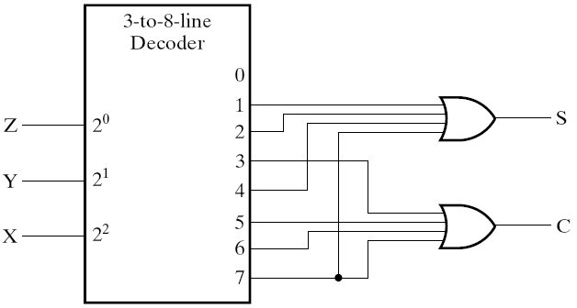
Decoder and OR Gates Example
Implement a binary Adder
Finding sum of minterms expressions
S(X, Y, Z) = Σ_{m}(1, 2, 4, 7) C(X, Y, Z) = Σ_{m}(3, 5, 6, 7)
Find circuit
Truth Table
Notes:
全加器

Slide 18
Decoder and OR Gates Example
Implement the following set of odd parity functions of (A₇, A₆, A₅, A₃) P₁ = A₇ A₅ A₃ P₂ = A₇ A₆ A₃ P₄ = A₇ A₆ A₅
Finding sum of minterms expressions
P₁ = Σ_{m}(1,2,5,6,8,11,12,15) P₂ = Σ_{m}(1,3,4,6,8,10,13,15) P₄ = Σ_{m}(2,3,4,5,8,9,14,15)
Find circuit
Is this a good idea?
+
+
A7
A6
A5
A3
P1
0
1
2
3
4
5
6
7
8
9
10
11
12
13
14
15
+
+
+
+
P2
P4
Notes:
No. The complexity is high. Much better to implement the functions with XOR gates.
Also, the sharing of logic can cause 2 bits in error, which for this application
(a Hamming encoder) is not detectable! Note that XOR gates should not be shared in the implementation as well.
P1P2P3 A4A5A6A7 组成FEC前项纠错码，可以找出哪一位错了并进行纠错

Slide 19
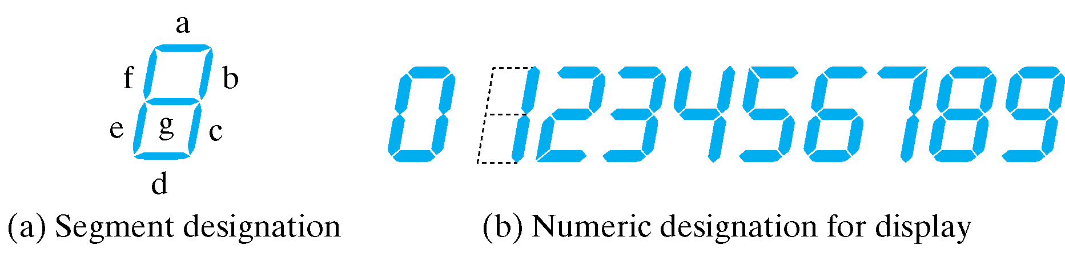
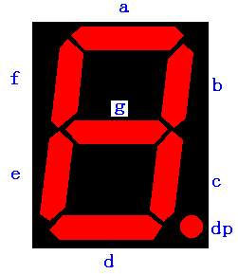
BCD-to-Segment Decoder
Seven-Segment Displayer

Slide 20
Seven-Segment Displayer
Common anode connected to +5V
Com.
Com.
d
c
b
a
a
Common anode
R
“0”
Com.
Common Cathode connected to GND
e
f
g
h
Com.
a
Common Cathode
R
“1”

Slide 21
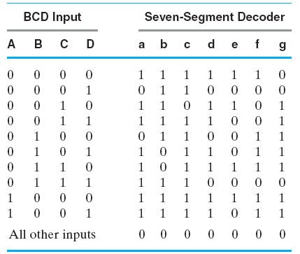
BCD-to-Segment Decoder (Cont.)
Truth Table for BCD-to-Seven-Segment Decoder

Slide 22
Encoding
Encoding - the opposite of decoding - the conversion of an m-bit input code to a n-bit output code with n ≤ m ≤ 2^{n} such that each valid code word produces a unique output code
Circuits that perform encoding are called encoders
An encoder has 2^{n} (or fewer) input lines and n output lines which generate the binary code corresponding to the input values
Typically, an encoder converts a code containing exactly one bit that is 1 to a binary code corres-ponding to the position in which the 1 appears.

Slide 23
Encoder
？
Bus Width?
Monitor
0
1
2
3
4
5
6
7

Slide 24
Encoder Example
A decimal-to-BCD encoder
Inputs: 10 bits corresponding to decimal digits 0 through 9, (D₀, …, D₉)
Outputs: 4 bits with BCD codes
Function: If input bit D_{i} is a 1, then the output (A₃, A₂, A₁, A₀) is the BCD code for i,
The truth table could be formed, but alternatively, the equations for each of the four outputs can be obtained directly.

Slide 25
Encoder Example (continued)
Input D_{i} is a term in equation A_{j} if bit A_{j} is 1 in the binary value for i.
Equations:
A₃ = D₈ + D₉
A₂ = D₄ + D₅ + D₆ + D₇
A₁ = D₂ + D₃ + D₆ + D₇
A₀ = D₁ + D₃ + D₅ + D₇ + D₉
F₁ = D₆ + D₇ can be extracted from A₂ and A₁ Is there any cost saving?
Notes:
No. The total gate input cost remains the same.

Slide 26
Priority Encoder
If more than one input value is 1, then the encoder just designed does not work.
One encoder that can accept all possible combinations of input values and produce a meaningful result is a priority encoder.
Among the 1s that appear, it selects the most significant input position (or the least significant input position) containing a 1 and responds with the corresponding binary code for that position.

Slide 27
Priority Encoder Example
Priority encoder with 5 inputs (D₄, D₃, D₂, D₁, D₀) - highest priority to most significant 1 present - Code outputs A2, A1, A0 and V where V indicates at least one 1 present.
Xs in input part of table represent 0 or 1; thus table entries correspond to product terms instead of minterms. The column on the left shows that all 32 minterms are present in the product terms in the table
No. of Min-terms/Row | Inputs |  |  |  |  | Outputs
 | D4 | D3 | D2 | D1 | D0 | A2 | A1 | A0 | V
1 | 0 | 0 | 0 | 0 | 0 | X | X | X | 0
1 | 0 | 0 | 0 | 0 | 1 | 0 | 0 | 0 | 1
2 | 0 | 0 | 0 | 1 | X | 0 | 0 | 1 | 1
4 | 0 | 0 | 1 | X | X | 0 | 1 | 0 | 1
8 | 0 | 1 | X | X | X | 0 | 1 | 1 | 1
16 | 1 | X | X | X | X | 1 | 0 | 0 | 1
Notes:
Go over table explaining how entries were obtained, particularly those containing Xs

Slide 28
Priority Encoder Example (continued)
Could use a K-map to get equations, but can be read directly from table and manually optimized if careful:
A₂ = D₄
A₁ = D₃ + D₂ = F₁, F₁ = (D₃ + D₂)
A₀ = D₃ + D₁ = (D₃ + D1)
V = D₄ + F₁ + D₁ + D₀
D4
D4
D3
D4
D4
D4
D3
D2
D4
D2

Slide 29
Selecting
Selecting of data or information is a critical function in digital systems and computers
Circuits that perform selecting have:
A set of information inputs from which the selection is made
A single output
A set of control lines for making the selection
Logic circuits that perform selecting are called multiplexers
Selecting can also be done by three-state logic or transmission gates

Slide 30
Multiplexers
A multiplexer selects information from an input line and directs the information to an output line
A typical multiplexer has n control inputs (S_{n − 1}, … S₀) called selection inputs, 2^{n} information inputs (I₂^{n} ₋ ₁, … I₀), and one output Y
A multiplexer can be designed to have m information inputs with m < 2^{n} as well as n selection inputs
MUX
DBUS
m
Y
n
CBUS

Slide 31
2-to-1-Line Multiplexer
Since 2 = 2¹, n = 1
The single selection variable S has two values:
S = 0 selects input I₀
S = 1 selects input I₁
The equation:
Y = I₀ + SI₁
The circuit:
S

Slide 32
2-to-1-Line Multiplexer (continued)
Note the regions of the multiplexer circuit shown:
1-to-2-line Decoder
2 Enabling circuits
2-input OR gate
To obtain a basis for multiplexer expansion, we combine the Enabling circuits and OR gate into a 2 × 2 AND-OR circuit:
1-to-2-line decoder
2 ⋅ 2 AND-OR
In general, for an 2^{n}-to-1-line multiplexer:
n-to-2^{n}-line decoder
2^{n} ⋅ 2 AND-OR

Slide 33
Example: 4-to-1-line Multiplexer
2-to-2²-line decoder
2² × 2 AND-OR
S
Decoder
1
S
4
×
2 AND-OR
0
Decoder
S
Decoder
S
1
1
S
S
0
I
0
0
Y
I
1
Y
Y
I
2
I
3

Slide 34
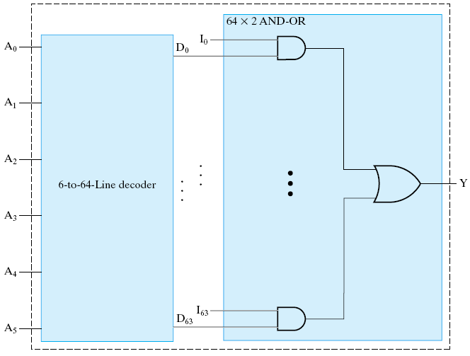
Example: 64-to-1-line Multiplexer
6-to-2⁶-line decoder
2⁶ ⋅ 2 AND-OR

Slide 35
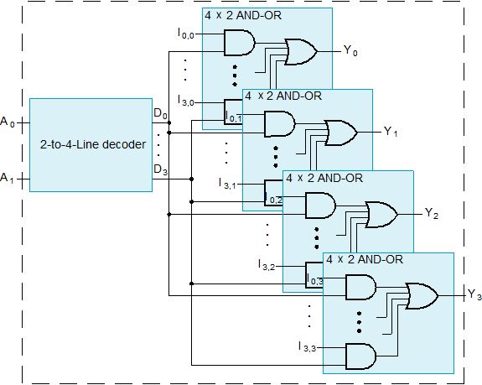
Multiplexer Width Expansion
Select “vectors of bits” instead of “bits”
Use multiple copies of 2^{n} ⋅ 2 AND-OR in parallel
Example: 4-to-1-line quad multi- plexer

Slide 36
Other Selection Implementations
Three-state logic in place of AND-OR
Gate input cost = 18
S
1
S
0
I
0
I
1
Y
I
2
I
3

Slide 37
Other Selection Implementations
Distributing the decoding across the three-state drivers
Gate input cost = 14 compared to 22 (or 18) for gate implementation
S
0
I
0
I
1
S
1
Y
I
2
I
3

Slide 38
Combinational Logic Implementation - Multiplexer Approach 1
Implement m functions of n variables with:
Sum-of-minterms expressions
An m-wide 2^{n}-to-1-line multiplexer
Design:
Find the truth table for the functions.
In the order they appear in the truth table:
Apply the function input variables to the multiplexer inputs S_{n − 1}, … , S₀
Label the outputs of the multiplexer with the output variables
Value-fix the information inputs to the multiplexer using the values from the truth table (for don’t cares, apply either 0 or 1)

Slide 39
Example: Gray to Binary Code
Design a circuit to convert a 3-bit Gray code to a binary code
The formulation gives the truth table on the right
It is obvious from this table that X = C and the Y and Z are more complex
Gray
Binary
A B C
x y z
0
0
0
0
0
0
1 0
0
0
0 1
1
1 0
0 1 0
0 1 0
0 1
1
0 1
1
1 0
0
1
1
1
1 0 1
1 0 1
1
1 0
0
0 1
1
1
1

Slide 40
Gray to Binary (continued)
Rearrange the table so that the input combinations are in counting order
Functions y and z can be implemented using a dual 8-to-1-line multiplexer by:
connecting A, B, and C to the multiplexer select inputs
placing y and z on the two multiplexer outputs
connecting their respective truth table values to the inputs

Slide 41
Gray to Binary (continued)
Note that the multiplexer with fixed inputs is identical to a ROM with 3-bit addresses and 2-bit data!
Gray A B C | Binary x y z
0 0 0 | 0 0 0
0 0 1 | 1 1 1
0 1 0 | 0 1 1
0 1 1 | 1 0 0
1 0 0 | 0 0 1
1 0 1 | 1 1 0
1 1 0 | 0 1 0
1 1 1 | 1 0 1
0
D00
0
D10
1
D01
1
D11
1
D02
1
D12
0
D03
0
D13
0
D04
1
D14
1
Out
Y
0
Out
Z
D05
D15
1
D06
0
D16
0
D07
1
D17
A
S2
A
S2
8-to-1
8-to-1
B
S1
B
S1
MUX
S0
MUX
C
S0
C

Slide 42
Combinational Logic Implementation - Multiplexer Approach 2
Implement any m functions of n + 1 variables by using:
An m-wide 2^{n}-to-1-line multiplexer
A single inverter
Design:
Find the truth table for the functions.
Based on the values of the first n variables, separate the truth table rows into pairs
For each pair and output, define a rudimentary function of the final variable (0, 1, X, )
Using the first n variables as the index, value-fix the information inputs to the multiplexer with the corresponding rudimentary functions
Use the inverter to generate the rudimentary function
X
X

Slide 43
Example: Gray to Binary Code
Design a circuit to convert a 3-bit Gray code to a binary code
The formulation gives the truth table on the right
It is obvious from this table that X = C and the Y and Z are more complex
Gray
Binary
A B C
x y z
0
0
0
0
0
0
1 0
0
0
0 1
1
1 0
0 1 0
0 1 0
0 1
1
0 1
1
1 0
0
1
1
1
1 0 1
1 0 1
1
1 0
0
0 1
1
1
1

Slide 44
Gray to Binary (continued)
Rearrange the table so that the input combinations are in counting order, pair rows, and find rudimentary functions
Gray A B C | Binary x y z | Rudimentary Functions of C for y | Rudimentary Functions of C for z
0 0 0 | 0 0 0
0 0 1 | 1 1 1
0 1 0 | 0 1 1
0 1 1 | 1 0 0
1 0 0 | 0 0 1
1 0 1 | 1 1 0
1 1 0 | 0 1 0
1 1 1 | 1 0 1
F = C
F = C
F = C
F = C
F = C
F = C
F = C
F = C

Slide 45
Gray to Binary (continued)
Assign the variables and functions to the multiplexer inputs:
Note that this approach (Approach 2) reduces the cost by almost half compared to Approach 1.
This result is no longer ROM-like
Extending, a function of more than n variables is decomposed into several sub-functions defined on a subset of the variables. The multiplexer then selects among these sub-functions.
C
D00
C
D10
C
D01
C
D11
C
C
C
D02
Out
Y
C
D12
Out
Z
C
D03
C
D13
A
S1
4-to-1
A
S1
4-to-1
B
S0
MUX
B
S0
MUX

Slide 46
Combinational Logic Implementation - Multiplexer Approach 2
Another Example Using a 8-to-1 MUX to implement the function:
Input: A B C D | Output: X
0 0 0 0 | 0
0 0 0 1 | 1
0 0 1 0 | 1
0 0 1 1 | 0
0 1 0 0 | 0
0 1 0 1 | 0
0 1 1 0 | 0
0 1 1 1 | 1
1 0 0 0 | 1
1 0 0 1 | 1
1 0 1 0 | 1
1 0 1 1 | 1
1 1 0 0 | 1
1 1 0 1 | 0
1 1 1 0 | 0
1 1 1 1 | 0

Slide 47
Assignments
3-28, 3-29, 3-37, 3-44, 3-47

