Slide 1
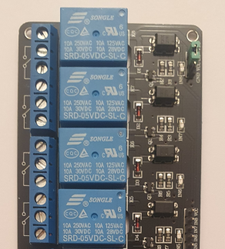
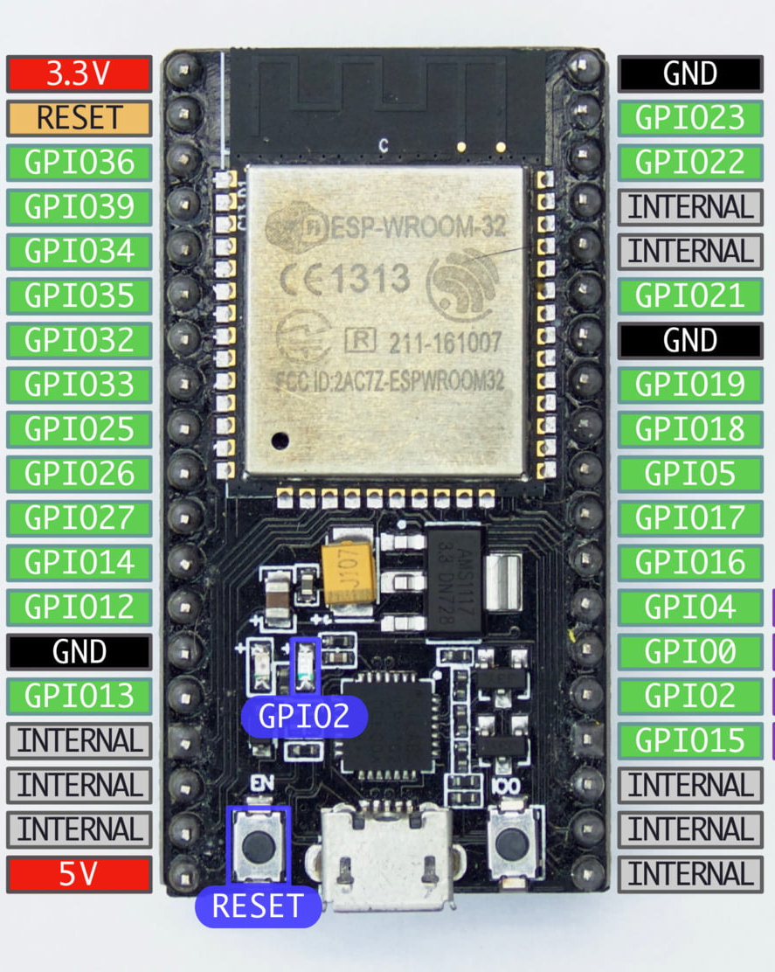
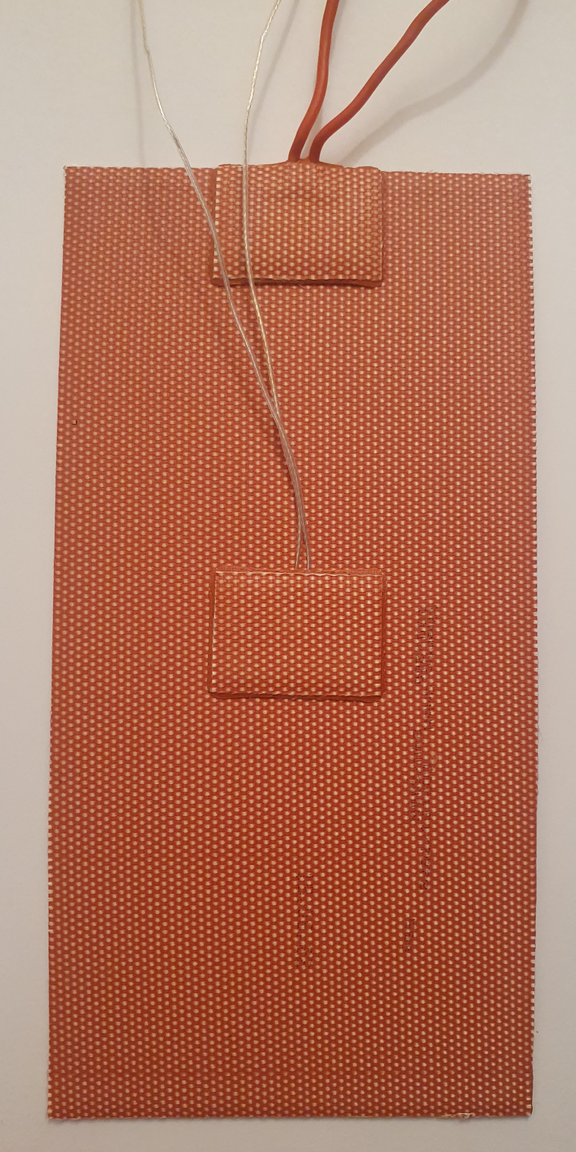
Acraea 2.0 Heating Module Wiring v0.1
5V
GND
IN1
IN2
IN3
ESP32
4-Channel Relay
5 V USB Power Supply
230 V AC L
230 V AC N
230 V AC GND
750 W
Power Supply
24 V DC +
24 V DC -
Wall
Plug
ThermoTech
IPX7
Silicon Heating Pad 200 W

