Slide 1
Phi-star (non-gaussian)
2018-07-04
Angus Leung

Slide 2
Phi-star summary
Non-gaussian phi-star computed on discretised variables
Median split (same as for phi-3)
Tau = 4ms
Pattern of non-gaussian phi-star values is a little more similar than gaussian values to phi-3 values
Non-gaussian phi-star values still not as sensitive to wake/anest as phi-3
2-ch values somewhat correlated with 3-,4-ch values

Slide 3
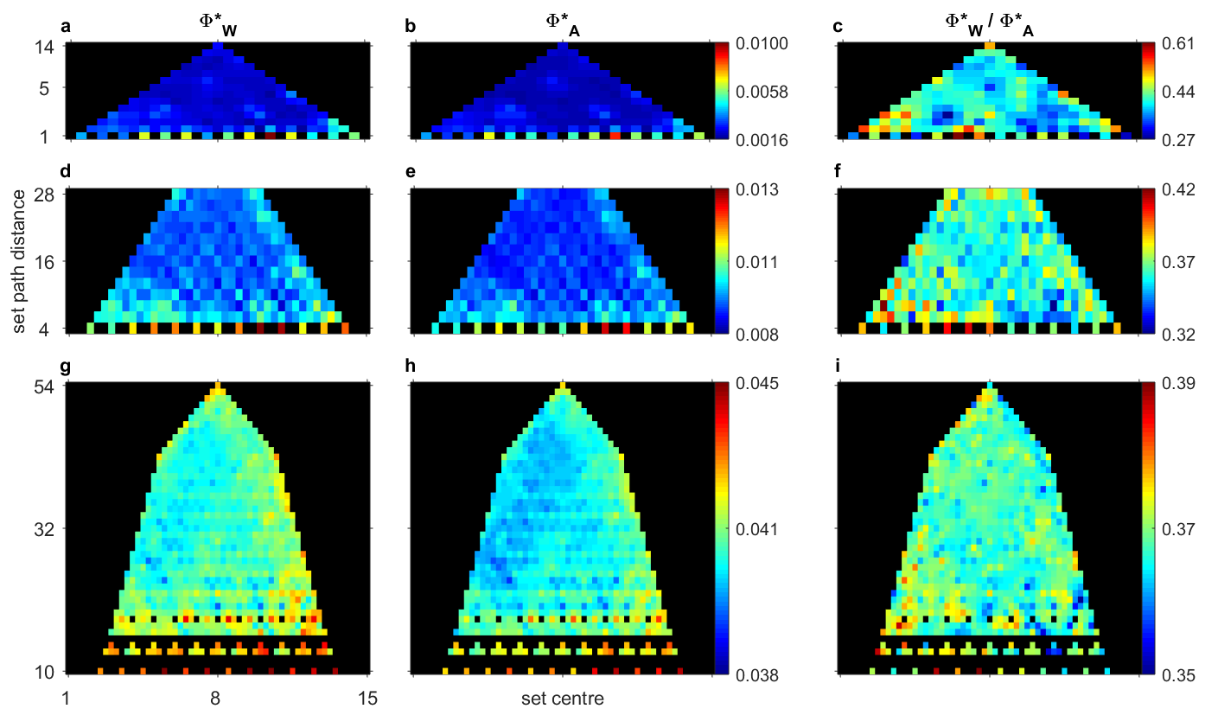
Average across trials (8 x 2.25s), flies

Slide 4
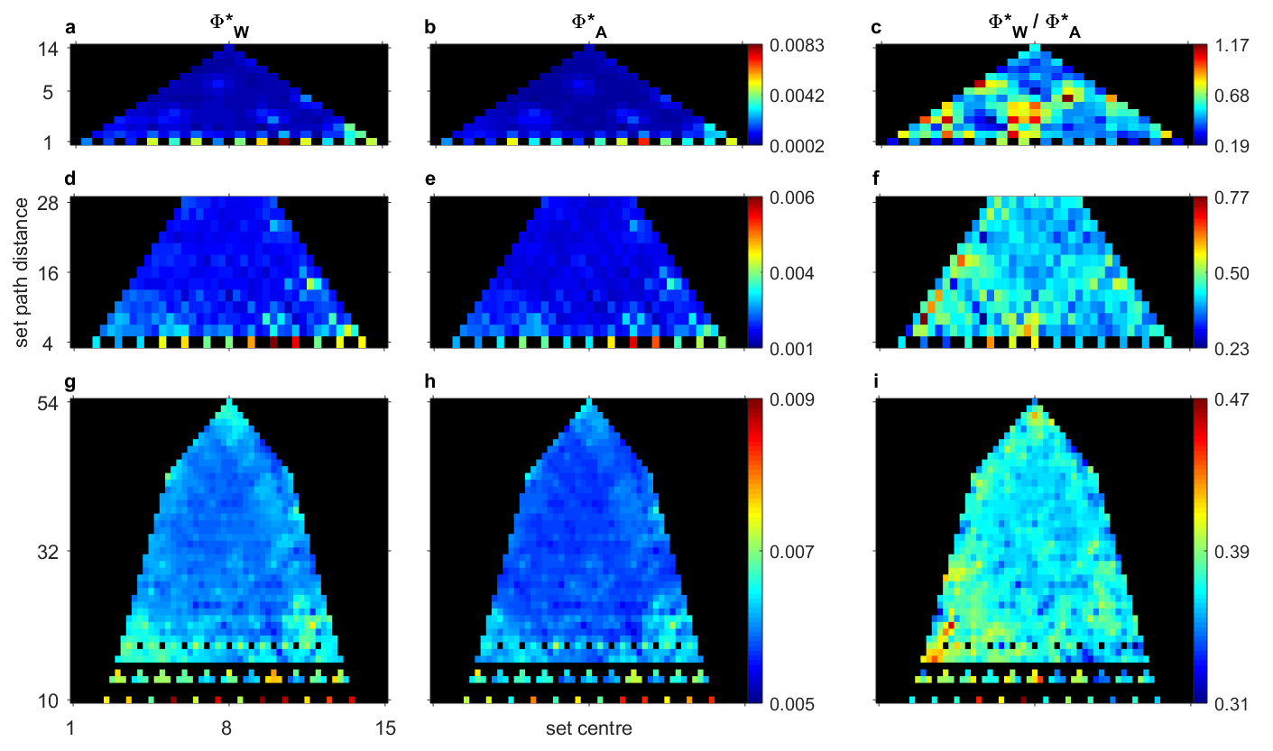
Average across flies (1 x 18s trial)

Slide 5
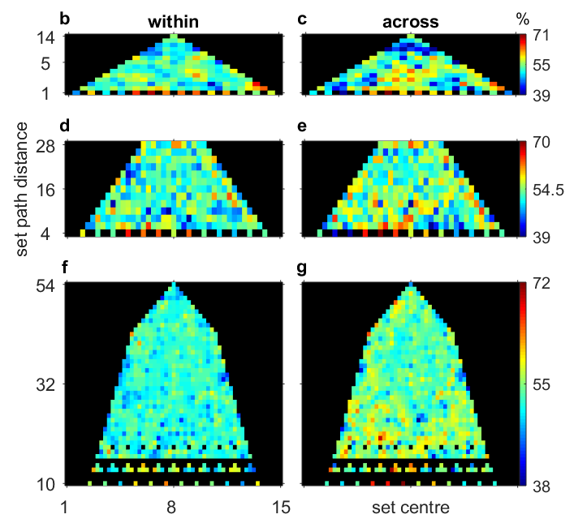
Leave-one-out classification using phi-star

Slide 6
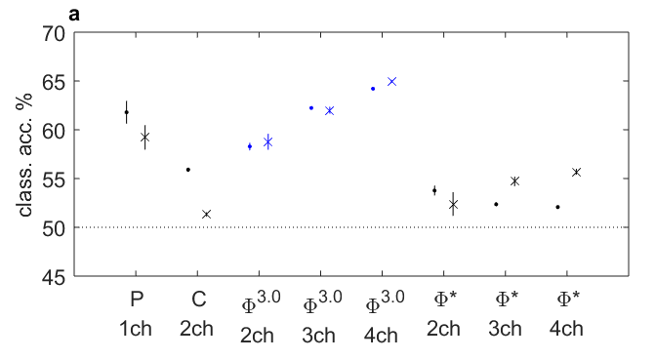
Classification summary
dots are classification across trials, averaged across flies then sets
crosses are classification across flies, averaged across sets
vertical lines are standard error of the mean across N=15 channels (power), N=105 (coherence), and N=105, 455, 1365 for 2-ch, 3-ch, 4-ch phi-3 and phi-star

Slide 7
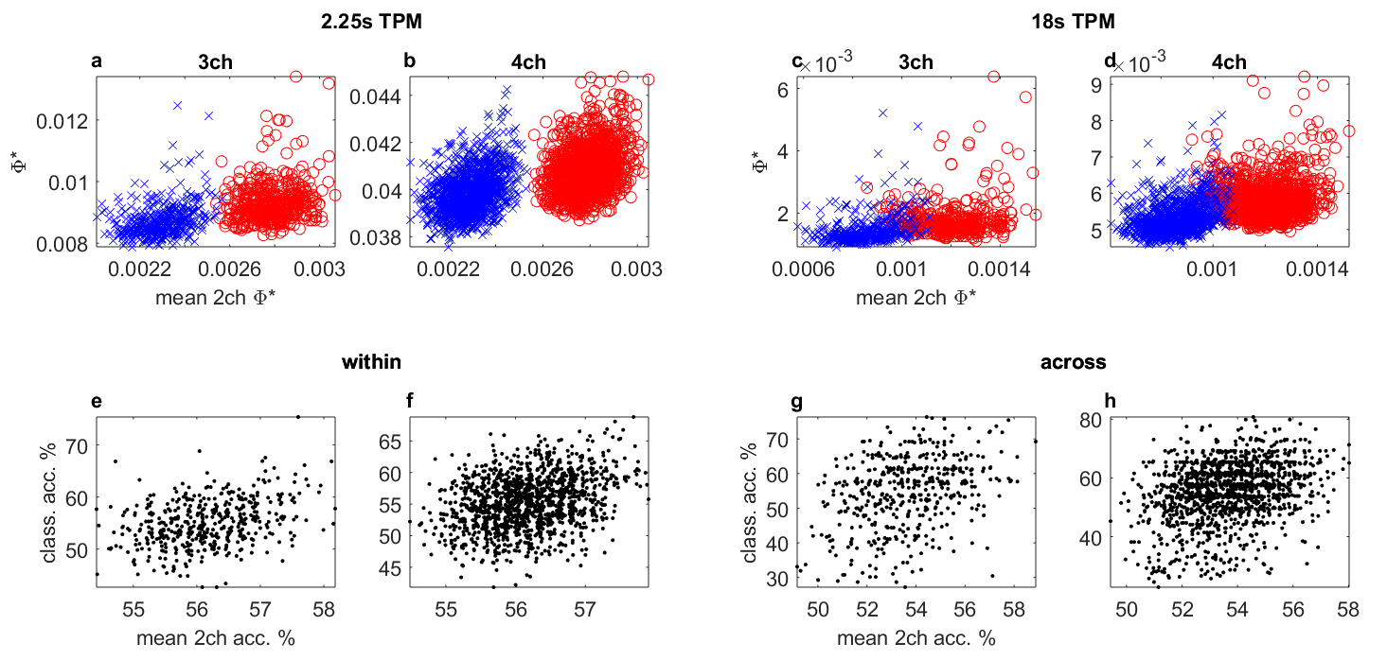
2-ch means vs 4-ch
blue=anest; red=wake
r=.17; r=.33 r=.29; r=.37 r=.15; r=.31 r=.10; r=.34
r=0.36 r=0.31 r=.34 r=.30

