Slide 1
Investigating Φ³: Analysis Plan
“phi-three”, not “phi-cubed”

Slide 2
3 Goals
Compare Φ³ between 2 states
(Potential) consciousness
(Potential) unconsciousness
Compare Φ* to Φ³
Comparison of values
Comparison of MIPs
Possible further comparison: Φ*_{atomic} to Φ*_{MIP}
Compare Φ³ to low frequency Granger Causality
Notes:
Questions are:
Does phi behave as we expect it to (i.e. is it lower under anaesthesia?)
Is phi-3 approximated by phi-star, and (if so) is phi-star approximated by phi-star via atomic partitioning?
Is the low GC finding of decreased feedback under anaesthesia represented by feedback cuts in the MIP?

Slide 3
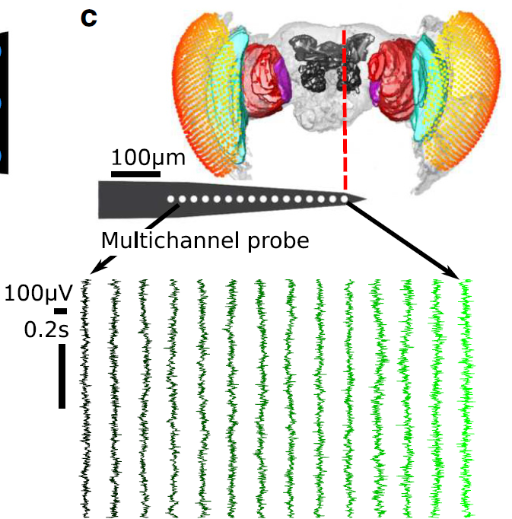
Fly Data
13 fruit flies (Drosphila melanogaster)
Half-brain probe: 16 electrodes
15 ‘channels’ after bipolar re-referencing
2 conditions:
0% isoflurane (air)
0.6% isoflurane (iso)
18s of ‘spontaneous’ LFP
18s period between an air puff and a visual stimulus block (irrelevant to this project)
18s period split into 8 x 2.25s trials
Notes:
Figure shows 14 bipolar rereferenced channels (the most peripheral was discarded, but it hasn’t been discarded in this analysis)
Recorded at 25kHz, downsampled to 1kHz
Air puff is ~180s after onset of isoflurane delivery

Slide 4
Φ Data
LFPs binarised using global (across trials) median split
Parameters used for Φ calculation:
Number of channels: 2 to 4 (all combinations)
Time lag: 4ms, 8ms, 16ms
Notes:
Phi-3 calculated with pyphi
Phi-star calculated using Haun’s functions
Choice of discretisation method seems arbitrary
Repeat tests for each parameter setting

Slide 5
1: Comparison between states
Simplest prediction of IIT:
Loss of consciousness = loss of Φ
If a system loses consciousness, Φ should be lower
Test for Φ_{air} > Φ_{iso}:
Test per n channels, τ lag
Nested design (channel combination and trials within fly): Nested ANOVA?
Average across channel combinations, and trials (paired t-test)?

Slide 6
2: Comparison between versions
Slight differences between IIT 2.0 and IIT 3.0
IIT 2.0 assesses how a state constrains a system’s past; IIT 3.0 assesses also how it constrains the future (more complex)
Φ*: symmetry between past-present and present-future
Φ³:
Inputs: TPM, state
Per trial: Φ calculated for each possible state, Φ is the average across states, weighted by the number of occurrences of each state within the trial
Φ*:
Inputs: past-past, past-present, present-present covariances
Per trial: Φ calculated per partition, Φ is that with smallest normalised Φ
Notes:
Symmetry means past-present can be treated as present-future (phi-star doesn’t take into account both past and future at one time)

Slide 7
2: Comparison between versions
Do Φ³ and Φ* increase/decrease together?
Test for correlation between Φ³ and Φ*
Do Φ³ and Φ* give the same MIPs?
Is the partitioning similar when ignoring directionality of Φ³ cuts?
Test for n channels = 3, 4
Find probability of Φ³ MIP cuts matching the partitioning scheme for Φ*
Extra: comparison between Φ*_{atomic} and Φ*_{MIP}
Test for correlation
Notes:
If phi-3 and phi-star are equivalent, then we may wish to use phi-star over phi-3 given its more practical compute time (under Gaussian assumption)
If atomic approximates MIP, then do we really need to find the MIP?

Slide 8
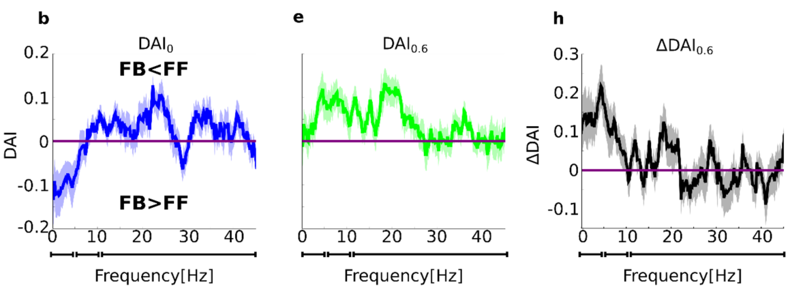
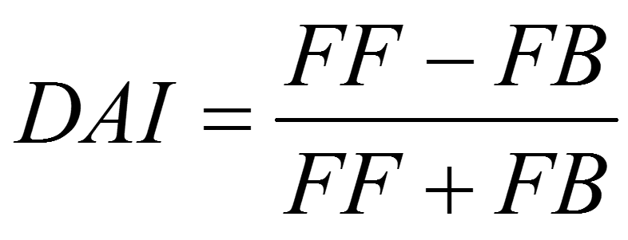
3: Comparison with low frequency GC
Past finding on same dataset using Granger Causality:
Feedback reduced under anaesthesia, for low frequencies
Feedback: periphery -> centre (p -> c)
Notes:
DAI-0 = air
DAI-0.6 = iso
C->p cut gives the smallest phi difference : assuming c->p is feedback, then cutting feedback changes the system the least, so feedback is less meaningful

Slide 9
3: Comparison with low frequency GC
Is this reflected in Φ³?
If feedback is less meaningful, MIP should consist of feedback cuts (as this would change Φ less than feedforward cuts)
Test if probability of c -> p cuts in the MIP is higher under isoflurane
GC only considers 2 channels at a time, so test for n channels = 2
Notes:
DAI-0 = air
DAI-0.6 = iso
C->p cut gives the smallest phi difference : assuming c->p is feedback, then cutting feedback changes the system the least, so feedback is less meaningful

