Slide 1
Investigating Φ³
Angus Leung
2017-07-05

Slide 2
Overview
Fly Data
Phi Data
3 investigations:
Air vs isoflurane
Φ³ vs Φ*
Φ³ vs low frequency Granger Causality

Slide 3
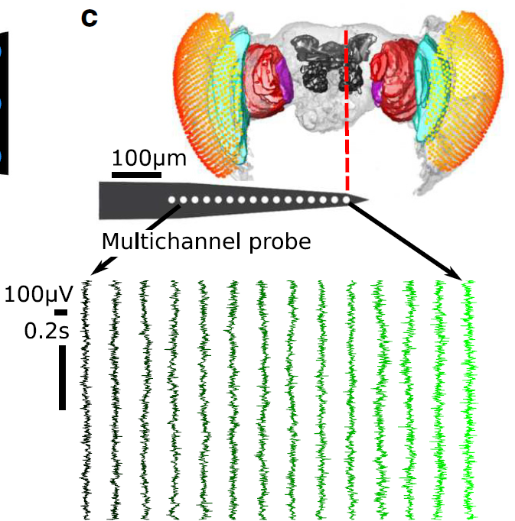
Fly Data
13 fruit flies (Drosphila melanogaster)
Half-brain probe: 16 electrodes
15 ‘channels’ after bipolar re-referencing
2 conditions:
0% isoflurane (air)
0.6% isoflurane (iso)
18s of ‘spontaneous’ LFP
18s period after an air puff
18s period split into 8 x 2.25s trials, 1kHz sampling rate (downsampled from 25kHz)
Notes:
Figure shows 14 bipolar rereferenced channels (the most peripheral was discarded, but it hasn’t been discarded in this analysis)
Recorded at 25kHz, downsampled to 1kHz
Air puff is ~180s after onset of isoflurane delivery

Slide 4
Φ³ Pipeline
LFPs binarised using global (across trials) median split
Phi-3 requires discretised variables
Discretised values allows identification of the state of a sample
E.g. for two channels, possible states are 00, 01, 10, and 11
Build transition probability matrix (TPM) across trials
Gives the probability of each state transitioning to each other state
PyPhi
Gives Φ per state
Φ³ = average Φ in trial, weighted by number of occurrences for each state

Slide 5
Φ Parameters
Number of channels: 2 to 4 (all combinations)
15 choose 2 = 105 sets
15 choose 3 = 455 sets
15 choose 4 = 1365 sets
Time lag (tau): 4ms, 8ms, 16ms
TPM for 4ms: for a state at sample t, probability of sample t+4 being a specific state
Notes:
Phi-3 calculated with pyphi
Phi-star calculated using Haun’s functions
Choice of discretisation method seems arbitrary
Repeat tests for each parameter setting

Slide 6
3 Goals
Compare Φ³ between 2 states
(Potential) consciousness: air
(Potential) unconsciousness: iso
Compare Φ* to Φ³
Comparison of values
Comparison of MIPs
Possible further comparison: Φ*_{atomic} to Φ*_{MIP}
Compare Φ³ to low frequency Granger Causality
Past finding – strong feedback at low frequencies, reduced under iso
Notes:
Questions are:
Does phi behave as we expect it to (i.e. is it lower under anaesthesia?)
Is phi-3 approximated by phi-star, and (if so) is phi-star approximated by phi-star via atomic partitioning?
Is the low GC finding of decreased feedback under anaesthesia represented by feedback cuts in the MIP?

Slide 7
1: Comparison between states
Simplest prediction of IIT:
Loss of consciousness = loss of Φ
If a system loses consciousness, Φ should be lower
Here we presume that flies are conscious under air, and lose consciousness under iso
Movement responses to air puffs diminished under anaesthesia

Slide 8
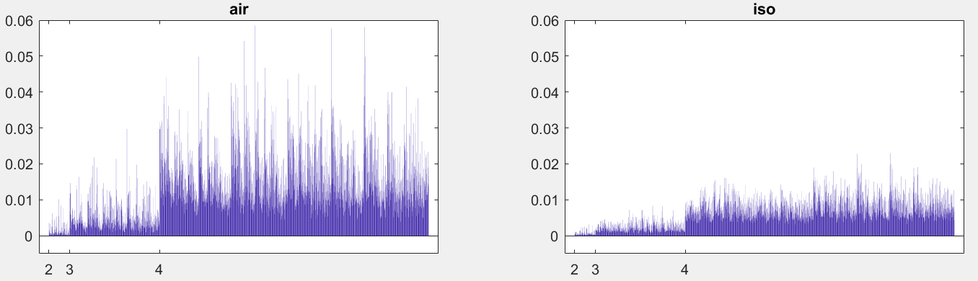
Φ³ values for 1 fly, lag=4ms
Φ
channel set
Notes:
Results for 1 fly, at tau = 4ms

Slide 9
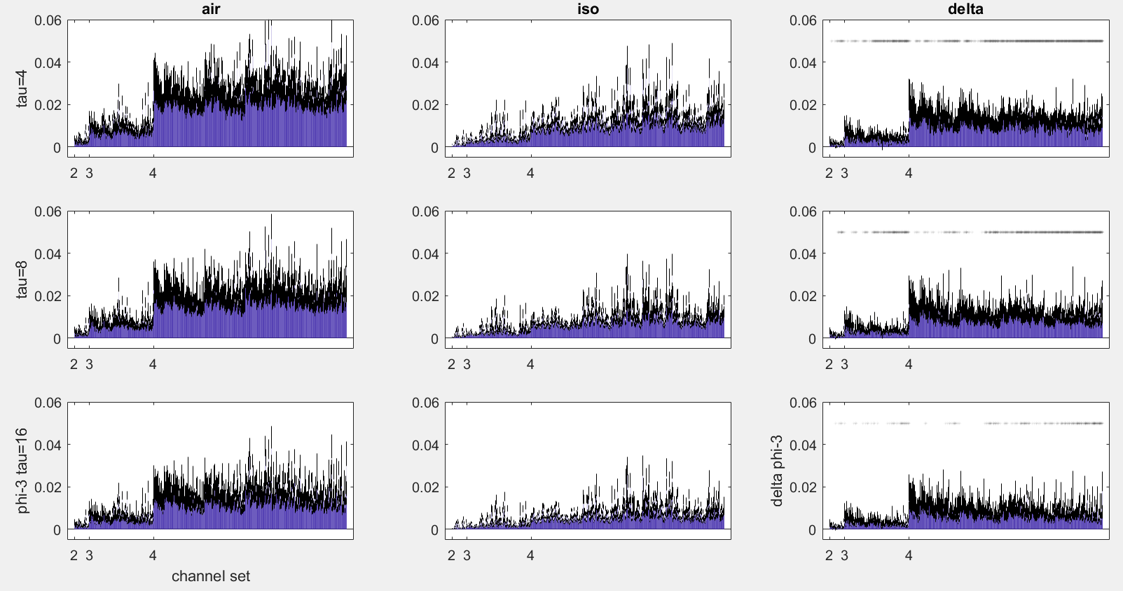
Notes:
FDR correction q=0.1
Mean results across 13 flies, black lines indicate standard error of 13 flies

Slide 10
2: Comparison of Φ* to Φ³
Φ³ computation is resource intensive
Φ* allows for faster computation (given the assumption that the probability distribution of neural states is Gaussian)
Φ* based on IIT 2.0
Slight differences between IIT 2.0 and IIT 3.0
IIT 2.0 assesses how a state constrains a system’s past; IIT 3.0 assesses also how it constrains the future (more complex)
Φ*: symmetry between past-present and present-future
Notes:
Symmetry means past-present can be treated as present-future (phi-star doesn’t take into account both past and future at one time)

Slide 11
Φ* Pipeline
Calculate covariance among channels for
Past-past (present-present)
Past-present (present-future)
Present-present (future-future)
Time lag determines which samples to consider as past/present
E.g. for lag=4ms, samples 1:2246 give the past, and samples 4:2250 give the present
Φ* toolbox – given a partitioning scheme, calculates Φ*
Φ* = Φ of partition scheme with smallest normalised Φ
Notes:
Normalisation factor seems to be number of groups in partition * minimum past entropy of the groups
Will go into partitioning (i.e. the MIP) later on

Slide 12
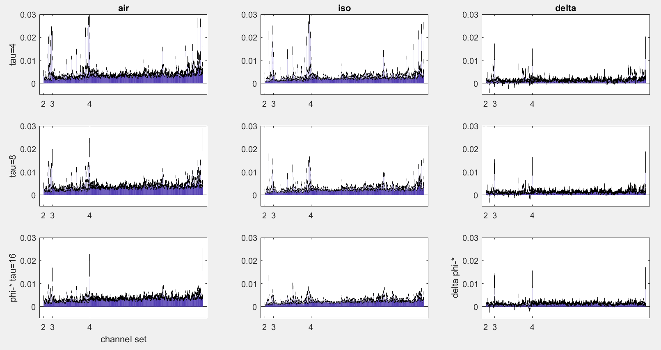
Notes:
Phi-star values for each channel set
Mean + stderr across flies

Slide 13
Comparing Φ* and Φ³
Do Φ³ and Φ* increase/decrease together?
Do Φ³ and Φ* give the same MIPs?
Is partitioning similar when ignoring directionality of Φ³ cuts?
Notes:
If phi-3 and phi-star are equivalent, then we may wish to use phi-star over phi-3 given its more practical compute time (under Gaussian assumption)
If atomic approximates MIP, then do we really need to find the MIP?

Slide 14
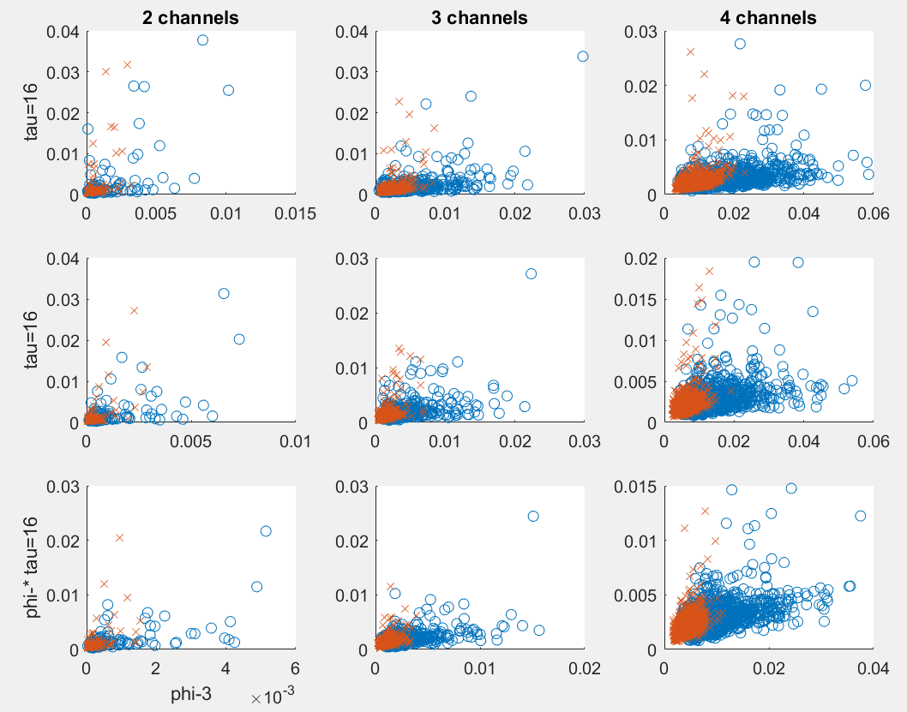
Φ³-Φ* correlations for 1 fly
o: air
x: iso
Notes:
Same fly as shown for air vs iso
Phi-star and phi-3 values are averaged across trials
Each point is a channel set (so there are more points for 4 channels)
Blue circles are air
Red crosses are iso

Slide 15
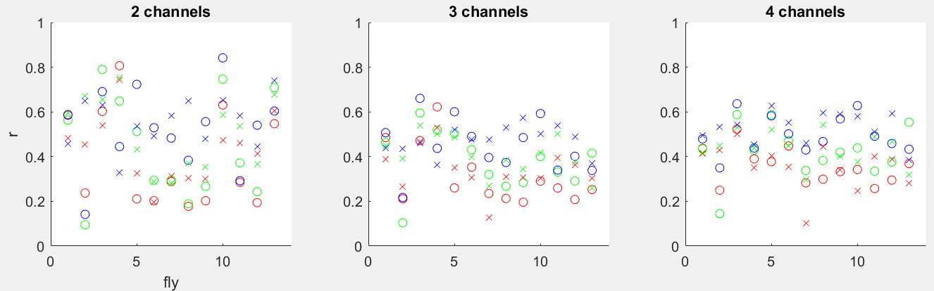
Φ³-Φ* Correlations for each fly
R: tau=4ms G: tau=8ms B: tau=16ms
Notes:
All flies
RGB = tau 4, 8, 16, respectively

Slide 16
MIP Matching
Minimum Information Partition (MIP) is used to assess if a system is integrated (or decomposes into separate parts)
To find the MIP, we cut the system into separate parts in all possible ways
MIP is the partition scheme which gives the least Φ
Φ* MIPs are non-directional
Cut connections leave partitions completely isolated
Φ³ MIPs are bipartitions from unidirectional cuts
Directional: A-/->B is different to B-/->A
Separated partitions can be considered appendages

Slide 17
MIP Matching
For comparison, ignore directionality of Φ³ MIPs
For comparison, only consider Φ* MIPs which are bipartitions

Slide 18
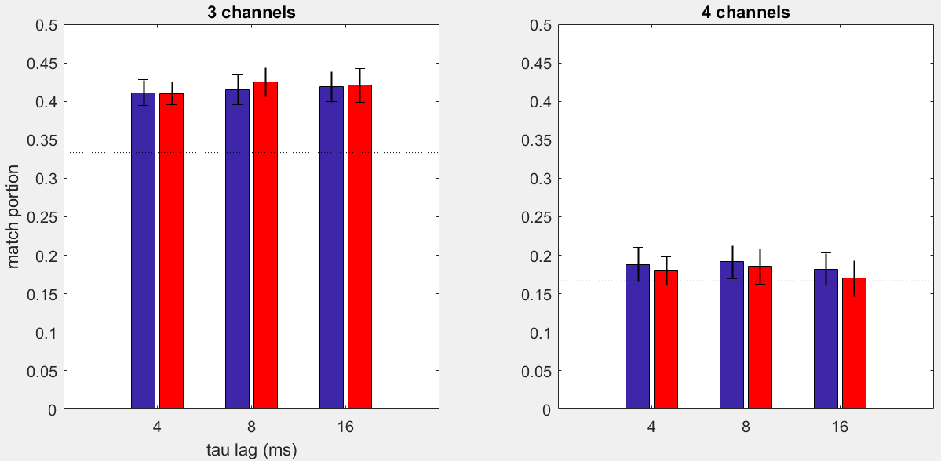
Portion of Samples
Notes:
Each trial, number of possible matches = 2250 * (number of sets which have a phi-star bipartition)
Each trial, number of actual matches = sum of (occurrences of matching mips) across sets
Dotted line is chance level
Take only trials whose phi-* MIP is a bipartition
Chances: 3/9, 7/42

Slide 19
Correlations after filtering for matching MIPs
Correlations might be stronger if MIPs match
Take only channel sets where Φ* and Φ³ MIPs are equivalent
‘Equivalent’ defined as 2*chance level
i.e. average match portion across trials > 2*chance

Slide 20
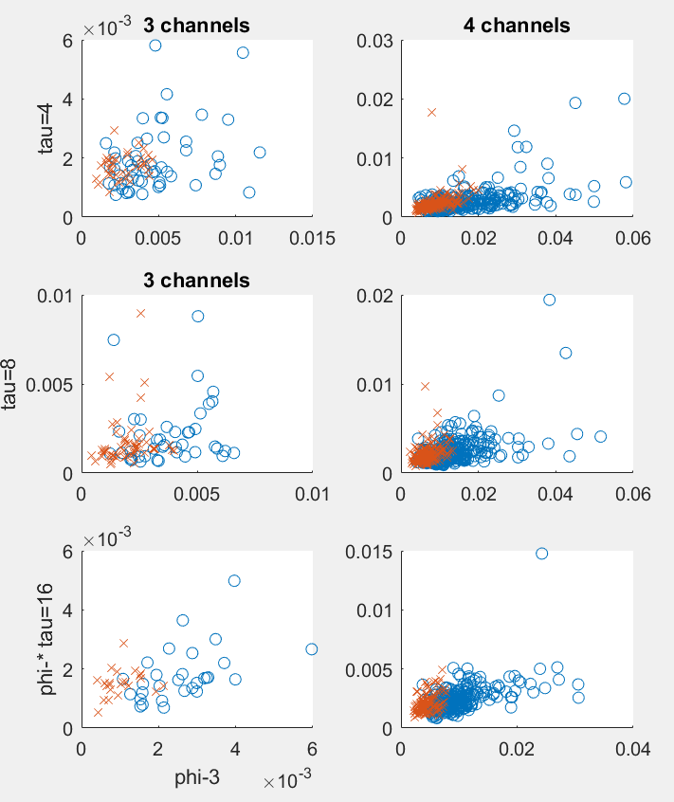
Φ³-Φ* correlations for 1 fly
o: air
x: iso

Slide 21
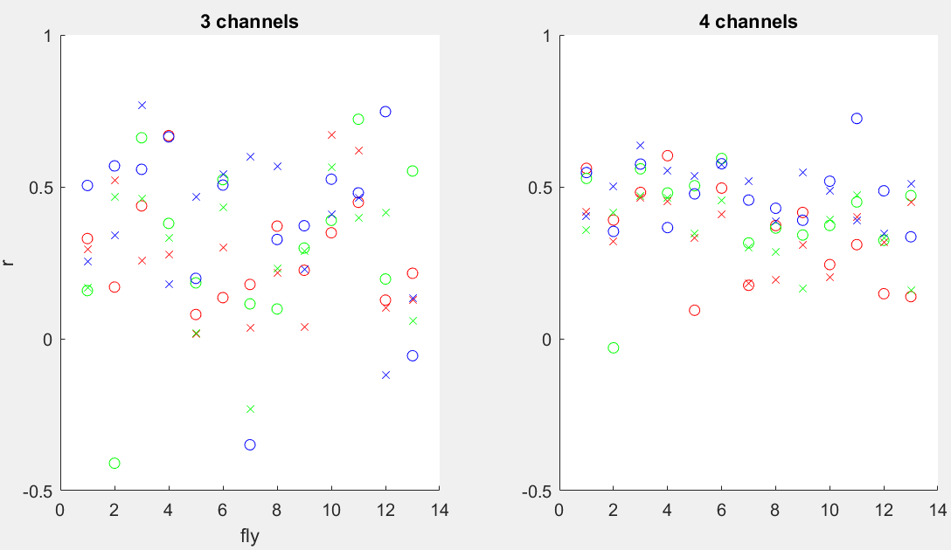
Correlations for each fly
R: tau=4ms G: tau=8ms B: tau=16ms

Slide 22
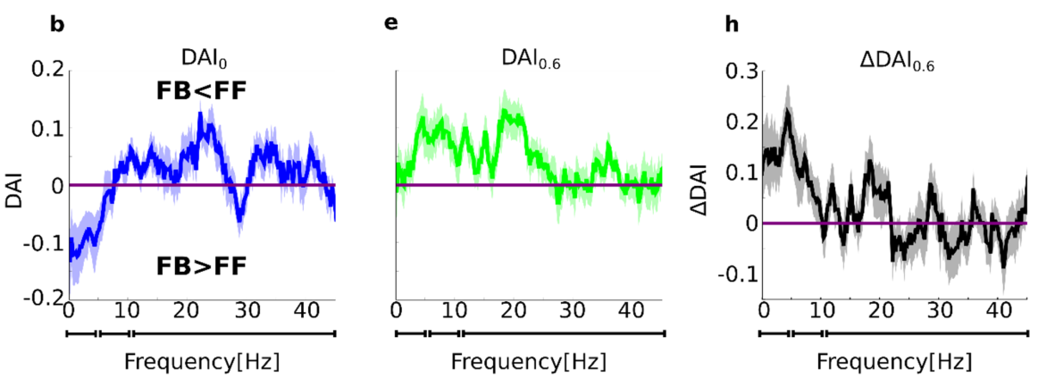
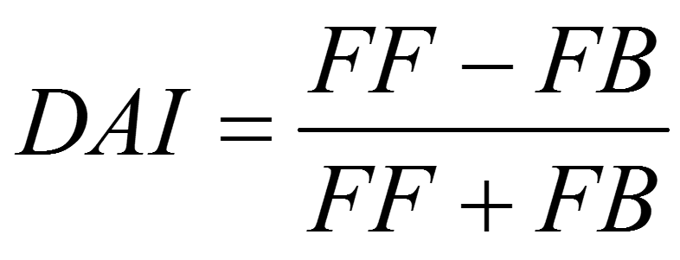
3: Comparison with low frequency GC
Past finding on same dataset using Granger Causality:
Feedback reduced under anaesthesia, for low frequencies
Feedback: periphery -> centre (p -> c)
Notes:
DAI-0 = air
DAI-0.6 = iso
C->p cut gives the smallest phi difference : assuming c->p is feedback, then cutting feedback changes the system the least, so feedback is less meaningful

Slide 23
3: Comparison with low frequency GC
Is this reflected in Φ³?
If feedback loses meaning under iso, feedback cuts (in the MIP) should be less common in air, and more under iso
GC only considers 2 signals (channels) at a time, so we compare to 2-channel Φ³ results
Periphery channels: 2-7 Centre channels: 10-15
Notes:
DAI-0 = air
DAI-0.6 = iso
C->p cut gives the smallest phi difference : assuming c->p is feedback, then cutting feedback changes the system the least, so feedback is less meaningful

Slide 24
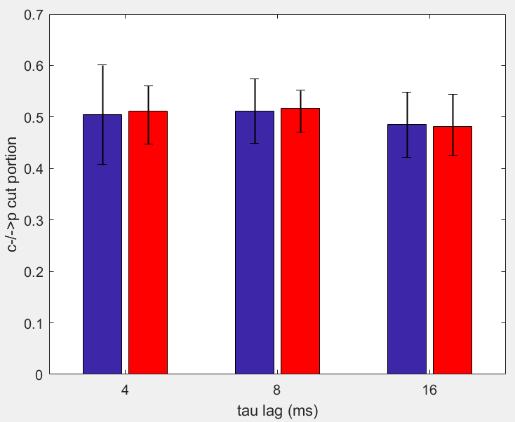
Portion of c-/->p cuts
Per trial, portion of samples with a feedback cut in the MIP
Averaged across channel sets and trials
B: air
R: iso
Notes:
Averaged
Seems to be chance level
Limitation: low frequencies were 1-10Hz, which would correspond(?) to down to 0.1s (100ms) – maybe 16ms is not sufficient to capture the same result

Slide 25
Conclusions
Clearest prediction of Φ³ met
Moderate correlations between Φ* and Φ³
Slightly better than chance MIPmatch
Strong GC feedback influences during air (and subsequent reduction under iso) not reflected in phi-3 MIP cuts
However, 16ms lag might not be sufficient to characterise this
Low frequency = 1-10Hz > min lag = 100ms
Further analysis: correlations/feedback cut assessment on a per channel basis (similar to results in goal 1)
Further analysis: calculate Φ* using discretised values
Notes:
Per set basis gives sample independence, but more comparisons

