Slide 1
Investigating Φ
Angus Leung
2017-07-28

Slide 2
Overview
Integrated Information Φ
2 investigations:
Air vs isoflurane Φ
Φ vs Φ*

Slide 3
Axioms of Integrated Information Theory
Existence
Composition
Information: out of all the experiences we can possibly have at any time (uncertainty), at any time we only experience one (reduction in uncertainty)
Integration: we cannot separate an experience into parts (binding problem: we don’t see red and a ball; we see a red ball)
Exclusion
Notes:
Consciousness is integrated information - Tononi 2008

Slide 4
Consciousness and Integration/Information
Loss of consciousness (e.g. NREM sleep, anaesthesia) has been associated with loss of information or integration
e.g. stereotyped responses to stimuli
e.g. reduced effective connectivity, feedback
But what about Φ?
IIT: Φ is consciousness (there’s a bit more to Φ)
Loss of consciousness <-> loss of Φ
Notes:
But what is phi?

Slide 5
What is Integrated Information Φ?
Integrated O
Information |
O = exists only when considering the whole
O = reduction due to splitting
I = reduction in uncertainty
Uncertainty: a neuron can be firing or not firing
The Whole
Yes
No
Some other neuron
1 neuron, 2 possible states
Notes:
Uncertainty – the number of possibilities
The larger the reduction, the greater the information
When considering a lot of neurons, there are many many possibilities, so high uncertainty
Reduction in uncertainty after we know another neuron and its interaction with the current neuron
“Some other neuron can be the same neuron at a different timepoint”
Note this is a unidirectional example
Phi = reduction in information after splitting a system

Slide 6
What is Integrated Information Φ?
Does a given a network state (e.g. state of all neurons in the brain) constrain the possible past and future network states?
Yes – constrained states = reduced uncertainty = information
No – states unconstrained = same uncertainty = no information
Does splitting the network (e.g. brain into two hemispheres) give us the same information as not splitting the network?
Yes – no integration
No – integration is a vital part of the system – difference in information is Φ
Notes:
Extending to a bigger system

Slide 7
Data

Slide 8
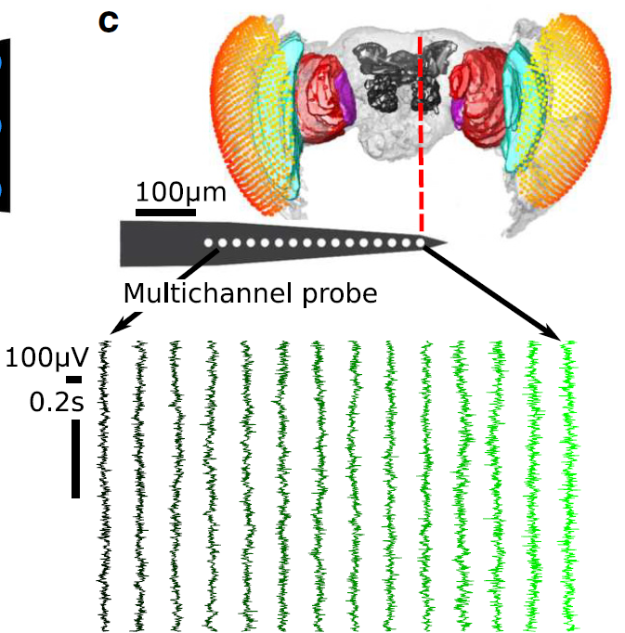
Fly Data
13 fruit flies (Drosphila melanogaster)
Half-brain probe: 16 electrodes
15 ‘channels’ after bipolar re-referencing
2 conditions:
0% isoflurane (air)
0.6% isoflurane (iso)
18s of ‘spontaneous’ LFP
18s period after an air puff
18s period split into 8 x 2.25s trials, 1kHz sampling rate (downsampled from 25kHz)
Notes:
Figure shows 14 bipolar rereferenced channels (the most peripheral was discarded, but it hasn’t been discarded in this analysis)
Recorded at 25kHz, downsampled to 1kHz
Air puff is ~180s after onset of isoflurane delivery

Slide 9
Φ Calculation
LFPs binarised using global (across trials) median split
Phi-3 requires discretised variables
Discretised values allows identification of the state of a sample
E.g. for two channels, possible states are 00, 01, 10, and 11
Build transition probability matrix (TPM) across trials
Gives the probability of each state transitioning to each other state
PyPhi
Gives Φ per state
Φ³ = average Φ in trial, weighted by number of occurrences for each state

Slide 10
Φ Parameters
Number of channels: 2 to 4 (all combinations)
15 choose 2 = 105 sets
15 choose 3 = 455 sets
15 choose 4 = 1365 sets
Time lag (τ): 4ms, 8ms, 16ms
TPM for 4ms: for a state at sample t, probability of sample t+4 being a specific state
Exclusion axiom: consciousness flows at a particular speed (where Φ is max)
Notes:
Phi-3 calculated with pyphi
Phi-star calculated using Haun’s functions
Choice of discretisation method seems arbitrary
Repeat tests for each parameter setting

Slide 11
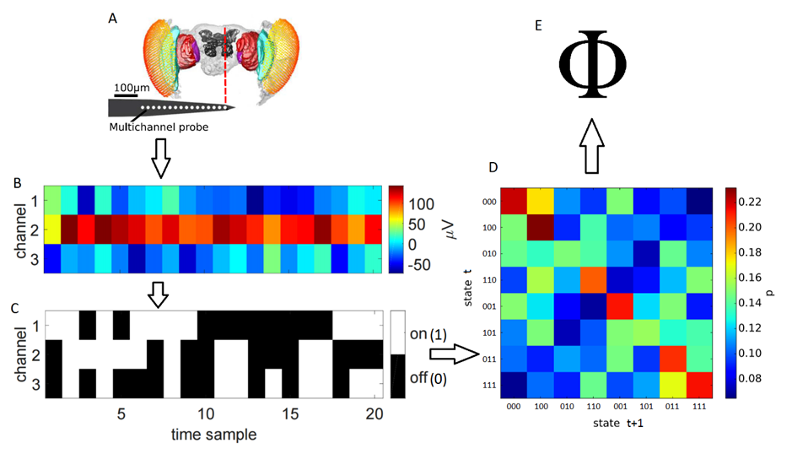
Φ Calculation
via PyPhi
Notes:
Phi requires discretised variables
LFPs binarised using global (across trials) median split
TPM constructed across trials – this is what allows for the quantification of uncertainty and information
Given a state and the TPM, we can get a phi value and associated MIP per sample (via pyphi)
Phi per trial is averaged across samples, weighting for frequency of state occurrences

Slide 12
3 Goals
Compare Φ³ between 2 states
(Potential) consciousness: air
(Potential) unconsciousness: iso
Compare Φ* to Φ³
Comparison of values
Comparison of MIPs
Possible further comparison: Φ*_{atomic} to Φ*_{MIP}
Compare Φ³ to low frequency Granger Causality
Past finding – strong feedback at low frequencies, reduced under iso
Notes:
Questions are:
Does phi behave as we expect it to (i.e. is it lower under anaesthesia?)
Is phi-3 approximated by phi-star, and (if so) is phi-star approximated by phi-star via atomic partitioning?
Is the low GC finding of decreased feedback under anaesthesia represented by feedback cuts in the MIP?

Slide 13
Air vs Isoflurane
Investigation 1

Slide 14
Investigation 1: air vs isoflurane
Is Φ lower during anaesthesia?
Simplest prediction of IIT:
Loss of consciousness = loss of Φ
If a system loses consciousness, Φ should be lower
Here we presume that flies are conscious under air, and lose consciousness under iso
Movement responses to air puffs diminished under anaesthesia

Slide 15
1: Comparison between states
Simplest prediction of IIT:
Loss of consciousness = loss of Φ
If a system loses consciousness, Φ should be lower
Here we presume that flies are conscious under air, and lose consciousness under iso
Movement responses to air puffs diminished under anaesthesia

Slide 16
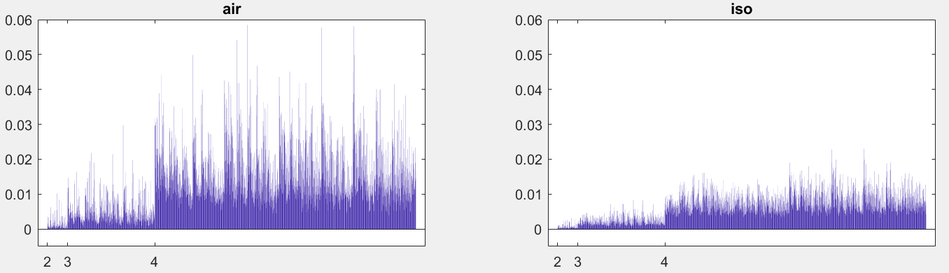
Φ values for 1 fly, lag=4ms
Φ
channel set
Notes:
Results for 1 fly, at tau = 4ms

Slide 17
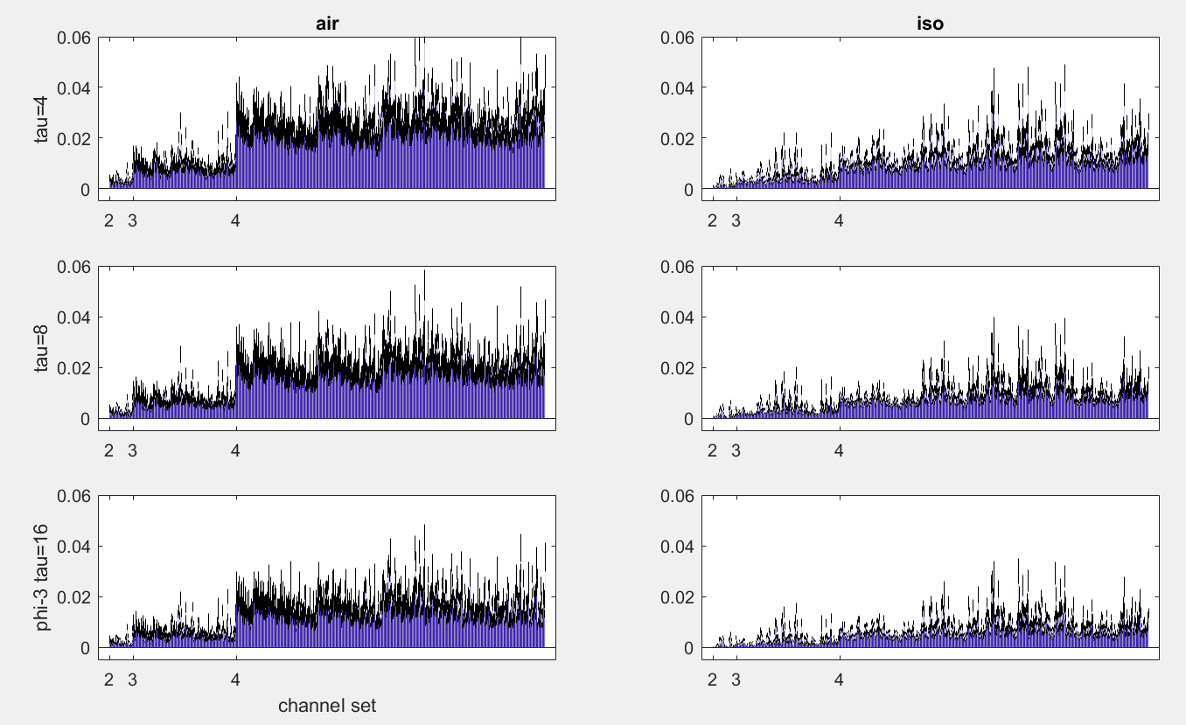
Notes:
Black bar is standard error of 13 flies

Slide 18
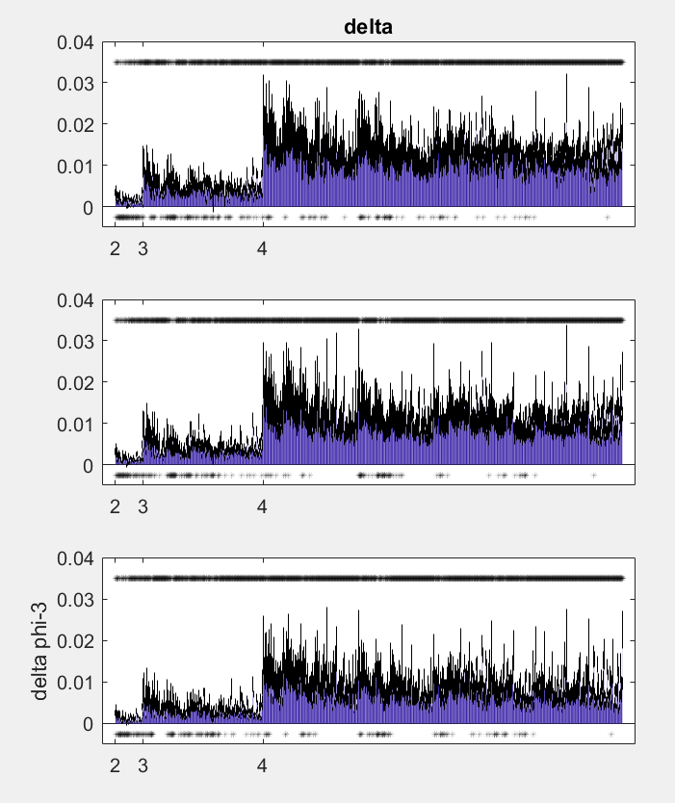
delta = air - iso
Notes:
Wilcoxon signed ranks with FDR q=0.05
Number of significant sets (out of 1925):
1687 (0.88)
1721 (0.89)
1713 (0.89)

Slide 19
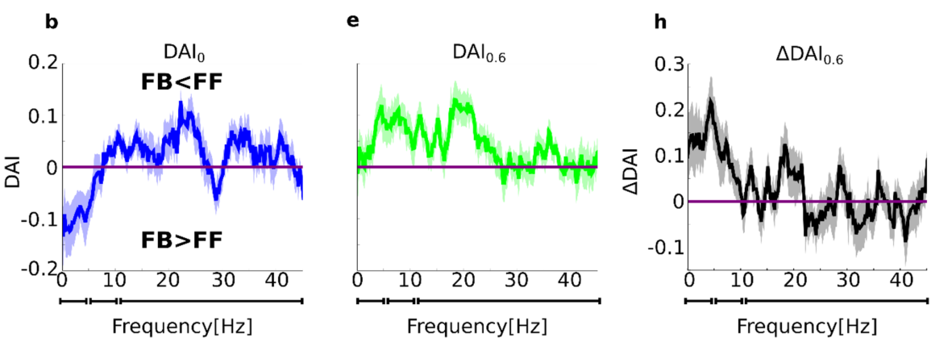
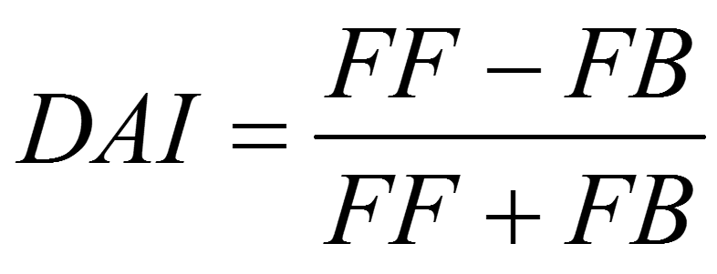
Past finding: reduced feedback under iso
Past finding on same dataset using Granger Causality:
Feedback reduced under anaesthesia, for low frequencies
Feedback: centre channel -> periphery channel
GC: one signal contains information about another

Slide 20
Is feedback reduction captured in the MIP?
The minimum information partition (MIP) is the unidirectional split which results in the least difference in information
No difference -> integration not vital among the split parts
MIP reduces the system as much as possible to independent parts
If feedback loses importance, then cutting this connection should give a smaller difference
So the centre -> periphery cut might be more common under isoflurane
2 channel scenario:
P
C
Notes:
Feedback result also works vice versa – if it is more important during wakefulness, then the c->p cut should be less common
Periphery channels: 2-7
Centre channels: 10-15
“importance” i.e. information

Slide 21
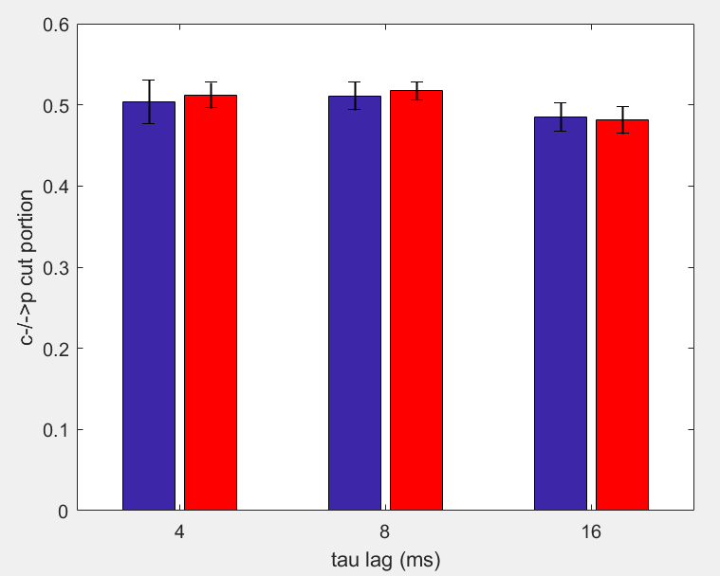
Portion of c-/->p cuts
2 channels = 4 states
Portion of samples within a trial with a feedback cut as the MIP
B: air
R: iso
Notes:
Averaged across trials, channel combinations, and flies
Seems to be chance level
Limitation: low frequencies were 1-10Hz, which would correspond(?) to down to 0.1s (100ms) – maybe 16ms is not sufficient to capture the same result

Slide 22
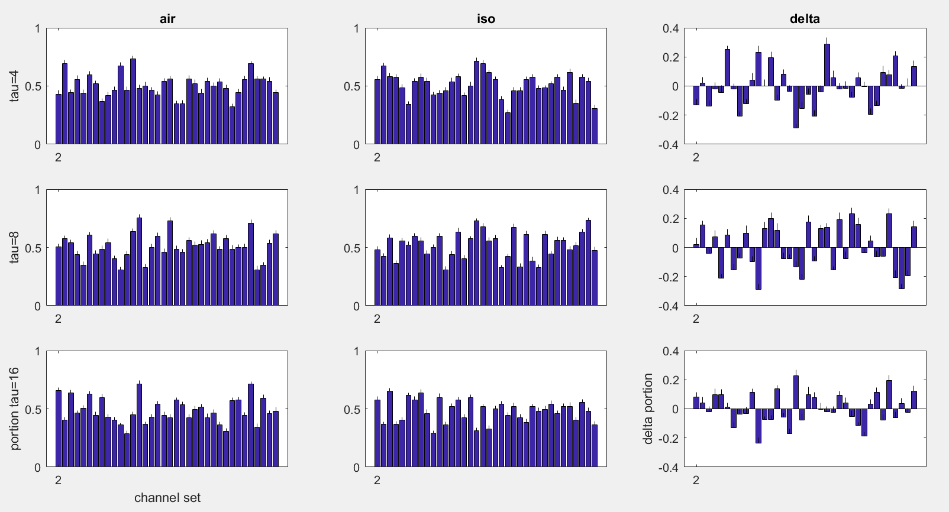
Notes:
It’s possible that the main change between conditions is the TPM, rather than the MIP

Slide 23
Φ vs Φ*
Investigation 2

Slide 24
Investigation 2: Φ* vs Φ
Φ computation is resource intensive
Φ* can be analytically computed using the Gaussian approximation (this means faster computation)
Φ* based on IIT 2.0
Slight differences between IIT 2.0 and IIT 3.0
IIT 2.0 assesses how a state constrains a system’s past; IIT 3.0 assesses also how it constrains the future (more complex)
Φ*: symmetry between past-present and present-future
Notes:
Symmetry means past-present can be treated as present-future (phi-star doesn’t take into account both past and future at one time)

Slide 25
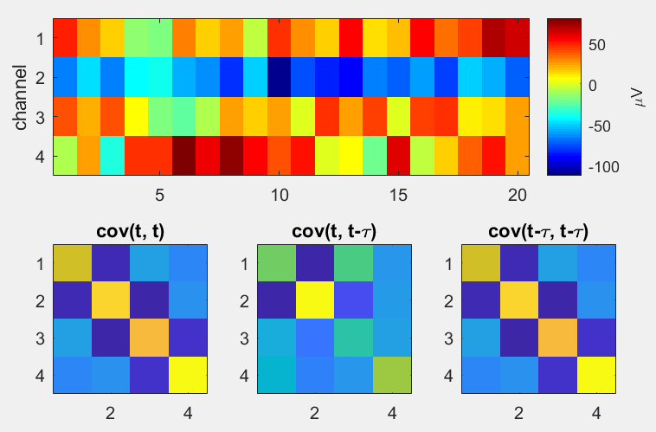
Φ* Calculation
Φ*
via phi_toolbox_Feb2014 (Haun et al., 2016)
Notes:
Normalisation factor seems to be number of groups in partition * minimum past entropy of the groups

Slide 26
Φ* Pipeline
Calculate covariance among channels for
Past-past (present-present)
Past-present (present-future)
Present-present (future-future)
Time lag determines which samples to consider as past/present
E.g. for lag=4ms, samples 1:2246 give the past, and samples 4:2250 give the present
Φ* toolbox – given a partitioning scheme, calculates Φ*
Φ* = Φ of partition scheme with smallest normalised Φ
Notes:
Normalisation factor seems to be number of groups in partition * minimum past entropy of the groups
Will go into partitioning (i.e. the MIP) later on

Slide 27
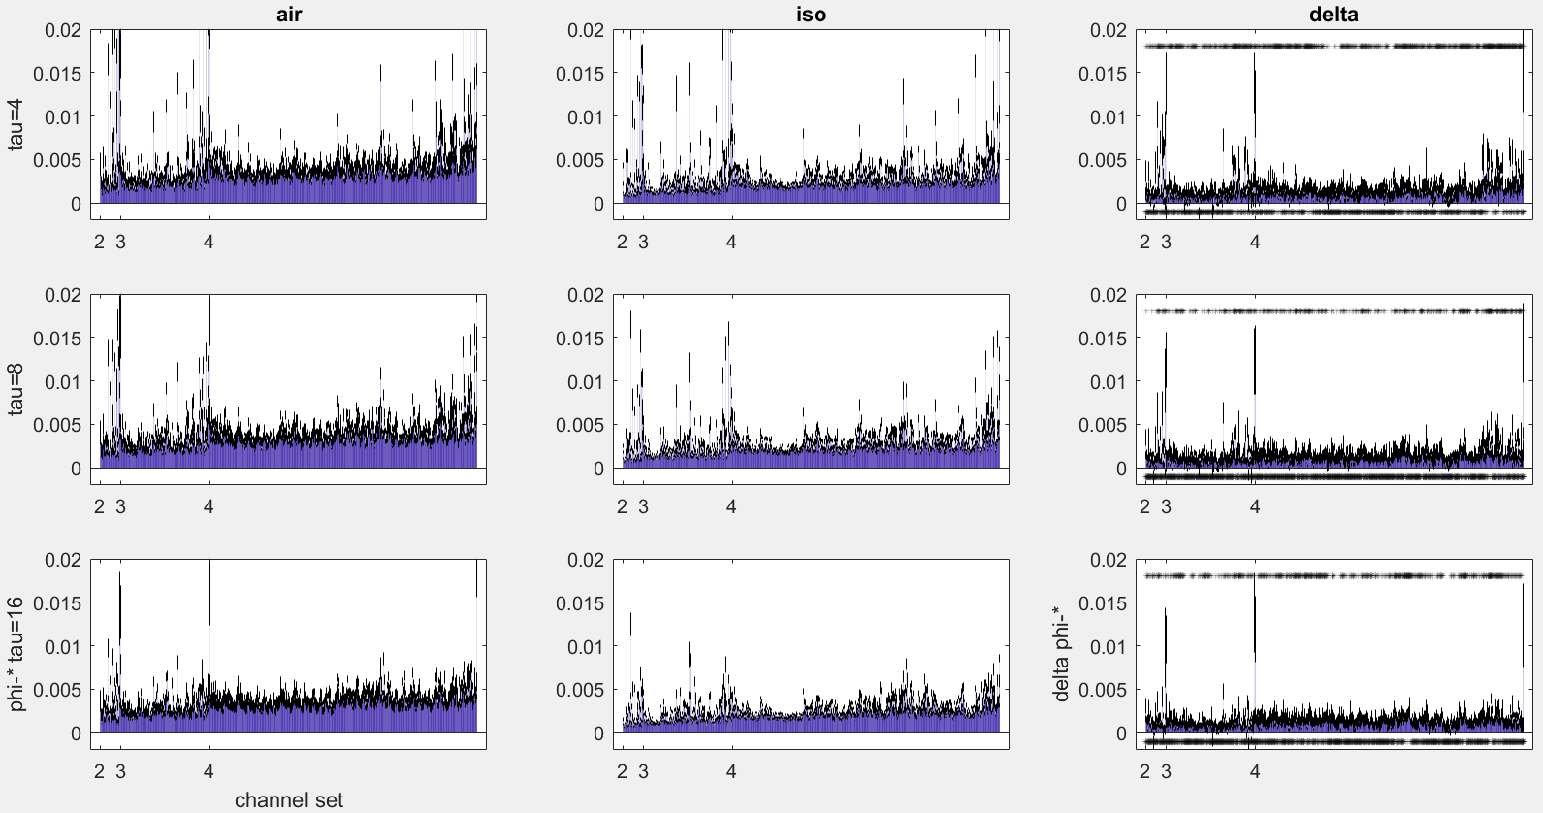
Notes:
Phi-star values for each channel set
Mean + stderr across flies
Number of significant sets (out of 1925):
849 (0.44)
448 (0.23)
588 (0.31)

Slide 28
Comparing Φ* to Φ
Do they increase/decrease together?
Do they give equivalent MIPs?
Notes:
If phi-3 and phi-star are equivalent, then we may wish to use phi-star over phi-3 given its more practical compute time (under Gaussian assumption)
If atomic approximates MIP, then do we really need to find the MIP?

Slide 29
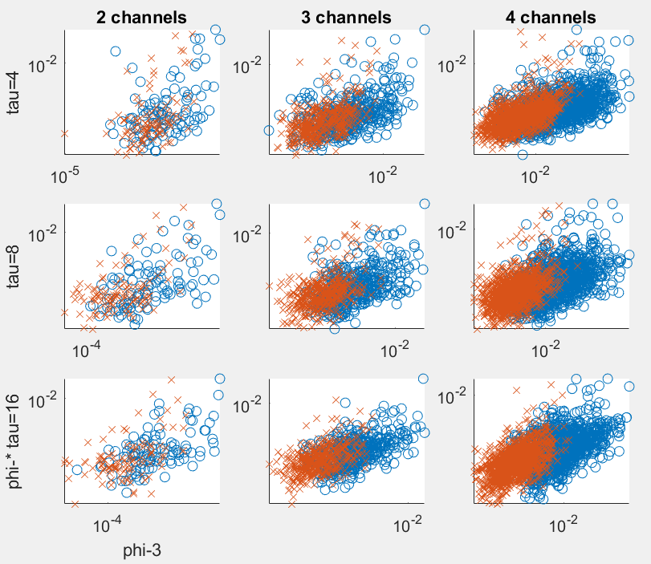
Φ-Φ* correlations for 1 fly
o: air
x: iso
Notes:
Same fly as shown for air vs iso
Phi-star and phi-3 values are averaged across trials
Each point is a channel set (so there are more points for 4 channels)
Blue circles are air
Red crosses are iso

Slide 30
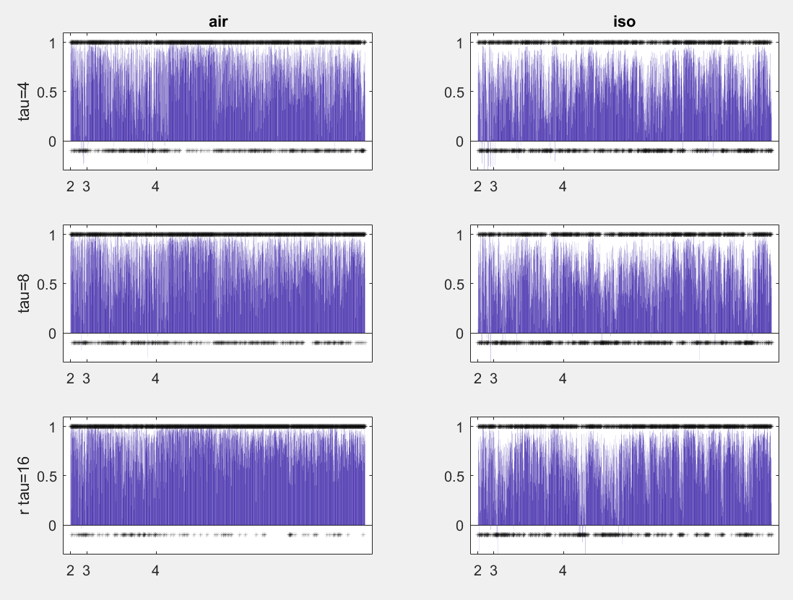
Correlations for each channel set
Notes:
Number of significant sets (out of 1925):
Air
1421 (0.74)
1507 (0.78)
1780 (0.92)
Iso
1126 (0.58)
1131 (0.59)
1416 (0.74)

Slide 31
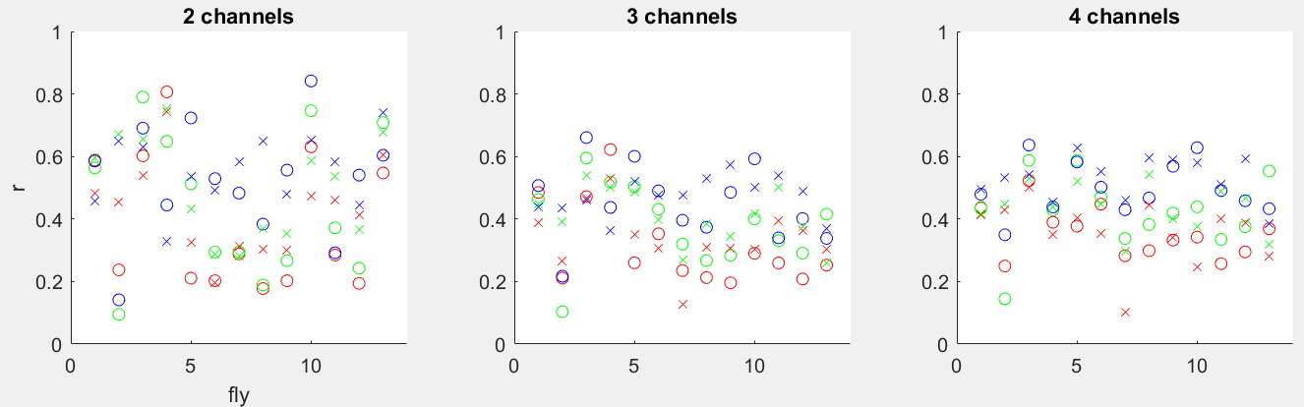
Correlations for each fly
R: tau=4ms G: tau=8ms B: tau=16ms
Notes:
RGB = tau 4, 8, 16, respectively
Higher correlations for longer tau!? Even though phi is higher for lower tau….

Slide 32
Difference between Φ and Φ* MIPs
IIT 3.0: MIPs are bipartitions from unidirectional cuts
Directional: A-/->B is different to B-/->A
Separated partitions can be considered appendages
Φ* MIPs are non-directional
IIT 2.0 only considers the past and present (symmetrically in Φ*)
Cut connections leave partitions completely isolated
Φ* MIPs are not limited to bipartitions

Slide 33
MIP Matching
For comparison, ignore directionality of Φ MIPs
For comparison, only consider Φ* MIPs which are bipartitions
Reminder: only one Φ* MIP per trial, but multiple Φ MIPs

Slide 34
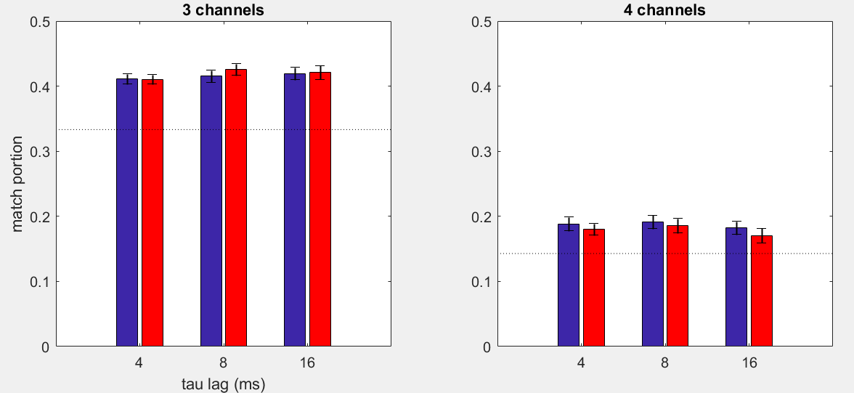
Portion of matching MIPs
Notes:
Each trial, number of possible matches = 2250 * (number of sets which have a phi-star bipartition)
Each trial, number of actual matches = sum of (occurrences of matching mips) across sets
Dotted line is chance level
Take only trials whose phi-* MIP is a bipartition
Chances: 1/3, 1/7

Slide 35
Correlations after filtering for matching MIPs
Correlations might be stronger if MIPs match
Take only channel sets where Φ* and Φ³ MIPs are equivalent
‘Equivalent’ defined as 2*chance level
i.e. average match portion across trials > 2*chance
Notes:
Results are very similar (same, except reduced number of datapoints)

Slide 36
Conclusions
Clearest prediction of IIT met
Reduced feedback not captured by MIP cuts
May be due to building the TPM once per condition
Moderate correlations between Φ and Φ*
Slightly stronger for larger τ
Likelihood of MIPs matching slightly higher than chance
Future direction: Use TPM built across both conditions to calculate Φ
Future direction: calculate Φ* using discretised values

