Slide 1
Phi-3 Classification
Angus Leung
2018-05-01

Slide 2
Data Summary
N = 13 flies
15 channels per fly
1000 Hz sampling rate (downsampled)
2 conditions
8x2.25s trials awake
8x2.25s trials anaesthetised
Phi: tau=4ms

Slide 3
Analysis Summary
Leave-one-out (LOL) classification of conditions within fly across 8x2 trials using
1-channel power
2-channel coherence
2-, 3-, 4-channel phi-3 and phi-star (2.25s TPM and covariance)
LOL classification of conditions across 13 flies using
trial-averaged power (TODO)
trial-averaged coherence (TODO)
trial-averaged 2-, 3-, 4-channel phi-3 (done) and phi-star (TODO) (18s TPM and covariance)

Slide 4
Power and Coherence
WITHIN flies

Slide 5
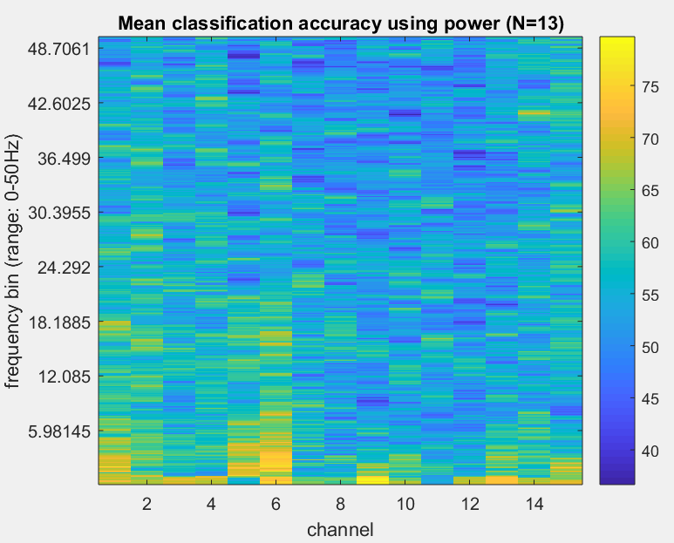
1-ch Power Classification
%
Power calculation:
3 tapers
frequency range 0-50Hz
padding = 1
Average across N=13 flies

Slide 6
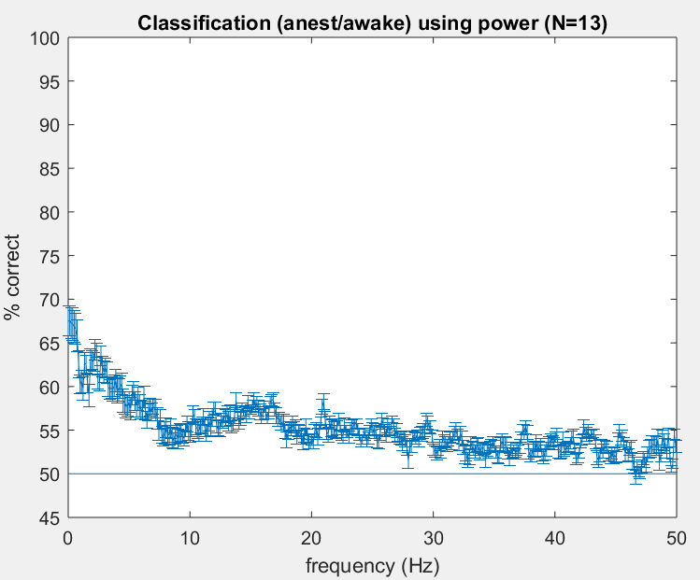
Power Classification
Average across 13 flies
Standard error across 13 flies

Slide 7
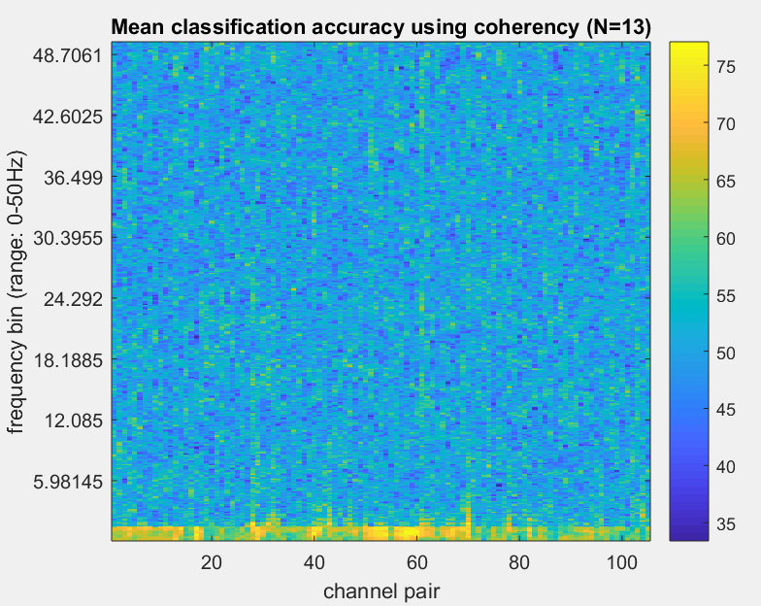
2-ch Coherence Classification
Coherence calculation
5 tapers
frequency range 0-50Hz
padding = 1
Average across N=13 flies

Slide 8
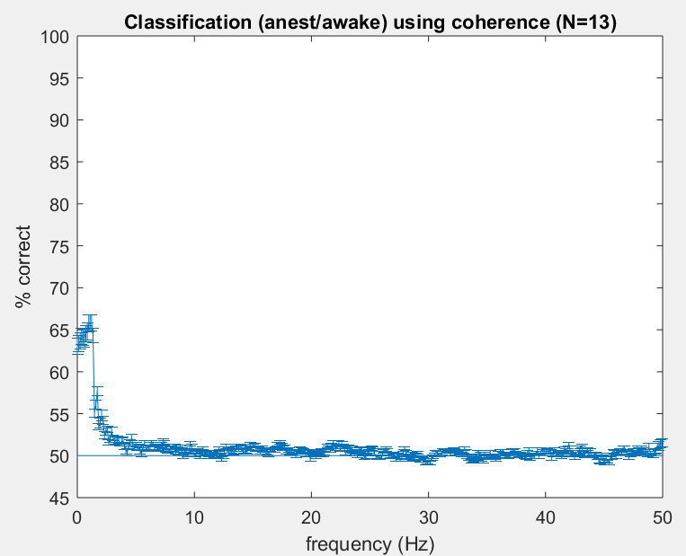
Power Classification
Average across 13 flies
Standard error across 13 flies

Slide 9
Phi-3
WITHIN flies

Slide 10
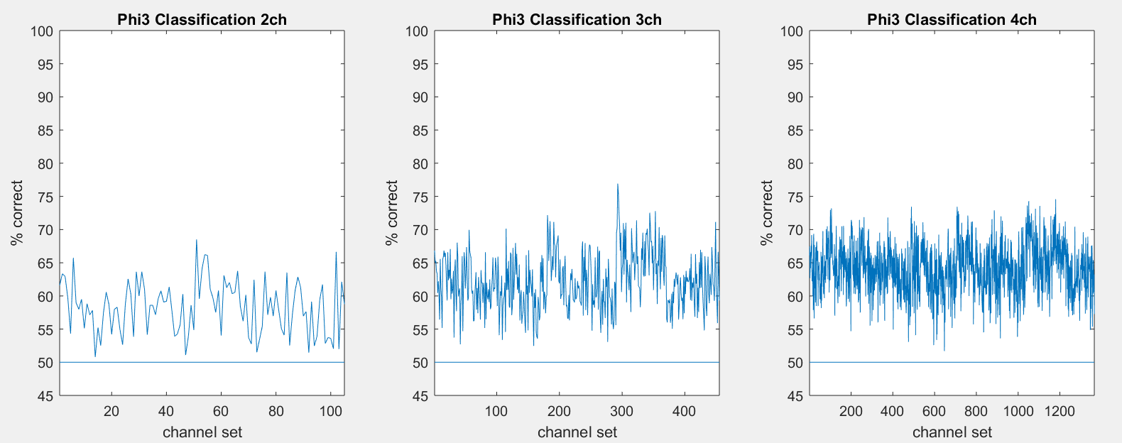
Accuracy per channel set

Slide 11
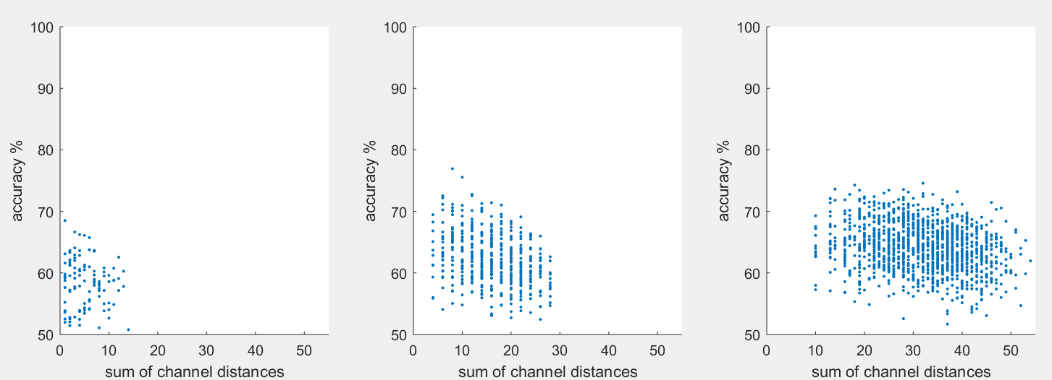
Accuracy vs sum of channel distances
Idea: sets which are more “global” have more distinct change in Phi
2-ch
3-ch
4-ch
r=-.09, p=.36
r=-.32, p<.001
r=-.23, p<.001

Slide 12
Phi-star
WITHIN flies

Slide 13
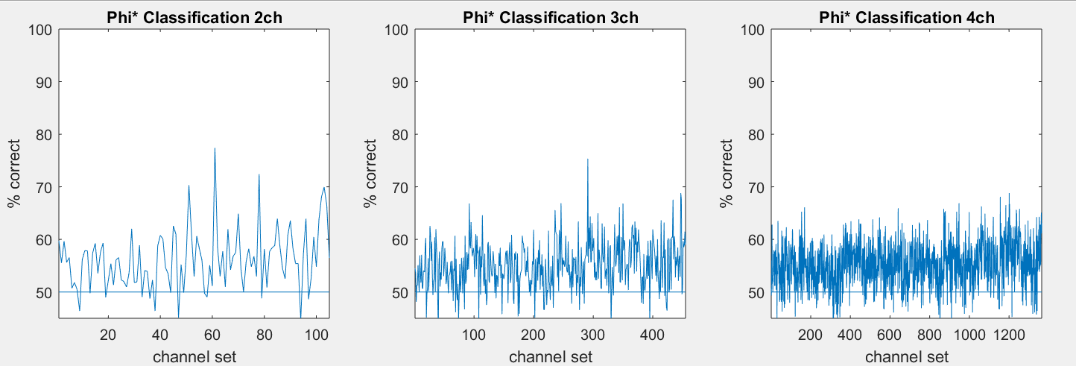
Accuracy per channel set

Slide 14
Phi-3
ACROSS flies

Slide 15
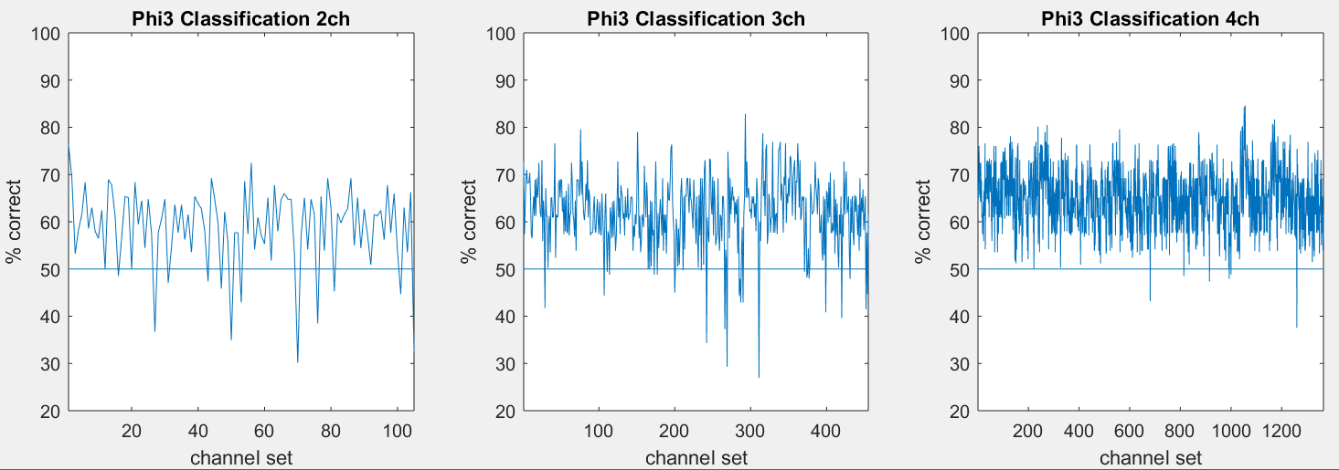
Accuracy per channel set

Slide 16
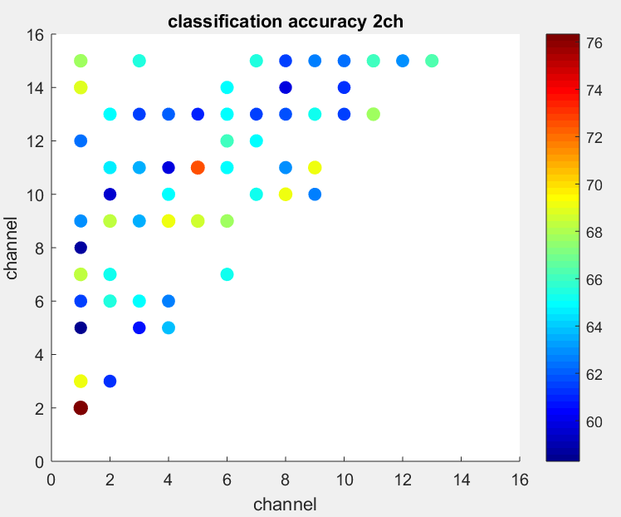
2-ch accuracy mapped to “set location”
Only showing accuracies > 58%

Slide 17
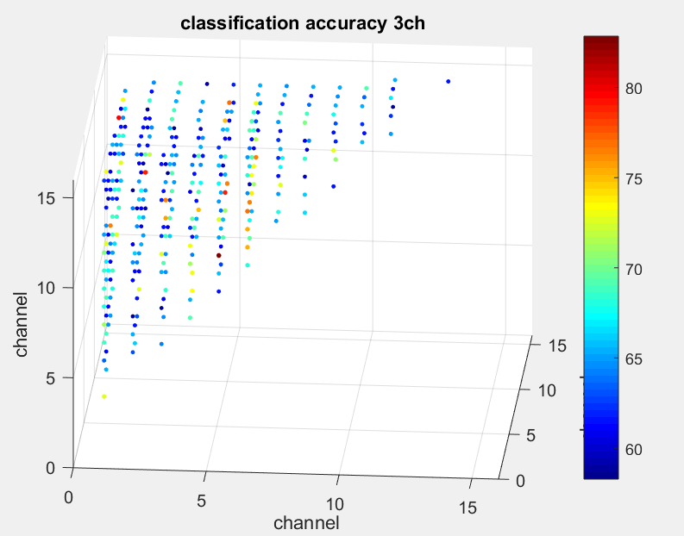
3-ch accuracy mapped to “set location”
Only showing accuracies > 58%

Slide 18
4-ch accuracy mapped to “set location”
On next slide
Each subplot is a “slice” of the 4th channel location (given by subplot title)
Colour axes are the same for all subplots

Slide 19
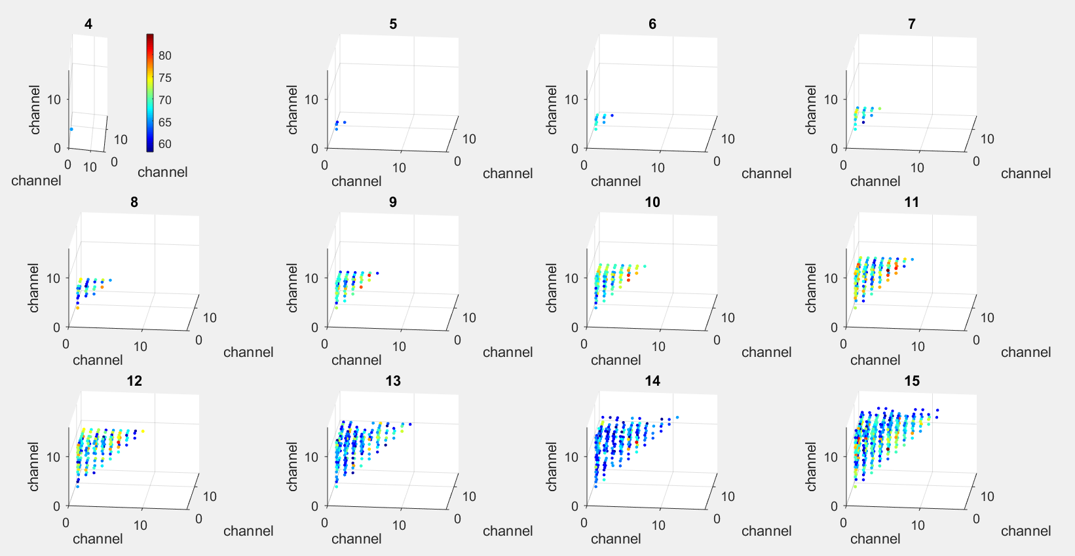
Only showing accuracies > 58%

Slide 20
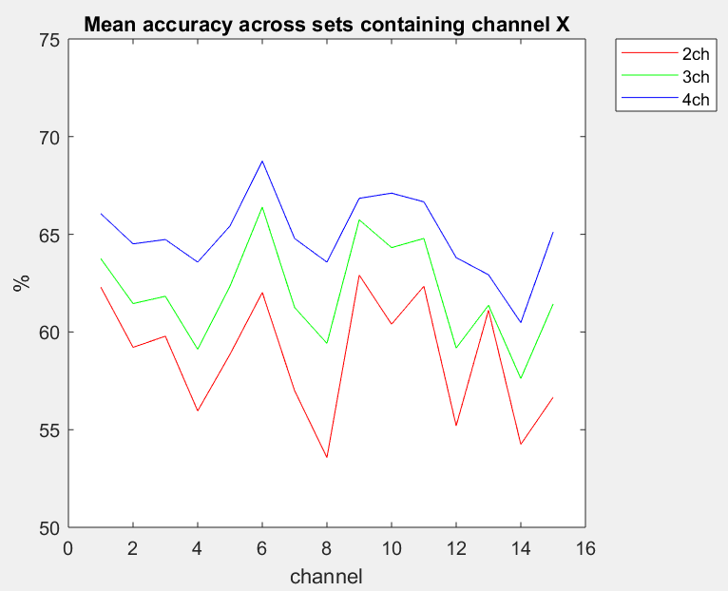
Accuracy per channel
Accuracy at one channel:
Average accuracy across all channel sets containing the channel

Slide 21
Phi-3 per channel
On next slide
Idea: greater Phi -> greater accuracy?
But, peaks in Phi don’t correspond to peaks in accuracy
Phi at one channel:
Average Phi across all channel sets containing the channel

Slide 22
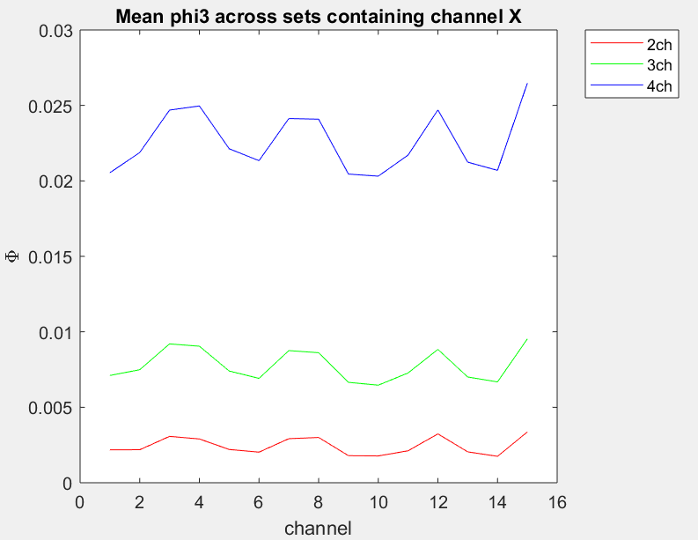
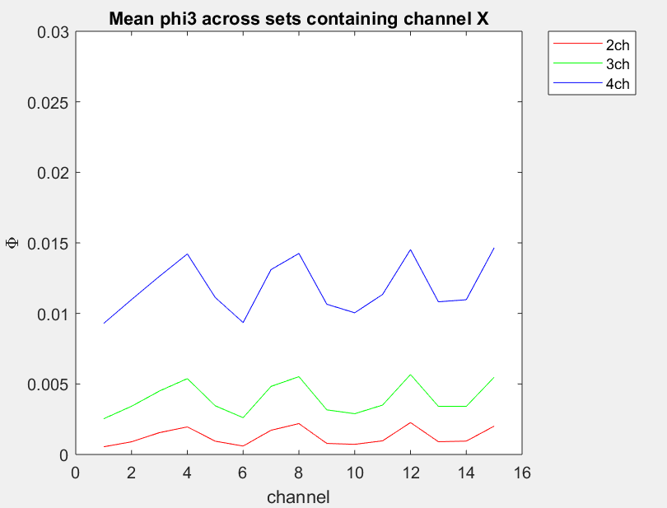
Wake
Anest

Slide 23
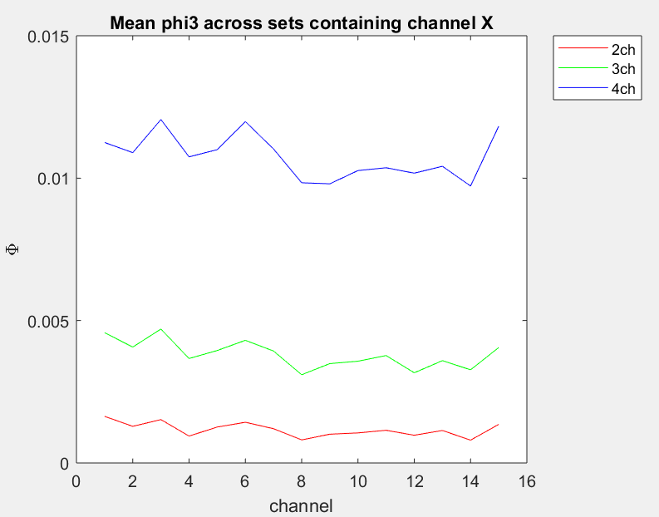
Wake - Anest
Shape after subtracting is more similar to classification accuracies
Greater delta Phi -> greater accuracy

Slide 24
Phi-3 values vs 2-ch single channel Phi
On next slide
Idea: channels which contribute more to Phi at the smaller scale (2-ch sets) also contribute more at the larger scale (3-ch, 4-ch sets)

Slide 25
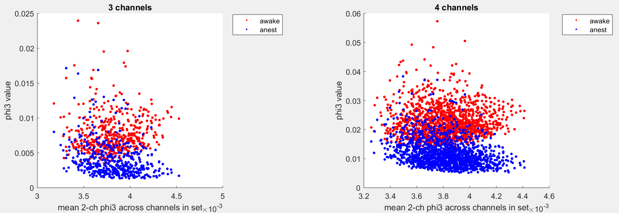
Phi-3 values vs 2-ch single channel Phi
awake: r=.02, p=.41
anest: r=-.30, p<.001
awake: r=.07, p=.13
anest: r=-.27, p<.001

