Slide 1
Integrated Information Φ Decreases in Anaesthetised Flies
Angus Leung
2017-09-18
Supervisor: Naotsugu Tsuchiya

Slide 2
Overview
Integrated Information Theory and Φ
Testing Φ in flies
Results
Implications

Slide 3
Consciousness
Wakefulness
Experience of the world
Distinct from self-awareness…
Conscious level
But how does it arise?
Search for neural correlates of level of consciousness
Mechanism X
Mechanism Y
Interaction Z
Explanatory gap

Slide 4
Integrated Information Theory (IIT)
Approach to explaining conscious experience – identify aspects of consciousness to deduce necessary interactions (Oizumi, Albantakis, & Tononi, 2014)
Information: out of all the experiences we can possibly have at any time (uncertainty), at any time we only experience one (reduction in uncertainty)
Integration: an experience cannot be separated into parts
Integrated Information Φ
Notes:
The Integrated Information Theory of consciousness (or IIT) attempts to link conscious experience to a physical substrate. To do this, it identifies aspects of consciousness with which to deduce the necessary physical interactions for consciousness.
Two key aspects of consciousness which it identifies are information and integration.
The idea of information is that every experience is informative – having any one experience rules out all the other experiences that you could possibly have – for example, you could be experiencing a much more interesting presentation, or experiencing just a plain white wall, but no, the experience you have now is that of me speaking.
Integration refers to how an experience cannot be split into separate parts – for example, the experience of a red ball cannot be split into two experiences of red, and a ball.
From these aspects (and a couple of others), IIT proposes a quantity which should reflect level of consciousness – integrated information, or phi.

Slide 5
What is Integrated Information Φ?
Integrated O
Information |
O = exists only when considering the whole
O = reduction due to splitting
I = reduction in uncertainty
Uncertainty: a neuron can be firing or not firing
The Whole
Yes
No
Some other neuron
1 neuron, 2 possible states
Notes:
So what is integrated information?
Information can be understood as a reduction in uncertainty. What do I mean by uncertainty? Well, given a neuron, there is uncertainty at a given time as to whether it is firing, or not.
If we consider another neuron, such that our original neuron fires when the new one fires, then knowing that the new one means that the first one must also be firing – we thus have a reduction in uncertainty from 2 possible states to 1 possible state – this reduction is information. You can think of it as knowledge about the new neuron constraining the possibilities of the first neuron.
Integration refers to something that exists only when considering the whole – for integrated information, this refers to the information gained (or uncertainty reduced) when considering the whole system. To assess this, we can find the information gained from a split system, for example if we ignore the connection between the two neurons, then our uncertainty as to the state of the first neuron returns to what it was before. So in this example, the information is integrated.
Uncertainty – the number of possibilities
The larger the reduction, the greater the information
When considering a lot of neurons, there are many many possibilities, so high uncertainty
Reduction in uncertainty after we know another neuron and its interaction with the current neuron
“Some other neuron can be the same neuron at a different timepoint”
Note this is a unidirectional example
Phi = reduction in information after splitting a system

Slide 6
What is Integrated Information Φ?
Does a given a network state (e.g. state of all neurons in the brain) constrain the possible past and future network states?
Yes – constrained states = reduced uncertainty = information
No – states unconstrained = same uncertainty = no information
Does splitting the network (e.g. brain into two hemispheres) give us the same information as not splitting the network?
Yes – no integration
No – integration is a vital part of the system – difference in information is Φ
Notes:
If we extend this to a larger system, or network, such as the brain, then the assessment of integrated information is akin to asking two questions:
Does the state of the network, in other words the states of all its elements, constrain the states it may take in the future, and is it informative as to what states it could have been in the past?
If there is information, how much of this information is integrated? If a split system generates the same amount of information, then the whole network reduces to independent networks.

Slide 7
Consciousness and Integration / Information
(Sarasso et al., 2014)
Notes:
Now, there is evidence showing that supporting loss of both information and integration during loss of consciousness such as during NREM sleep or anaesthesia. For example EEG signals become stereotyped (i.e. more similar), reducing the amount of information they can convey. Also, during loss of consciousness, we see a reduction of feedback interactions and effective connectivity, suggesting loss of integration among parts.
But what about “integrated information”?
How the latest derivation of phi behaves with a change in level of consciousness has not been investigated.
So, the aim of my project was to investigate whether phi decreases during loss of consciousness, as controlled through anaesthesia.

Slide 8
But what about Φ?
Φ not yet calculated as a measure of conscious level
High computing costs
Difficult to make necessary observations in a biological system
Aim: apply Φ to fly model
~135,000 neurons versus ~70,000,000 neurons in the mouse brain
IIT prediction: reduced conscious level <-> reduced Φ
Notes:
But what about “integrated information”?
How the latest derivation of phi behaves with a change in level of consciousness has not been investigated.
So, the aim of my project was to investigate whether phi decreases during loss of consciousness, as controlled through anaesthesia.
Timescale will become apparent later on

Slide 9
Measuring Φ in Flies

Slide 10
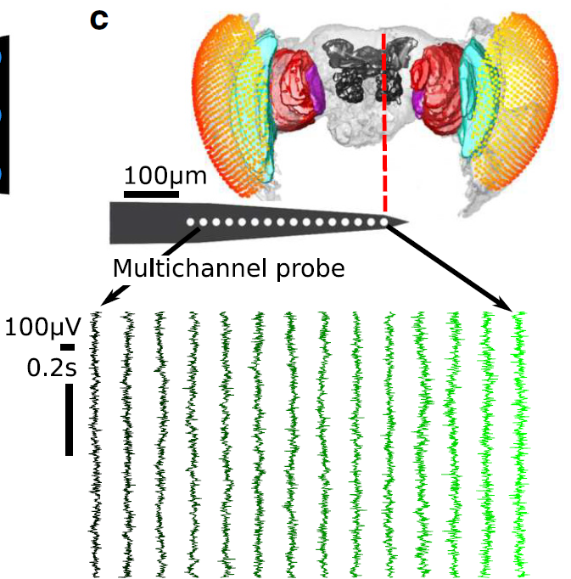
Measuring Φ in Flies
13 fruit flies (Drosphila melanogaster)
Half-brain probe: 16 electrodes
15 ‘channels’ after bipolar re-referencing
2 conditions:
0% isoflurane (air)
0.6% isoflurane (iso)
18s of ‘spontaneous’ LFP
18s period after an air puff
18s period split into 8 x 2.25s trials, 1kHz sampling rate
(Cohen et al. 2016)
Notes:
To investigate this question, I ended up taking local field potentials from the fruit fly. This data was previously collected and preprocessed by a newly anointed Dr Dror Cohen.
To investigate this question, I ended up using local field potentials from the fruit fly, collected previously by a newly anointed Dr Dror Cohen.
Essentially, as shown in the figure there, a linear multichannel probe was inserted into the fly brain, which yields 15 re-referenced recordings, or channels.
Conscious level was manipulated through the administration of isoflurane.
Lastly, recordings were 18 seconds long. I split these 18 seconds into 8 trials.
1kHz downsampled from 25kHz
Figure shows 14 bipolar rereferenced channels (the most peripheral was discarded, but it hasn’t been discarded in this analysis)
Recorded at 25kHz, downsampled to 1kHz
Air puff is ~180s after onset of isoflurane delivery

Slide 11
Measuring Φ in Flies
13 fruit flies (Drosphila melanogaster)
Half-brain probe: 16 electrodes
15 ‘channels’ after bipolar re-referencing
2 conditions:
0% isoflurane (air)
0.6% isoflurane (iso)
18s of ‘spontaneous’ LFP
18s period after an air puff
18s period split into 8 x 2.25s trials, 1kHz sampling rate
(Cohen et al. 2016)
Notes:
To investigate this question, I ended up taking local field potentials from the fruit fly. This data was previously collected and preprocessed by a newly anointed Dr Dror Cohen.
To investigate this question, I ended up using local field potentials from the fruit fly, collected previously by a newly anointed Dr Dror Cohen.
Essentially, as shown in the figure there, a linear multichannel probe was inserted into the fly brain, which yields 15 re-referenced recordings, or channels.
Conscious level was manipulated through the administration of isoflurane.
Lastly, recordings were 18 seconds long. I split these 18 seconds into 8 trials.
1kHz downsampled from 25kHz
Figure shows 14 bipolar rereferenced channels (the most peripheral was discarded, but it hasn’t been discarded in this analysis)
Recorded at 25kHz, downsampled to 1kHz
Air puff is ~180s after onset of isoflurane delivery

Slide 12
Measuring Φ in Flies
13 fruit flies (Drosphila melanogaster)
Half-brain probe: 16 electrodes
15 ‘channels’ after bipolar re-referencing
2 conditions:
0% isoflurane (air)
0.6% isoflurane (iso)
18s of ‘spontaneous’ LFP
18s period after an air puff
18s period split into 8 x 2.25s trials, 1kHz sampling rate
(Cohen et al. 2016)
Notes:
To investigate this question, I ended up taking local field potentials from the fruit fly. This data was previously collected and preprocessed by a newly anointed Dr Dror Cohen.
To investigate this question, I ended up using local field potentials from the fruit fly, collected previously by a newly anointed Dr Dror Cohen.
Essentially, as shown in the figure there, a linear multichannel probe was inserted into the fly brain, which yields 15 re-referenced recordings, or channels.
Conscious level was manipulated through the administration of isoflurane.
Lastly, recordings were 18 seconds long. I split these 18 seconds into 8 trials.
1kHz downsampled from 25kHz
Figure shows 14 bipolar rereferenced channels (the most peripheral was discarded, but it hasn’t been discarded in this analysis)
Recorded at 25kHz, downsampled to 1kHz
Air puff is ~180s after onset of isoflurane delivery

Slide 13
Measuring Φ in Flies
13 fruit flies (Drosphila melanogaster)
Half-brain probe: 16 electrodes
15 ‘channels’ after bipolar re-referencing
2 conditions:
0% isoflurane (air)
0.6% isoflurane (iso)
18s of ‘spontaneous’ LFP
18s period after an air puff
18s period split into 8 x 2.25s trials, 1kHz sampling rate
(Cohen et al. 2016)
Notes:
To investigate this question, I ended up taking local field potentials from the fruit fly. This data was previously collected and preprocessed by a newly anointed Dr Dror Cohen.
To investigate this question, I ended up using local field potentials from the fruit fly, collected previously by a newly anointed Dr Dror Cohen.
Essentially, as shown in the figure there, a linear multichannel probe was inserted into the fly brain, which yields 15 re-referenced recordings, or channels.
Conscious level was manipulated through the administration of isoflurane.
Lastly, recordings were 18 seconds long. I split these 18 seconds into 8 trials.
1kHz downsampled from 25kHz
Figure shows 14 bipolar rereferenced channels (the most peripheral was discarded, but it hasn’t been discarded in this analysis)
Recorded at 25kHz, downsampled to 1kHz
Air puff is ~180s after onset of isoflurane delivery

Slide 14
Measuring Φ in Flies
13 fruit flies (Drosphila melanogaster)
Half-brain probe: 16 electrodes
15 ‘channels’ after bipolar re-referencing
2 conditions:
0% isoflurane (air)
0.6% isoflurane (iso)
18s of ‘spontaneous’ LFP
18s period after an air puff
18s period split into 8 x 2.25s trials, 1kHz sampling rate
(Cohen et al. 2016)
Notes:
To investigate this question, I ended up taking local field potentials from the fruit fly. This data was previously collected and preprocessed by a newly anointed Dr Dror Cohen.
To investigate this question, I ended up using local field potentials from the fruit fly, collected previously by a newly anointed Dr Dror Cohen.
Essentially, as shown in the figure there, a linear multichannel probe was inserted into the fly brain, which yields 15 re-referenced recordings, or channels.
Conscious level was manipulated through the administration of isoflurane.
Lastly, recordings were 18 seconds long. I split these 18 seconds into 8 trials.
1kHz downsampled from 25kHz
Figure shows 14 bipolar rereferenced channels (the most peripheral was discarded, but it hasn’t been discarded in this analysis)
Recorded at 25kHz, downsampled to 1kHz
Air puff is ~180s after onset of isoflurane delivery

Slide 15
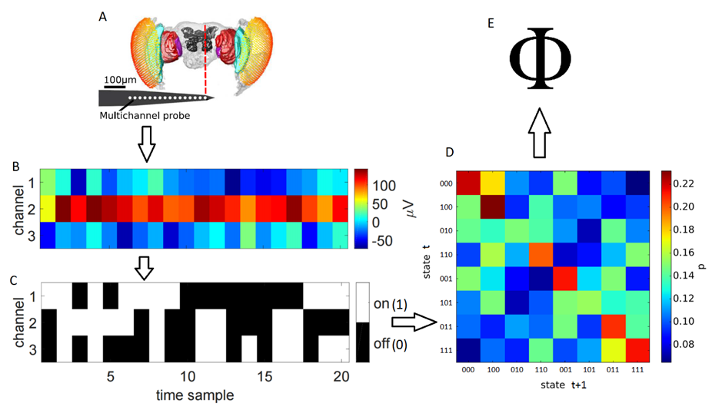
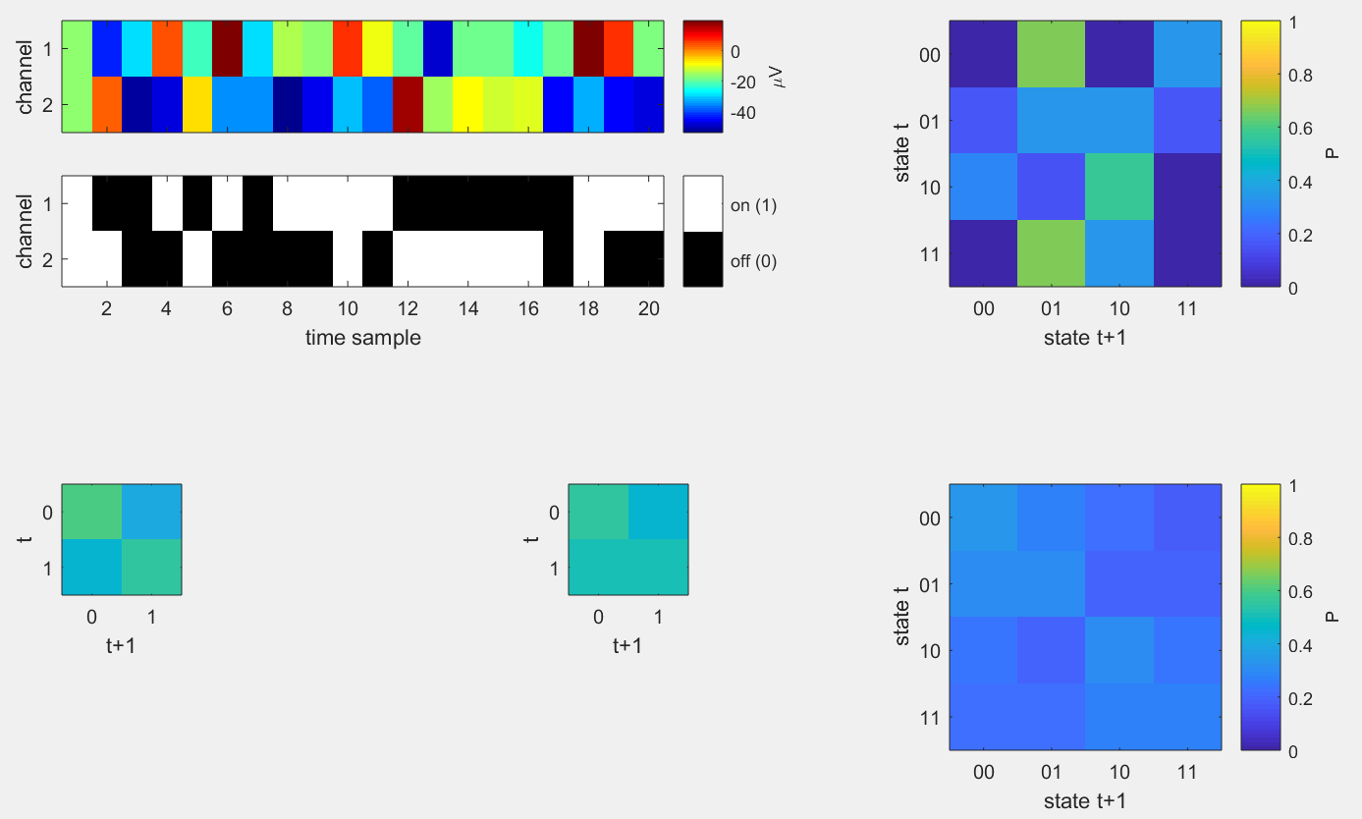
Measuring Φ in Flies
A
E
via PyPhi
B
D
C
Notes:
Using these recordings, I calculated phi across different sets of channels.
From some set of channels, we can calculate a phi value.
Here I have the processing pipeline for a sample set of 3 channels. For each channel, I binarized its recording based on its median value across trials – if a sample was above the median, it was classed as ON, and otherwise OFF. Binarising the recordings in this manner allows us to obtain 2 things:
In C, every column thus gives the state of the network at a given time sample.
By looking across time samples, we can also obtain the empirical probabilities of each state transitioning into another state, which we store in a transition probability matrix, as in D. Knowledge of state transition probabilities allows us to assess the information generated by a given state, and factorisation of the matrix allows us to conceptually split the system in order to compare the information generated by the system at a given time sample against that generated by a split system.
Finally, I used a Python toolbox which essentially calculated phi, when given a system state and a transition probability matrix. As each trial contains many states, I average phi across all states, weighting by the number of times each state occurs within the trial to obtain a single phi value for the trial.
Phi requires discretised variables
LFPs binarised using global (across trials) median split
TPM constructed across trials – this is what allows for the quantification of uncertainty and information
Given a state and the TPM, we can get a phi value and associated MIP per sample (via pyphi)
Phi per trial is averaged across samples, weighting for frequency of state occurrences

Slide 16
Measuring Φ in Flies
Full
Split
Channel 1
Channel 2
⊗

Slide 17
Φ Parameters
Which channels to use?
15 choose 2 = 105 sets
15 choose 3 = 455 sets
15 choose 4 = 1365 sets
Scale of transition probabilities?
τ = 4 ms, 8 ms, 16 ms
4 ms: for a state at sample t, probability of sample t+4 being a specific state
IIT: consciousness flows at a particular speed (where Φ is max)
Notes:
I didn’t choose – I calculated across all combinations of channels consisting up to 4 channels.
Why not more? Because computational (and memory) costs for computing phi grows exponentially with the number of elements in the system. Compounding this is the combinatorial growth of possible channel combinations.
And what about the scale of transition probabilities? Do I calculate using probabilities with a 1 ms delay? Or a 20 ms delay? Given no testing of phi in the past, virtually any choice is arbitrary at this stage. So I chose calculate phi at 3 lags.
Finally, IIT states that phi should be computed at the temporal resolution which maximises phi. It’s unclear what this resolution is, so I calculated phi at 3 different temporal resolutions. The selected resolution changes only the transition probability matrix – for example, with a transition resolution of 4ms, I consider the probabilities of each state transferring to another state after a lag of 4ms have passed.
Phi-3 calculated with pyphi
Phi-star calculated using Haun’s functions
Choice of discretisation method seems arbitrary
Repeat tests for each parameter setting

Slide 18
Results

Slide 19
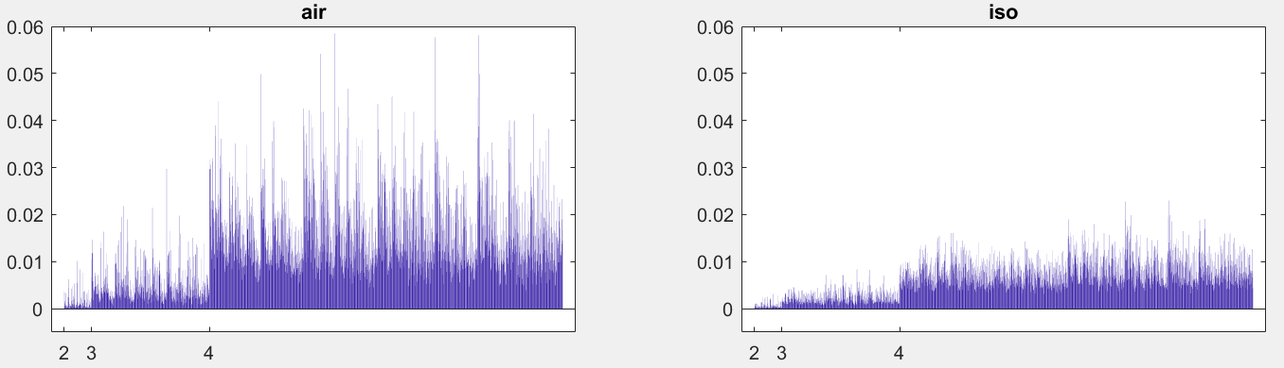
Φ values for 1 fly, lag=4ms
Φ
channel set
Notes:
Here are some results for a single fly, at one lag parameter.
To the left are the phi values in the air condition, and to the right are phi values during anaesthesia.
On the x axis we have the candidate systems, sorted by number of channels in the system, and within that, sorted from those which contain more peripheral channels to those with more central channels.
So each vertical bar gives the phi value, averaged across trials, for a given set of channels.
Results for 1 fly, at tau = 4ms

Slide 20
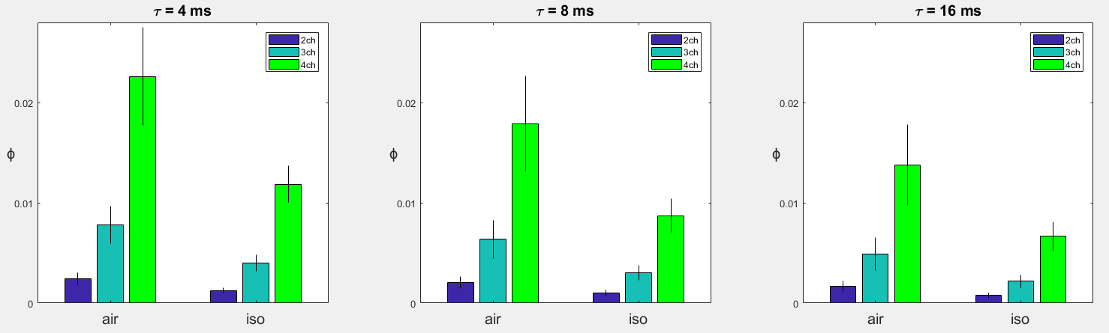
Φ values across flies
Notes:
If we average each the phi values across all channel sets, then across flies…
Here we see that larger networks yield larger phi
But more importantly, there is a significant reduction in phi during anaesthesia

Slide 21
Φ values across flies

Slide 22
Φ values across flies

Slide 23
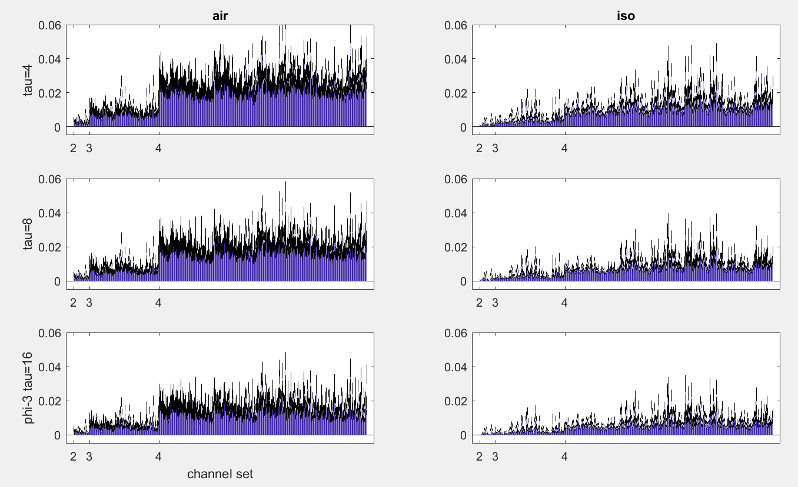
Notes:
And here we have phi values averaged across 13 flies, at each lag parameter, with each of the three rows corresponding to increasing lag parameters.
Black bars represent standard error
Notably, phi is larger for systems with more channels (for both conditions), and is noticeably decreased under anaesthesia. Also, while it’s not so visible, phi seems to be lower for longer lags.
Black bar is standard error of 13 flies

Slide 24
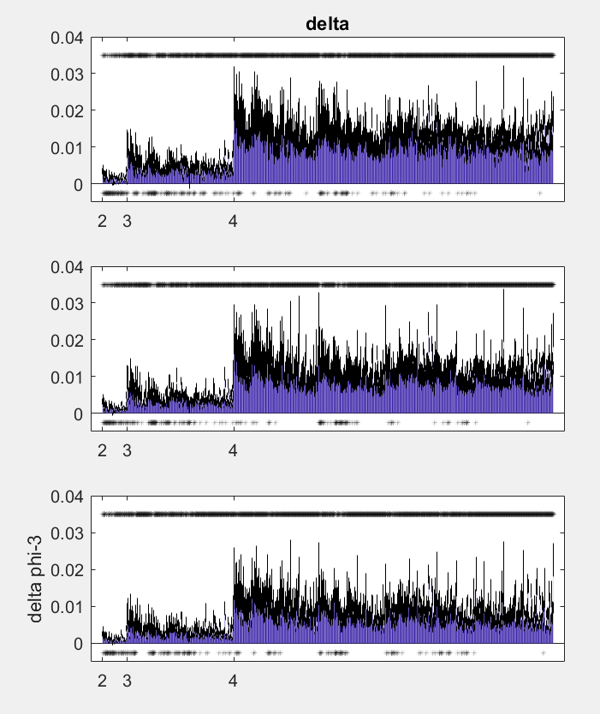
Air - Isoflurane
Omnibus test (LME) for effects of:
Number of channels *
Lag *
Condition *
Post-hoc signed ranks tests at each channel set with FDR correction (q=.05)
Notes:
And here we reach the juicy part.
These are the results for the change in phi under the air condition to during anaesthesia.
Asterisks at the top denote significant differences after correction for multiple comparisons, and I’ve also included asterisks at the bottom to indicate channel sets which yielded a non-significant difference.
Notably, the difference in phi between conditions is larger for systems with more channels.
Maybe include portions of significance per nChannels
Wilcoxon signed ranks with FDR q=0.05
Number of significant sets (out of 1925):
1687 (0.88)
1721 (0.89)
1713 (0.89)

Slide 25
Summary
Good for IIT – reduced Φ under anaesthesia
Consistent – anaesthetics affect the fly brain similarly to vertebrates
Φ attributes in the fly model:
Shorter lag -> greater Φ
Larger networks -> greater Φ
But – Conscious levels in flies?
Shorter lags -> greater Φ: possibly fly specific
Notes:
Link between metabolic rate and animal size with “perception of temporal information” (Healy et al. 2013)

Slide 26
Summary
Future assessment: isoflurane mechanism - reduction in just I or O?
Basic prediction regarding Φ is met in the fly model:
Good starting ground to continue testing concepts of IIT (not covered here)
The “location” of consciousness in flies
Subjective “experience” of flies
Calls for testing in vertebrates
Are flies conscious?
Notes:
Reduction in phi could be due to reduction in just information or just integration, as in the figure shown in NREM sleep.
If this is the case however, phi still allows for reduction in the other quantity to result in reduced consciousness
The result of reduced Φ in the fly brain indicates that:
The fly model may be a good starting place to continue testing ideas of IIT

Slide 27
Thanks – Questions?

Slide 28
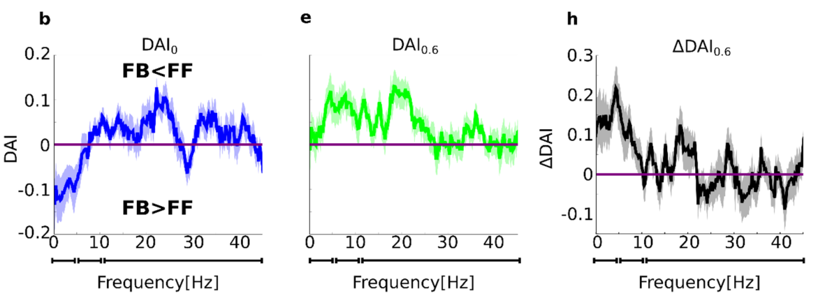
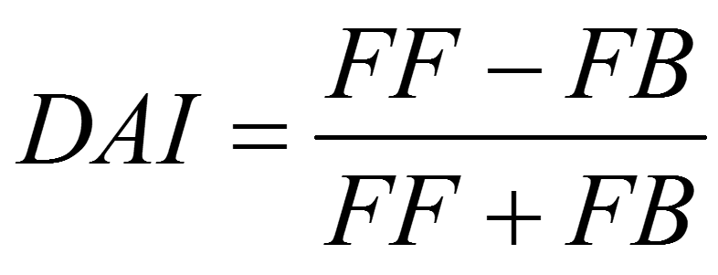
Past finding: reduced feedback under iso
Past finding on same dataset using Granger Causality:
Feedback reduced under anaesthesia, for low frequencies
Feedback: centre channel -> periphery channel
GC: one signal contains information about another

Slide 29
Is feedback reduction captured in the MIP?
The minimum information partition (MIP) is the unidirectional split which results in the least difference in information
No difference -> integration not vital among the split parts
MIP reduces the system as much as possible to independent parts
If feedback loses importance, then cutting this connection should give a smaller difference
So the centre -> periphery cut might be more common under isoflurane
2 channel scenario:
P
C
Notes:
Feedback result also works vice versa – if it is more important during wakefulness, then the c->p cut should be less common
Periphery channels: 2-7
Centre channels: 10-15
“importance” i.e. information

Slide 30
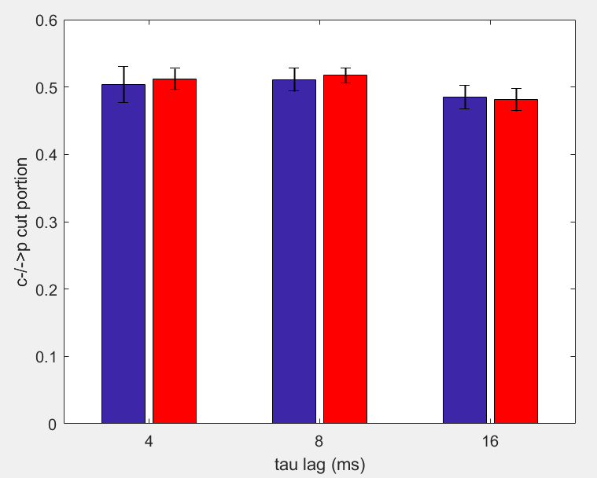
Portion of c-/->p cuts
2 channels = 4 states
Portion of samples within a trial with a feedback cut as the MIP
B: air
R: iso
Notes:
Averaged across trials, channel combinations, and flies
Seems to be chance level
Limitation: low frequencies were 1-10Hz, which would correspond(?) to down to 0.1s (100ms) – maybe 16ms is not sufficient to capture the same result

Slide 31
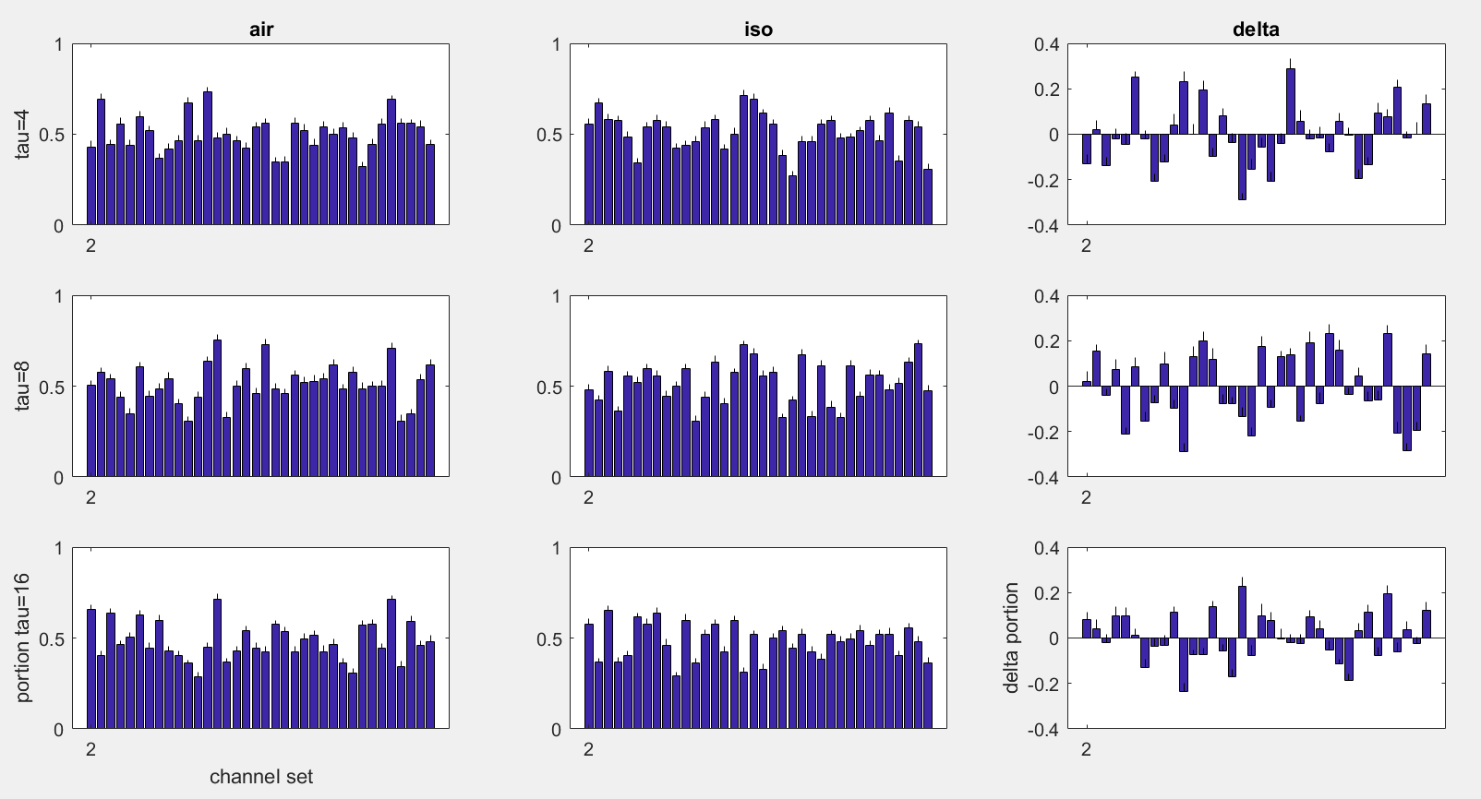
Notes:
It’s possible that the main change between conditions is the TPM, rather than the MIP

Slide 32
Φ vs Φ*
Investigation 2

Slide 33
Investigation 2: Φ* vs Φ
Φ computation is resource intensive
Φ* can be analytically computed using the Gaussian approximation (this means faster computation)
Φ* based on IIT 2.0
Slight differences between IIT 2.0 and IIT 3.0
IIT 2.0 assesses how a state constrains a system’s past; IIT 3.0 assesses also how it constrains the future (more complex)
Φ*: symmetry between past-present and present-future
Notes:
Symmetry means past-present can be treated as present-future (phi-star doesn’t take into account both past and future at one time)

Slide 34
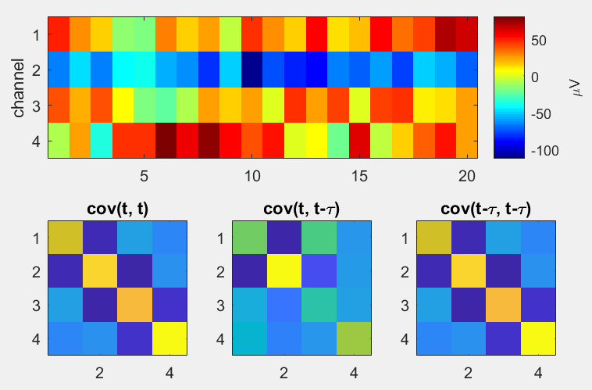
Φ* Calculation
Φ*
via phi_toolbox_Feb2014 (Haun et al., 2016)
Notes:
Normalisation factor seems to be number of groups in partition * minimum past entropy of the groups

Slide 35
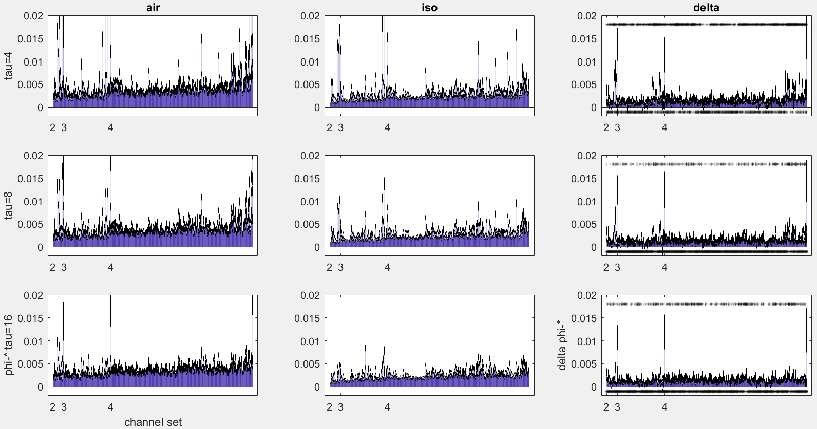
Notes:
Phi-star values for each channel set
Mean + stderr across flies
Number of significant sets (out of 1925):
849 (0.44)
448 (0.23)
588 (0.31)

Slide 36
Comparing Φ* to Φ
Do they increase/decrease together?
Do they give equivalent MIPs?
Notes:
If phi-3 and phi-star are equivalent, then we may wish to use phi-star over phi-3 given its more practical compute time (under Gaussian assumption)
If atomic approximates MIP, then do we really need to find the MIP?

Slide 37
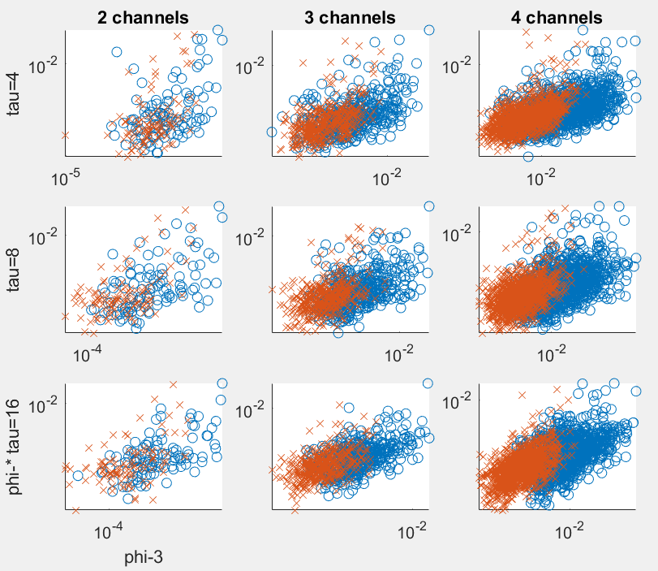
Φ-Φ* correlations for 1 fly
o: air
x: iso
Notes:
Same fly as shown for air vs iso
Phi-star and phi-3 values are averaged across trials
Each point is a channel set (so there are more points for 4 channels)
Blue circles are air
Red crosses are iso

Slide 38
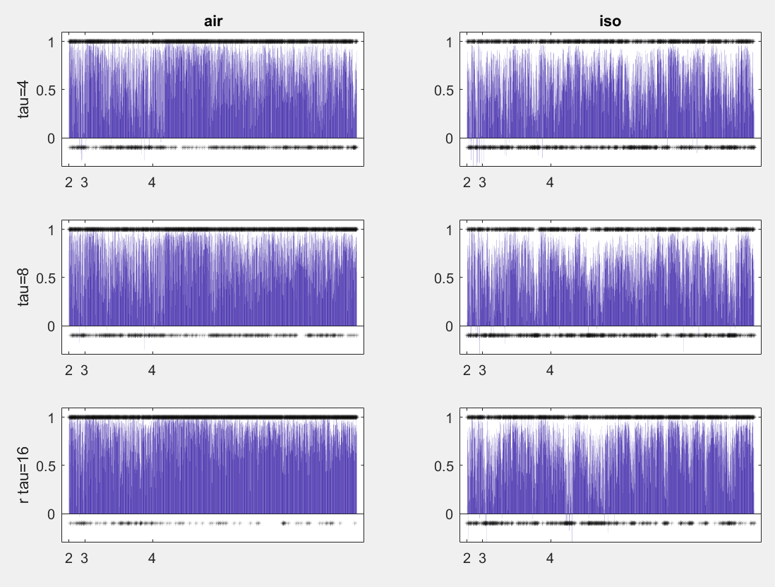
Correlations for each channel set
Notes:
Number of significant sets (out of 1925):
Air
1421 (0.74)
1507 (0.78)
1780 (0.92)
Iso
1126 (0.58)
1131 (0.59)
1416 (0.74)

Slide 39
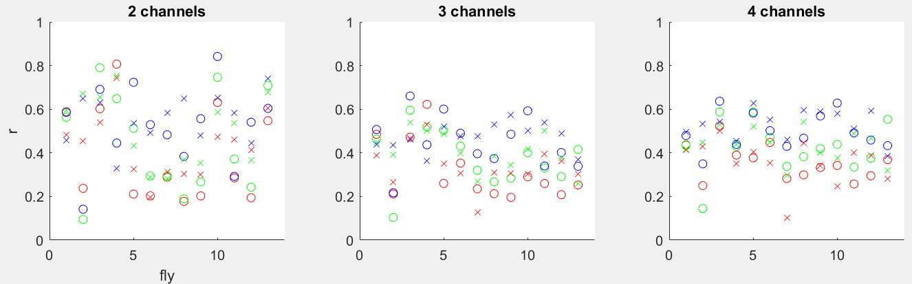
Correlations for each fly
R: tau=4ms G: tau=8ms B: tau=16ms
Notes:
RGB = tau 4, 8, 16, respectively
Higher correlations for longer tau!? Even though phi is higher for lower tau….

Slide 40
Difference between Φ and Φ* MIPs
IIT 3.0: MIPs are bipartitions from unidirectional cuts
Directional: A-/->B is different to B-/->A
Separated partitions can be considered appendages
Φ* MIPs are non-directional
IIT 2.0 only considers the past and present (symmetrically in Φ*)
Cut connections leave partitions completely isolated
Φ* MIPs are not limited to bipartitions

Slide 41
MIP Matching
For comparison, ignore directionality of Φ MIPs
For comparison, only consider Φ* MIPs which are bipartitions
Reminder: only one Φ* MIP per trial, but multiple Φ MIPs

Slide 42
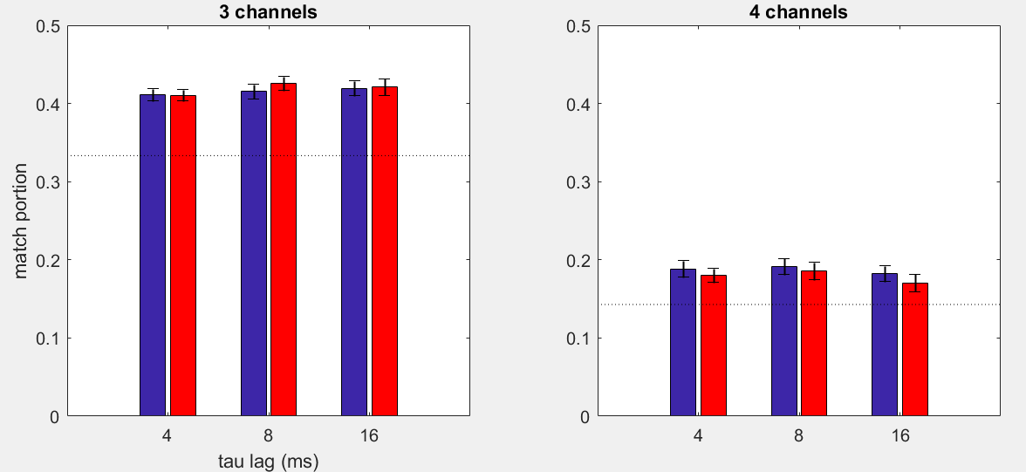
Portion of matching MIPs
Notes:
Each trial, number of possible matches = 2250 * (number of sets which have a phi-star bipartition)
Each trial, number of actual matches = sum of (occurrences of matching mips) across sets
Dotted line is chance level
Take only trials whose phi-* MIP is a bipartition
Chances: 1/3, 1/7

Slide 43
Conclusions
Clearest prediction of IIT met
Reduced feedback not captured by MIP cuts
May be due to building the TPM once per condition
Moderate correlations between Φ and Φ*
Slightly stronger for larger τ
Likelihood of MIPs matching slightly higher than chance
Future direction: Use TPM built across both conditions to calculate Φ
Future direction: calculate Φ* using discretised values

