Slide 1
Contact Manager

Slide 2
Members
Joshua Bartz (Database)
Eugenio Diaz (API)
Joshua Jarquin (PM)
Benjamin Monroy (Front-End)
Gabriel Rechdan (API)
Alejandro Tejeira (Front-End)

Slide 3
What is this project
how it was developed, and anything that you feel is important

Slide 4
Technology Used
LAMP stack implemented
Linux: Hosted on an ubuntu 22.04 server from DigitalOcean
Apache (HTTP):
MySQL: The database solution to store user login info and each user’s contact’s info
PHP: The interface used to communicate between the front-end (user actions) and the database (the info which is then displayed in browser).

Slide 5
Technology Used Cont.
Github: Source Code & document digital repository host.
Discord: Primary source of communication
Ganttpro: Used to create the gantt chart

Slide 6
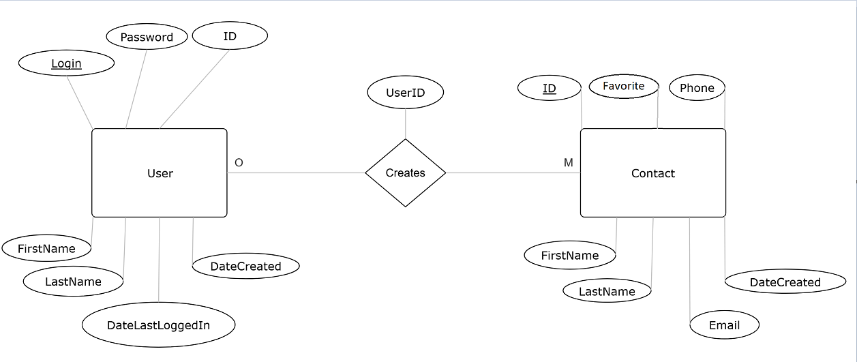
ERD

Slide 7
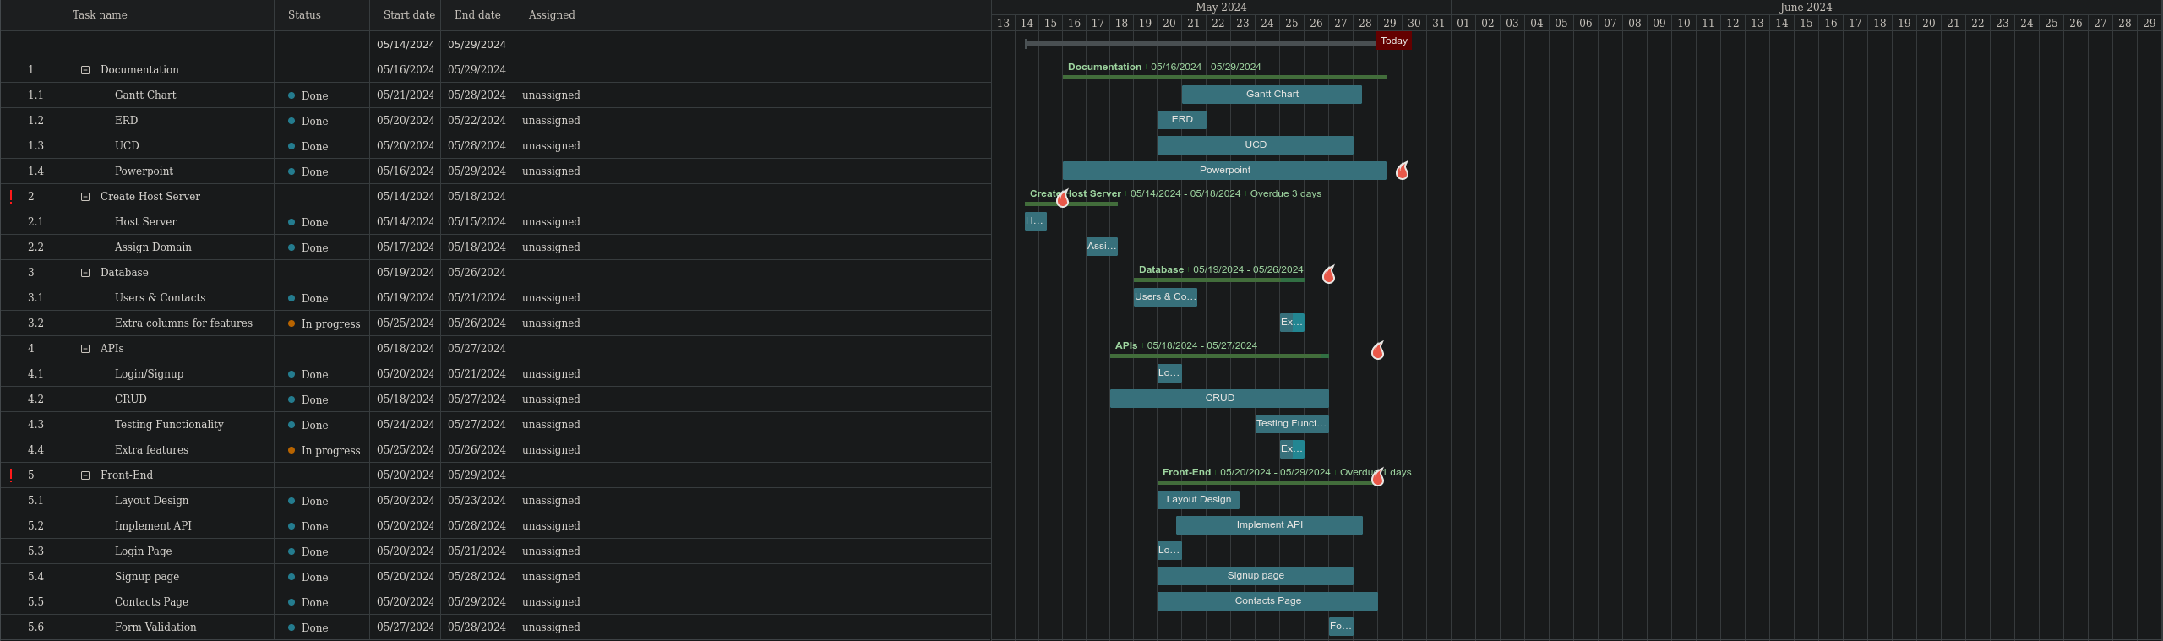
Gantt chart

Slide 8
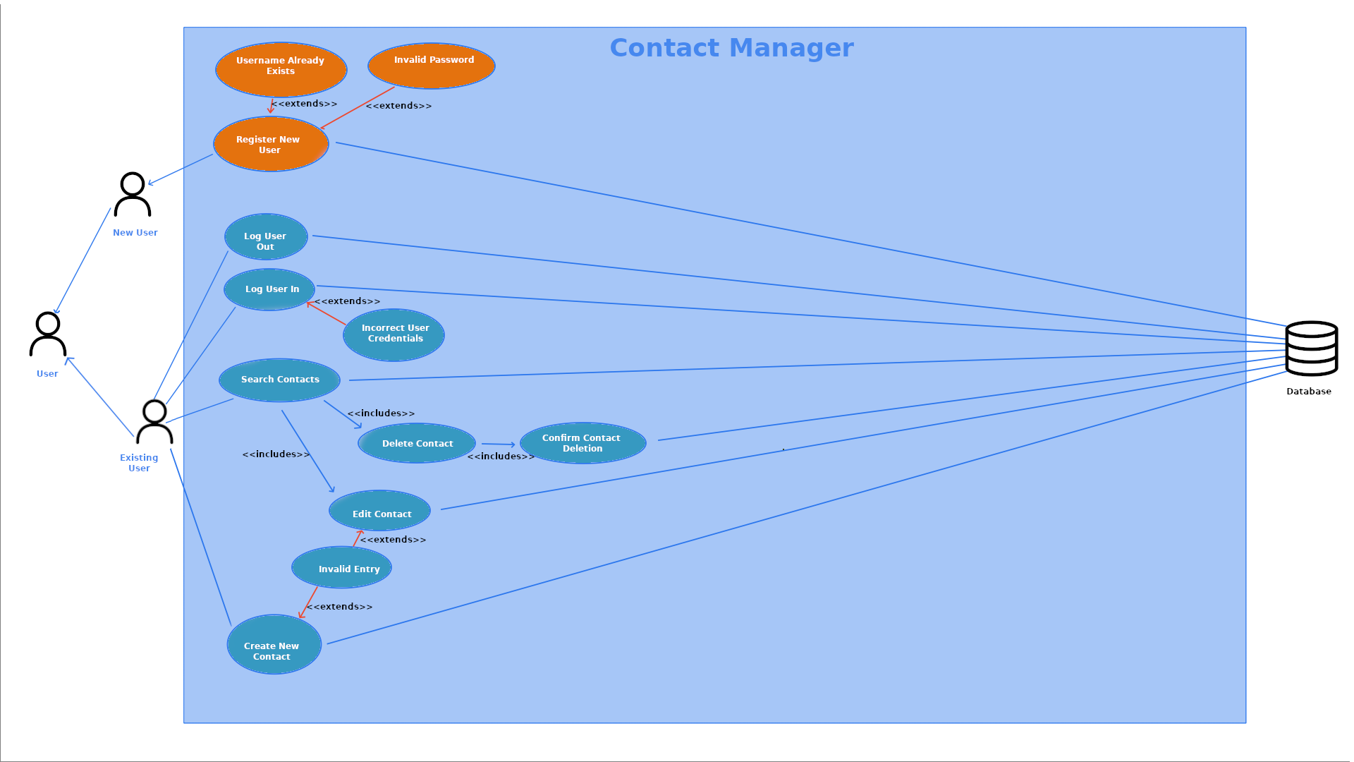
Use Case Diagram

Slide 9
Talk about what did not go well
Front-End?

Slide 10
Talk about what went well
Database
API

Slide 11
API demonstration

Slide 12
App Demonstration

Slide 13
Q&A

