Slide 1

Contacts Connect

Slide 2
A web app to manage your digital contacts
Sign up for a contact manager! (It’s FREE!)
Create, Delete and Edit contacts
Manage your favorite people
Difficulties looking for someone amongst your 6 contacts? Just search them up!

Slide 3
Brought to you by...
Joshua Bartz (Database)
Eugenio Diaz (API)
Joshua Jarquin (PM)
Benjamin Monroy (Front-End)
Gabriel Rechdan (API)
Alejandro Tejeira (Front-End)

Slide 4

Technology Used - Creation
LAMP stack implementation:
Linux:
Hosted on an Ubuntu 22.04 server rented from DigitalOcean.
Apache (HTTP):
An HTTP web server used to deliver web pages across the internet.
MySQL:
The database solution to store/modify/fetch relevant data.
PHP:
The language used to bridge requests to and from the website to the database.

Slide 5



Technology Used - Organization
Github: Repository for source code and documentation.
Discord: Primary platform for communication and exchanges.
Ganttpro: Gantt chart creation tool used to keep track of workflow and timelines.

Slide 6
Other Technologies
Dbeaver
Filezilla
MobaXTerm
Postman
ARC
SwaggerHub
Bootstrap5
DALL-E

Slide 7
What Went Well - PM
Communication was solid
Weekly in-person meetings
Frequent updates about status / problems in Discord
No conflicts between teammates
Workload was split evenly
Quick adoption of languages and technologies

Slide 8
What Didn’t Go Well - PM
Adoption of new languages (PHP, CSS & JS)
(Working in a real team with task-dependencies)?
Scheduling and workflow (late start, slow-start)
Lack of Gantt chart to direct our work

Slide 9
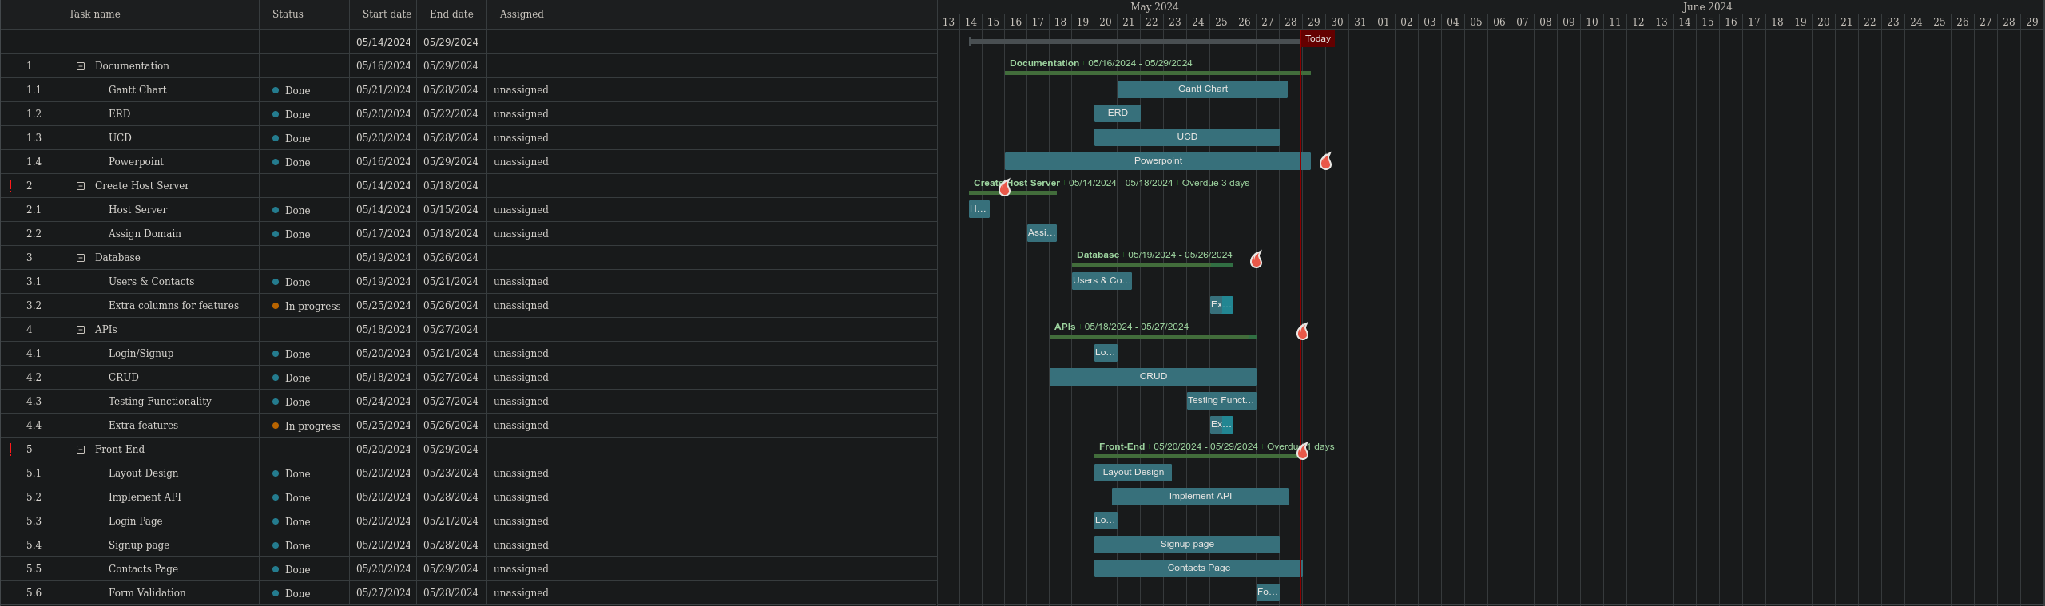
Gantt chart

Slide 10
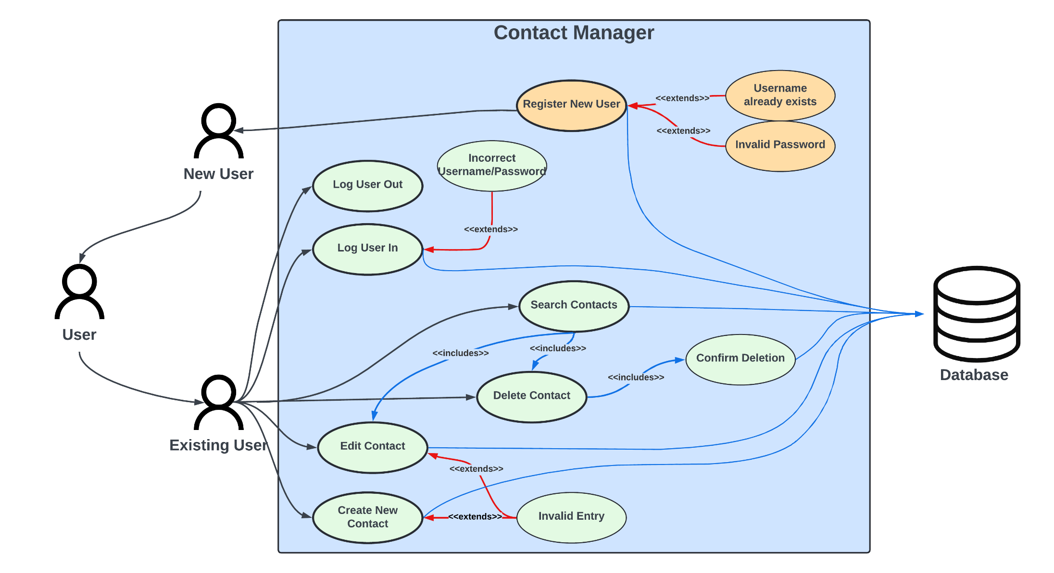
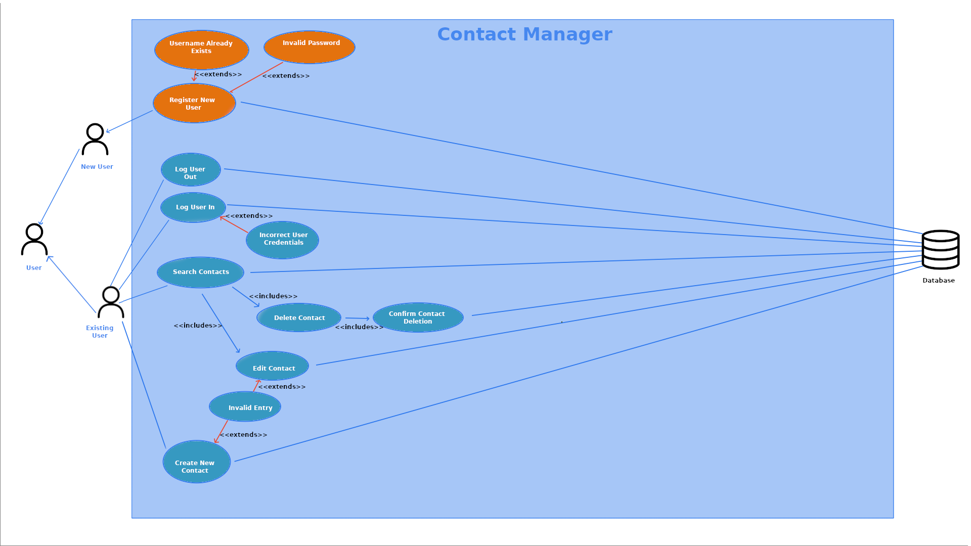
Use Case Diagram

Slide 11
What Went Well - Database
Previous knowledge of SQL
Quick adoption of MySQL syntax
Simple database design was easy to create
Helping the API team with SQL queries

Slide 12
What Didn’t Go Well - Database
Trying to help the other roles with their workload
Not stepping over their work

Slide 13
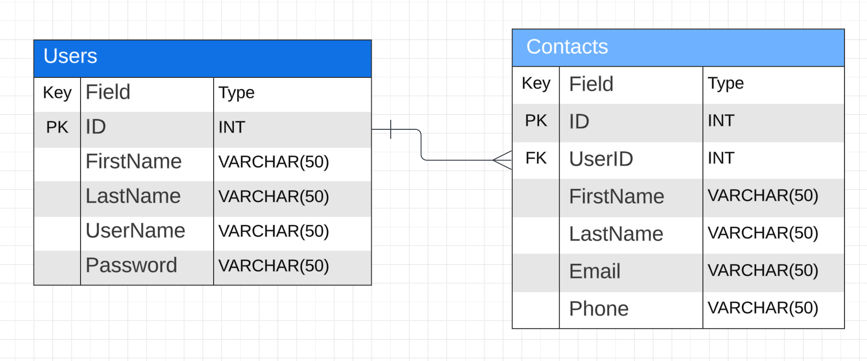
Tabular ERD

Slide 14
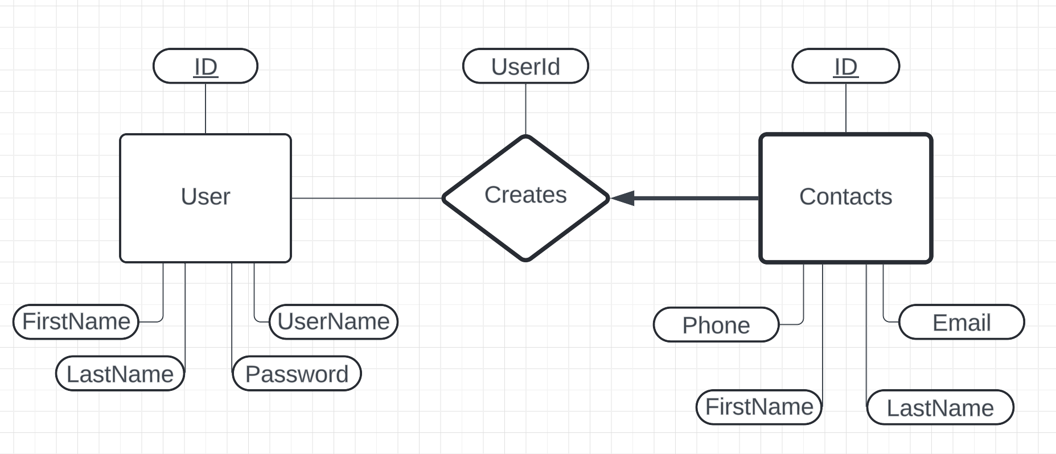
ERD w/ Weak Entity

Slide 15
What Went Well - API
Pieces fell into place after getting an initial understanding
Understanding one endpoint usually led to understanding others
Documentation was simple and functional
Testing phase was short and fixed problems quickly

Slide 16
What Didn’t Go Well - API
PHP read like hieroglyphics as beginners
Getting the initial understanding took time
Variable ordering in MySQL statements caused unjustified struggles
Despite documentation, API functionality was not communicated enough

Slide 17
Color Palette
[INSERT COLORS]

Slide 18
API demonstration
https://app.swaggerhub.com/apis/genomegalul/Contacts/1.0.0

Slide 19
What Went Well – Front End
Online resources for learning html/css
Good collaboration and division of work

Slide 20
What Didn’t Go Well – Front End
Different ways to accomplish same task
Outdated resources
Copying over work when pushing to website
First experience with creative project / frontend

Slide 21

App Demonstration
http://thisisforourclass.xyz/

Slide 22
Accessibility
GOOGLE LIGHTHOUSE

Slide 23
Q&A
?

