Slide 1

Contacts Connect

Slide 2
A web app to manage your digital contacts
Sign up for a contact manager! (It’s FREE!)
Create, Delete and Edit contacts
Manage your favorite people
Difficulties looking for someone amongst your 6 contacts? Just search them up!

Slide 3
Brought to you by...
Joshua Bartz (Database)
Eugenio Diaz (API)
Joshua Jarquin (PM)
Benjamin Monroy (Front-End)
Gabriel Rechdan (API)
Alejandro Tejeira (Front-End)

Slide 4

Technology Used - Creation
LAMP stack implementation:
Linux:
Hosted on an Ubuntu 22.04 server rented from DigitalOcean.
Apache (HTTP):
An HTTP web server used to deliver web pages across the internet.
MySQL:
The database solution to store/modify/fetch relevant data.
PHP:
The language used to bridge requests to and from the website to the database.

Slide 5



Technology Used - Organization
Github: Repository for source code and documentation.
Discord: Primary platform for communication and exchanges.
Ganttpro: Gantt chart creation tool used to keep track of workflow and timelines.

Slide 6
Talk about what did not go well
Adoption of new languages (PHP, CSS & JS)
(Working in a real team with task-dependencies)?
Scheduling and workflow (late start, slow-start)

Slide 7
Talk about what went well
Communication was solid
No conflicts between teammates

Slide 8
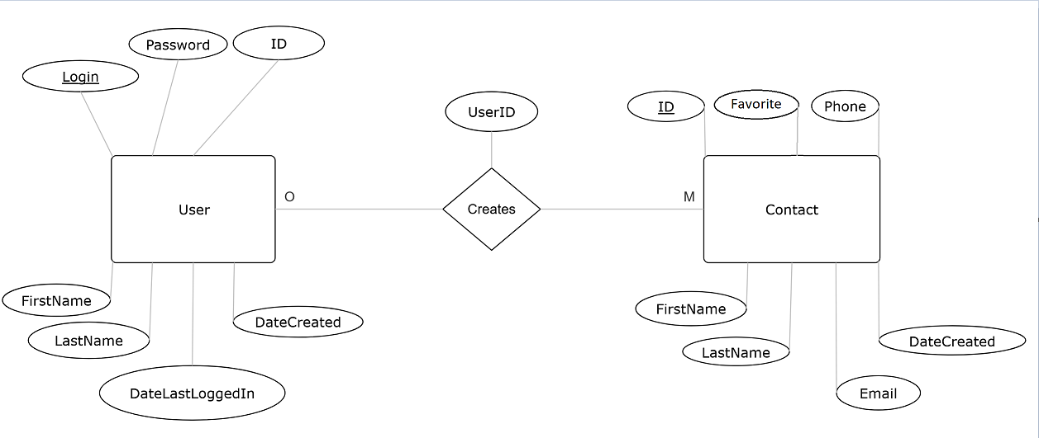
ERD w/ fav

Slide 9
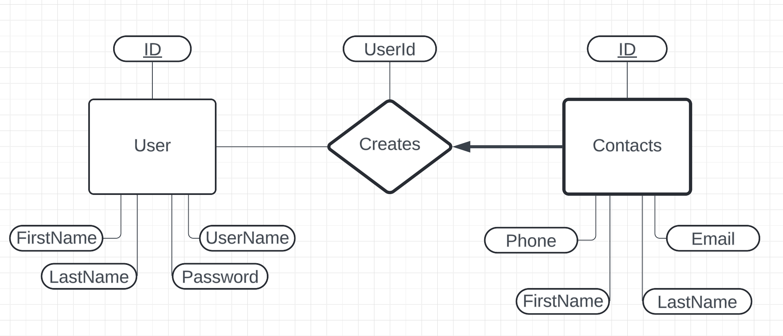
ERD w/o fav

Slide 10
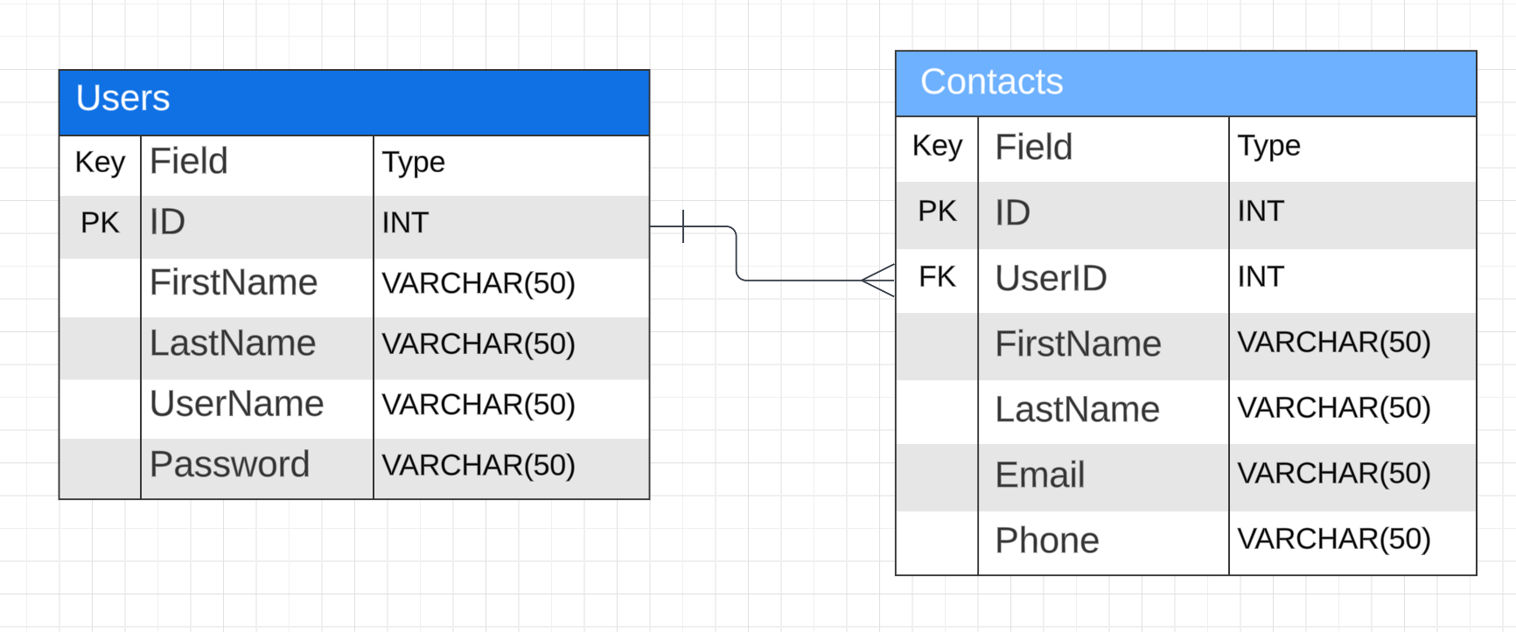
ERD?

Slide 11
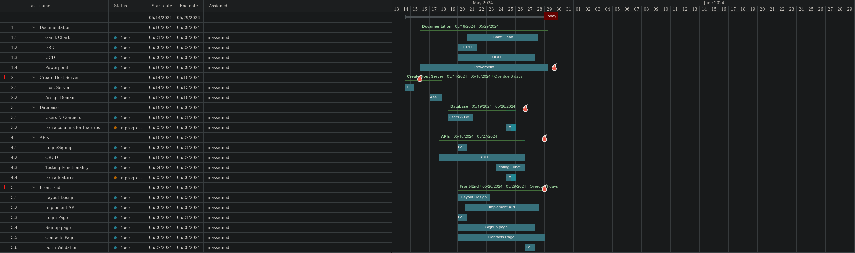
Gantt chart

Slide 12
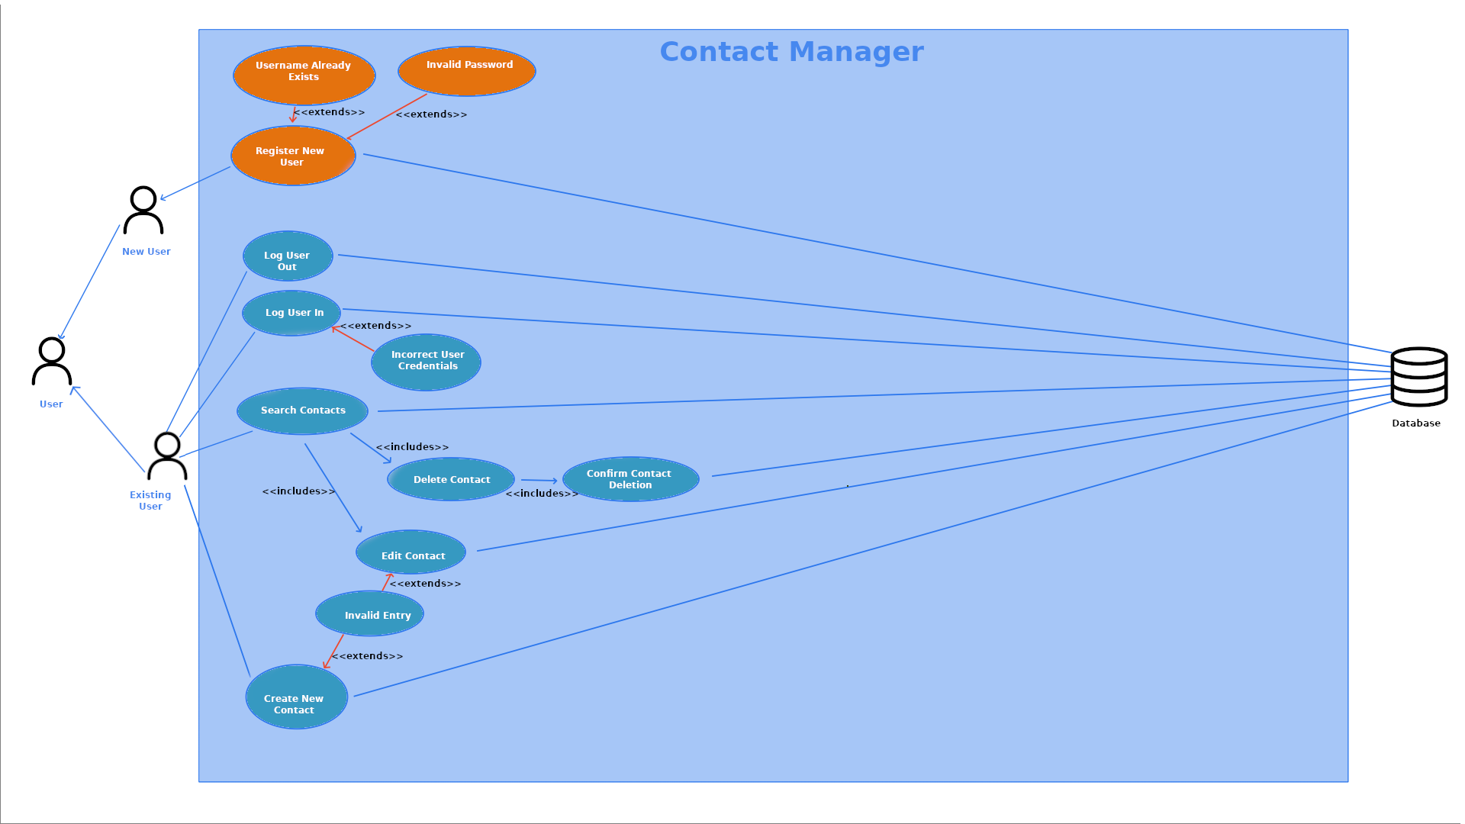
Use Case Diagram

Slide 13
Color Palette
[INSERT COLORS]

Slide 14
API demonstration
[ADD SWAGGERHUB LINK]

Slide 15

App Demonstration
http://thisisforourclass.xyz/

Slide 16
Accessibility
GOOGLE LIGHTHOUSE

Slide 17
Q&A
?

