Slide 1
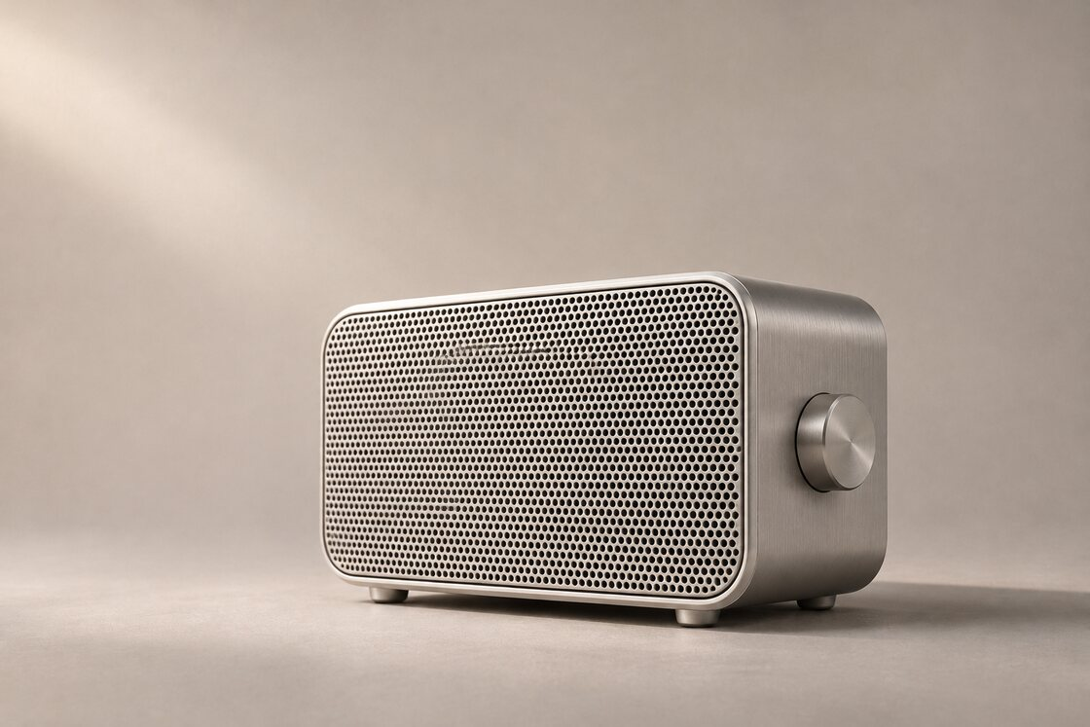
FIELDNOTES AUDIO
Launch briefing
Launch date: Nov 19
Rehearsal date: Nov 12

Slide 2
FIELDNOTES AUDIO
Production notes
Rehearsal date: Nov 12
Venue: North studio

