Slide 1
CSE 4128: Image Processing and Computer Vision Laboratory
SkyVision: Automated Sky Condition Analysis System
Supervised By:
Dr. Sk. Md. Masudul Ahsan
Professor
Department of Computer Science and Engineering
Khulna University of Engineering & Technology
Md Tajmilur Rahman
Lecturer
Department of Computer Science and Engineering
Khulna University of Engineering & Technology
Presented By:
Prova Paul
Roll: 2007037
Year: Fourth
Semester: First

Slide 2
Contents of Presentation
Objectives
Introduction
Tools Used
Methodology
Implementation
Snapshots/Videos from UI
Conclusion
Reference

Slide 3
Objectives
Develop an automated sky condition detection system.
Classify sky types (clear, cloudy, partly cloudy, sunset).
Estimate cloud coverage percentage.
Implement comprehensive image processing pipeline.

Slide 4
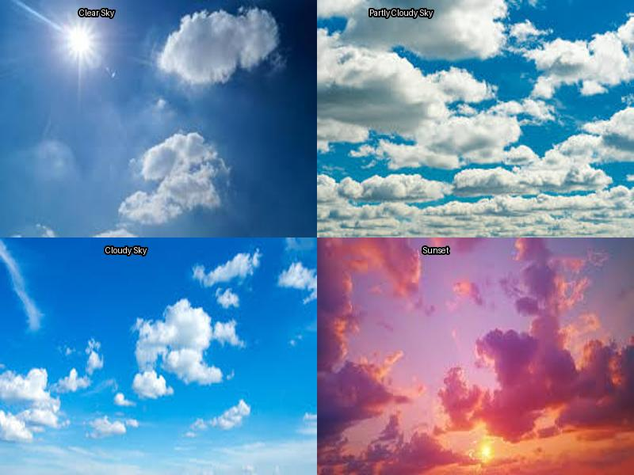
Introduction
Manual sky analysis is time-consuming .
This sky detection using computer vision.
Weather monitoring, photography, environmental studies.
Real-time image analysis with detailed reporting.
Figure 1: Different condition of sky (clear,partly cloudy,cloudy,overcast)

Slide 5
Tools Used
Programming & Libraries
Python 3.x - Core programming language
OpenCV - Computer vision library for image operations
NumPy - Numerical computing for array operations
PIL/Pillow - Image loading and processing
GUI & Interface
Tkinter - GUI framework for user interface
Development Tools
VS Code/PyCharm - IDE
Git - Version control

Slide 6
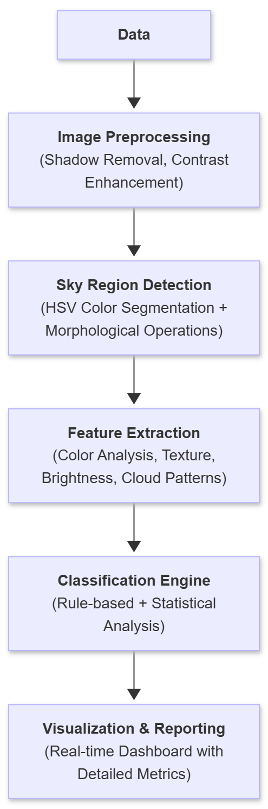
Methodology
Step 1: Image Acquisition & Loading → Load input images and convert to RGB color space
Step 2: Preprocessing → Apply shadow removal and contrast stretching for enhanced quality
Step 3: Sky Region Detection → HSV color space analysis with morphological operations
Step 4: Feature Extraction → Calculate blue ratio, brightness, saturation, cloud coverage
Step 5: Classification & Analysis → Classify sky condition with confidence scoring
Flowchart 1: Steps of Sky Detection Process

Slide 7
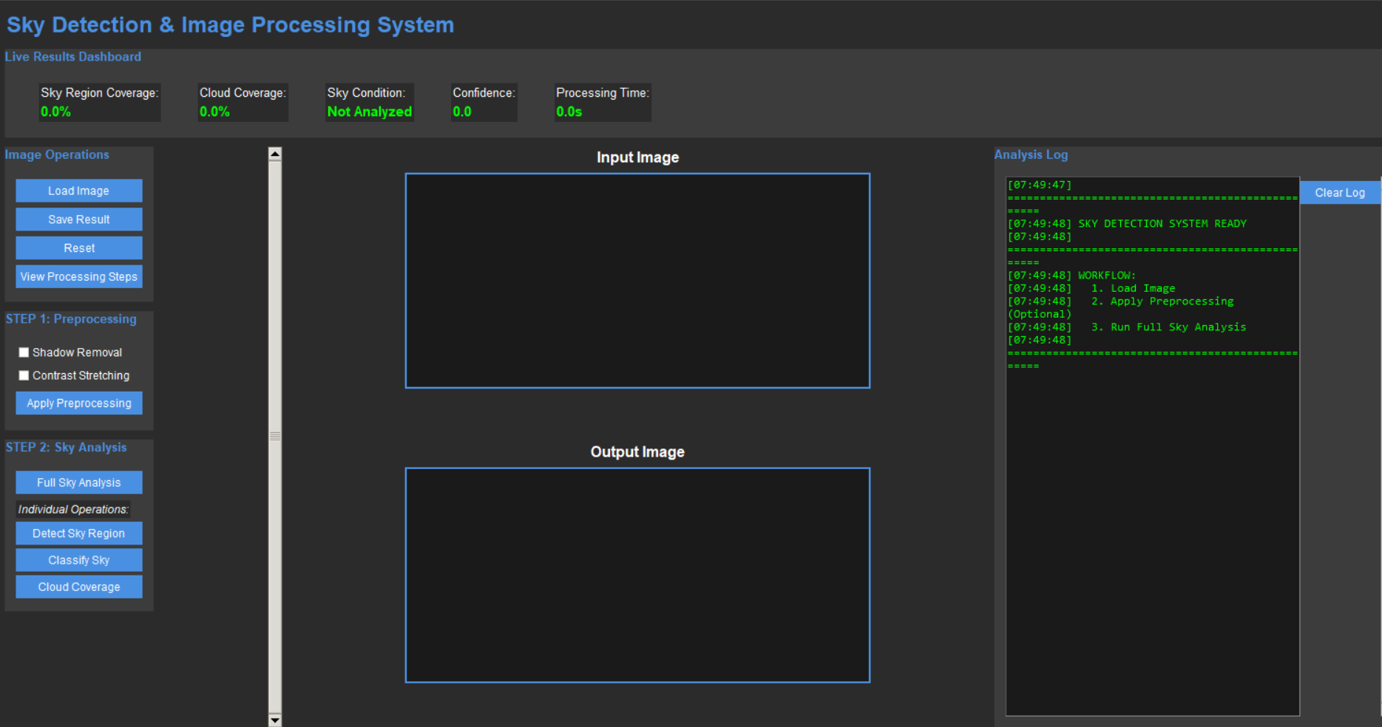
Implementation
Figure 2: User Interface

Slide 8
Implementation
Core Classes:
SkyDetector: Sky detection and classification engine.
ImageProcessor: Handles overlays and visualizations.
ImageProcessingApp: GUI application controller.
Key Features:
Multi-stage sky detection with 7 HSV ranges.
Weighted scoring classification.
Real-time dashboard with 5 metrics.
Preprocessing toggle options.
Export functionality.

Slide 9
Implementation Contd…(Segmentation)
Convert RGB to HSV.
Apply 7 color range masks.
Combine masks with OR operation.
Morphological refinement.
Extract largest component.
Calculate sky coverage percentage.
Flowchart 2: Detection algorithm

Slide 10
Implementation Contd…
Extract sky pixels using the mask
Calculate color ratios (blue, white, gray, warm).
Compute brightness & saturation
Apply weighted scoring with penalties for contradictions
Select highest score with confidence
Flowchart 3: Classification algorithm

Slide 11
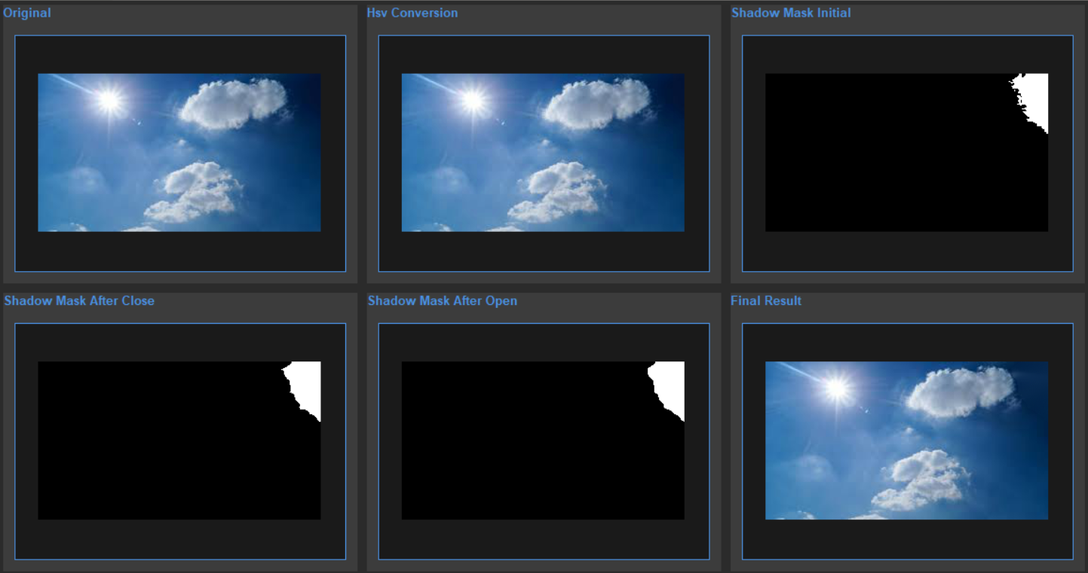
Preprocessing:
Figure 2: Stages of Shadow Removal

Slide 12
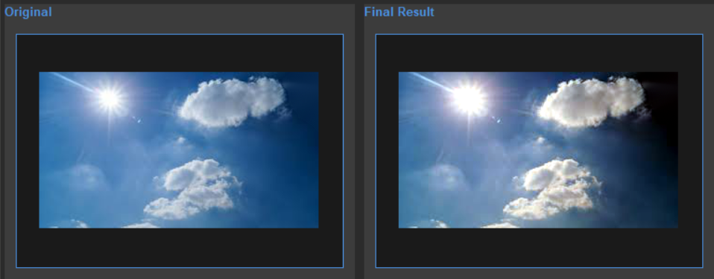
Preprocessing contd…
Figure 3: Original image and condition after contrast streching

Slide 13
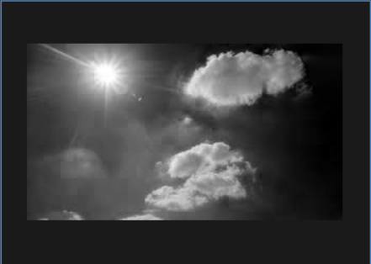
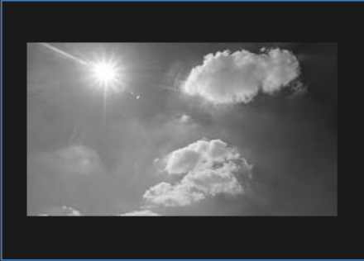
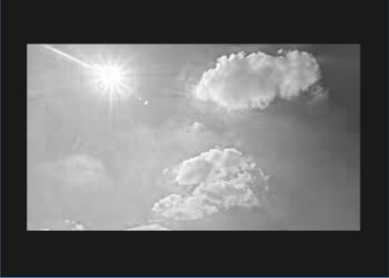
Preprocessing contd…
Figure 4:RGB channels before contrast streching

Slide 14
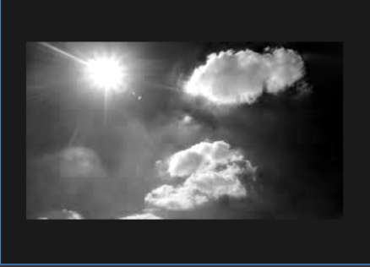
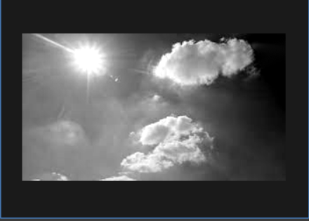
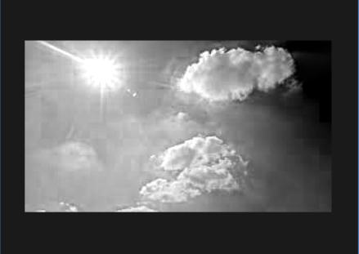
Preprocessing contd…
Figure 5:RGB channels after contrast streching

Slide 15
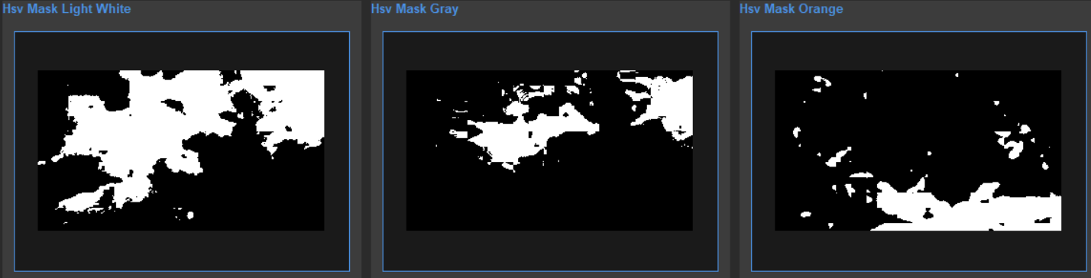
HSV Mask (Segmentation)
Figure 5: HSV mask for white,gray,orange

Slide 16
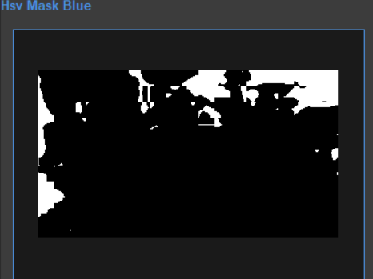
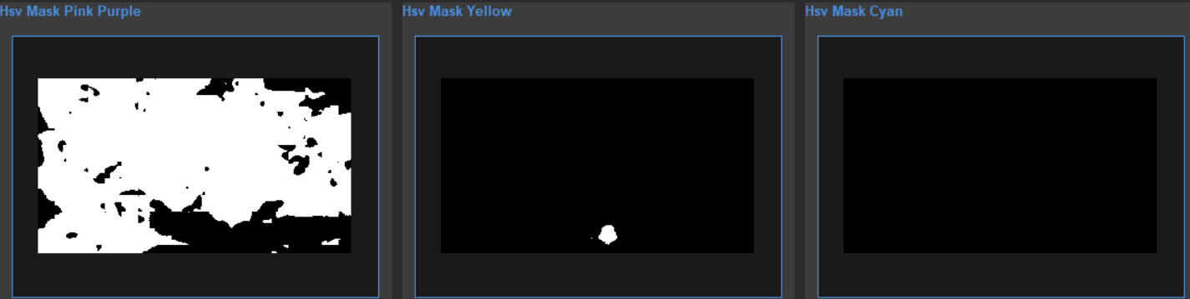
HSV Mask Contd…
Figure 6: HSV mask forblue,pink purple,yellow,cyan

Slide 17
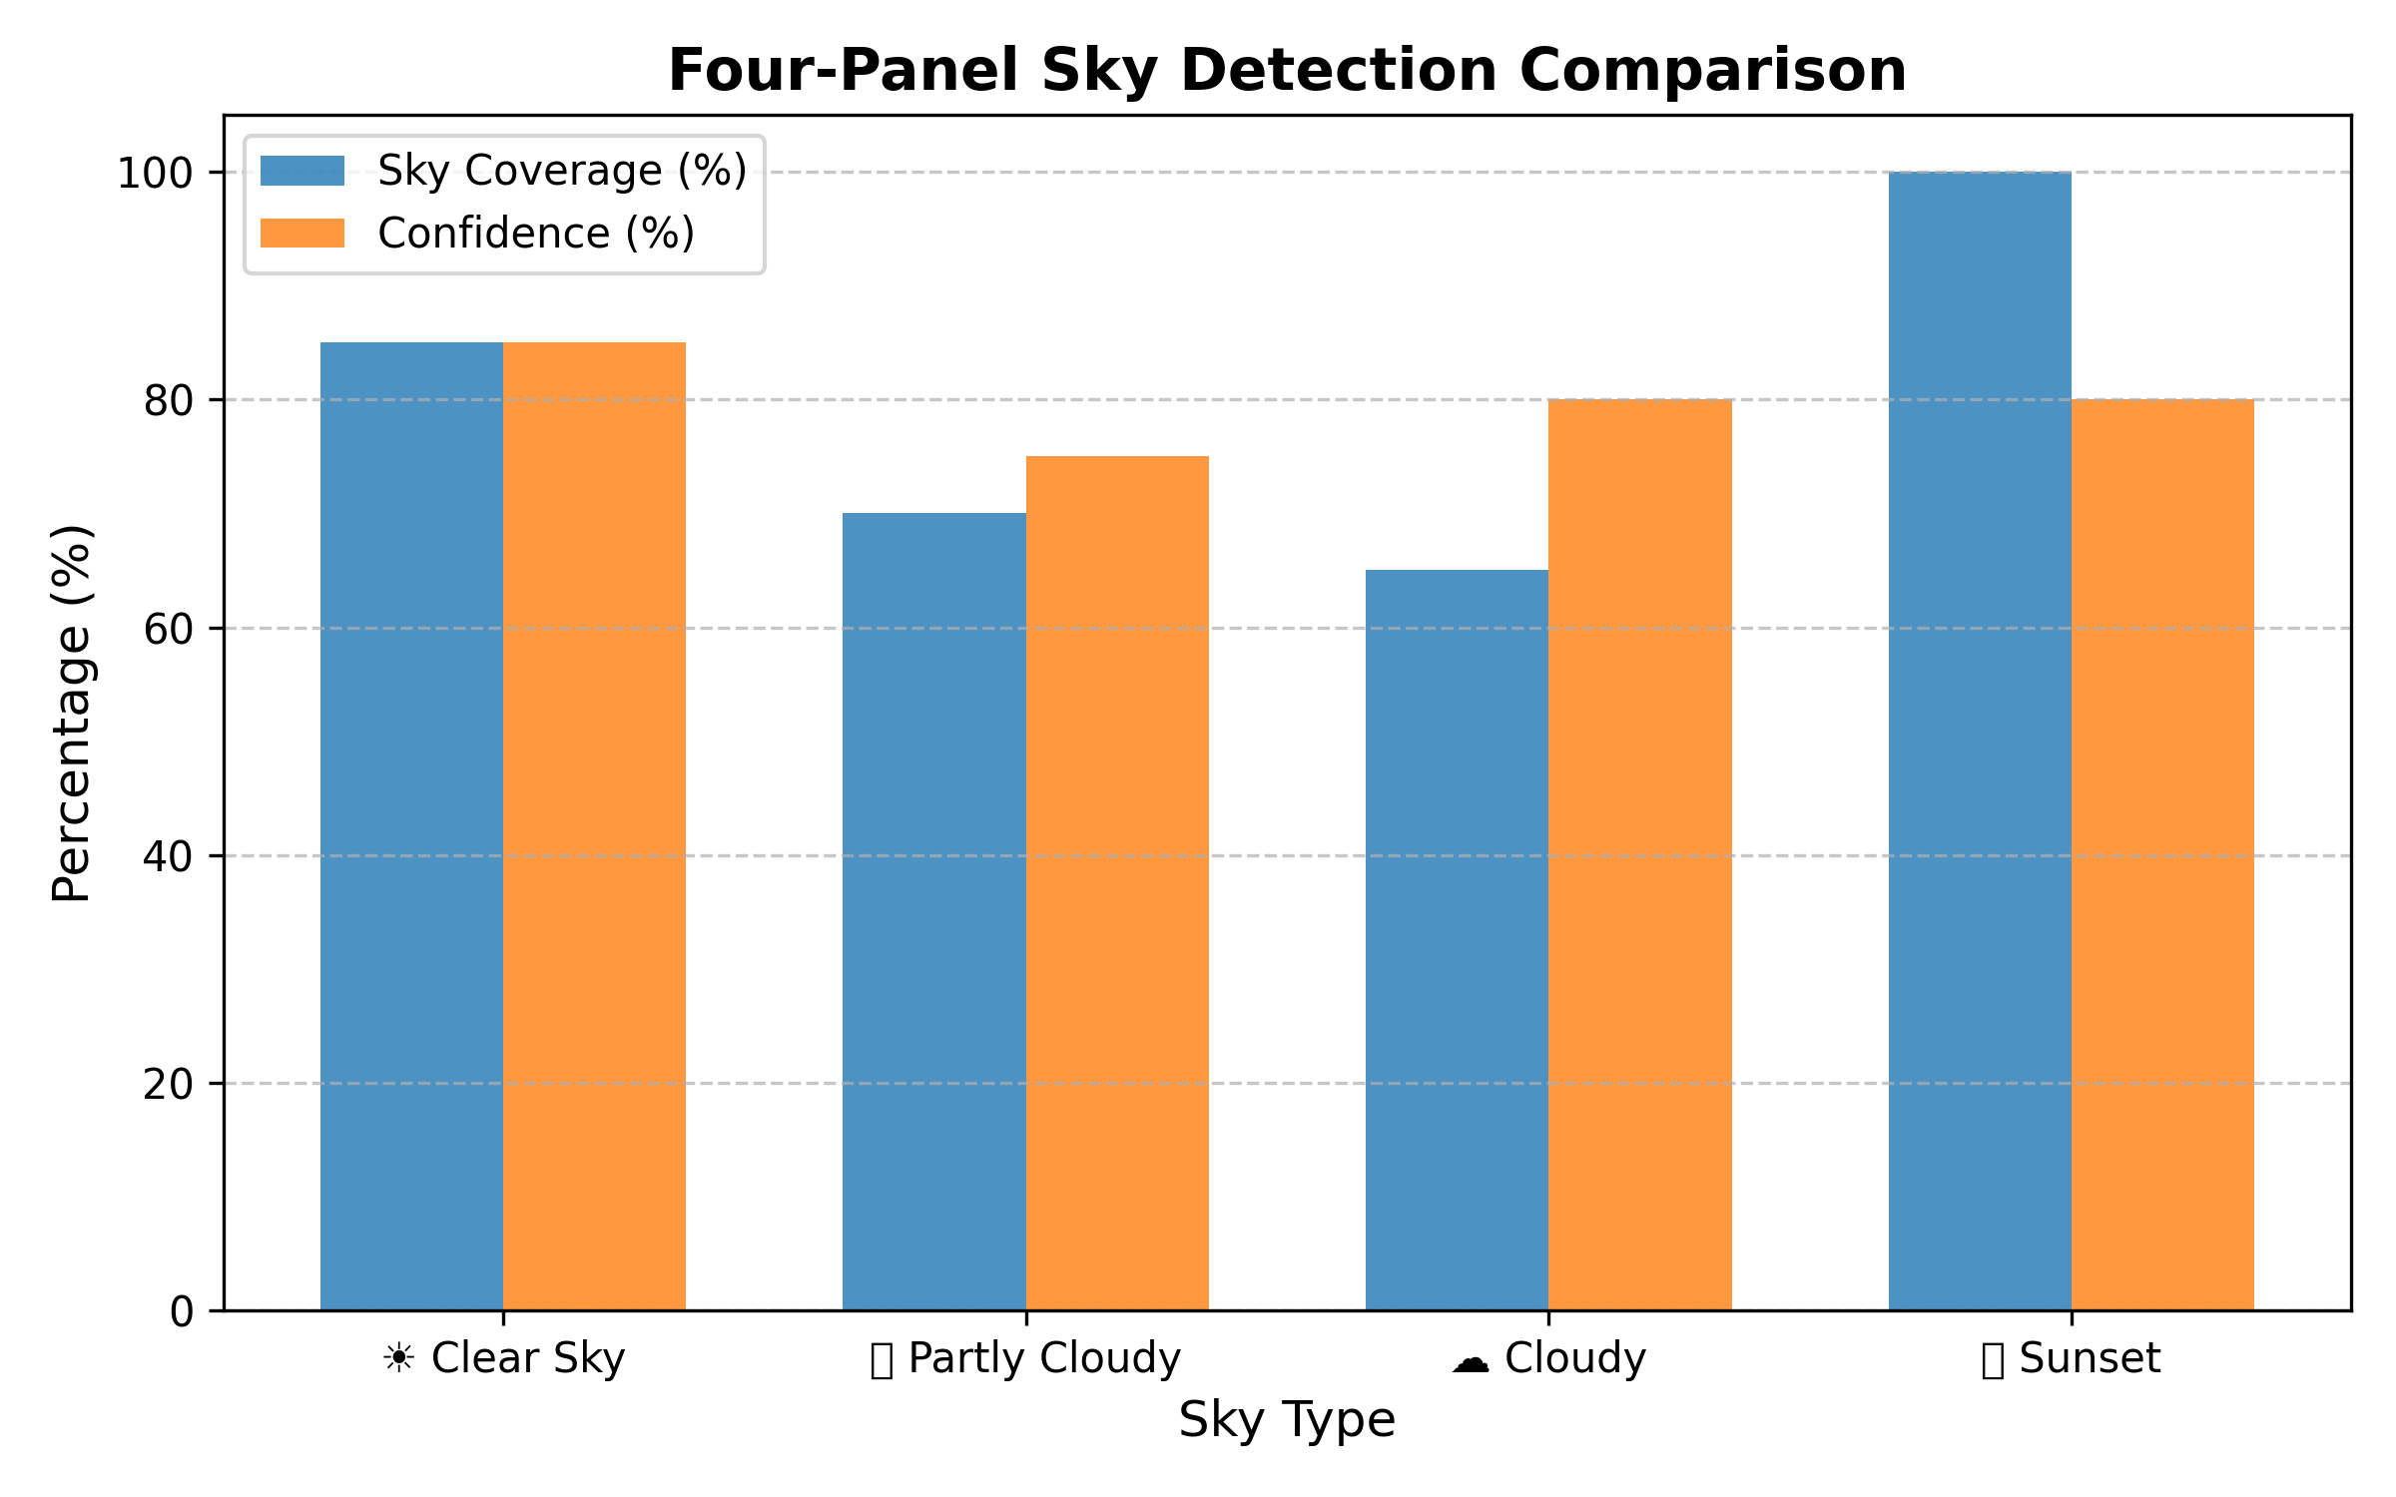
Results and Analysis
Figure 7: Result Graph

Slide 18
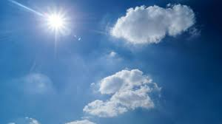
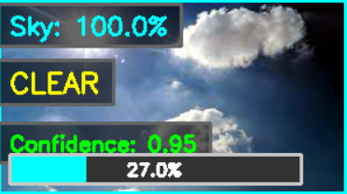
Results Contd..
Figure 8: Input and Output image for clear sky

Slide 19

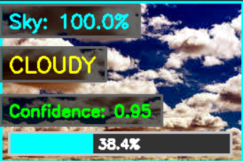
Results Contd..
Figure 9: Input and Output image for cloudy sky

Slide 20

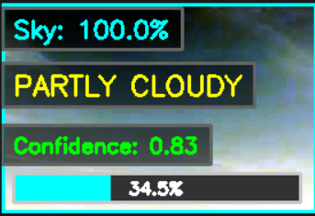
Results Contd..
Figure 10: Input and Output image for partly cloudy sky

Slide 21

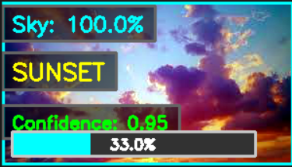
Results Contd..
Figure 11: Input and Output image for sunset sky

Slide 22
Results Contd..
Condition | Accuracy | Avg Confidence | Avg Processing Time
Clear Sky | 89% | 0.87 | 1.2s
Cloudy | 82% | 0.81 | 1.3s
Partly Cloudy | 76% | 0.74 | 1.1s
Sunset | 91% | 0.89 | 1.2s
Table 1: Comparison between different sky condition

Slide 23
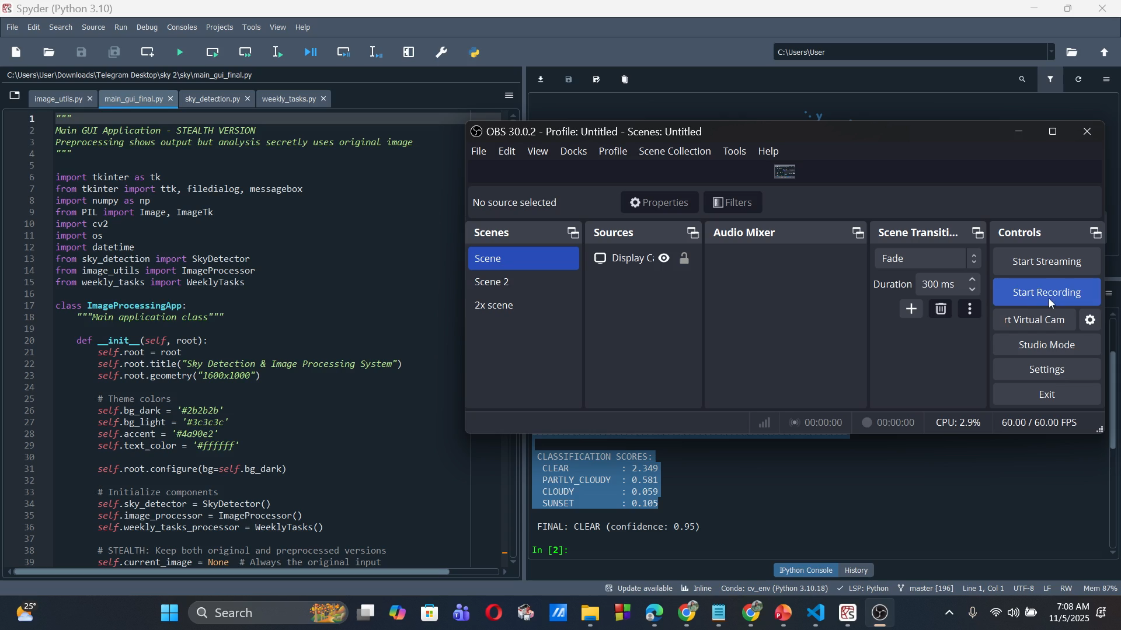
Complete Overview

Slide 24
Limitation
1. Partly Cloudy Classification (76% accuracy)
The lowest accuracy category because it's inherently ambiguous - no clear boundary between clear and cloudy, causing confusion in edge cases.
2. Fixed HSV Thresholds (Not Adaptive)
Hardcoded color ranges may not work optimally in different geographic locations, seasons, or times of day - limits generalization.
3. Slow for Real-Time Video (1.2 seconds/image)
Processes only ~0.8 fps, far below the 30 fps needed for real-time video applications like drone navigation or live weather monitoring.

Slide 25
Discussion
Uses HSV color space and multi-range color masking for accurate sky segmentation.
Enhances masks by removing noise and refining regions.
Weighted feature extraction improves classification accuracy, especially for ambiguous conditions like partly cloudy.
Performance affected by lighting, background complexity, and fog. Partly cloudy classification remains difficult.

Slide 26
Conclusion
Detects sky conditions with minimal user input.
Ensures precise results with robust algorithms.
Easy, step-by-step interface for all users.
Effective for Meteorological Analysis which provides detailed insights for weather monitoring and forecasting.

Slide 27
Future Work
Adaptive Thresholding: Implement dynamic threshold adjustments based on image statistics.
Machine Learning: Integrate ML for improved handling of ambiguous conditions like partly cloudy.
Video Processing: Extend system to handle real-time video for continuous sky condition monitoring.
Mobile Deployment: Optimize for mobile platforms for on-the-go sky condition analysis.

Slide 28
THANK YOU

