Slide 1


Using JavaScript in our models
Notes:
Hello. In this video, we will discuss how JavaScript is part of the Provengo’s modelling language and show how it can be used in this context.

Slide 2
bthread("A sequence", function () {
sync({ request: Event("A") })
sync({ request: Event("A") })
sync({ request: Event("A") })
})
bthread("B sequence", function () {
sync({ request: Event("B") })
sync({ request: Event("B") })
sync({ request: Event("B") })
})
bthread("C sequence ", function () {
sync({ request: Event("C") })
sync({ request: Event("C") })
sync({ request: Event("C") })
})
Same, same, but parametrized
const events = [Event("A"), Event(“B"), Event(“C")]
const LENGTH = 3
events.forEach(function (e) {
bthread(e.name + " sequence", function () {
for (var i = 0; i < LENGTH; i++) {
sync({ request: e })
}
})
})
Notes:
Our modeling language, embedded within JavaScript, allows us to leverage all the language features for parametrizing our b-threads. In this example, we’ve parametrized both the set of events and the length of each subsequence. Instead of repeating the creation of the b-threads for each event ‘A,’ ‘B,’ and ‘C,’ we use a loop over the set of events and create the b-thread inside this loop. Additionally, instead of repeating the line that requests three times, we use another loop to repeat this line. The number of repetitions is now specified using the LENGTH parameter.

Slide 3
bthread("Don't allow two consecutive events of the same type", function () {
last = Event(undefined)
while (true) {
last = sync({ block: last, waitFor: events })
}
})
Notes:
JavaScript can also be used to design more powerful b-threads. To allow flexibility, the sync function allows one to request, wait-for, or block a list of events. Additionally, the function returns the event that has been chosen. The demonstrated code utilizes these features to ensure that the same event cannot be selected consecutively. This is achieved by maintaining a variable named ‘last,’ which stores the most recently triggered event, initially undefined, used to block an immediate repetition of the previous event.

Slide 4
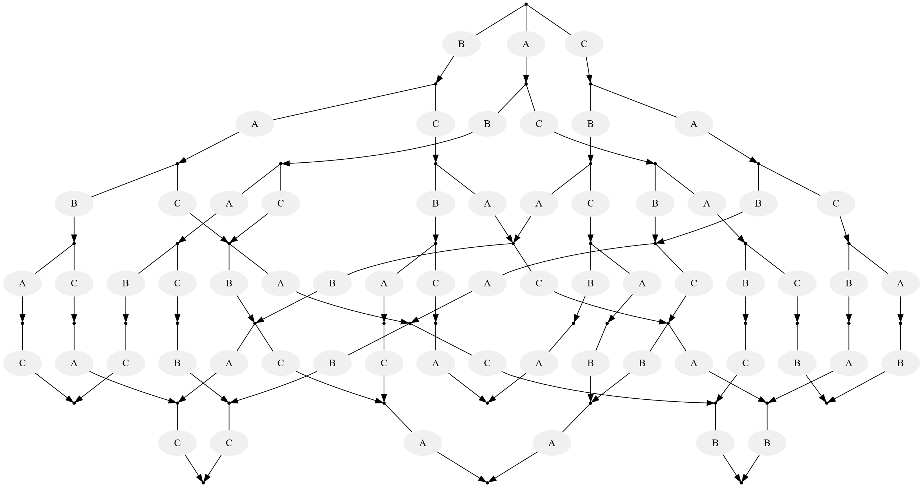
const events = [Event("A"), Event(“B"), Event(“C")]
const LENGTH = 2
events.forEach(function (e) {
bthread(e.name + " sequence", function () {
for (var i = 0; i < LENGTH; i++) {
sync({ request: e })
}
})
})
bthread(“No stuttering", function () {
last = Event(undefined)
while (true) {
last = sync({ block: last, waitFor: events })
}
})
Notes:
When these four b-threads are executed concurrently, the resulting diagram is as depicted. This diagram illustrates all possible sequences that comprise two ‘A’ events, two ‘B’ events, and two ‘C’ events where no two consecutive events are of the same type.

Slide 5
bthread("Don't allow three consecutive events of the same type", function () {
[beforeLast, last] = [Event(undefined), Event(undefined)]
while (true) {
[beforeLast, last] =
[
last,
sync({
block: last.name == beforeLast.name ? last : [],
waitFor: [Event("A"), Event("B"), Event("C")]
})
]
}
});

Slide 6
Notes:
This concludes our lesson. We have learned how javascript can be used in Provengo’s models.

