Slide 1

IILM UNIVERSITY
Greater Noida, Uttar Pradesh
Sales & Outreach Internship
Internship Selection & Engagement Report — Pawzz Foundation
Student Name
Nehal Alam
Enrollment Number
25SCS1003003788
Program & Semester
B.Tech CSE (AI & ML)
Organization
Pawzz Foundation

Slide 2
About the Organization — Pawzz Foundation
Pawzz Foundation is an animal welfare organization based in Gurgaon, India.
It runs an online platform that connects animal lovers, pet parents, veterinary clinics, and NGOs — enabling people to volunteer, adopt, fund campaigns, and share rescue stories.
SECTOR
Animal Welfare
& Pet-Tech Platform
Mission: balancing the human–animal ecosystem across India
Builds a verified network of clinics, NGOs, and pet businesses
Engages pet parents and supporters through digital outreach
Offers remote, outreach-driven internship roles via Internshala
LOCATION
Gurgaon, Haryana, India
ROLE OFFERED
Sales and Outreach (S&O) Intern
MODE
Remote / Virtual
IILM University | Sales & Outreach Internship
2

Slide 3
Scope of the Sales & Outreach Role
As described in the internship listing, the Sales & Outreach role at Pawzz is typically centered on the following responsibilities:
1
2
3
4
Partner Outreach
Community Engagement
Research & Records
Relationship Building
Reach out to veterinary clinics, pet businesses, NGOs, and rescuers to introduce Pawzz and onboard them onto its verified network.
Connect with pet parents through social media and outbound outreach to understand needs and generate interest.
Support market research, build contact databases, and maintain records as per internal processes.
Follow up with leads, gather feedback, and support business development efforts to expand reach.
IILM University | Sales & Outreach Internship
3

Slide 4
My Engagement with Pawzz
Note: This internship was completed at a light, correspondence level rather than as a full structured project. The account below reflects only the actual activity undertaken.
Selection
Selected for the Sales and Outreach (S&O) internship at Pawzz through Internshala; Certificate of Selection issued on October 9, 2025.
Outreach Emails
Sent emails to the Pawzz team to establish contact virtually regarding the internship.
Correspondence
Received multiple replies from the organization in response to the outreach emails.
Scope Completed
Engagement was limited to this virtual correspondence; no further structured tasks, targets, or deliverables were undertaken beyond this stage.
IILM University | Sales & Outreach Internship
4

Slide 5
Key Takeaways
1
Professional Communication
2
Understanding Outreach Roles
Practiced drafting and sending formal outreach emails to an organization.
Gained a clearer picture of what a Sales & Outreach internship in a mission-driven organization involves.
3
Organizational Awareness
4
Scope for Growth
Learned about Pawzz's mission and its model of connecting pet parents, clinics, and NGOs.
Identified that completing the full task list would have required sustained follow-through beyond initial correspondence.
IILM University | Sales & Outreach Internship
5

Slide 6
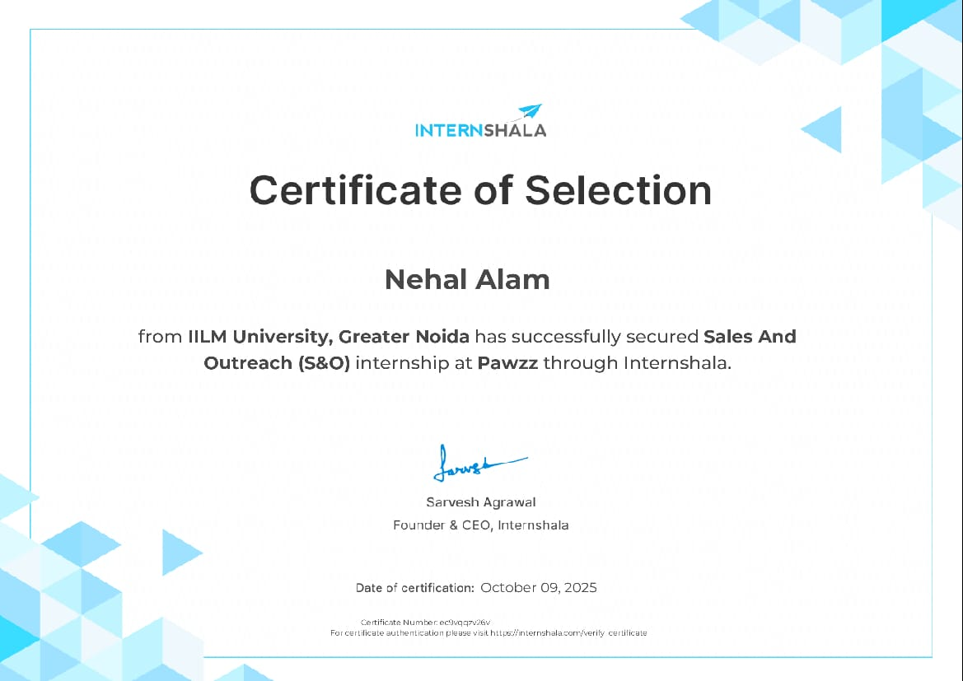
Certificate of Selection
IILM University | Sales & Outreach Internship
6

Slide 7
Conclusion
Being selected for the Sales & Outreach internship at Pawzz Foundation offered an initial, real point of contact with a mission-driven organization.
While engagement stayed at the level of outreach correspondence rather than a completed project, it provided a genuine, if limited, first exposure to professional communication and the outreach-based work such organizations run on.
Thank You

