Slide 1
Product Characteristics
(KPC’s & QCI’s)
(CTIS Course Code #26812)
Feb 28, 2006

Slide 2
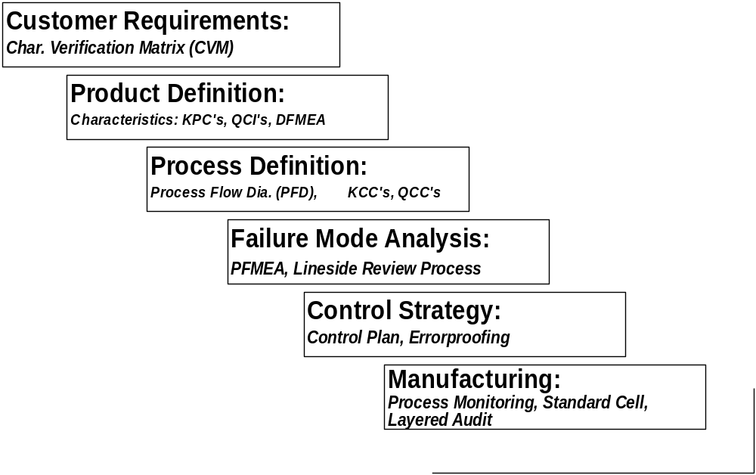
Characteristics Deployment

Slide 3
Critical Few
Focus is on identifying the critical few.
All characteristics are important and must be to print
Some are more important than others and warrant more attention
A
H
G
G
D
E
D
B
E
B
I
F
I
C
C
F
Non-Critical Many
All products and processes
Critical Few
Graphic from GM Scope Material

Slide 4

Commutate Loud and Clear
document and communicate
Size and Location VERY Critical
Supplier’s and manufacturing can’t read your mind
Distance VERY Critical
Location Important
Graphic from GM Scope Material

Slide 5
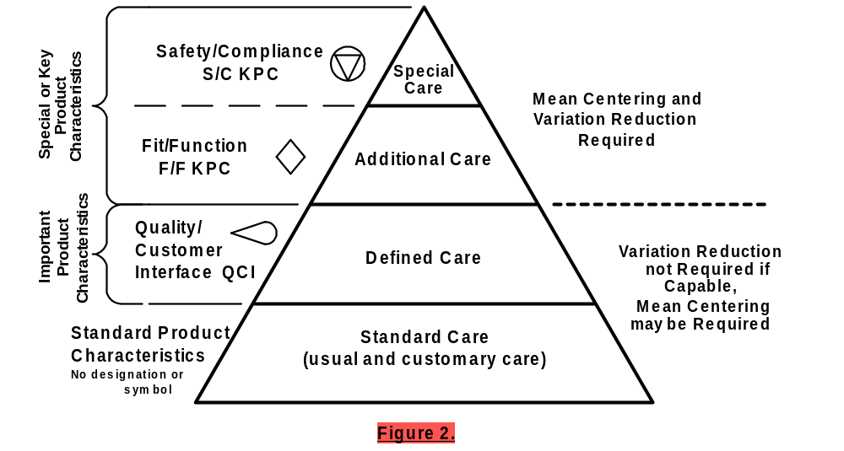
Product Characteristics
Reference D.P. 272

Slide 6
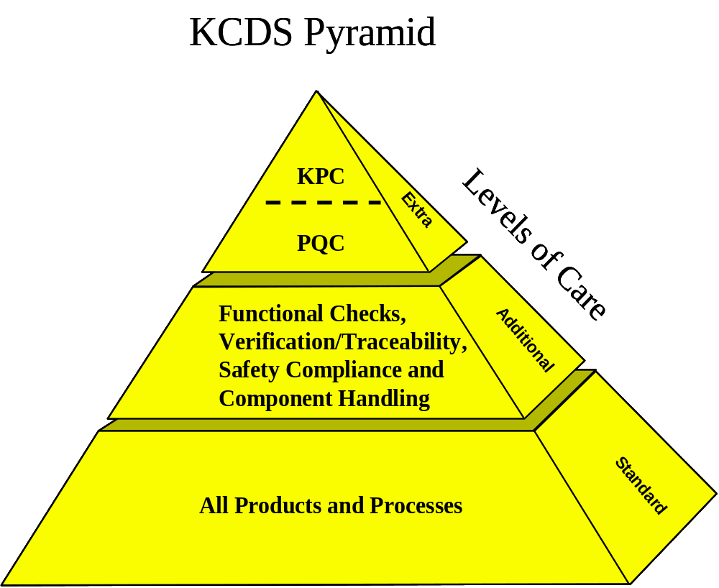
GM Product Quality Characteristic
Graphic from GM Scope Material

Slide 7
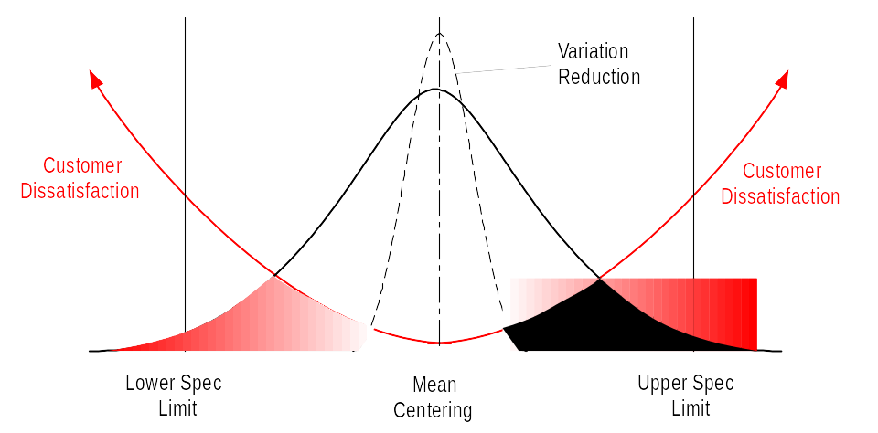
Key Product Characteristic (KPC)
A Key Product Characteristic (KPC) is a product characteristic for which reasonably anticipated variation significantly affects (a) the product’s safety or compliance with governmental standards or regulations, or (b) customer satisfaction.
  Designating Special/Important Characteristics (DP 272)

Slide 8
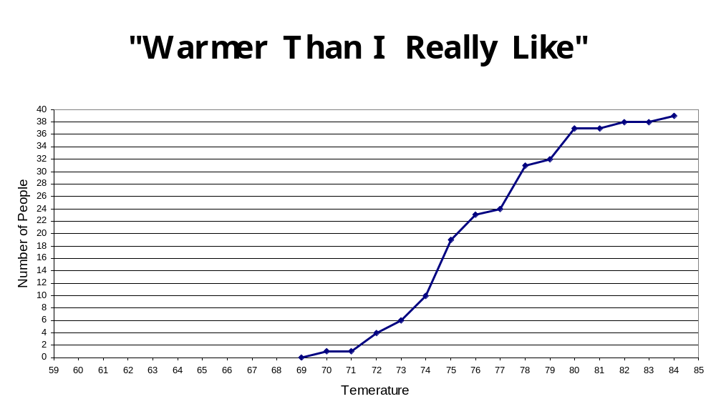
Loss Function

Slide 9
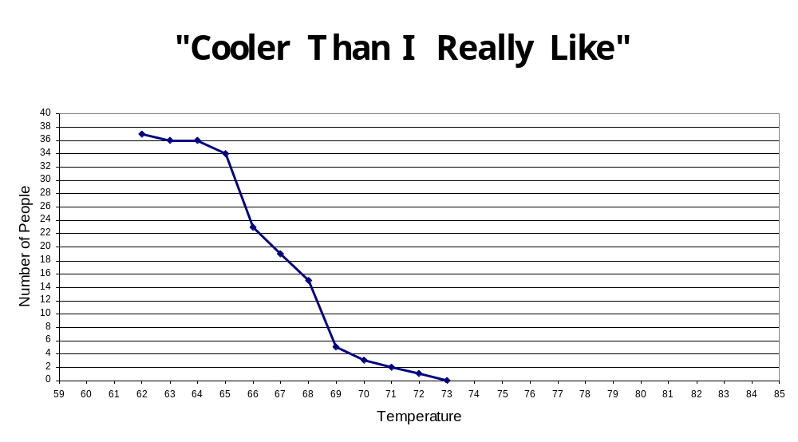
Loss Function

Slide 10
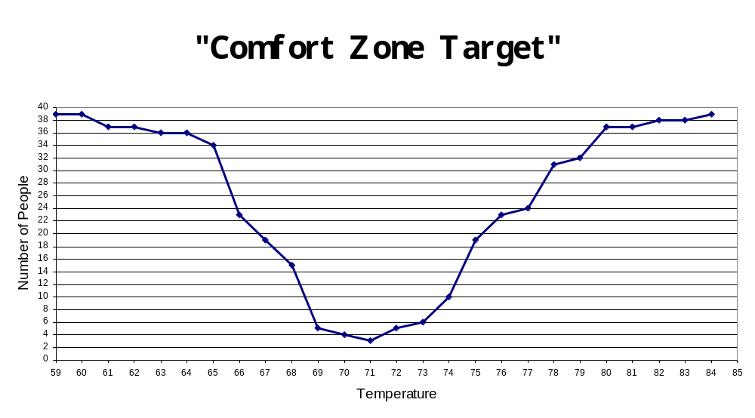
Loss Function

Slide 11
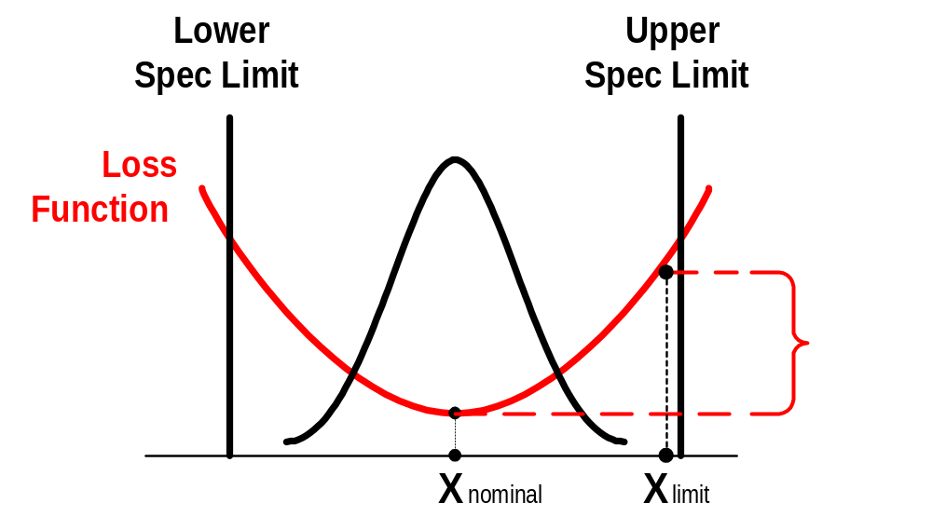
KPC Question
Is there a significant difference in loss between a perfect part and one that is near the spec limit?
  How does the customer perceive the loss?

Slide 12
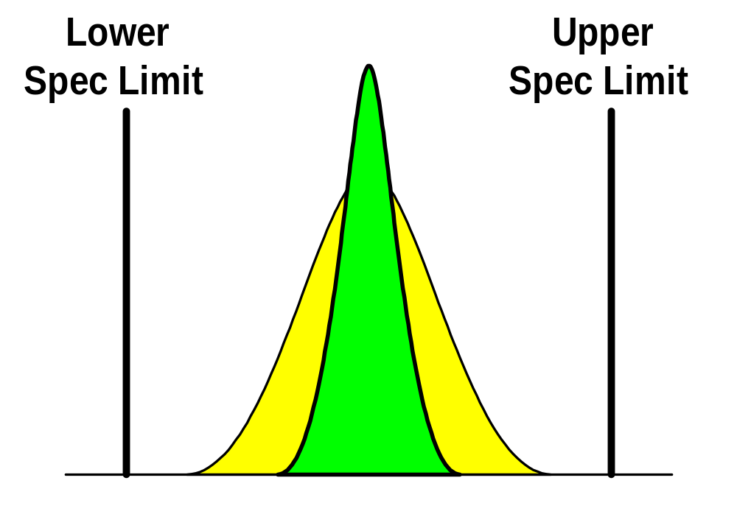
KPC Question
Does reducing variation and thereby improving process capability give Delphi a significant competitive advantage?
  Variation reduction should always be a goal, but other factors need to be taken into consideration.
  There becomes a point of diminishing return.
    Time, people, $

Slide 13
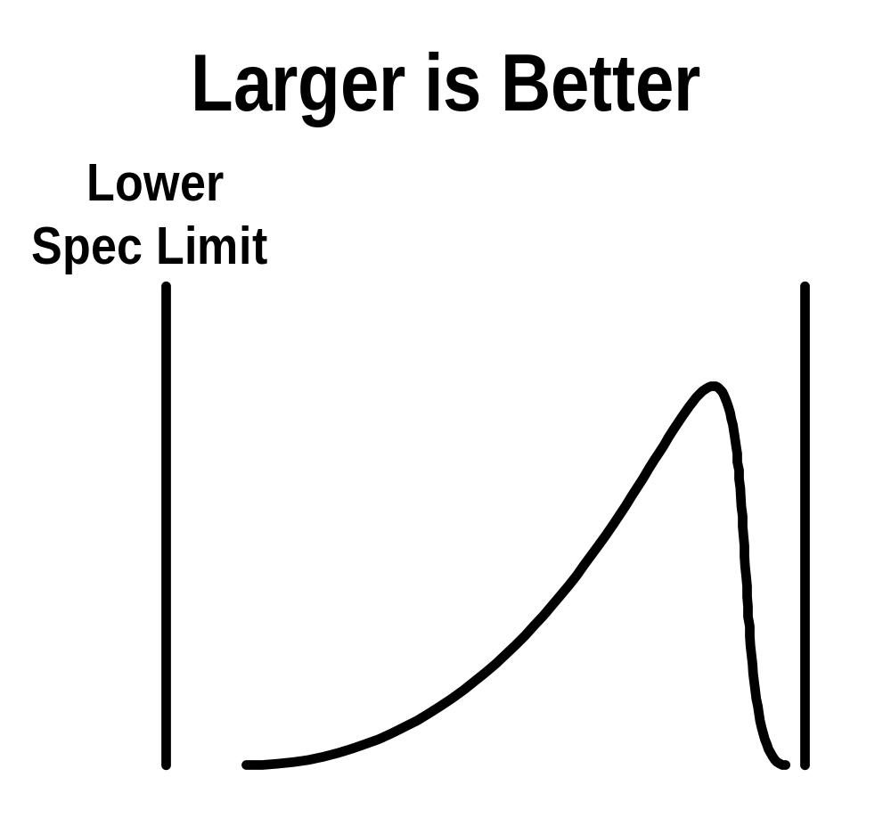
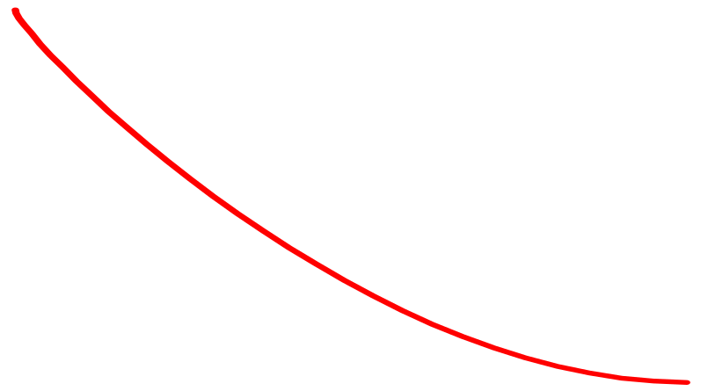
Product Characteristics
Examples:
  Light Density in Lumens/cm²
  Lamp Life in Hours
  Battery Life in Hours
Loss
Function

Slide 14
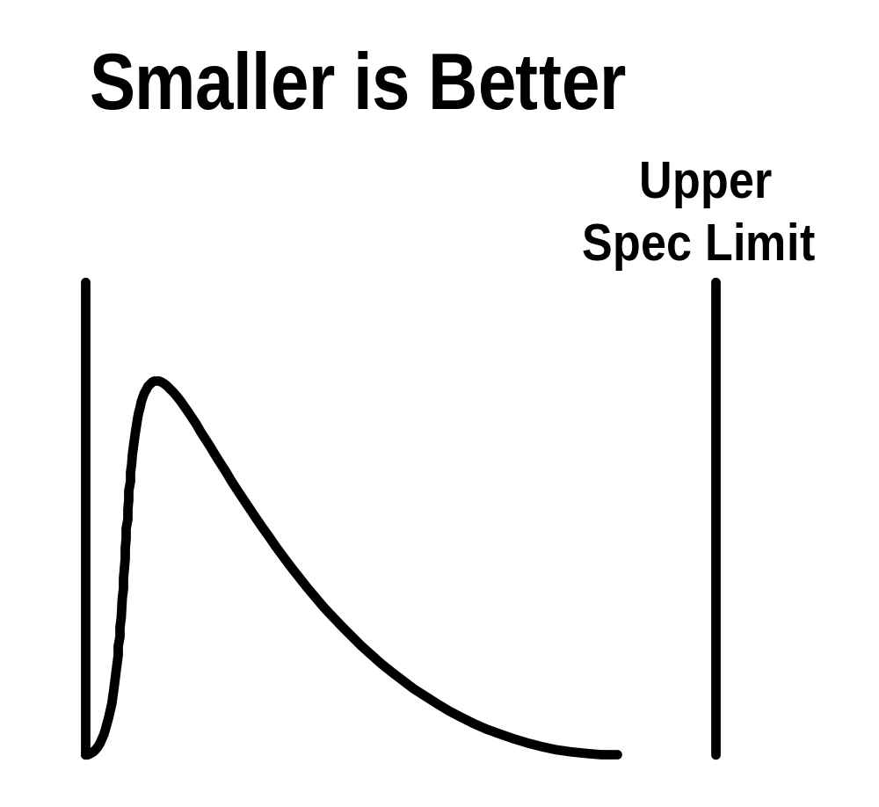
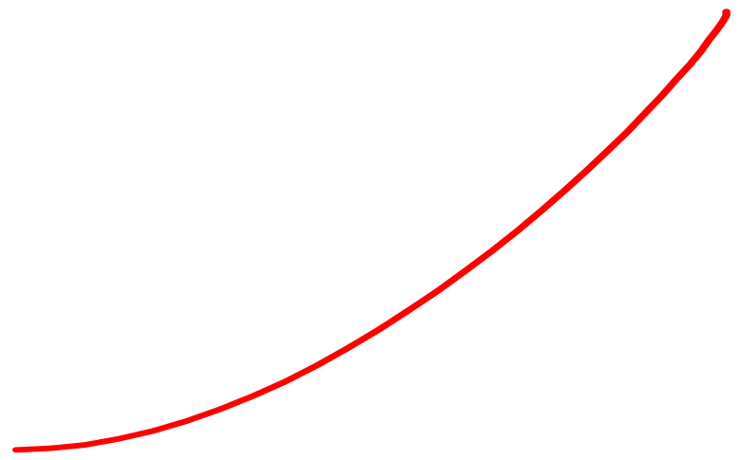
Product Characteristics
Examples:
  Leak in cc/min
  Current Draw in mA
Loss
Function

Slide 15
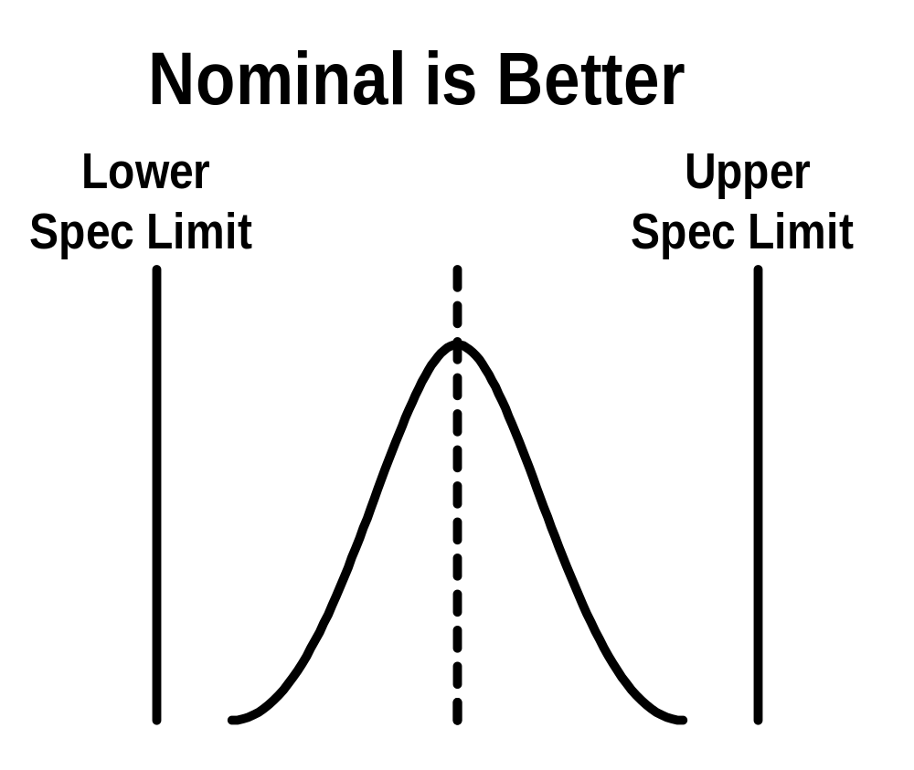
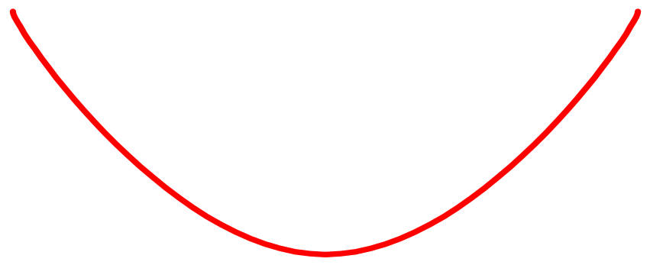
Product Characteristics
Examples:
  Operating (Turn “ON”) Torque in Nm
  “On” -”Off” Position in degrees
Loss
Function

Slide 16
Product Characteristics
Loss function can be from different perspectives
  Customer
  Manufacturing
  Others
Most of this presentation is from our customers point of view

Slide 17
Quality/Customer Interface (QCI)
Purpose: To communicate the relative importance of standard characteristics to manufacturing operations and suppliers. These characteristics do not meet the KPC criteria, but require some level of defined care (control plan, error-proofing, etc).
  Designating Special/Important Characteristics (DP 272)
A Quality / Customer Interface (QCI) is a feature or property of a product that is contacted directly by the customer and has an immediate impact on their satisfaction if not within limits. OR
A characteristic that does not meet the KPC criteria, but is deemed critical to the final product or its’ manufacturability.
QCI’s are identified by the symbol.
  Engineering drawings, prints
  Engineering specifications, material specifications
  DFMEA, PFMEA, PFD, Control plan

Slide 18
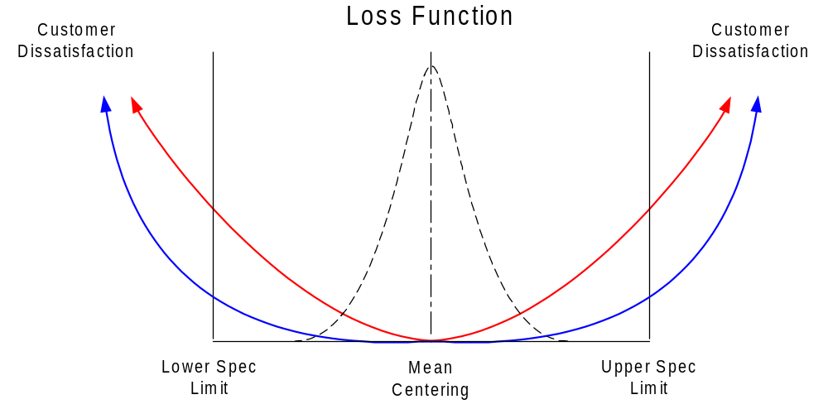
Loss Function
KPC
Loss Function
QCI
Loss Function

Slide 19
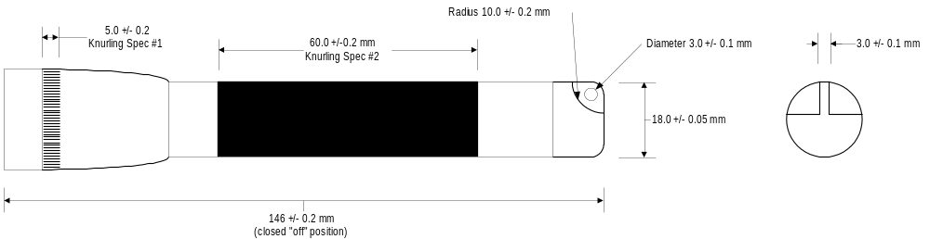
QCI Examples
When developing a gauging technique for a Customer Interface (QCI) it is helpful to:
“LOOK AT IT THE WAY THE CUSTOMER SEES IT”
Handle diameter:
Key chain hole:
Clearance for key chain hole:
Thickness of key chain tang:
Knurling: (2 Places)
Overall length:

Slide 20
Product Characteristics
KPCs & QCIs can be applied to any aspect of the product
    Dimension features on prints
    Material Specifications
    Performance or Test Requirements
KPCs & QCIs can be applied for:
    Performance Reasons
    Durability Reasons
    Customer Interface Reasons
    Manufacturability Reasons
      Part to part interfaces
      Part to tool interfaces

Slide 21
Product Characteristics
KPCs & QCIs need to flow through drawings and specifications
KPCs & QCIs cascade downstream from Outline and Assembly drawings to Component level drawings.
  This assures that controls are in place at the first point in the manufacturing process.
  This assures that processes upstream are not expected to process uncontrolled components and provide a controlled output.
KPCs & QCIs cascade upstream until the point that the feature is no longer distinguishable.
  This assures controls are in place to confirm no damage has occurred to the KPC/QCI during additional process steps.
  This assures the KPC/QCI can be found at the highest level print possible. People generally look at high level prints and do not work well with requirements that are 2-3 levels deep in our documentation.

Slide 22
Stack-up KPCs & QCIs
If an Assembly has a KPC or QCI that is a stack-up resultant, KPCs and QCIs need to be cascaded downstream to assure the inputs will result in a capable Assembly.
Component A
Material B
Assembly
Component C
Component A

Slide 23
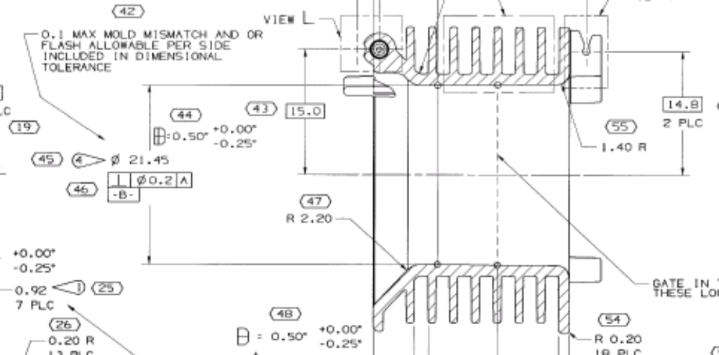
Product Characteristics

Slide 24
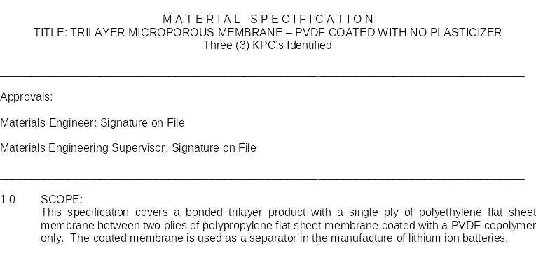
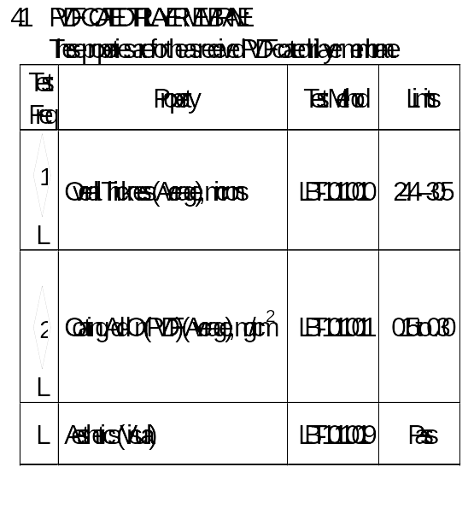
Product Characteristics

Slide 25

Loss Function
What data can I use to define the loss function?
LSL
USL
Customer Dissatisfaction
LSL
USL
Customer Dissatisfaction
LSL
USL
Customer Dissatisfaction
Graphic from GM Scope Material

Slide 26

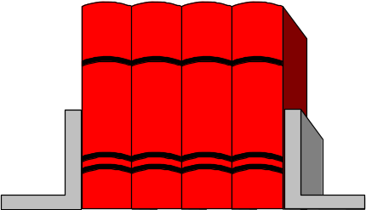
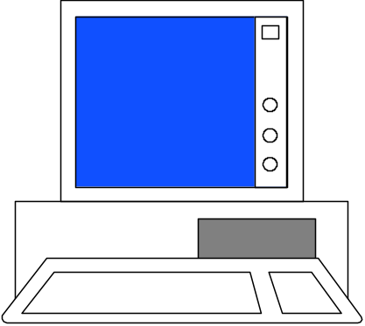





Loss Function
How might we identify characteristics that fit?
Design of Experiments
Past Experience
Warranty/Campaign Data
Sensitivity Analysis
V.O.C
Design FMEAs
Our Distrib.
Math Modeling and/or Simulation
Consensus Judgment
Parameter Loss Functions
Graphic from GM Scope Material

Slide 27
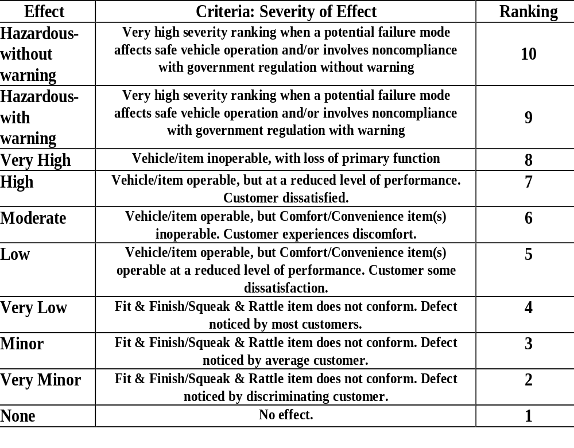
DFMEA and Level of Control
Highest Level of Control
Added Controls
Possibly added controls
Graphic from GM Scope Material

Slide 28
Severity and Likelihood
CRITICAL
Severity
REDESIGN
QCI
Severity of an Adverse Consequence
KPC, work on Robustness
MAJOR
Severity
QCI
MINOR
Severity
STANDARD
Zero Likelihood
Small Likelihood
Significant Likelihood
High Likelihood
Likelihood of an Adverse Consequence
Graphic from GM Scope Material
Notes:
82
82

Slide 29
Risk / Robust
Target
Target
Target
LSL
LSL
USL
LSL
USL
USL
Standard
QCI
KPC
LSL = Lower Spec Limit USL = Upper Spec Limit
Graphic from GM Scope Material

Slide 30
Comments from a Delphi Visit to GM
Delphi was asked to look at situations in which we supply the same part from multiple locations. Implication was that Cpk for each site may be greater than 1 but if the two processes are not centered, the overall Cpk of the two processes combined maybe equal to one. Further, some assembly plant processes run better when a supplier's capable process mean is centered around a certain value within the specification range. Multiple supplier plants likely have different process means and therefore the GM assembly process sees too much variation as parts arrive from different supplier plants. GM would like Delphi to recognize these conditions and take measures to ensure processes are centered around the optimum value.
Not only is our customer impacted by variation, Delphi is impacted also.
  Supplier to Supplier
  Line to Line
  Cavity to Cavity
Process Stream 1
Process Stream 2
Resulting Variation
Lower
Upper
Lower
Upper
Lower
Upper
Spec Limit
Spec Limit
Spec Limit
Spec Limit
Spec Limit

Slide 31
Supporting Product Characteristics
with
Target Tolerancing

Slide 32
The Old Way of Thinking
No-Good
Good
No-Good
Loss
Loss
Loss
No Loss
LSL
USL
Measured Value of the Characteristics
LSL – Lower Specification Limit
USL – Upper Specification Limit

Slide 33
The New Way of Thinking
Target
Poor
Poor
Fair
Fair
Loss Increases at an Increasing Rate
Good
Good
Loss
Best
Measured Value of the Characteristics

Slide 34
Targeting Processes vs. RMS Stack-ups
Stack up - Meets
Stack up - Better
Stack up - Violates
Lower
Upper
Lower
Upper
Lower
Upper
Spec Limit
Spec Limit
Spec Limit
Spec Limit
Spec Limit
Spec Limit
Lower
Upper
Lower
Upper
Lower
Upper
Spec Limit
Spec Limit
Spec Limit
Spec Limit
Spec Limit
Spec Limit
Lower
Upper
Lower
Upper
Spec Limit
Spec Limit
Lower
Upper
Spec Limit
Spec Limit
Spec Limit
Spec Limit
Lower
Upper
Lower
Upper
Lower
Upper
Spec Limit
Spec Limit
Spec Limit
Spec Limit
Spec Limit
Spec Limit
Notes:
Dr. Taguchi’s Loss Function is a useful way of measuring quality because it looks at two critical measures -- average performance … and variation.
As we know, the Loss Function establishes a financial measure of user dissatisfaction … with a product’s performance as it deviates from an assigned target value.
On the horizontal axis, we have the degree of variation. On the vertical axis, we have the “loss to society,” which can be dollars, time, safety performance … or any one of a number of different metrics. The bigger the variation … the greater area there is for real societal loss.
The ultimate goal for us is to create a product design or a manufacturing design that is completely insensitive to uncontrolled sources of variation, which Dr. Taguchi calls “noise factors.”
Of course, perfection isn’t attainable. But we can adjust various factors that will help us both attain our desired product attributes while reaching our quality goals.

Slide 35
Product Characteristics
(KPC’s & QCI’s)
Questions and Comments
Dec. 12, 2005

