Slide 1
Shared Library

Slide 2
object
file
object
file
static linking
function
library
function
library
executable
files
object
file
object
file
dynamic linking
pointer
pointer
shared
function
library

Slide 3
Static Library
Carried out only once to produce an executable file.
If static libraries are called, the linker will copy all the modules referenced by the program to the executable.

Slide 4
Shared Library
Allows a process to add, remove, replace or relocate object modules during its execution.
If shared libraries are called,
Only copy a little reference information when the executable file is created.
Completing the linking during loading time or running time.

Slide 5
File Suffix
Static:
*.a, *.lib
Shared:
*.so, *.dll

Slide 6
Big Difference
If several processes call the same object module of a shared library simultaneously.
Only one copy in memory (dynamic)
Several copies each for a process in memory (static)

Slide 7
Static linking VS. Dynamic linking
Dynamic produces smaller executable files.
Dynamic consumes less memory.
Dynamic runs more slowly.
Dynamic has more system calls.
Dynamic need more loading time.

Slide 8
Sharing Across File System
There are 1831 dynamically linked programs and only one static linked (/bin/ash.static), which also has its dynamic version (/bin/ash) in the system.
Dynamic linking is dominant throughout the system.

Slide 9
Building a ‘Shared Library’
Functions must be ‘reentrant’
This implies: No global variables
Code must be ‘position-independent’
Can’t jump or call to fixed addresses
Can’t access data at fixed locations

Slide 10
Command-formats
For building the shared library:
$ gcc –c –fPIC func.c
$ gcc –shared –fPIC func.o –o libfunc.so
(position-independent code (PIC))
For linking application with shared library:
$ gcc app.c –o app –L. –lfunc

Slide 11
Command-line options
Use the -L. option to tell the linker where to search the for your libxxx.so files
Use the -l option to tell the linker which shared object files to link with first
See the man pages for additional details
https://gcc.gnu.org/onlinedocs/gcc-2.95.2/gcc_2.html#SEC6

Slide 12
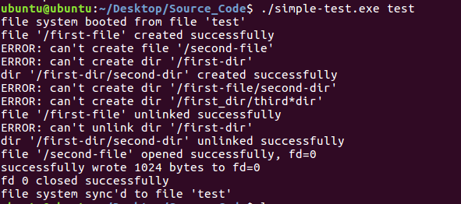

Slide 13
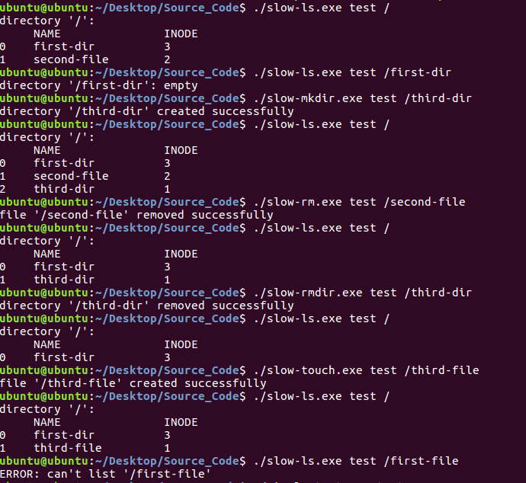

Slide 14
