Slide 1
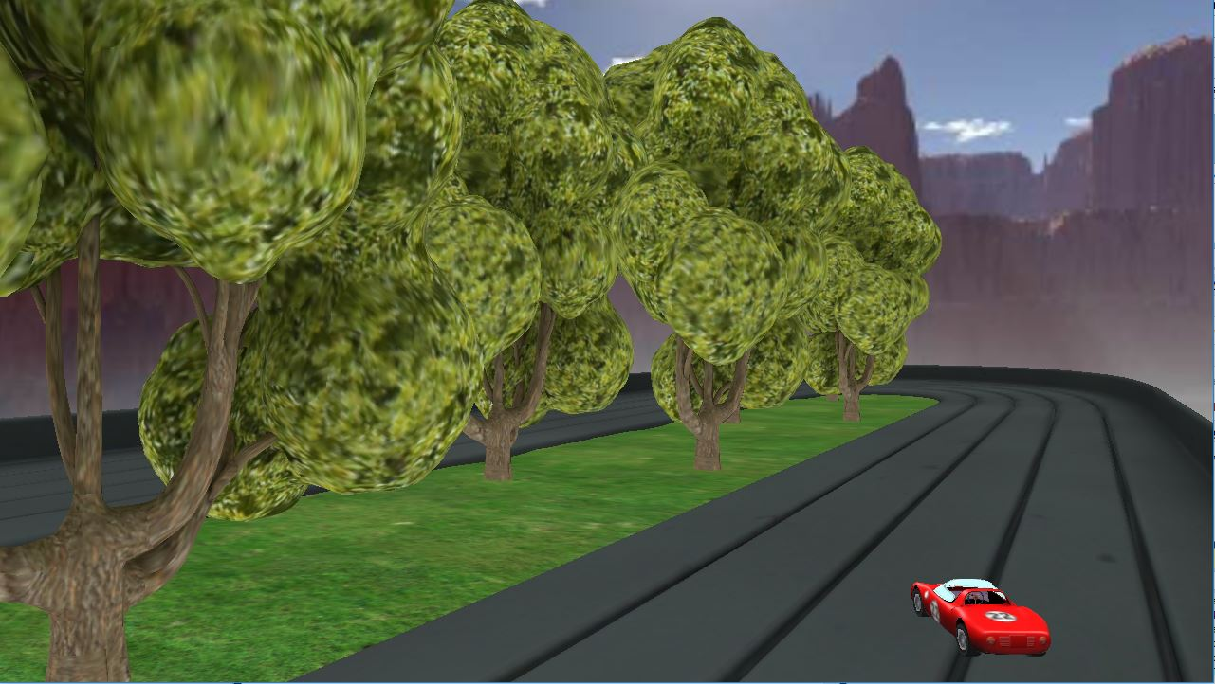
Car-Racing

Slide 2
Technical Specifications
GLFW based
Only 2 shaders have been used, one for vertex, one for fragment
Implementation:
*Models are imported – Shaders are set
*Camera is set
*Matrixes are set
*Skybox is added
*Movement algorithm is set
*Bot is added
*Menu is set

Slide 3
Movement algorithm
Firstly, car rotates then moves forward. Here we assumed displacement as sin(radian) on x axis, as cos(radian) on z axis.
Continuously updates positions of both cam and car.
Car’s position saved for use in rotation ( restriction of rotating camera at origin every time it called ).

Slide 4
Bot works in way
FILL ME FILL ME FILL ME FILL ME FILL ME
FILL ME FILL ME FILL ME FILL ME FILL ME
FILL ME FILL ME FILL ME FILL ME FILL ME
FILL ME FILL ME FILL ME FILL ME FILL ME

