Slide 1
Serverless Web Application in AWS

Slide 2
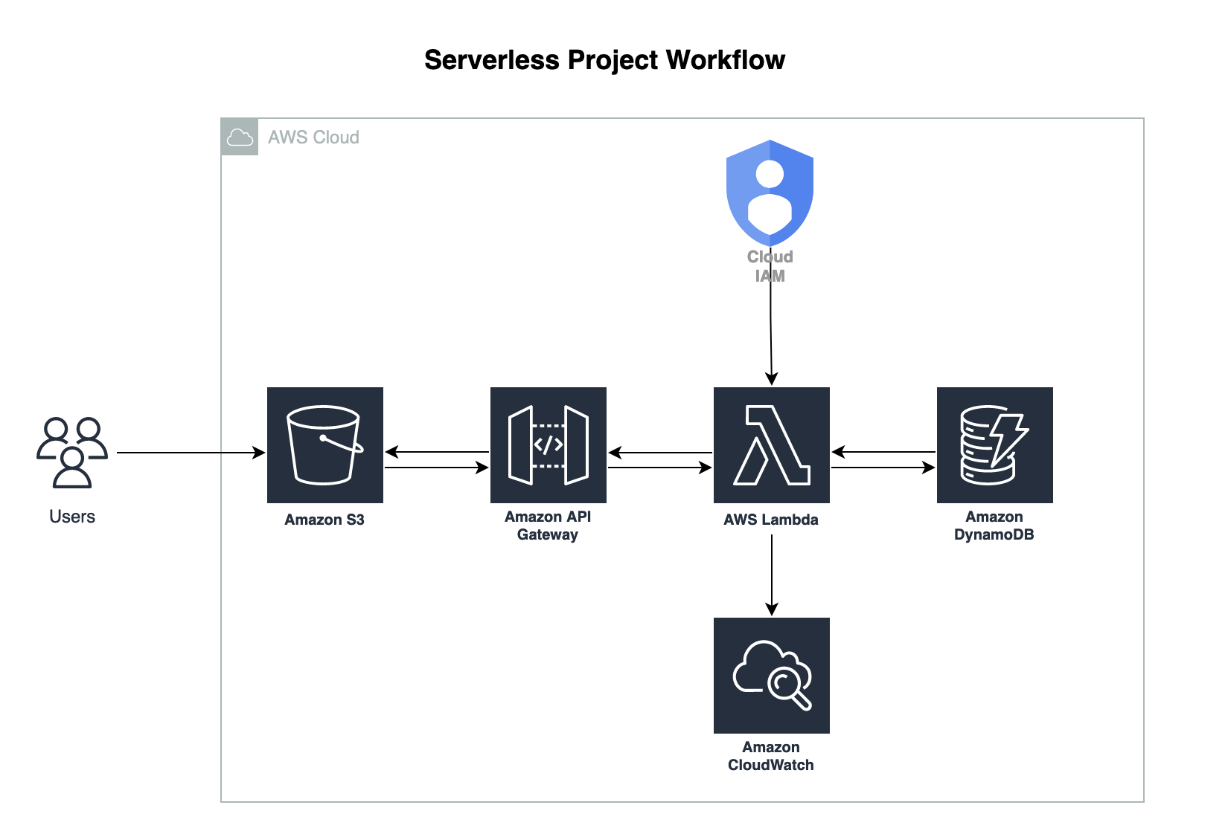
Notes:
Explain the architecture Serverless: Build and run applications without infrastructure management.
How will they deploy an application in general?

Slide 3
Advantages
Greater Scalability
More Flexibility
Quicker time to release
Notes:
Can scale for greater workloads without our intervention

Slide 4
Steps:
Host a static website using S3.
Create DynamoDB and Lambda using the given code and test it.
Create an API Gateway and Verify whether the data is stored in DynamoDB.

Slide 5
Prerequisites
AWS Account (Free tier)
Visual Studio Code or similar editors

Slide 6
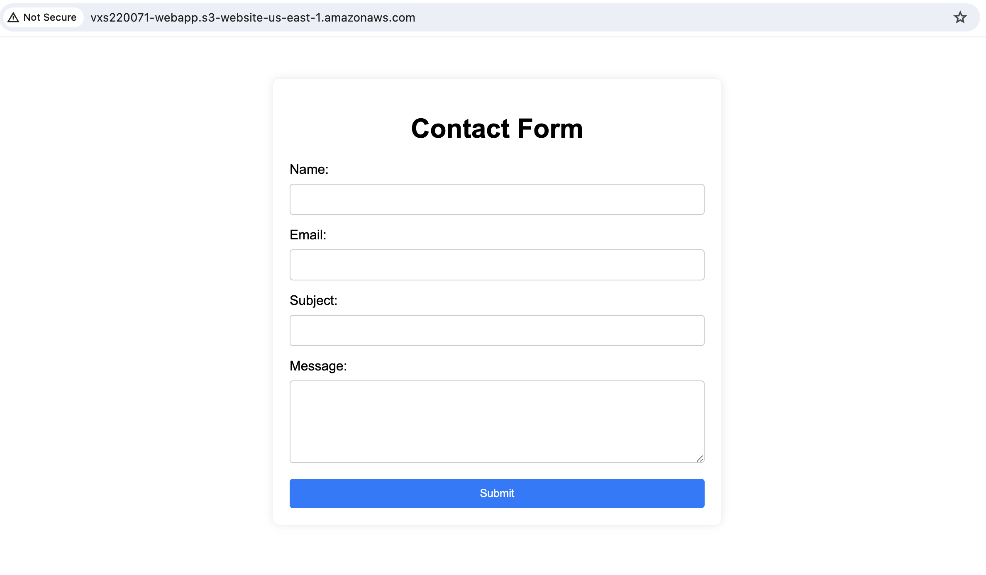
Step 1:
Static Website Hosting using s3
Output:
Notes:
Show the demo on the console.

Slide 7
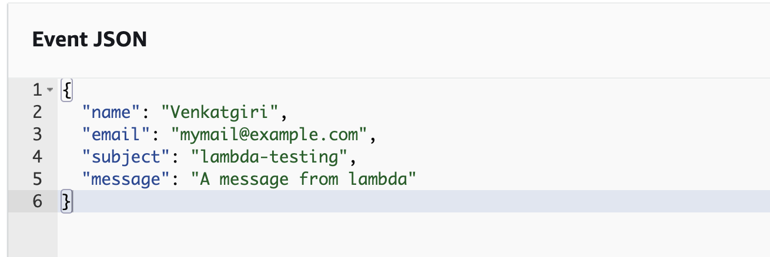
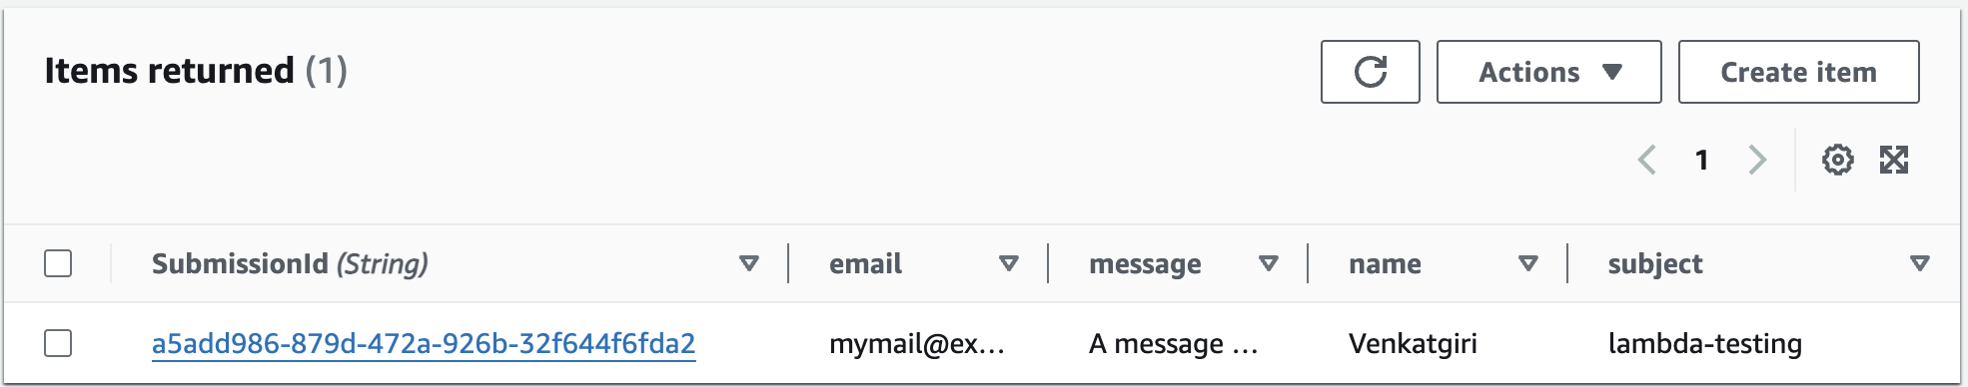
Step 2:
Create a lambda function
with NodeJS.
Create DynamoDB.
If you get a permission error assign the necessary policy to the lambda role
Output:
Notes:
Show the demo on the console

Slide 8
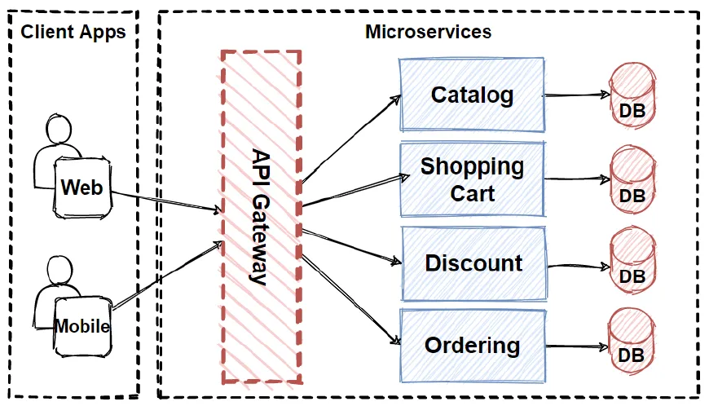
Source: Medium
Notes:
Explain API Gateway with real-world examples.
Remind them about the Database Class where they did the DB modeling.

Slide 9
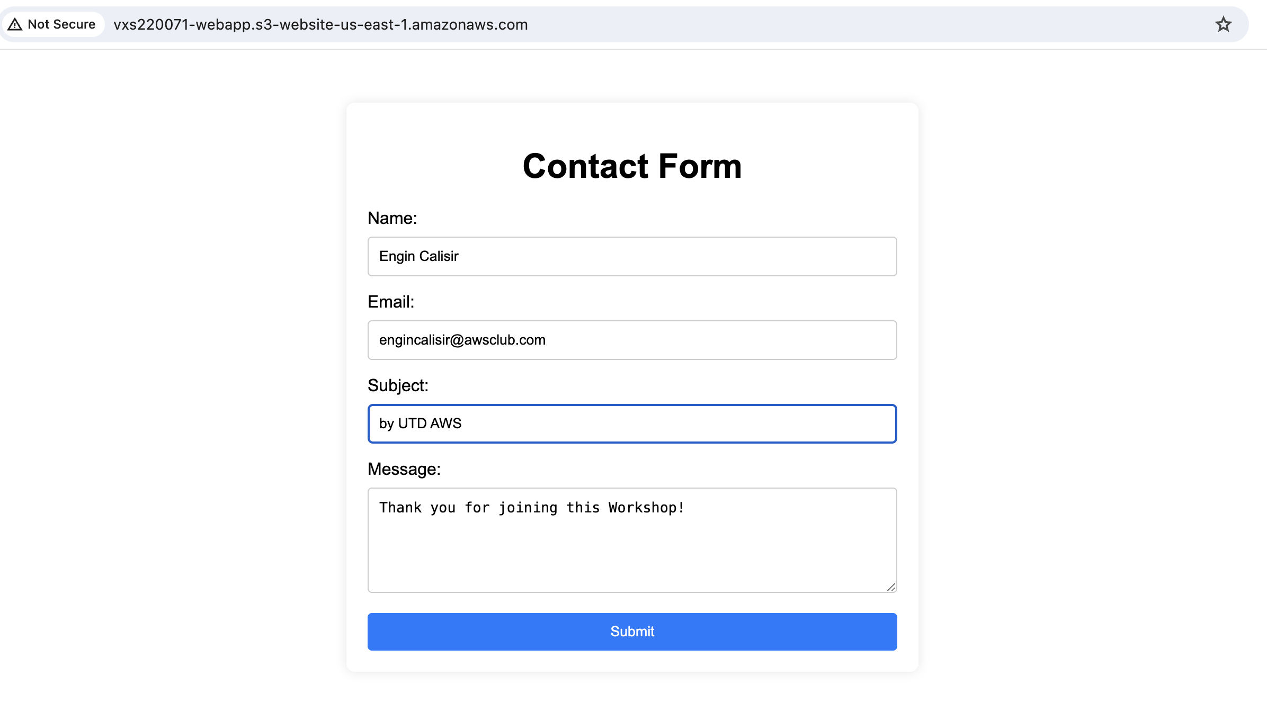
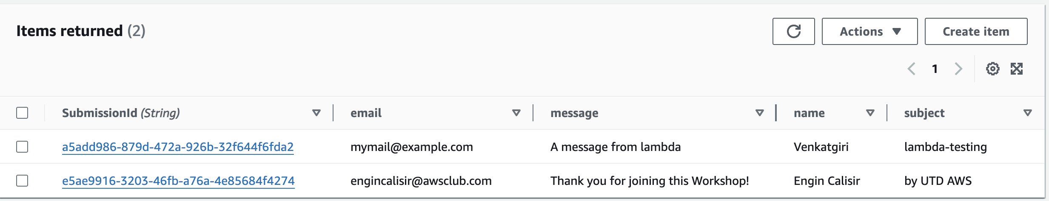
Step 3:
Create a REST API in API Gateway
Create Resource
Create Method
Deploy API
Enable CORS (Optional)
Output:
Notes:
Show the demo on AWS Console

Slide 10

Thank You

