Slide 1
WHY MOVE TO TEXAS?
Alteryx Datathon-Group 10

Slide 2
TABLE OF CONTENTS
01
02
03
04
INTRODUCTION
FACTORS
RESULTS
CONCLUSION

Slide 3
01
Introduction

Slide 4
INTRODUCTION
Texas aka the Lone Star state is a southern state in the United States. We are exploring why this state is a great place to move in for both US citizens and non-citizens.

Slide 5
02
Factors

Slide 6
FACTORS TO CONSIDER
These are the factors we think that make Texas a great place to move to ☺
Business & Economy + Model | Ex: Consumer Confidence Index, Consumer Price Index, Unemployment
Education | Growing education opportunities
Texas State Lottery | The results are surprising!
Public Safety | Very important if we are moving to any state :p

Slide 7
03
Results

Slide 8
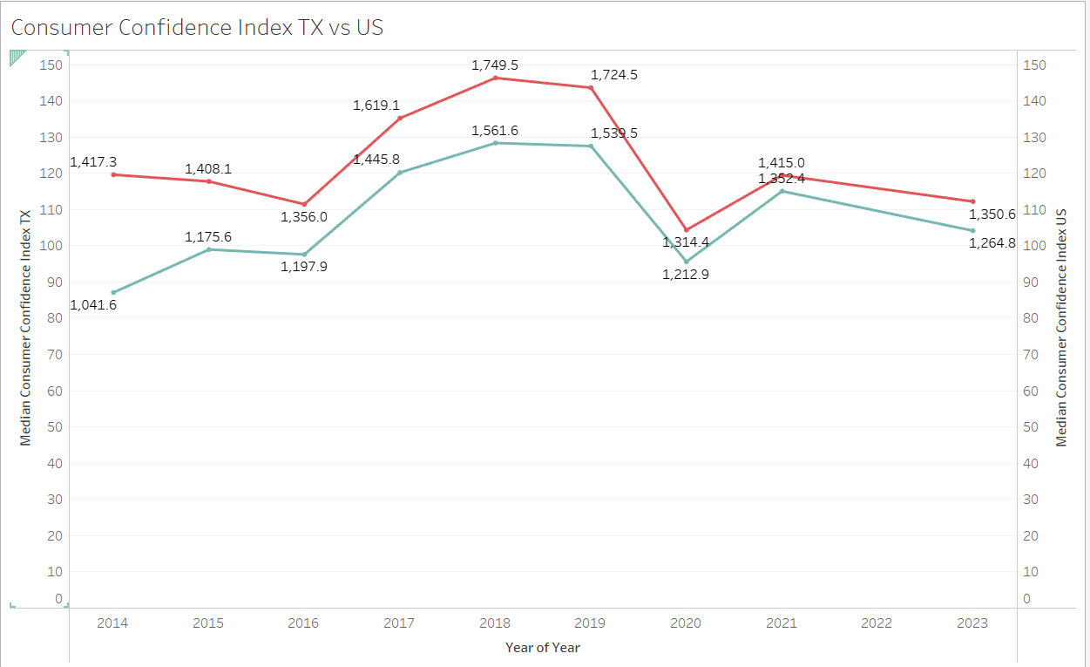
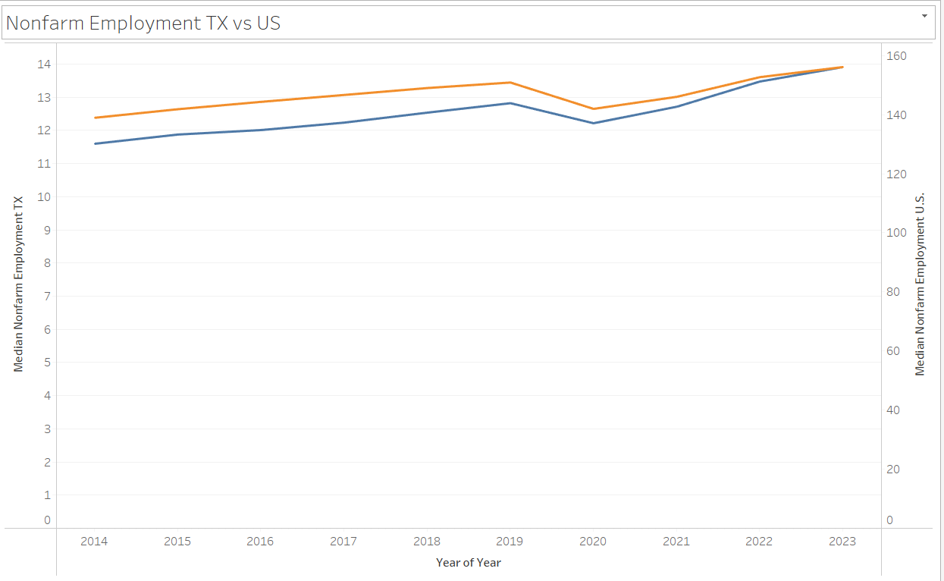
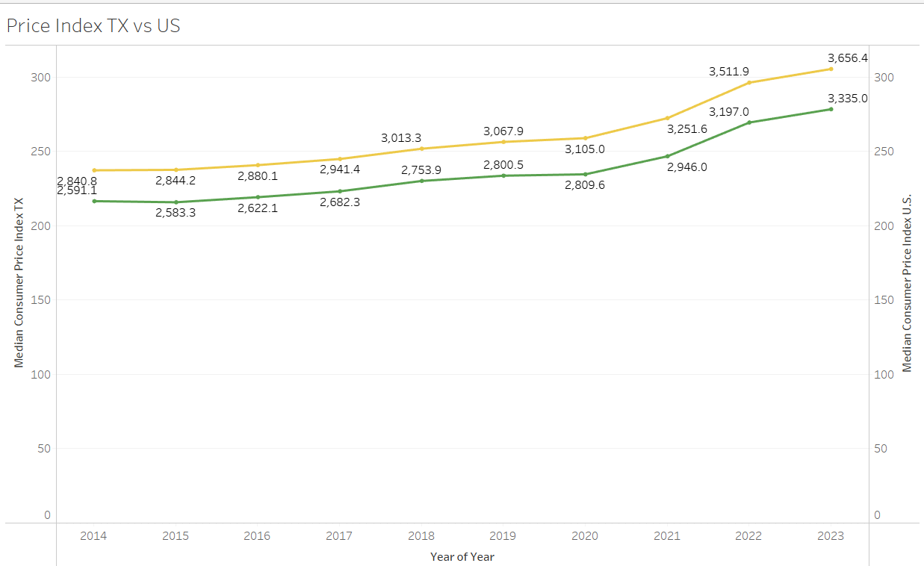
Texas Economy

Slide 9
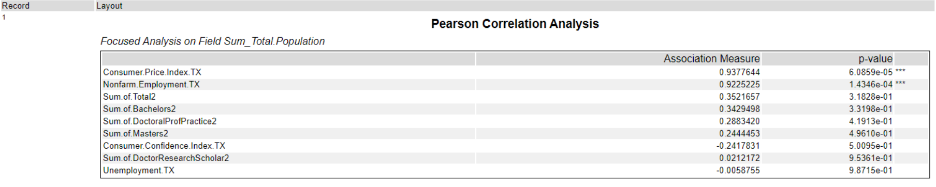

Slide 10
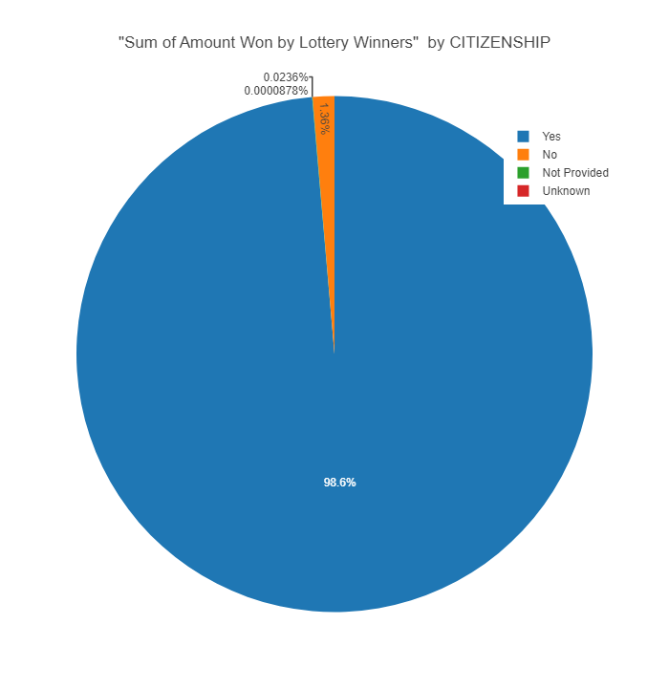
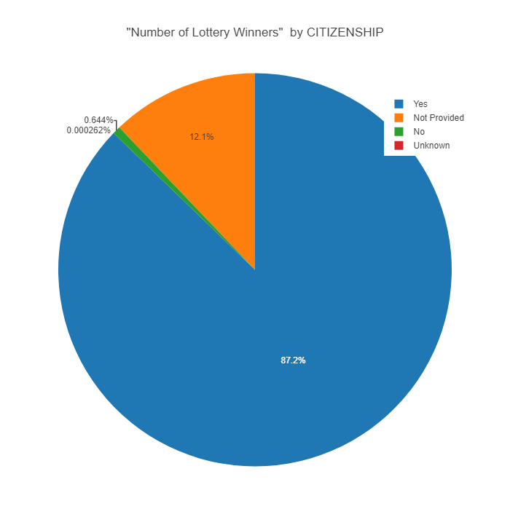
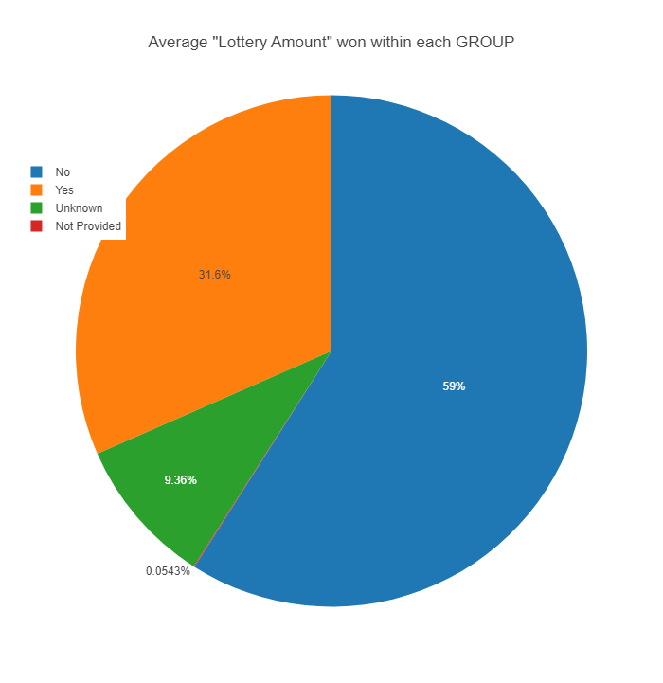
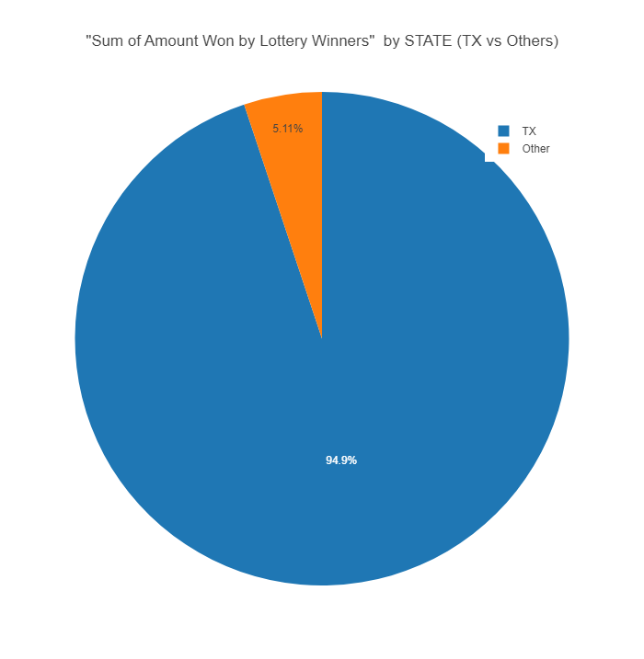
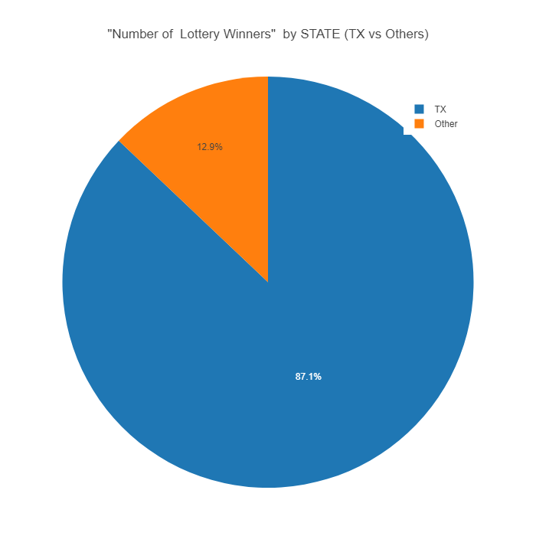
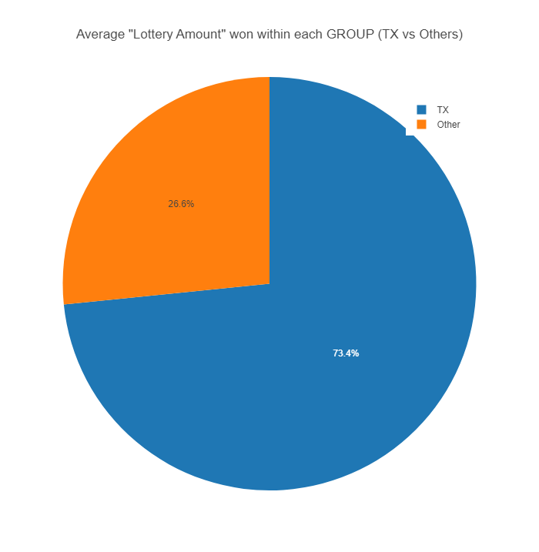

Slide 11
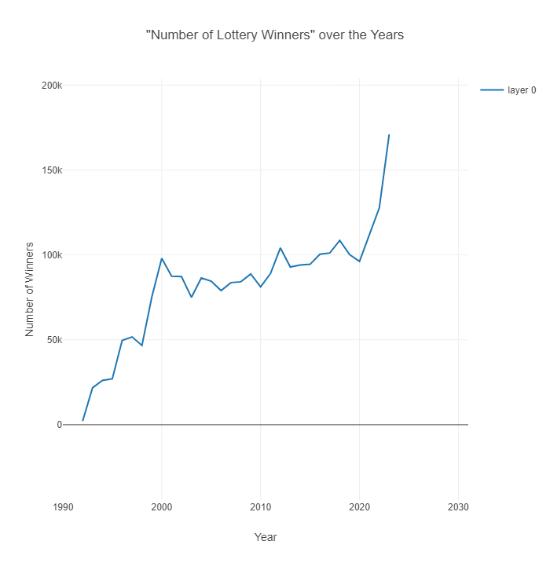

Slide 12
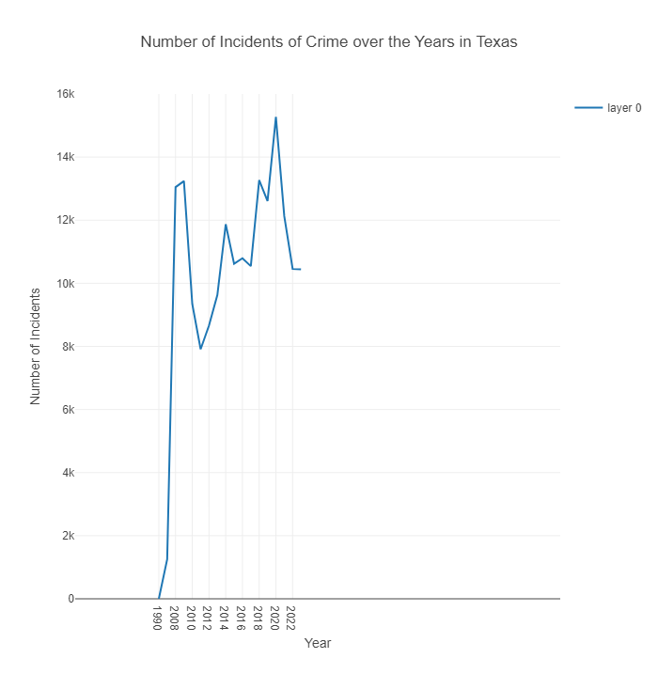
PUBLIC SAFETY

Slide 13
04
Conclusion
Great Economy, Growth in Education opportunities, Decreasing Crime statistics, Awesome Lottery

