Slide 1
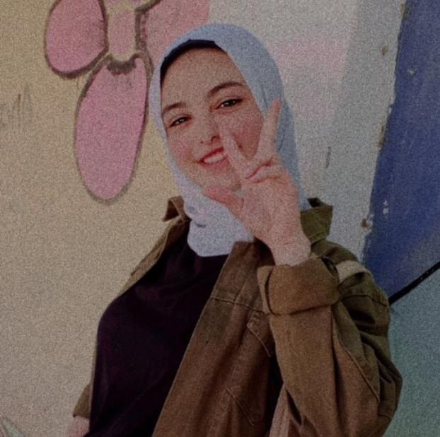
JOSEPH BAHLA
EDUCATION
HIGH SCHOOL
+201022820459
WORK EXPERIENCE
menamena2005303@gmail.com
Head Hr prt
Digital social media markting
searcher sci sys
Writer fya
Social media Zakat E3lm
Media GA
Hr GIT
years old16
PROFILE
A student in the second year of secondary schoolHe has many skills, including:Leadership, organization and managementWorking with a teamand HR skills
LANGUAGES
USE ARABIC HAVE EXPREINCE AT ENGLISH LEARN FREANCH
SKILLS
HOBBIES
HR
Cinéma Music Games Books
Markting
Writing
MS WORD
MS POWERPOINT
MS EXCEL
Design phone design
Design phone design
MS ACCESS
MS ACCESS
Notes:
جميع الحقوق محفوظة لموقع www.bestfreecv.com

