Slide 1
FOOD ORDERING SYSTEM IN MINI/MAIN CANTEEN
Submitted By:
CH PRUDHVI SAIRAM - B160555CS
J VISHNU VARDHAN SAI - B160733CS
G HEMANTHNATH CHOWDARY - B160747CS
LAM TEJA - B160745CS

Slide 2

ABSTRACT
The purpose of this project is to develop a food ordering system.It is a system that enable customers to place their order at mini/main canteen.
The reason to develop this system is a long waiting time for students at counters of mini/main canteens for ordering food.
Therefore,this system increases the speed of taking the order and displays it to the mini/main canteen staff accordingly.
It save the time of students and also make things organized for the canteen staff.

Slide 3
USER MODULES
This project involves modules like:
1.User registration : This is a form with a list of fields that a user will input data into which enables a new user to register.
2.User Login : This module makes users login with their details to view the menu and order the food.
3.Menu : This contains the food details along with their prices and quantity.
4.Cart : This module contains details of the food that customer has ordered along with its quantity and the total price of the food ordered.
5.My Orders : This module shows details about the current and previous orders of the customer. It shows the status and details of present order .

Slide 4
OBJECTIVES
To develop a system that will surely satisfy the customer service.
To design a system able to accommodate a huge number of orders at a time by.
To evaluate its performance and acceptability in terms of security, user-friendliness, accuracy and reliability.

Slide 5
Hardware Requirements Software Requirements
An android phone with minimum following requirements
● Processor : 1.2GHz or faster
● Ram : Minimum of 512 MB , 2GB is recommended
● Space : Minimum of 20 MB or more
OS : Android Kitkat(version 4.4) or Higher
Proper Internet connection

Slide 6
Functional Requirements
This section presents the identified functional requirements for the app.
The following are the identified functional requirements for the USER side:
User will be able to register and then login to enter the menu page.
Every User need to use unique email address for registration.
If a User forgets the password, they can change it using forgot password option.
User will be able to view the menu and categories of food items.
User will be able to add or remove items from cart.
On clicking cart_icon button in the menu page, user will be navigated to cart page.
User will be able to navigate between menu page and cart page and can add items to the cart.

Slide 7
8) On clicking place_order button in the cart page, user will be navigated to order_confirmation page which will display the order details.
9) After placing the order, user will be able to navigate back to the menu page by clicking re-order button.
10) To view the details of an order, users should go to Myorders page in the dropdown menu which will display all the orders.
The following are the identified functional requirements for the ADMIN side:
Admin will be able to add or remove items.
Admin will be able to update the details of the items.
Admin will be able to manage the orders from the users.

Slide 8
Non functional requirements
The following are the identified non-functional Compatibility and Security requirements:
The user will able to use the app in different platforms like different versions of OS/Mobiles.
The app contains authentication process for login.
The app performs encryption and decryption of data for password which is given by user for login.
The following are the identified non-functional safety and performance requirements:
The server shall be able to handle the expected traffic from the users.
The database can get crashed and hence a backup is provided by firebase.
The response time for the user is quick.

Slide 9
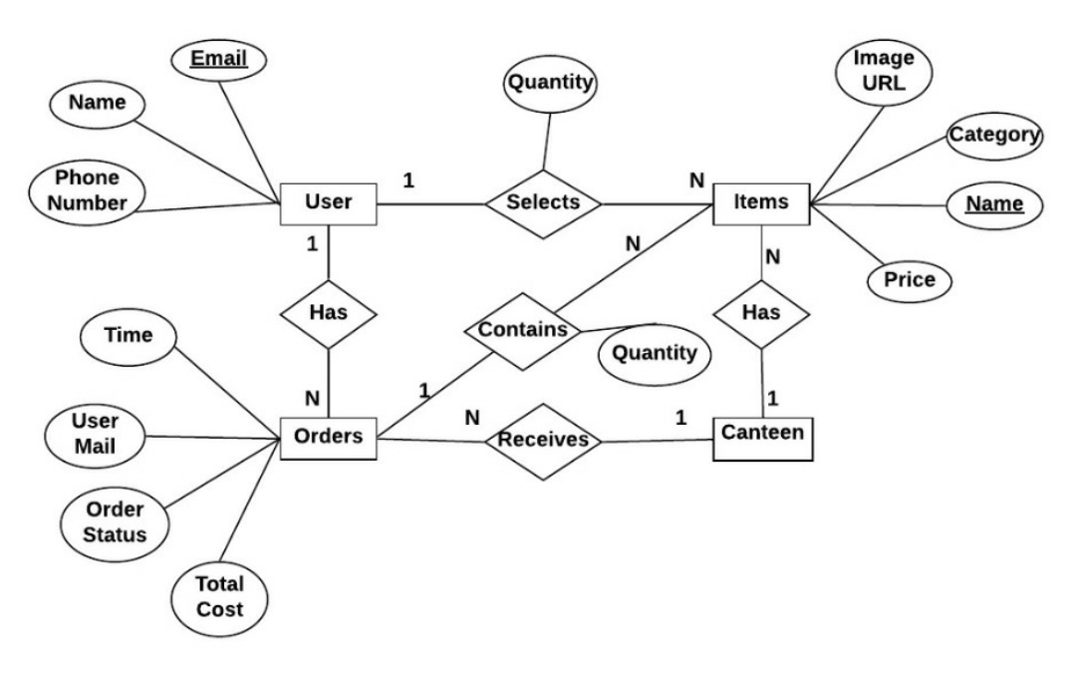
ER DIAGRAM

Slide 10
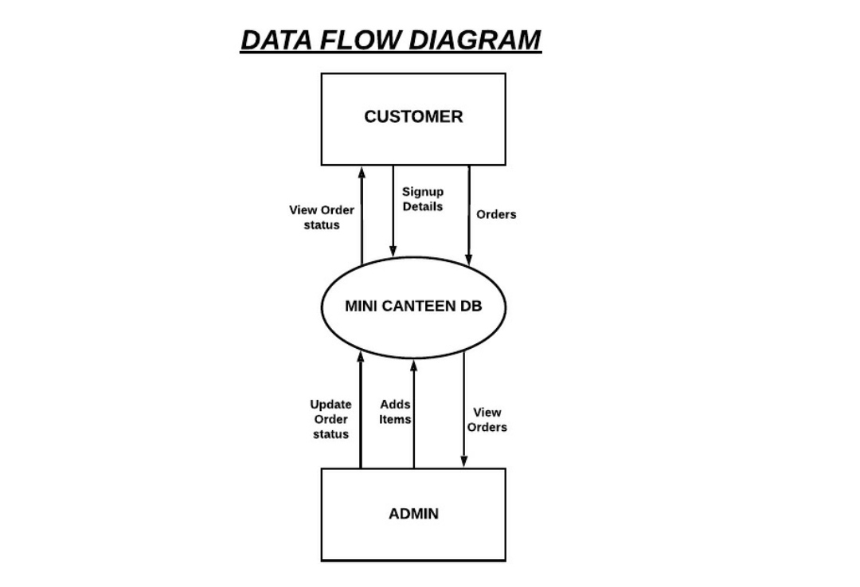

Slide 11
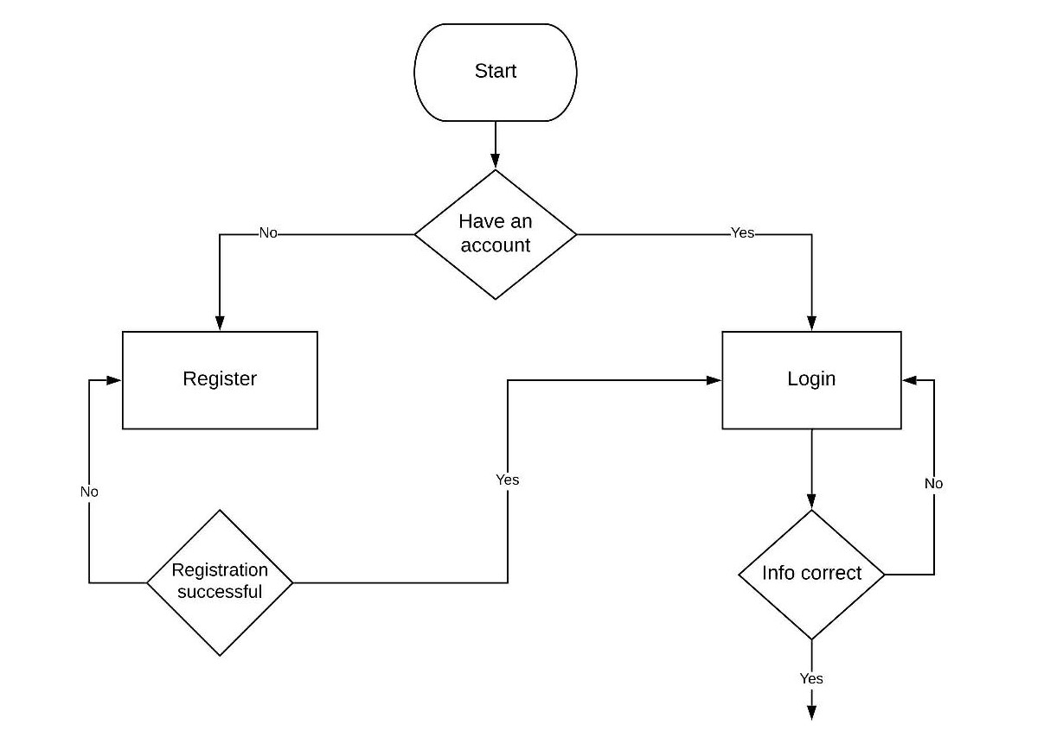
Activity flow Diagram

Slide 12
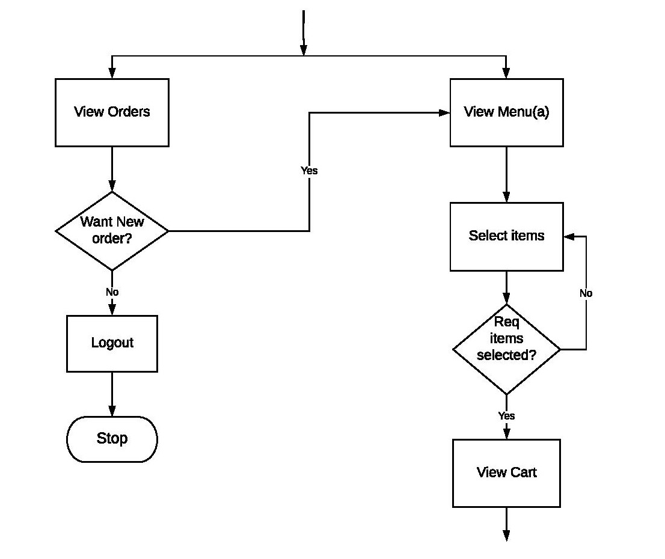

Slide 13
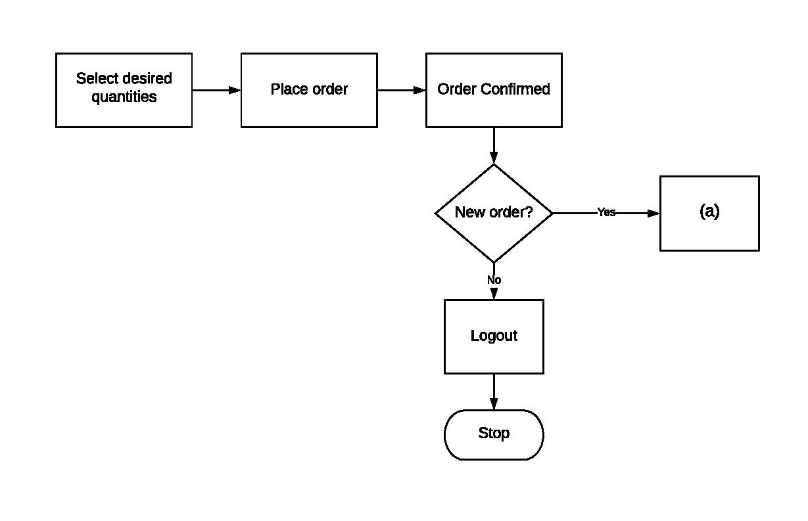

Slide 14
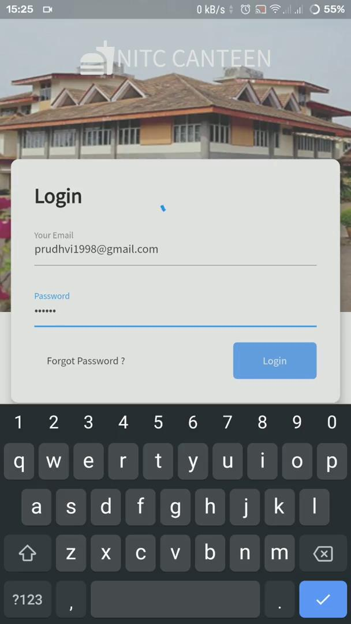
User End App Demonstration

Slide 15
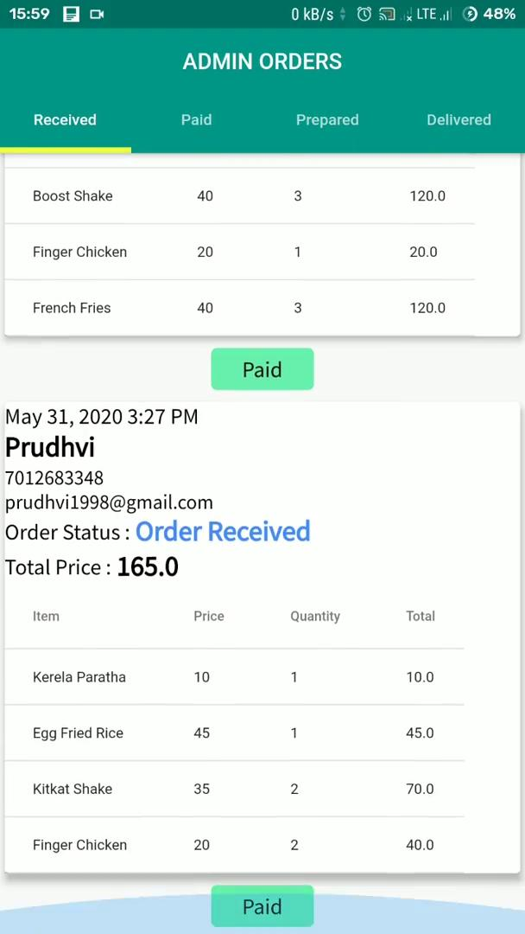
Admin End App Demonstration

Slide 16
THANK YOU

