Slide 1
Chukkala Prudhvi Raj
Final Project
3/21/2024 Annual Review

Slide 2
PROJECT TITLE
Keylogger And Security
3/21/2024 Annual Review

Slide 3
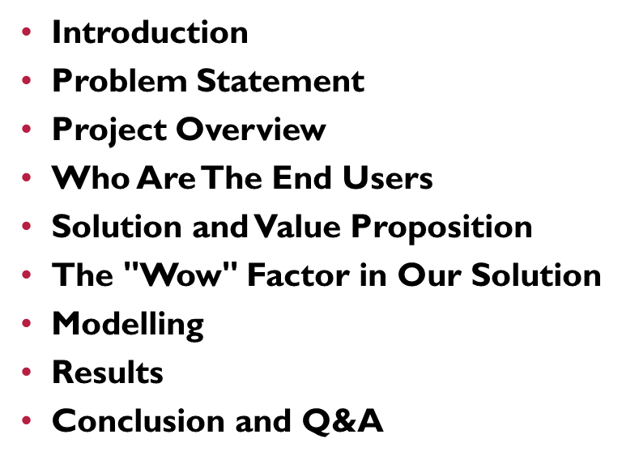


AGENDA
3/21/2024 Annual Review

Slide 4
Introduction
A keylogger is a type of surveillance software designed to record keystrokes on a computer or mobile device. It can capture all user inputs, including passwords and personal information, often without the user's knowledge. Keyloggers are used for both legitimate purposes, such as monitoring employee activity, and malicious purposes, like stealing sensitive data.

Slide 5

PROBLEM STATEMENT
Keyloggers are a significant threat to cybersecurity, leading to unauthorized access to sensitive information , identity theft, and financial fraud.
Affects individuals, businesses, and organizations by compromising data privacy and security.
3/21/2024 Annual Review

Slide 6

PROJECT OVERVIEW
This project aims to investigate key loggers, devices or software that secretly record keystrokes to steal sensitive information. By understanding their mechanisms and potential risks, the project will develop strategies for detecting and preventing these threats, ensuring robust data security and privacy
3/21/2024 Annual Review

Slide 7

WHO ARE THE END USERS?
The end users of keyloggers include employers who monitor employee activities, parents who keep track of their children's online behavior, and cybercriminals who use them to steal personal information and sensitive data. Additionally, IT professionals may use keyloggers for diagnostic purposes to troubleshoot system issues.
3/21/2024 Annual Review

Slide 8

YOUR SOLUTION AND ITS VALUE PROPOSITION
Our solution is an advanced keylogging detection and prevention software that safeguards users' devices from unauthorized surveillance and data theft. By utilizing cutting-edge algorithms and real-time monitoring, it identifies and neutralizes keylogger threats swiftly. The value proposition lies in its ability to provide comprehensive protection for individuals and organizations, ensuring privacy, data security, and peace of mind. This solution is easy to install, user-friendly, and offers continuous updates to combat emerging threats.
3/21/2024 Annual Review

Slide 9

THE WOW IN YOUR SOLUTION
1. Real-Time Threat Detection: Instantly identifies and neutralizes keyloggers, offering unparalleled protection without compromising device performance.
2. Advanced AI Algorithms: Utilizes cutting-edge AI to detect even the most sophisticated and stealthy keylogging techniques.
3. User-Centric Design: Intuitive interface and seamless integration ensure that users of all technical levels can easily protect their devices and data.
3/21/2024 Annual Review
9

Slide 10
MODELLING
Our keylogging detection model employs machine learning algorithms trained on vast datasets of known keylogging behaviors. It continuously learns and adapts to emerging threats through real-time data analysis. This model ensures high accuracy in identifying both traditional and advanced keylogging techniques.
3/21/2024 Annual Review
10

Slide 11

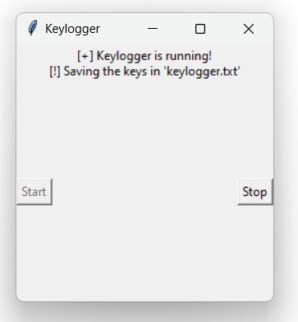
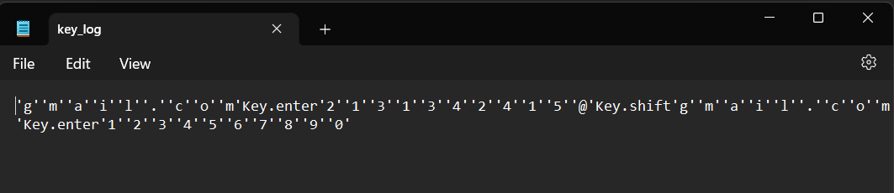
RESULTS
3/21/2024 Annual Review
11

Slide 12
Successfully implemented a keylogger that captures keystrokes and records them into both text and JSON files.
Real-time keylogging with start and stop functionality controlled via a simple GUI.
The keylogger project demonstrated the capability to effectively capture and log keystrokes in real-time.
The GUI provided a user-friendly way to control the keylogger, making it accessible and easy to use.
Emphasized the ethical use of keyloggers and the importance of implementing security measures to protect against malicious use.

Slide 13
Github link
https://github.com/Prudhvi-98/APSSDC-finalProject

