Slide 1
Self Learning car in simulated environment
Sai Prudhvi Valicherla

Slide 2
Project Advisor Dr. Yanqing Zhang
Project Defence Dr. Ying Zhu

Slide 3
Agenda
Abstract
Modules
Future work

Slide 4
Abstract
Vehicular technology is very competitive and demanding with Tesla's successful introduction of electric cars. A self-driving car can sense its surroundings and make decisions through traffic and other obstacles with minimum or no human interactions. The market for autonomous driving is booming, and building accurate positioning technologies to factor in the different types of uncertainties, such as pedestrian behavior, random objects, and types of roads and their settings, is critical to achieving safe and reliable intelligent transportation systems. Such systems bring revolution in transportation for physical and mental individuals. This project aims to demonstrate the self-learning car in the simulated environment and is the first step toward autonomous cars.
Considering the car's physics, laws of motion, center of mass, rotation angle, traffic rules, road borders, sensors, collision detection, ray tracing, neural networks, visualization, and genetic algorithm, this project is a simple implementation of the self-learning car.

Slide 5
Modules
Car Mechanics
Borders and Lanes
Sensors
Reading the borders
Collision detection
Traffic
Neural network
Network Visualization
Genetic Algorithm

Slide 6
Car Mechanics
The following are the parameters for the car
Position – coordinates (x, y)
Where do we need to place our car initially.
It’s the center of mass of the car.
Width, Height
To find the borders of the car.
Control Type
If its controlled using the keys or Neural brain or traffic.
Max Speed
The maximum speed a car can go in forward direction.
The speed in all the rest of direction.
Color
Color of the Neural brain.
Color of Neural brain when damaged.
Color of the traffic.

Slide 7
Car Mechanics(continued)
The following are the parameters for the control
Control Type
If its controlled using the keys or Neural brain or traffic.
Forward
Right
Reverse
Left
Speed
The Max Speed is set to 3
Acceleration is set to 0.2
Forward => speed += acceleration
Reverse => speed -= acceleration
If speed is greater than Max Speed then speed = Max Speed
If speed is less than the negative of Max Speed/2, then speed = - Max Speed/2

Slide 8
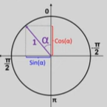
Car Mechanics (continued)
Friction is set to 0.05
If the speed is greater than zero then subtract the friction from speed
If the speed is less than zero add the friction
If the absolute value of the speed is less the friction then the car is at rest.
Movement in the different directions
Circle rotated 90 degrees in the anti clock wise direction
Initial angle is set is 0, on left, angle is increased by 0.03.
On right, angle is decreased by 0.03
The following values are multiplied with the speed to move in the directions.

Slide 9
Borders And Lanes
The Road has the following parameters
Position – coordinates (x)
To represent the center
Width – width of defined path
To define the borders of the road
Left border x – width/2
Right border x + width/ 2
The height of the road is set to a very large value and is extended in both upward and downward directions.
Lane Count – a default value of 3
Centre of each lane
Width of each lane will be width of the lane divisible of number of lanes.
Centre of each lane will be summation of left border of the road and half of lane width.

Slide 10
Sensors
It takes all the properties of the car
Number of sensors; rayCount
Angle between the first and last sensors; raySpread
Length of the sensors; rayLength
Angle between the sensors; rayAngle
Starting position of the sensors will be center of the car
Ending position will be determined with the following formula.
x:this.car.x-Math.sin(rayAngle)*this.rayLength
y:this.car.y-Math.cos(rayAngle)*this.rayLength

Slide 11
Reading the borders
The Readings takes the following inputs
Rays – array of sensors/rays
roadBorders – array of border coordinates
As soon as the ray touches the border or the traffic the readings are updated.
If there are no touches then the car moves on.
The touches are generated using another function getIntersections.
GetIntersections
The function returns the
X, Y coordinates of the intersection.
Offset – minimum distance of all the intersections.

Slide 12
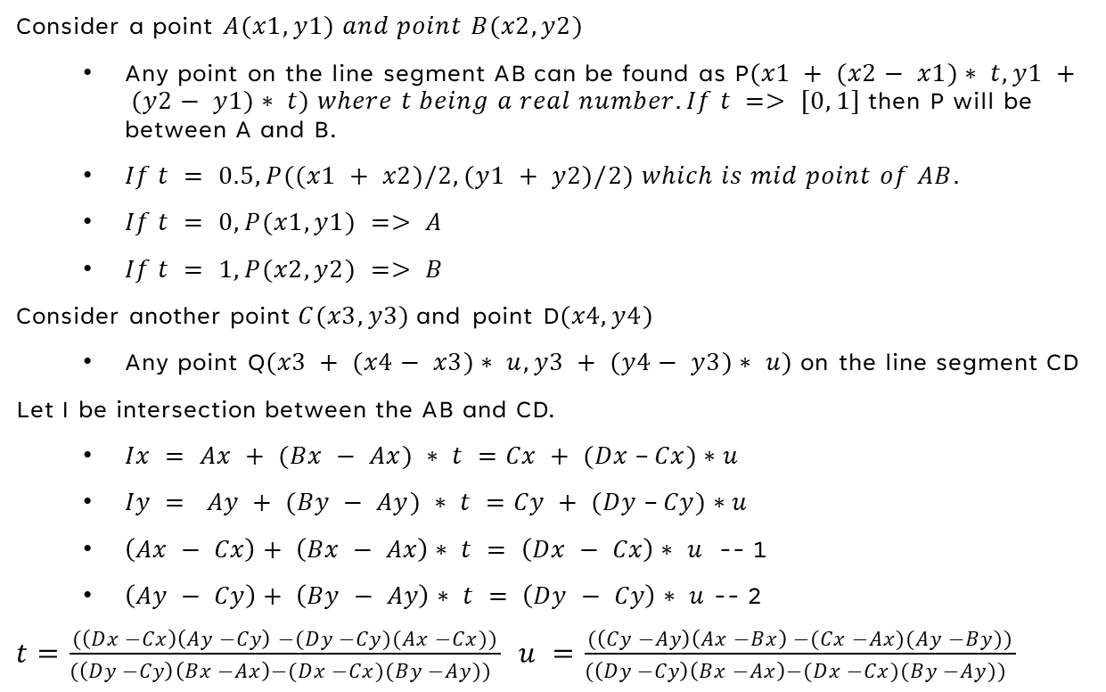
Reading the borders (continued)
Consider a point $A(x1, y1) and point B(x2, y2)$
Any point on the line segment AB can be found as P$(x1 + (x2− x1)∗ t, y1 + (y2− y1)∗ t) where t being a real number. If t => [0, 1]$then P will be between A and B.
$If t = 0.5, P((x1 + x2)/2, (y1 + y2)/2) which is mid point of AB.$
$If t = 0, P(x1, y1) => A$
$If t = 1, P(x2, y2) => B$
Consider another point$C(x3, y3)$and point D$(x4, y4)$
Any point Q$(x3 + (x4− x3)∗ u, y3 + (y4− y3)∗ u)$on the line segment CD
Let I be intersection between the AB and CD.
$Ix = Ax + (Bx − Ax) ∗ t =Cx + (Dx –Cx)∗u$
$Iy = Ay + (By − Ay) ∗ t =Cy + (Dy –Cy)∗u$
$\left(Ax − Cx\right)+ \left(Bx − Ax\right)∗ t = \left(Dx − Cx\right)∗ u$ -- 1
$\left(Ay − Cy\right)+ \left(By − Ay\right)∗ t = \left(Dy − Cy\right)∗ u$ -- 2
$t=\frac{(\left(Dx −Cx\right)\left(Ay −Cy\right) −(Dy −Cy)(Ax −Cx))}{(\left(Dy −Cy\right)\left(Bx −Ax\right)−(Dx −Cx)(By −Ay)) }$ $u =\frac{(\left(Cy −Ay\right)\left(Ax −Bx\right) −(Cx −Ax)(Ay −By))}{(\left(Dy −Cy\right)\left(Bx −Ax\right)−(Dx −Cx)(By −Ay)) }$

Slide 13
Collision Detection
w
Borders of the car
The 4 borders of the rectangle car can be found using the Pythagorean theorem.
The distance between the center and the vertex points is always same.
rad=Math.hypot(this.width,this.height)/2
The angle between the height and hypotenuse is co tangent of width / height.
alpha=Math.atan2(this.width,this.height)
The top right vertex is
x:this.x-Math.sin(this.angle-alpha)*rad
y:this.y-Math.cos(this.angle-alpha)*rad
The top left vertex is
x:this.x-Math.sin(this.angle+alpha)*rad
y:this.y-Math.cos(this.angle+alpha)*rad
h
α
α

Slide 14
Collision Detection(continued)
The bottom right vertex is
x:this.x-Math.sin(Math.PI+this.angle-alpha)*rad
y:this.y-Math.cos(Math.PI+this.angle-alpha)*rad
The bottom Left vertex is
x:this.x-Math.sin(Math.PI+this.angle+alpha)*rad
y:this.y-Math.cos(Math.PI+this.angle+alpha)*rad
Collision detection
The collision is not recorded if all the car borders are not interested with the road borders, other wise the collision is recorded.
The intersection can be identified using the technique from the previous module.
If the collision is recorded the colour of the car is changed to grey.
The damaged car will not moving and breaks the entire operation.

Slide 15
Traffic
The traffic can be generated by calling the car class and has the following parameters.
Position – coordinates (x, y)
Where do we need to place our car initially.
It’s the center of mass of the car.
Width, Height
To find the borders of the car.
Control Type
Traffic.
Speed
The speed can be greater than or less than the max speed.
Color
Color of the traffic.

Slide 16
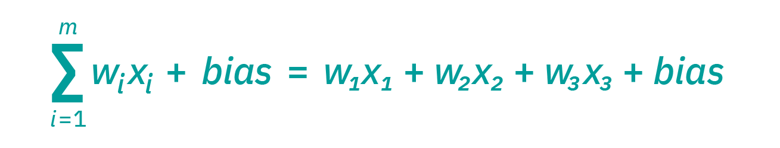
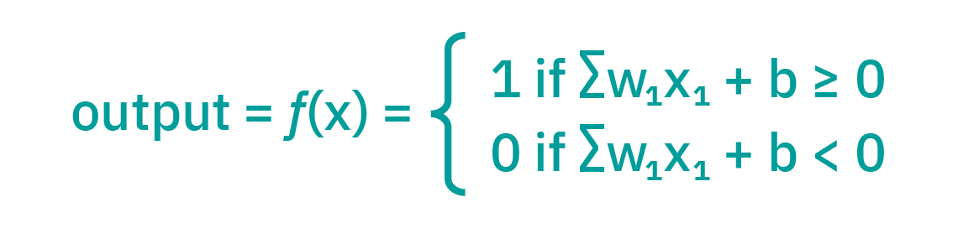
Neural Network
Definition
Neural networks reflect the human brain, allowing computer programs to recognize patterns and solve common problems in AI, machine learning, and deep learning.
Neural networks contain node layers, an input layer, one or more hidden layers, and an output layer.
Each node connects to another and has an associated weight and threshold.
If the output of any individual node is above the specified threshold value, that node is activated, sending data to the next layer of the network. Otherwise, it remains deactivated without sending any data.

Slide 17
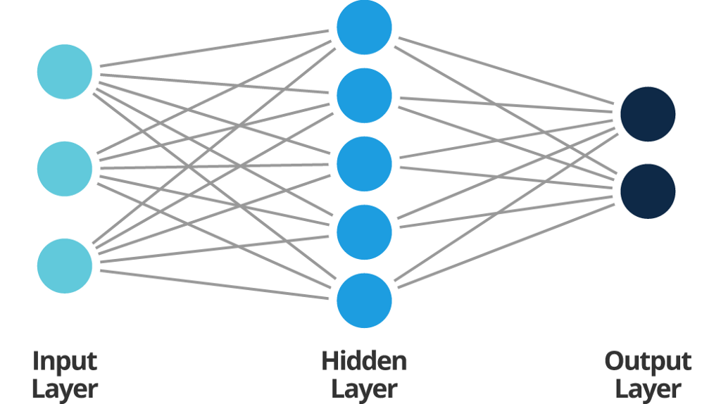
Neural Network(continued)
Input layer
Input nodes provide information from the outside world to the network.
The Input nodes pass the information to the hidden nodes without performing any computation.
In the current scenario, the input layer receives the data from the sensors.
This data contains information about the intersection of either car and road borders and/or the car and traffic.
If there are any intersections, the distance from the car's center to the intersection is recorded and later used.
Hidden layers
The Hidden nodes have no direct connection with the outside world.
They perform computations and transfer information from input to output node.

Slide 18
Neural Network (continued)
A collection of hidden nodes forms a "Hidden Layer.“
While a feedforward network will only have a single input layer and a single output layer, it can have zero or multiple Hidden Layers.
The values for the nodes in the hidden layer are the product of randomly generated weights in the range [-1, 1] and the input values.
The node is activated if the summation of all such products is more significant than the bias.
Output layer
The Output nodes are collectively responsible for computations and transferring information from the network to the outside world.
The direction the car should move is determined by the outputs generated from the Network.
Bias and Weights
Randomly generated values between the range [-1, 1]

Slide 19
Neural Network(continued)
Start with a random values for weights and bias between -1 and -1
level.weights[i][j]=Math.random()*2-1
level.biases[i]=Math.random()*2-1
Feed forward
The arguments are sensor inputs and current level.
The input to the network will be the readings from the sensors.
The outputs are calculated by the product of a given input and its corresponding weight to the output.
sum+=level.inputs[j]*level.weights[j][i]
If the sum is greater than the bias of the neuron/output then the neuron/output will be fired.
if(sum>level.biases[i]){ level.outputs[i]=1; }

Slide 20
Neural Network(continued)
If the sensor reads any intersections then the offsets(distance between the centre of the car and border or other car) is subtracted from 1, so the if the intersection is very far then the value sent to the neuron will be less and vice versa.
const offsets=this.sensor.readings.map(
s=>s==null?0:1-s.offset);
Connecting the brain to the output controls.
if(this.useBrain){
this.controls.forward=outputs[0];
this.controls.left=outputs[1];
this.controls.right=outputs[2];
this.controls.reverse=outputs[3]; }

Slide 21
Neural Visualization
Visualizing the feedback from the output values is very interesting compared to understanding the values.
Starting from the top of the visualizer is the output, which determines the direction of movement for the car, followed by the hidden layers, and the bottom is the input layer filling up with the data from the sensors.
Yellow represents the positive values, whereas blue represents the negative values.
The dashed lines around the hidden layer and the output represents the bias and follows the yellow and blue color format.

Slide 22
Genetic Algorithm
A genetic algorithm is a metaheuristic inspired by Charles Darwin's theory of natural evolution.
This algorithm reflects the process of natural selection, where the fittest individuals are selected for reproduction to produce offspring of the next generation.
Genetic algorithms are commonly used to generate high-quality optimization and search problem solutions.
On the general scale the Genetic Algorithm has the following phases
Initialization
Randomly generated population in the given range and the size generally depends on the problem.
In some specific cases the population is generated in the search space where there is high likely to find the optimal solutions.
Fitness Function
Determines how fit an individual is, and gives a fitness score, it’s an ability of an individual to compete.
The probability that an individual will be selected for reproduction is based on its fitness score.

Slide 23
Genetic Algorithm (continued)
Selection
Selects the fittest individuals and let them pass their genes to the next generation.
If the generation is 0 then the parents are randomly selected from the population.
Two pairs of individuals (parents) are selected based on their fitness scores.
Random Selection – the parents are selected randomly and not recommended, except for generation 0.
Tournament Selection - Provides selection pressure by holding a tournament among S competitors in each group, until it converges to 2 winners from all the groups with S being the tournament size.

Slide 24
Genetic Algorithm(continued)
Crossover
Off springs are created by exchanging the genes of parents among themselves until the crossover point is reached.
Single-point crossover
Two-point crossover
Mutation
Mutation occurs to maintain diversity within the population and prevent premature convergence.
The mutation factor determines the percentage of mutation an off spring can undergo.
Merging the off springs with the population
The offspring's compete with the parents, and after every generation, the performance and diversity of the offspring is measured.
The algorithm terminates if the diversity and performance of the offspring remain constant.

Slide 25
Genetic Algorithm (continued)
Termination
If there is no diversity or reached the certain generation limit.
Parallelization
The process of distributing the neural network across different processors.
In order to achieve quicker and more reliable results, one of the best solutions is to make a copy of the neural network brain on each car and run the simulations.

Slide 26
Genetic Algorithm(continued)
A fitness function is required to evaluate the best car from the parallelization, and multiple optimal functions can be created, such as
The maximum distance covered by the car
The drawback of this approach is that the car can go backward without interacting with the traffic.
The car can go in circles with a fixed center.
The Minimum distance covered in the direction of the y-axis.
While representing the simulation in the computer, the positive value of y is moving in the downward direction; hence, to achieve the maximum route without collisions is to get the car with a minimum value of y.
The best car generated is saved for the mutation. The mutation factor is the percentage that represents the offspring's diversity, where one is 100% new, and zero represents a replica.

Slide 27
Results
Number of Hidden layers | Total number of nodes in hidden layer | Traffic | Mutation factor | Parallelization | Time taken | Number of attempts
1 | 6 | 1 | 1 | 100 |  | Many
1 | 6 | 1 | 1 | 10 |  | Many
1 | 6 | 1 | 1 | 1 |  | Many
1 | 6 | 1 | 0.5 | 100 | 10.584 Sec | 85
1 | 6 | 1 | 0.5 | 10 | 5.699 Sec | 2
1 | 6 | 1 | 0.5 | 1 | 5.144 Sec | 1
1 | 6 | 1 | 0.2 | 100 | 6.095 Sec | 1

Slide 28
Results
Number of Hidden layers | Total number of nodes in hidden layer | Traffic | Mutation factor | Parallelization | Time taken | Number of attempts
1 | 6 | 1 | 0.2 | 10 | 5.016 Sec | 1
1 | 6 | 1 | 0.2 | 1 | 4.743 Sec | 1
1 | 6 | 1 | 0.1 | 100 | 7.742 Sec | 1
1 | 6 | 1 | 0.1 | 10 | 6.332 Sec | 1
1 | 6 | 1 | 0.1 | 1 | 4.765 Sec | 1
1 | 6 | 5 | 0.1 | 1 |  | Many
1 | 6 | 5 | 0.1 | 10 | 11.568 Sec | 1

Slide 29
Results
Number of Hidden layers | Total number of nodes in hidden layer | Traffic | Mutation factor | Parallelization | Time taken | Number of attempts
1 | 6 | 5 | 0.1 | 100 | 16.354 Sec | 1
1 | 6 | 5 | 0.2 | 100 | 13.857 Sec | 1
1 | 6 | 5 | 0.2 | 10 | 12.593 Sec | 1
1 | 6 | 5 | 0.2 | 1 | 11.805 Sec | 1
1 | 6 | 5 | 0.5 | 100 | 12.810 Sec | 1
1 | 6 | 5 | 0.5 | 10 | 11.876 sec | 1
1 | 6 | 5 | 0.5 | 1 | 12.440 Sec | 1

Slide 30
Results
Number of Hidden layers | Total number of nodes in hidden layer | Traffic | Mutation factor | Parallelization | Time taken | Number of attempts
1 | 6 | 7 | 0.1 | 100 | 21.988 Sec | 95
1 | 6 | 7 | 0.1 | 10 | 16.120 Sec | 1
1 | 6 | 7 | 0.1 | 1 | 15.024 Sec | 1
1 | 6 | 10 | 0.4 | 300 | 50.086 Sec | 110
1 | 6 | 10 | 0.4 | 10 | 30.054 Sec | 1
1 | 6 | 10 | 0.1 | 1 | 28.069 Sec | 1

Slide 31
Future Work
Considering the weight of the car will way in many empirical challenges.
Considering the lane speed, signals while changing lanes, automatic lights synchronized with the clock, oncoming traffic, merging lanes, and reading the signals on the road.
This project just considered the straight-line road and paved the way for the curved, sharp turns, roundabouts, and many more real-life scenarios.
Using other techniques of neural network to initialize the values for weights and bias.
Fitness function that rewards the car by maintaining the course in a single lane and following the speed regulations and penalizes for unnecessary lane changes.
Regarding other selection algorithms and drawing the comparison for the selection of the parents and offspring.
Implementing the cross-over algorithm.

Slide 32
THANK YOU

