Slide 1

budgEAT

Slide 2


Where flavour meets affordability

Slide 3
CONTENTS
Problem Statement
Modularization of Problem Statement
Design Methodology
Software C Hardware Requirements
Test case specification
Screenshot of output
Conclusion
GitHub repository and YouTube video explanation links

Slide 4
PROBLEM STATEMENT
Many college students struggle to balance their food expenses with limited budgets, facing challenges in finding the best value among numerous campus dining options. Diverse college demographics, including coeducational, women's, degree, and polytechnic institutions, further complicate food choices. A user-friendly platform is needed to help students identify affordable food options on campus, tailored to their budget and location constraints.

Slide 5
MODULARIZATION AND PROBLEM STATEMENT
User Interface Module: Designing and implementing a user-friendly
website interface for easy navigation and interaction.
Store Integration Module: Developing a module to integrate data from
various food stores within your college campus, including menu items
and prices.
Budget Filtering Module: Creating a module that allows users to set their
budget constraints and filters out food options accordingly.
Recommendation System Module: Implementing a module that
provides personalized recommendations based on user preferences,
budget, and dietary restrictions.
Favorite Food Management Module: Implementing a module that allows
users to save their favorite food items for quick access and future
reference. This module would enable users to easily revisit and reorder
their preferred meals without having to search through the entire menu
each time.

Slide 6
DESIGN METHODOLOGY
User Research: Conduct surveys and interviews to understand
the budget constraints and food preferences of college students.
Prototyping: Create wireframes and mockups to visualize the user interface and system flow.
Agile Development: Adopt an iterative approach to software development, allowing for continuous improvement based on user feedback.
Backend Development: Implement algorithms to match user budgets with available food items and store locations.
Frontend Development: Develop a responsive and user-friendly interface for easy navigation and int

Slide 7
SOFTWARE AND HARDWARE REQUIREMENTS
Software:
Frameworks: Node.js (for backend), React.js (for frontend)
Database: MongoDB
IDEs: Visual Studio Code
Hardware:
Server: Minimum 2GB RAM, 1GHz Processor
Client: Chrome web browser

Slide 8
TEST CASE SPECIFICATION
Budget filtering Verify filtering works for budgets within, outside, and at the limit of the available range
.Favorite Food Management : Ensure adding, removing, and preventing duplicates in the favorites list functions correctly.
User Interface : Test interface responsiveness, usability, and
error message display.
Database Integrity : Verify correct storage and retrieval of food items and favorites list integrity
.Integration : Test integration with external systems and
compatibility across browsers and devices.

Slide 9
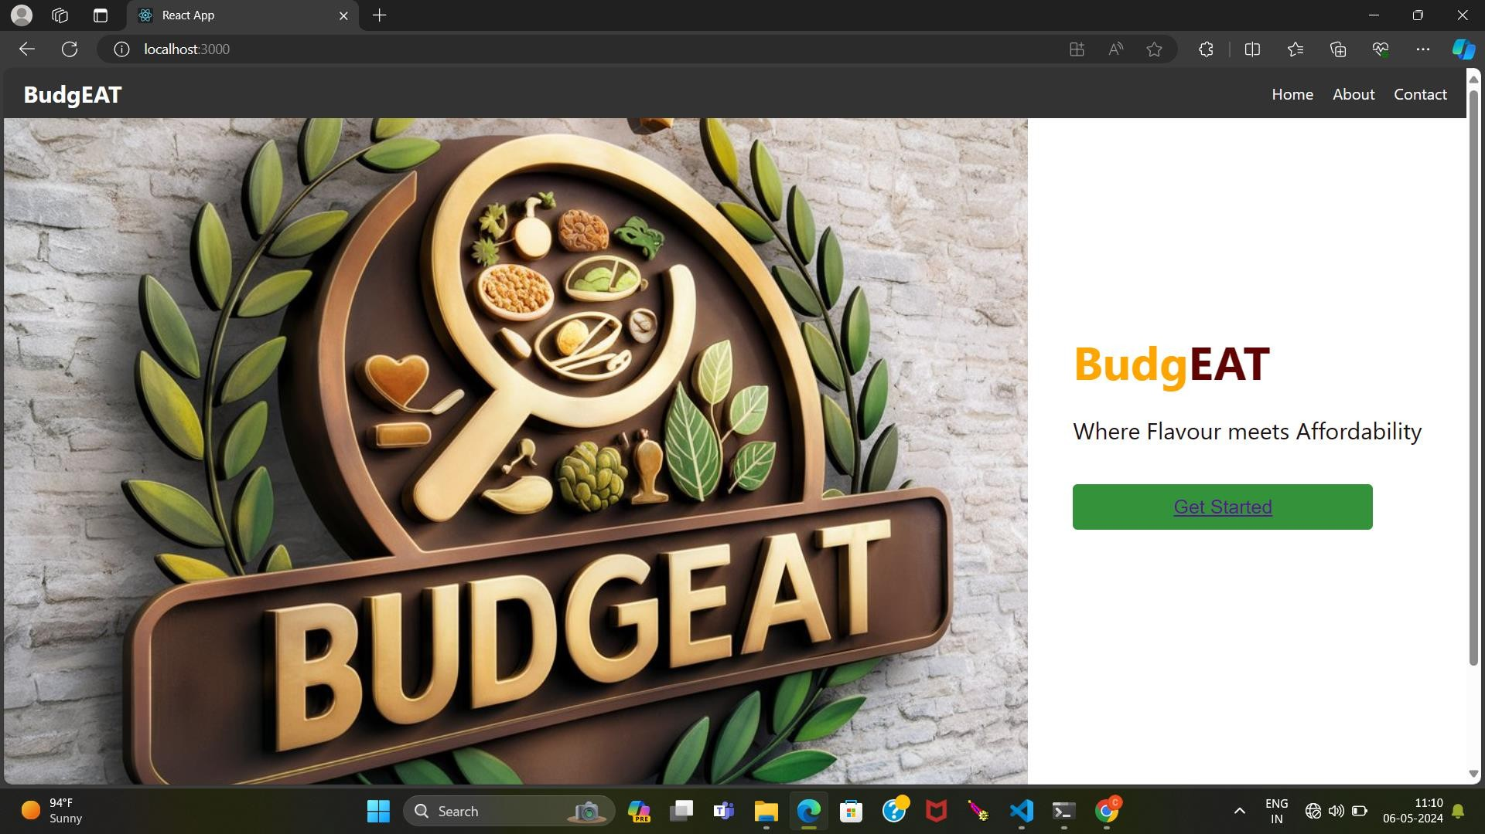
SCREENSHOT OF OUTPUT

Slide 10
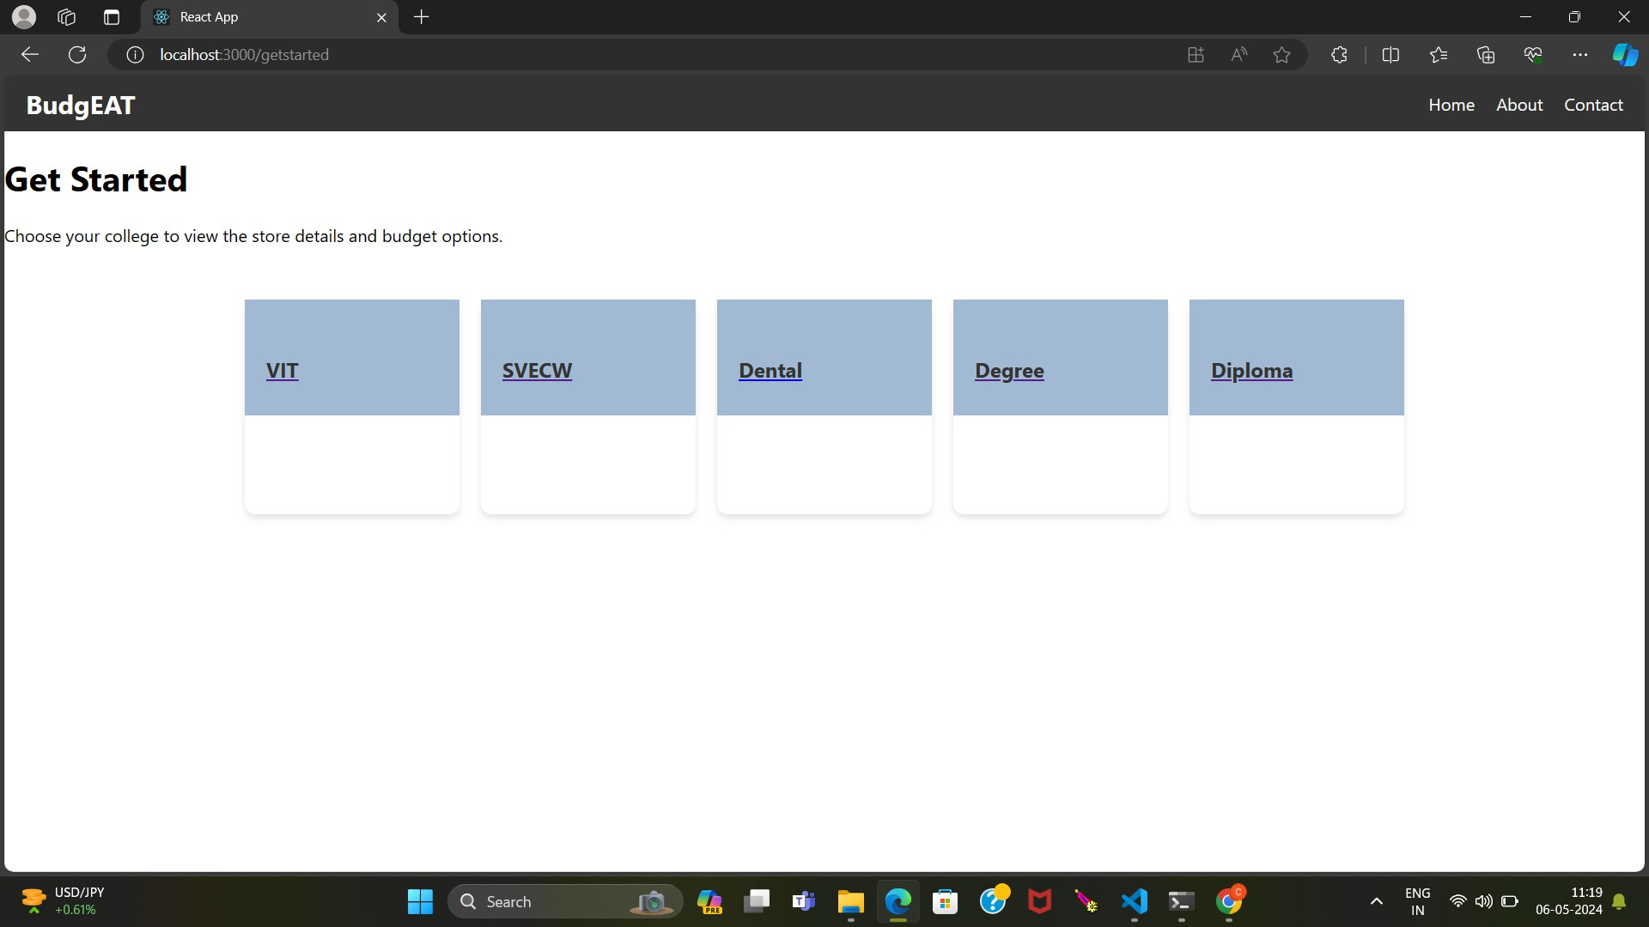
.

Slide 11
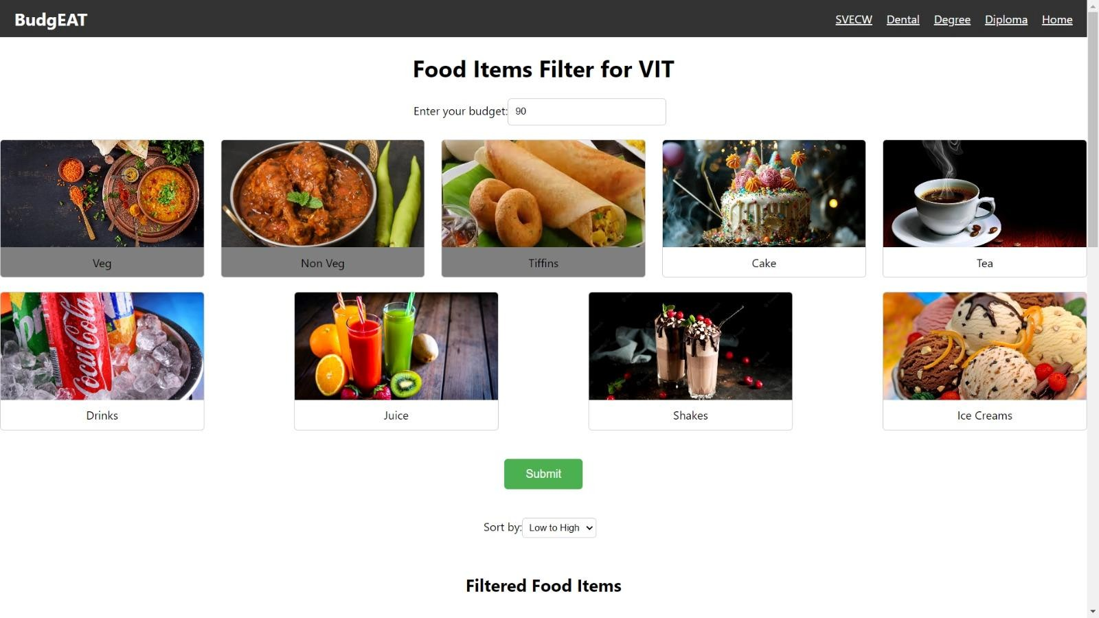
.

Slide 12
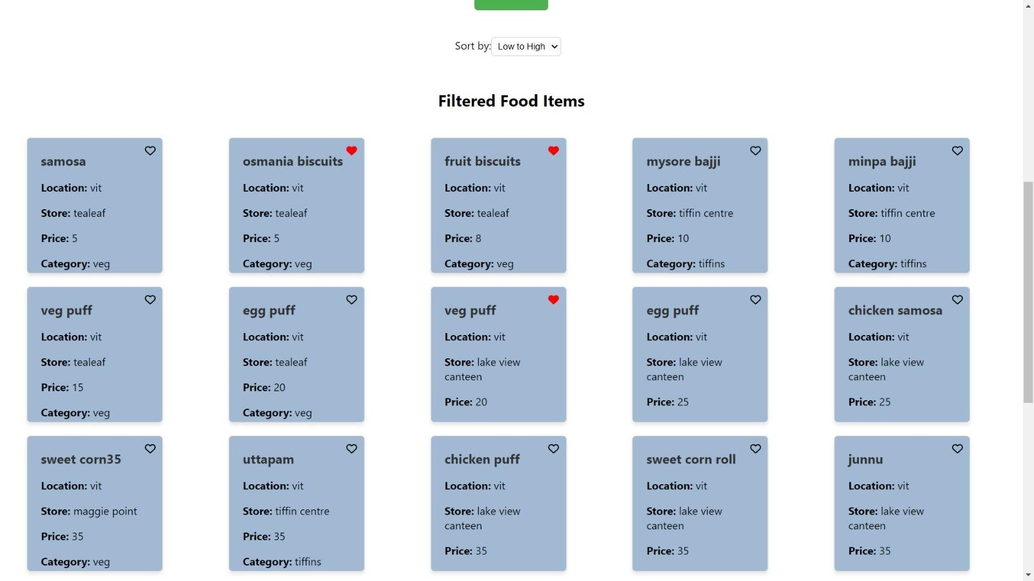
.

Slide 13
CONCLUSION
The project aims to address the challenge of filtering food items under budget and managing favorite foods across different college domains. By implementing a user-friendly interface, robust database management, and effective integration with external systems, the project seeks to provide a seamless experience for users to explore and select food options within their budget constraints while conveniently managing their favorite items. With careful attention to software and hardware requirements, along with thorough testing and refinement, the project aims to deliver a valuable solution that enhances the dining experience for college students and promotes healthy eating habits within budgetary limits.

Slide 14
GitHub repository and YouTube video explanation link
https://github.com/Prudhvi226/Mini-Project/tree/main

Slide 15
A.DIVYA
T.CHARAN ROHIT
CH.MARTHA GRACE- TEAM LEAD D.PRUDHVI RAJ
G.VASAVI
thank you

