Slide 1

FRAUD DETECTION IN CREDIT CARDS USING MACHINE LEARNING
Department of Computer Science and Engineering
Under The Guidance of
Dr. M. BABU RAO, M.Tech, PhD
Professor, Head of The Department
BY
T. Eekshitha (17481A05I2)
G. N. V. Prudhvi (17481A05M8)
V. Anusha (17481A05M6)
Abdul Kaleem (17481A05K9)

Slide 2
ABSTRACT
Credit Card Fraud is increasing considerably with the development of modern technology.
Credit card fraud happens frequently and leads to massive financial losses. Online transaction have increased drastically significant no of online transaction are done by online credit cards.
Identification of fraud credit card transactions is important to credit card companies for the prevention of being charged for items transaction of items which the customer did not purchase.
In this project intends to illustrate the modeling of a knowledge set using machine learning with Credit Card Fraud Detection.
Our model will determine whether a new transaction tends to be fraud or legitimate. We have an objective to detect 100% of the fraud transactions while reducing invalid fraud classifications.

Slide 3
OBJECTIVES
The main objective of this project is to implement machine learning algorithms to detect credit card fraud detection with respect to time and amount of transaction
This project helps to increase the security in credit card transactions.
To build a predictive model such that with high efficiency in terms of accuracy.
Prediction of frauds in credit cards can be made very efficiently and effectively.
Evaluating Deep Learning models for automated decision making

Slide 4
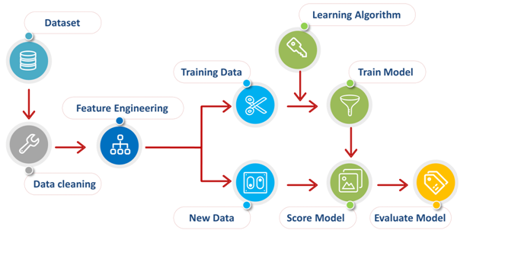
METHODOLOGY
It predicts that the transaction is a Fraud or normal by using the Machine learning algorithms. And we used the Random Forest regression model to predict it.
The steps to be followed to build the model are :
Training the data
Data preprocessing
Model training
Prediction
Using the Flask deployment model we are designed to develop the UI for the project

Slide 5
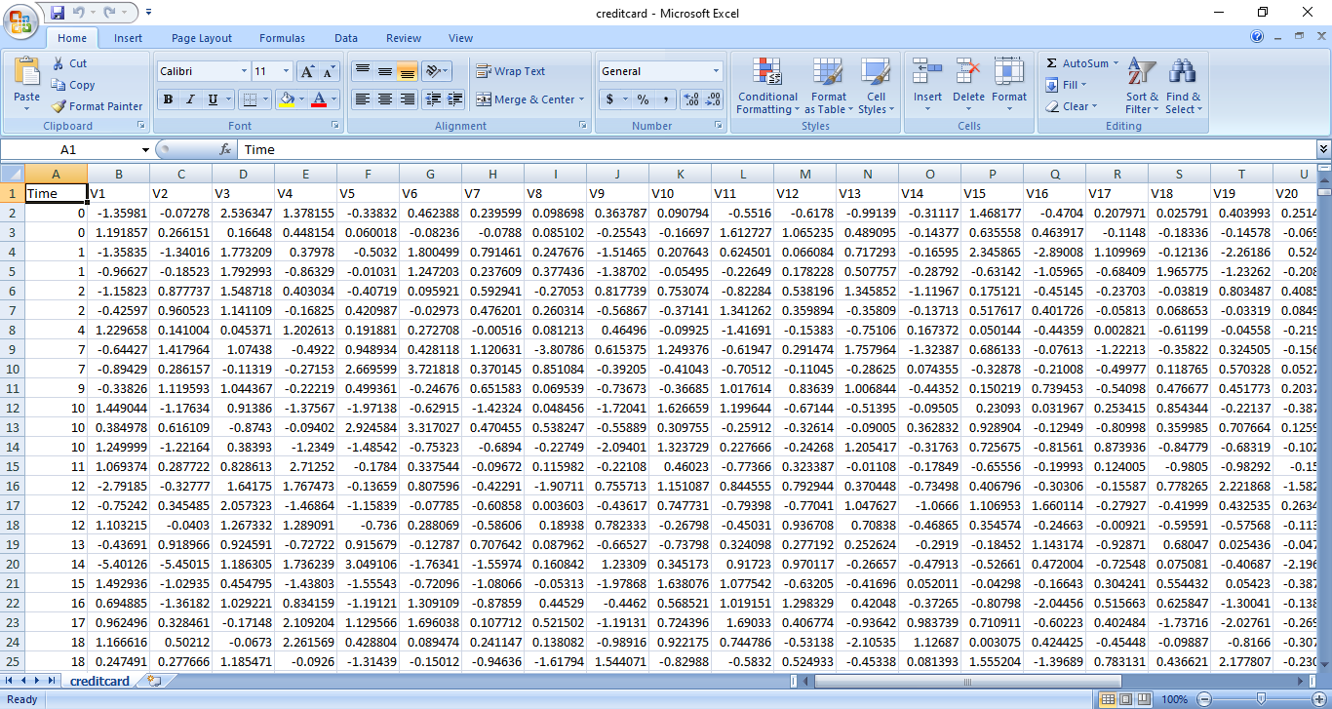
IMPLEMENTATION The proposed system is implemented using Jupyter Notebook and Flask. The steps included in this implementation are Data gathering and preprocessing, model training and prediction.
The data is sourced from the Kaggle.
Dataset contains totally 30 attributes and 284,807 records.
Dataset contains the details of the transaction that done through the credit cards in september 2013 by European Cardholders.

Slide 6
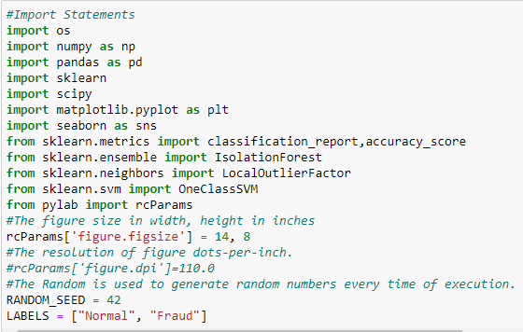
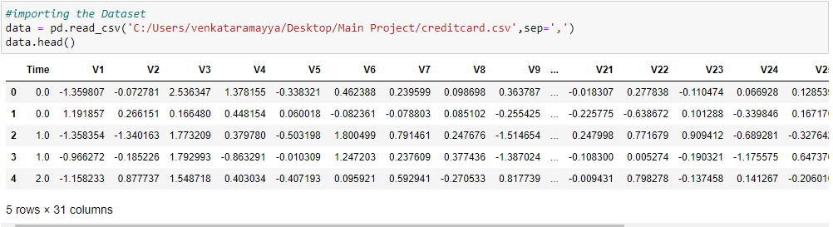
Data Preprocessing : Data preprocessing can be done in 5 steps Step 1: Importing the libraries and reading the data.

Slide 7

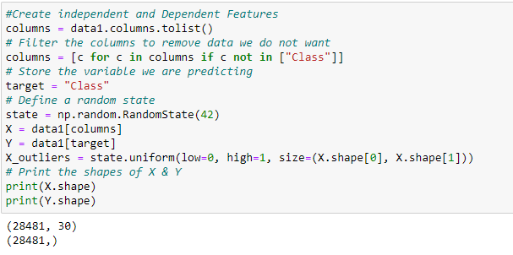
Step 2: Checking for missing values in the dataset.
Missing Values
Step 3: Creating Dependent and Independent Features.

Slide 8
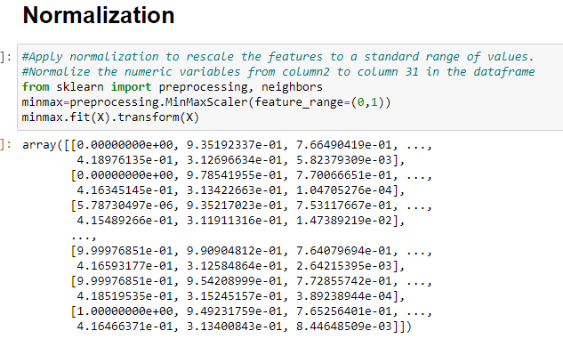
Step 4: Normalization The StandardScaler will transform the data so that its distribution will have a mean value 0 and a standard deviation of 1.

Slide 9
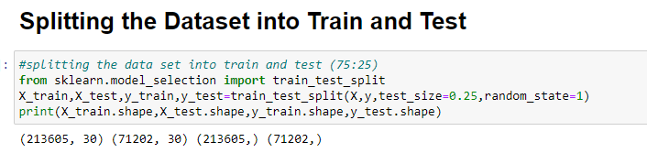
Step 5: Splitting the dataset for training and testing.

Slide 10
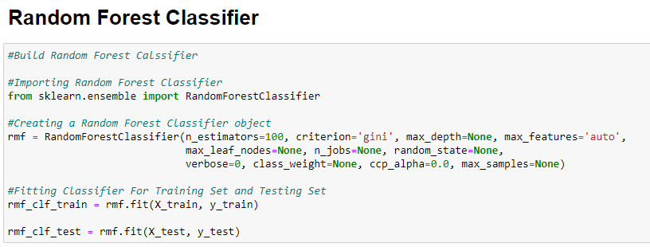
Model Training : Using the training data we train the Random Forest model.
Here we are importing the Random Forest Classifier Model to predict the Fraud Transactions.

Slide 11
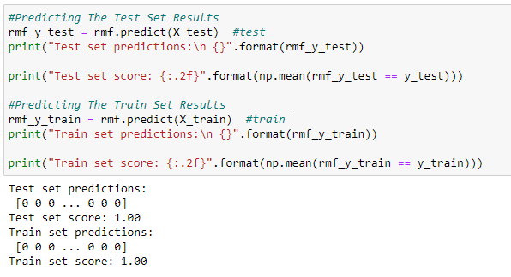
Prediction : Using the model built we predict the attrition values for the testing data and training data.

Slide 12
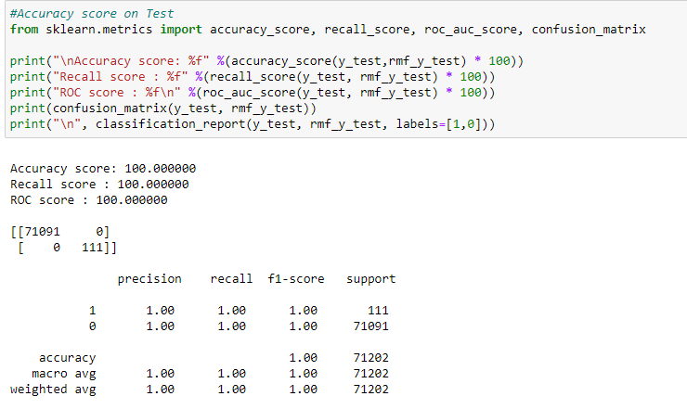
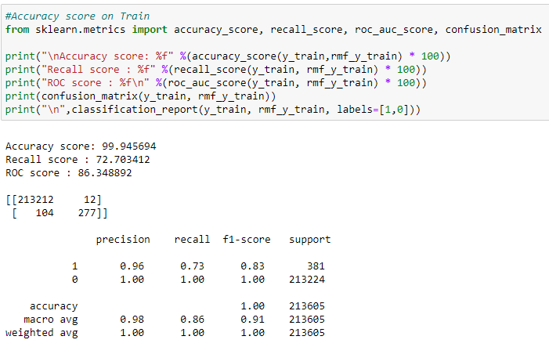
Accuracy Score : Using the predicted data and the test data we got the accuracy score . Confusion Matrix : Using the confusion matrix we can get the detailed representation of the accuracy score.
For Test Data
For Train Data

Slide 13
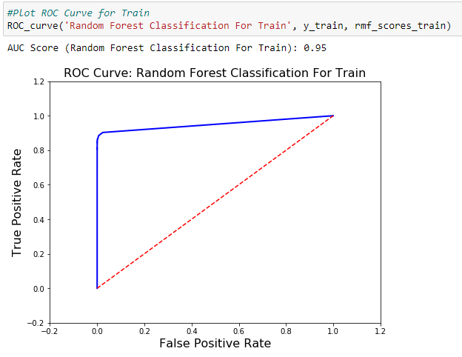
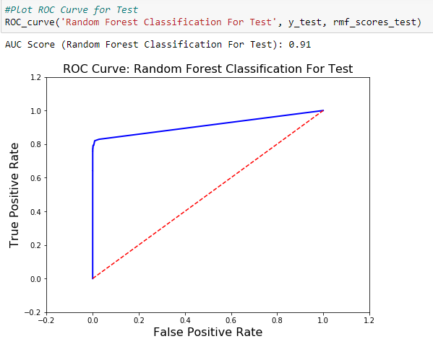
ROC Curve : The receiver operating characteristic curve is a graphical plot that illustrates the diagnostic ability of a random forest classifier system as its discrimination threshold is varied.
For Train Data
For Test Data

Slide 14
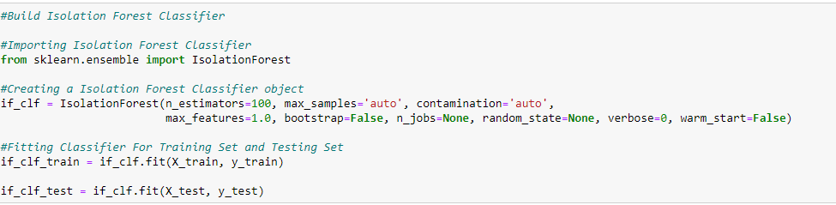
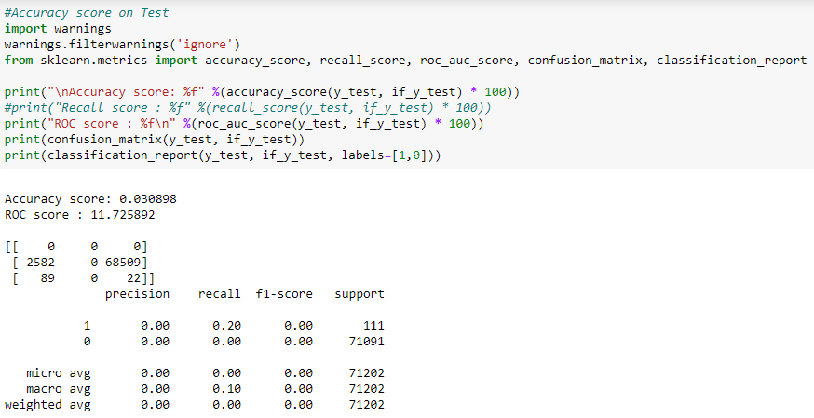
Other Classification Algorithms
Isolation Forest Algorithm

Slide 15
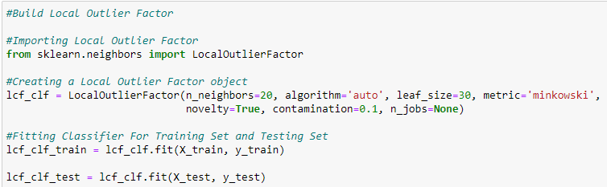
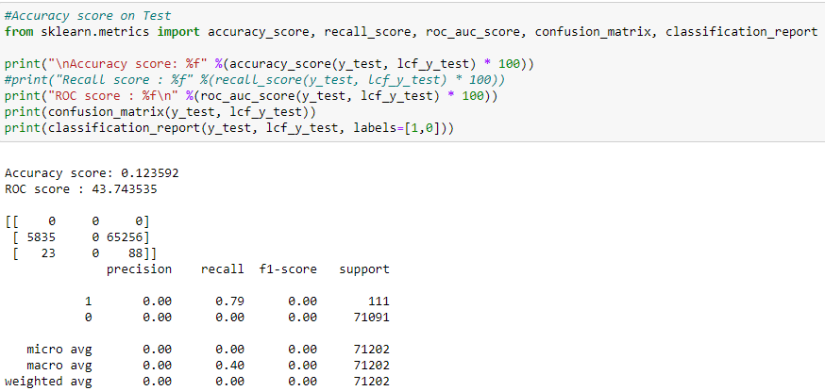
Local Outlier Factor

Slide 16
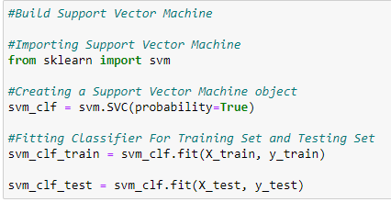
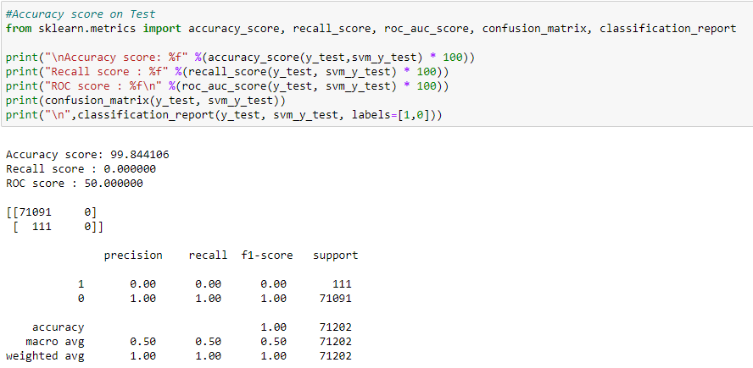
Super Vector Machine (SVM)

Slide 17
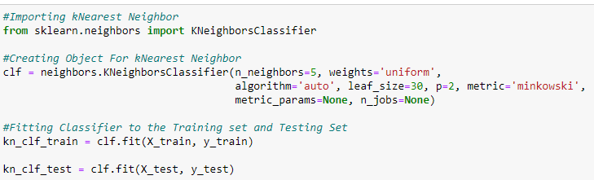
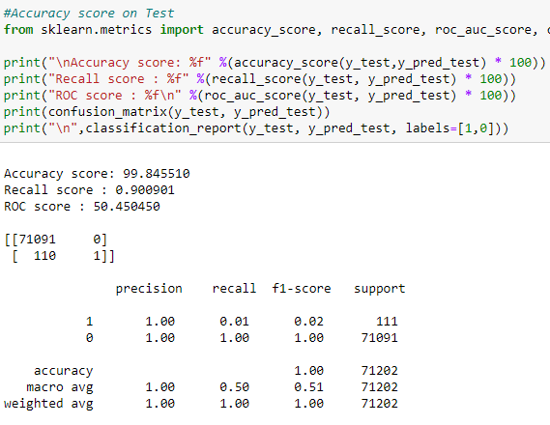
kNearest Neighbor

Slide 18
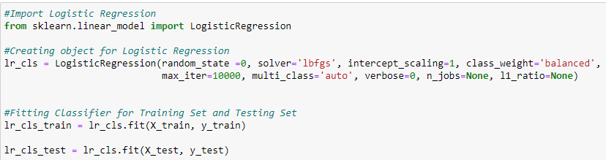
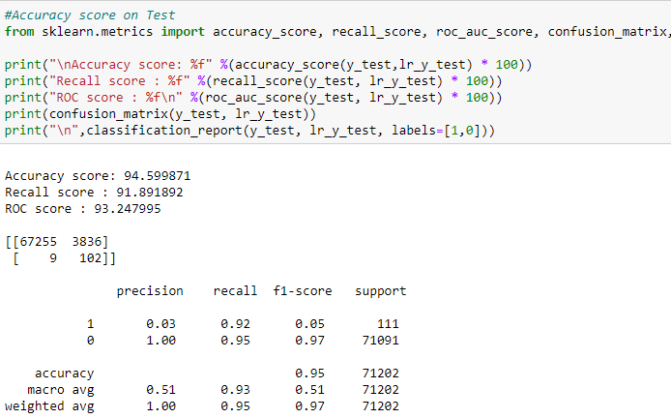
Logistic Regression

Slide 19
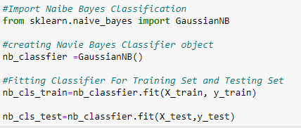
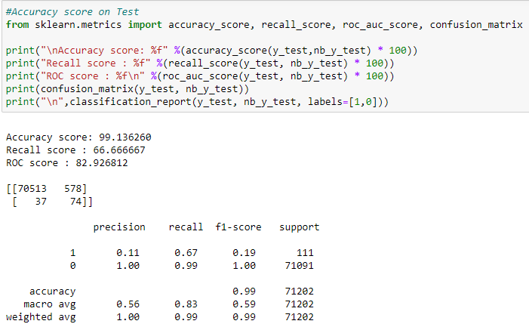
Navie Bayes Classification

Slide 20
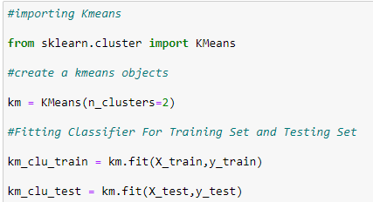
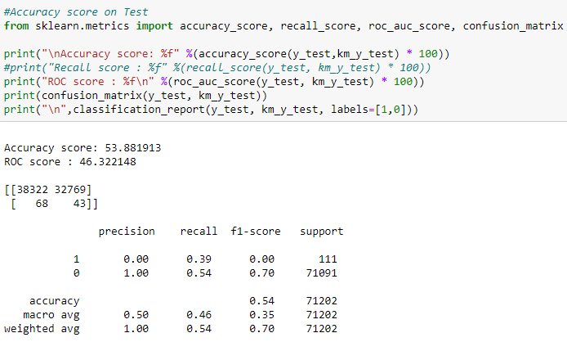
Kmeans Classification

Slide 21
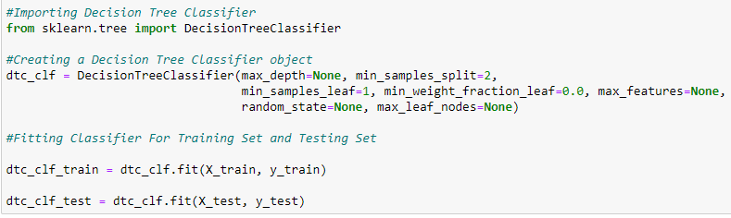
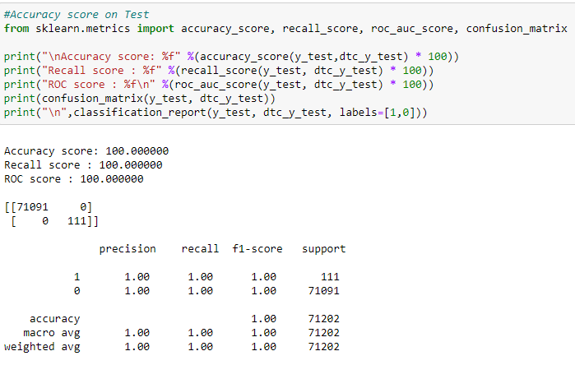
Decision Tree Classifier

Slide 22
Classification Algorithm | Test Data Accuracy | Train Data Accuracy
Isolation Forest Algorithm | 0.0337 | 0.0308
Local Outlier Factor | 0.1235 | 0.137
Support Vector Machine (SVM) | 99.84 | 99.82
kNearest Neighbor | 99.84 | 99.82
Logistic Regression | 94.5 | 94.67
Navie Bayes Classification | 99.13 | 99.13
Kmeans Clustering | 29.61 | 29.53
Decision Tree Classifier | 100 | 99.89
Random Forest | 100 | 99.94
From the table it can be observed that Random Forest Regression gave the best accuracy among all the other algorithms.

Slide 23
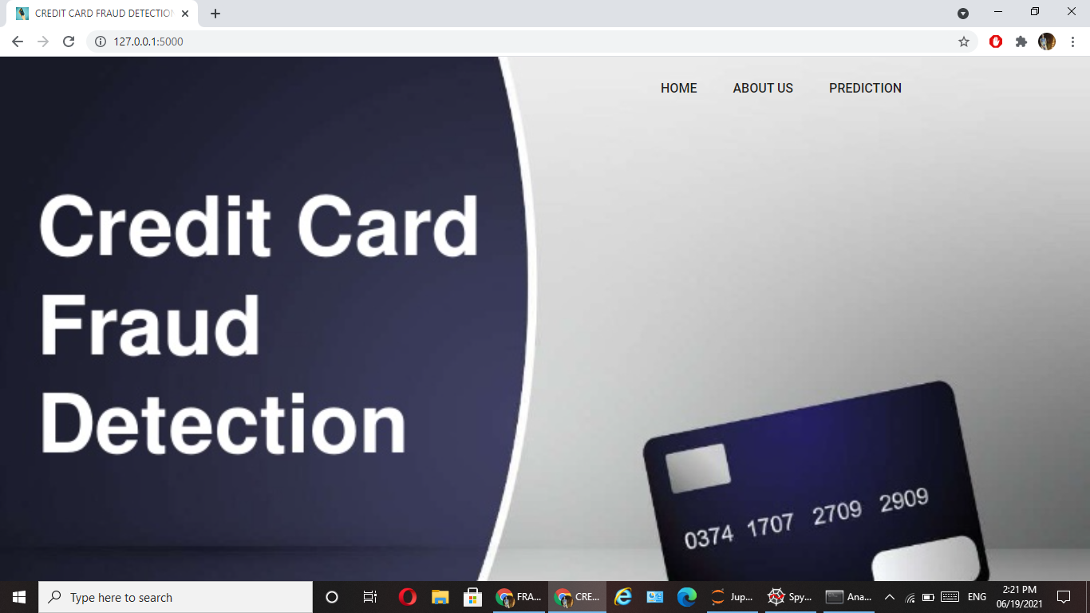
Result: Here we are predicting that the Transaction is normal or Fraud. The result will be: 0 ----→ Normal Transaction. 1 ----→ Fraud Transaction
Home Page

Slide 24
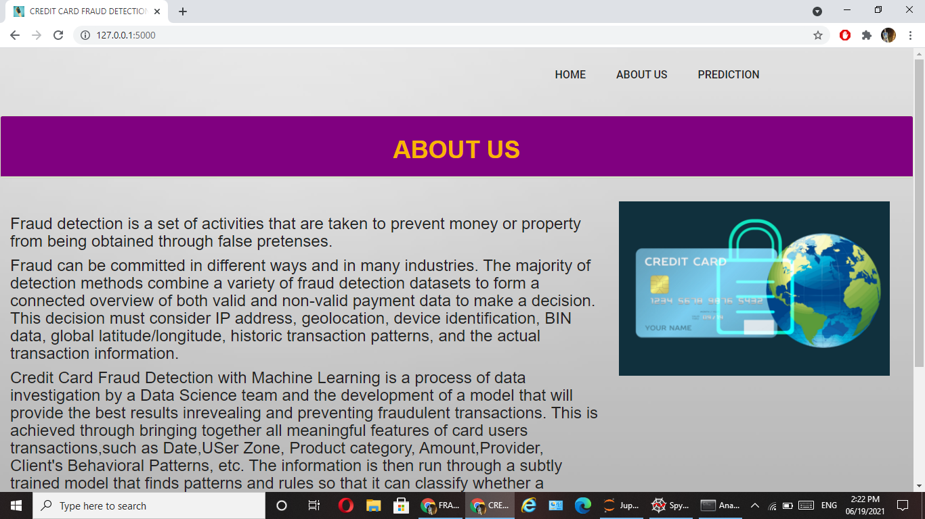
About Page

Slide 25
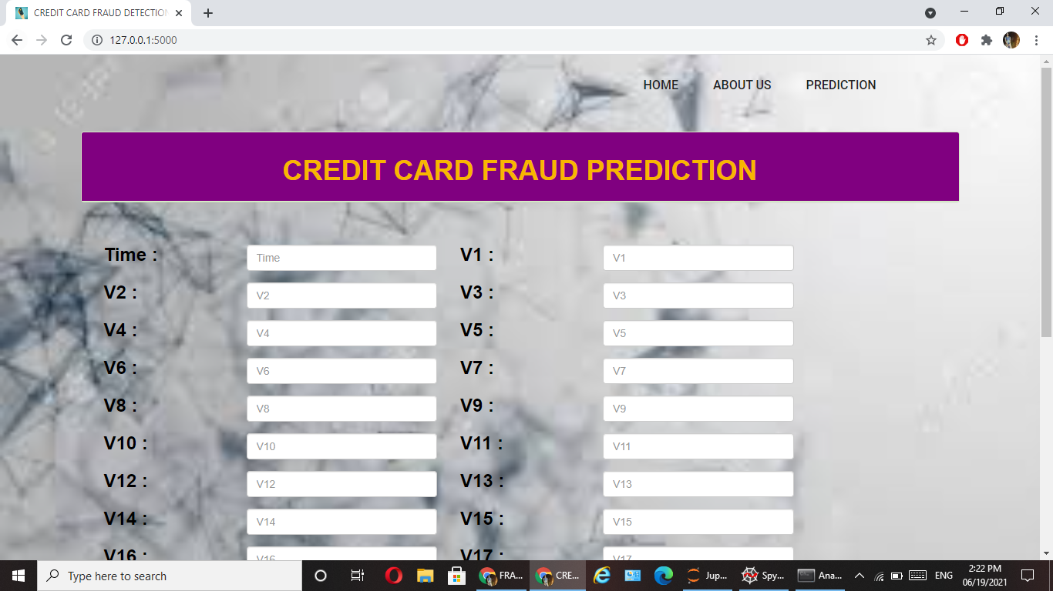
Prediction Page

Slide 26
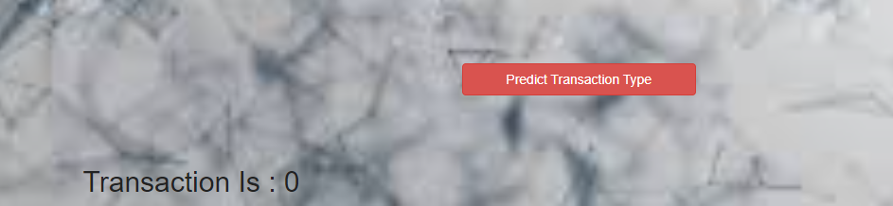
Result: 0 ---→ Transaction is Normal.

Slide 27


