Slide 1
Small Network at Tech Institute- Critical Issues and Planning a Migration
TEAM
Saikiranreddy Kota
Nikita Patole
Siva BIKKINA
PRUDHVI KRISHNA MODEGUNTA

Slide 2
Introduction
In this project, we plan a migration over a period of two years of the current network which is outdated to an advanced network which is scalable, secure, flexible, and reliable. Thus, the four-campus Tech Institute intends to replace its current network infrastructure with a much better one that has high speed and appropriate placements of modern gear.

Slide 3
Project Summary
7450 pupils in all, 50 members of support staff, 50 teachers, and 20 managers.
• Campus-A exclusively houses the School of Media and includes 4 classes (500 students)
• Campus-B is home to three schools: Business (2000 students), Engineering (3000 students), and Health Sciences (150 students), and it includes 12 classrooms.
• Campus-C has 8 classrooms, 350 students enrolled in the School of General Arts, and IT services (support staff of 20).
• Campus-D houses the School of Aviation and has four classes (100 students).

Slide 4
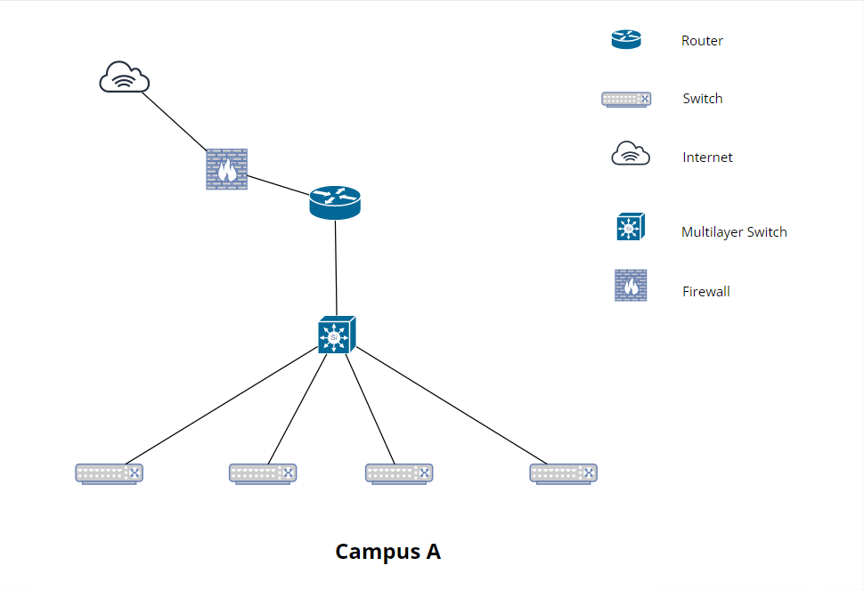
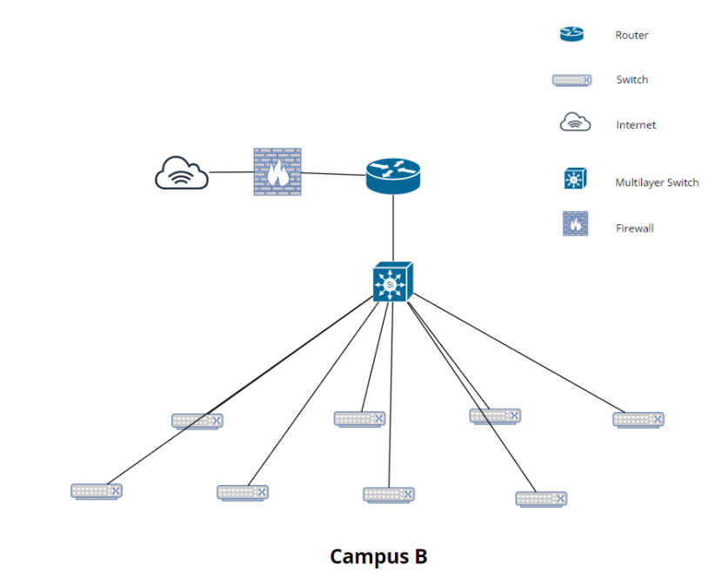
Network Designs (Stage I)

Slide 5
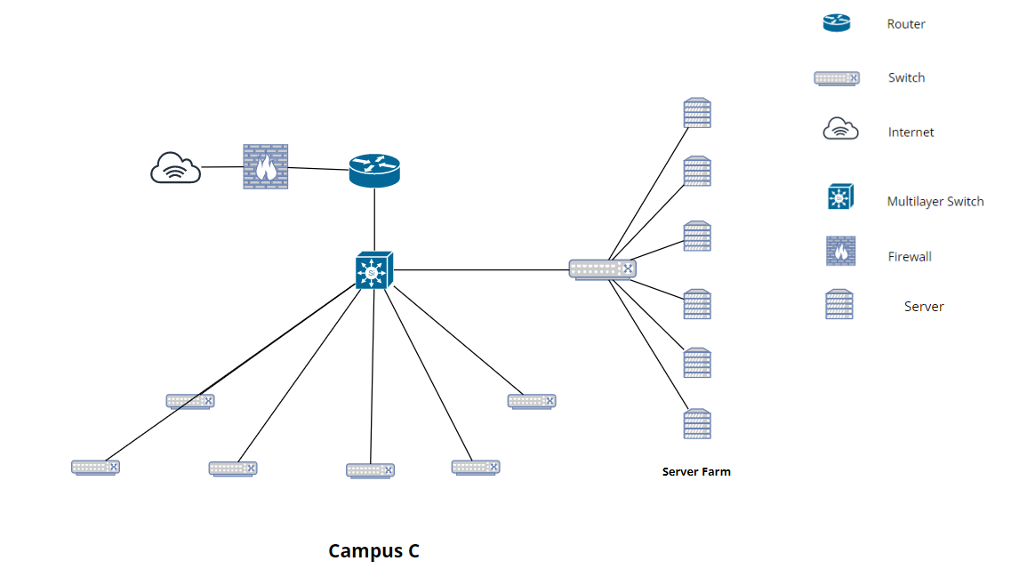
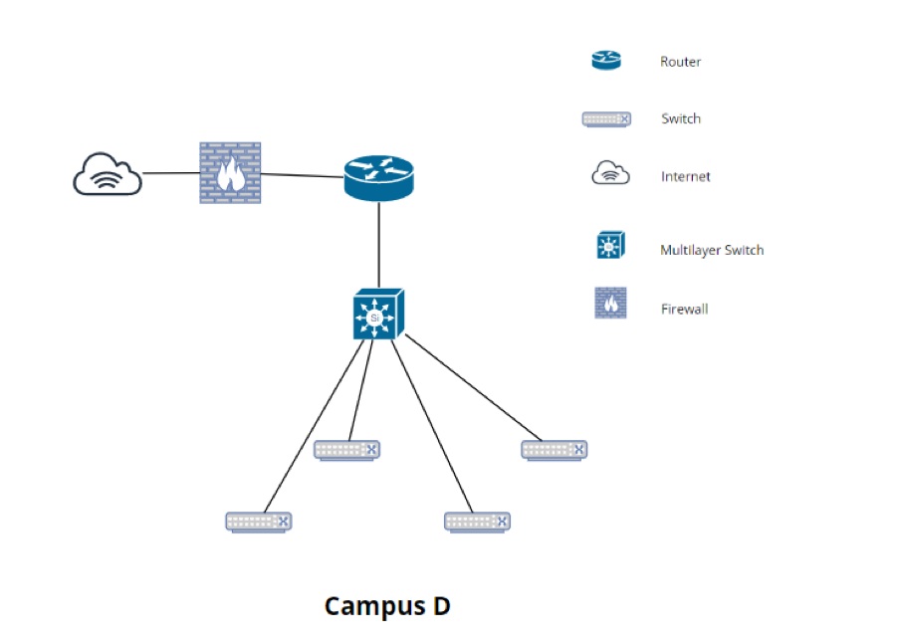
Network Designs (Stage II)

Slide 6
Ip Address Distribution
ACCESS POINT DISTRIBUTION TABLE
Campus | IP range | Subnet Mask
Campus A | 172.16.2.1 – 172.16.2.254 | /23
Campus B | 172.16.3.1 – 172.16.5.254 | /23
Campus C | 172.16.6.1 – 172.16.7.254 | /24
Campus D | 172.16.8.1 – 172.16.8.254 | /24
VLAN NAMES | NETWORK ADDRESS | SUBNET MASK | Default Gateway
WAP - A | 192.168.7.0 | 255.255.255.192 | 192.168.7.1
WAP - B | 192.168.7.64 | 255.255.255.192 | 192.168.7.65
WAP - C | 192.168.7.128 | 255.255.255.192 | 192.168.7.129
WAP - D | 192.168.7.192 | 255.255.255.192 | 192.168.7.193

Slide 7
Hardware Details
UPS: APC- SYH4K6RMT
Layer 3 Switch: Cisco WS-c2960+48PST-S
Wireless Access Point: Cisco Catalyst C9200L-24P-4G-E
Firewall: ASA5516-FPWR-K9
Router: Cisco 4000 Router ISR4331
Wireless LAN Controller: C1-AIR-CT3504-K9 - Cisco WLAN Controller
UPS: APC Symmetra RM 2kVA

Slide 8
Cost Estimation
Campus A - 12640$
Campus B - 14640$
Total cost of Campus A and B Upgradation for the first year – 27280$
Campus C - 12460$
Campus D - 10540$
Total cost of Campus C and D Upgradation – 23000$

Slide 9
Implementation Plan
For more flexibility and performance, networks must be upgraded. For Campus A and B, we intend to begin the first stage of network upgrading on September 10, 2022
For Campus C and D, we intend to begin the second stage of network upgrading on September 10, 2023

Slide 10
Conclusion
We can improve the network in two stages while staying within the budget. For two years, the expected total cost is CDN $50280. The redesign and application of the suggested network topology will successfully address all network-related problems.
THANK YOU

