Slide 1
Secure data hiding in images using stegnography
CAPSTONE PROJECT
Presented By: Chalasni Prudhvi Sai
Student Name : Chalasni Prudhvi Sai
College Name & Department : Dr. Lankapalli Bullaya College of Engineering

Slide 2
OUTLINE
Problem Statement
Technology used
Wow factor
End users
Result
Conclusion
Git-hub Link
Future scope

Slide 3
Problem Statement
The goal of this project is to develop a method for securely transmitting sensitive information within an image file using steganography techniques. Steganography allows for the concealment of a secret message within a non-secret medium (in this case, an image), providing an additional layer of security beyond traditional encryption.

Slide 4
Technology used
Programming Language: Python is chosen for its extensive library support and ease of use.
Libraries:
OpenCV: Used for image processing and manipulation.
os: Used for operating system interactions, such as opening files.
PIL (Python Imaging Library): Could be used for additional image manipulation and processing tasks.

Slide 5
Wow factors
Real-time Encoding and Decoding: The project allows users to hide and retrieve secret messages within images almost instantly.
High Image Quality: The technique ensures the image looks unchanged to the human eye, making it hard to detect any hidden message.
User Input: Users can add a passcode for an extra layer of security, ensuring only authorized individuals can decode the message.
Cross-Platform Compatibility: Implemented in Python, the tool can run on various operating systems like Windows, macOS, and Linux.

Slide 6
End users
Journalists: Can securely share sensitive information without detection.
Whistleblowers: Can transmit critical information safely and discreetly.
Activists: Can communicate securely in regions with limited freedom of speech.
Business Professionals: Can share confidential information within images to authorized colleagues.
Everyday Users: Can use it for personal, secure communication with friends and family.

Slide 7
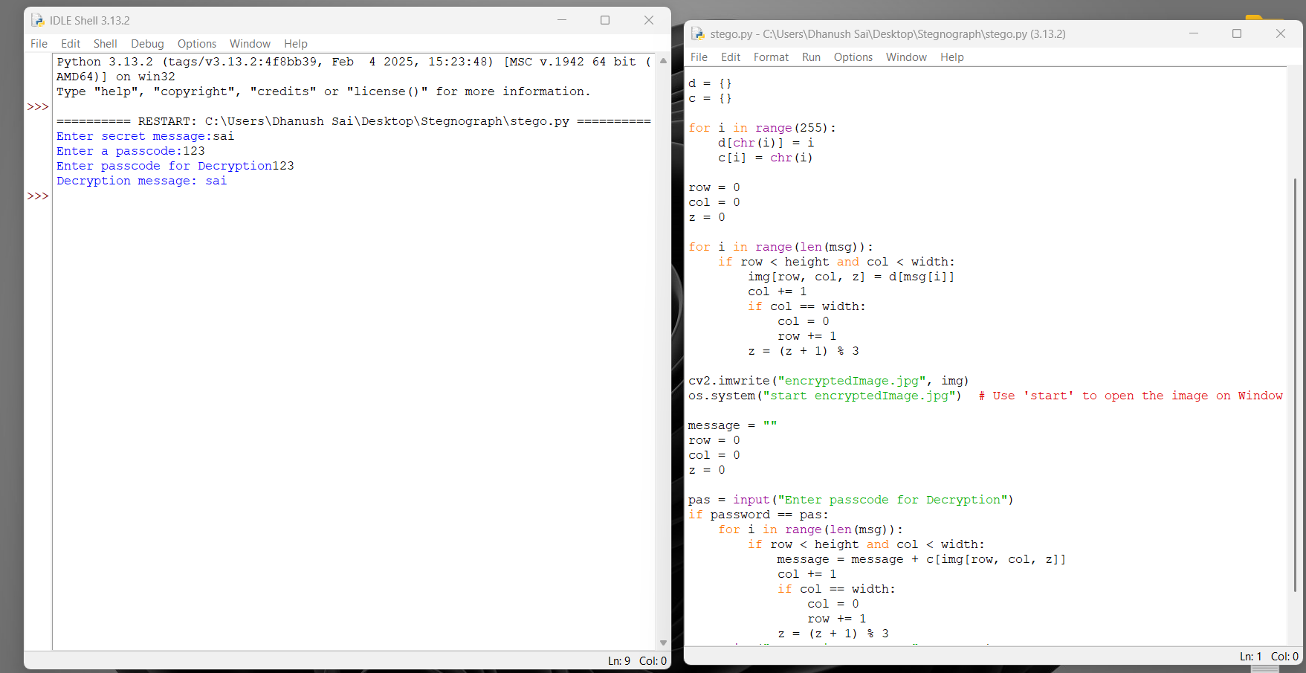
Results

Slide 8
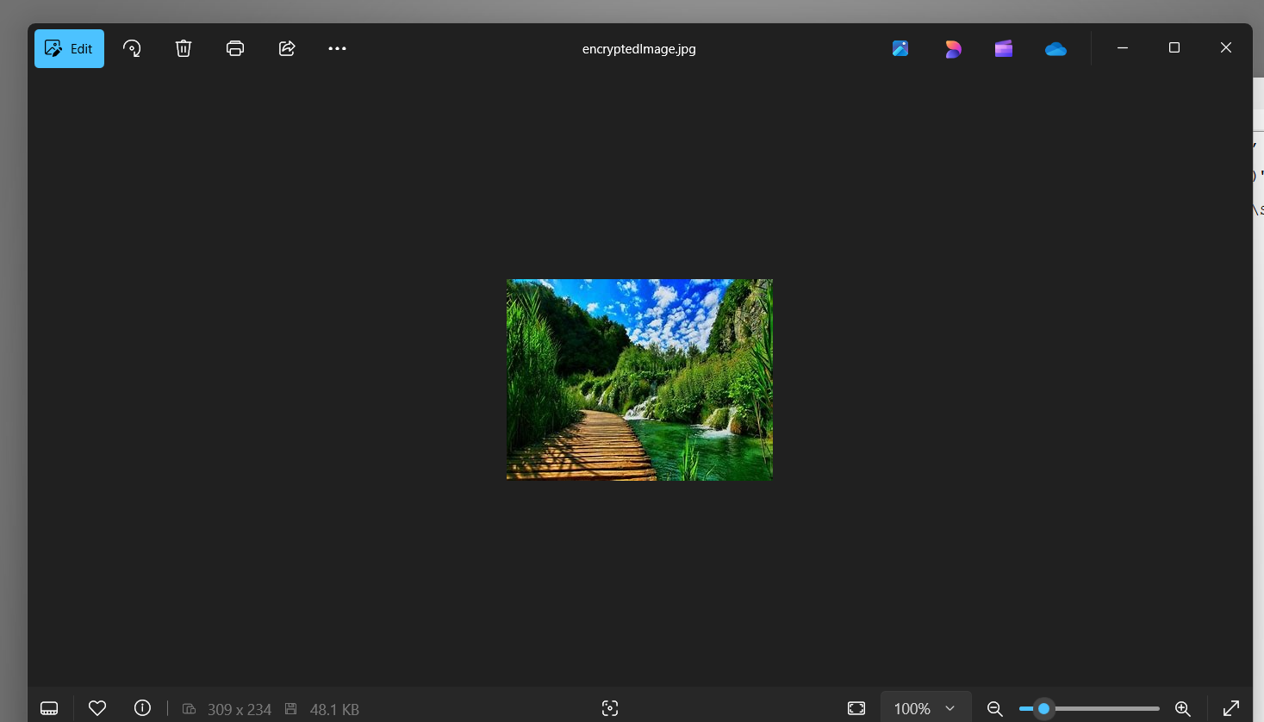

Slide 9
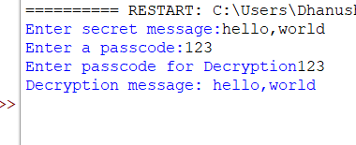

Slide 10
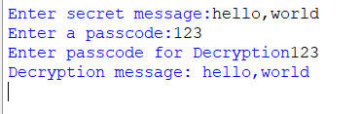

Slide 11
Conclusion
Our steganography project shows that it's possible to hide secret messages in images securely. Using Python and its libraries like OpenCV, we created a tool that lets users hide and retrieve messages without changing the image quality. The extra security with a passcode ensures only the right people can access the hidden message.

Slide 12
GitHub Link
PrudhviSai990/Stegnography: This is made as part of the cybersecurity internship

Slide 13
THANK YOU

