Slide 1
Secure data hiding in images using stegnography
CAPSTONE PROJECT
Presented By: Chalasni Prudhvi Sai
Student Name : Chalasni Prudhvi Sai
College Name & Department : Dr. Lankapalli Bullaya College of Engineering

Slide 2
OUTLINE
Problem Statement
Technology used
Wow factor
End users
Result
Conclusion
Git-hub Link
Future scope

Slide 3
Problem Statement
The goal of this project is to develop a method for securely transmitting sensitive information within an image file using steganography techniques. Steganography allows for the concealment of a secret message within a non-secret medium (in this case, an image), providing an additional layer of security beyond traditional encryption.

Slide 4
Technology used
Programming Language: Python is chosen for its extensive library support and ease of use.
Libraries:
OpenCV: Used for image processing and manipulation.
os: Used for operating system interactions, such as opening files.
PIL (Python Imaging Library): Could be used for additional image manipulation and processing tasks.

Slide 5
Wow factors
Real-time Encoding and Decoding: The project allows users to hide and retrieve secret messages within images almost instantly.
High Image Quality: The technique ensures the image looks unchanged to the human eye, making it hard to detect any hidden message.
User Input: Users can add a passcode for an extra layer of security, ensuring only authorized individuals can decode the message.
Cross-Platform Compatibility: Implemented in Python, the tool can run on various operating systems like Windows, macOS, and Linux.

Slide 6
End users
Journalists: Can securely share sensitive information without detection.
Whistleblowers: Can transmit critical information safely and discreetly.
Activists: Can communicate securely in regions with limited freedom of speech.
Business Professionals: Can share confidential information within images to authorized colleagues.
Everyday Users: Can use it for personal, secure communication with friends and family.

Slide 7
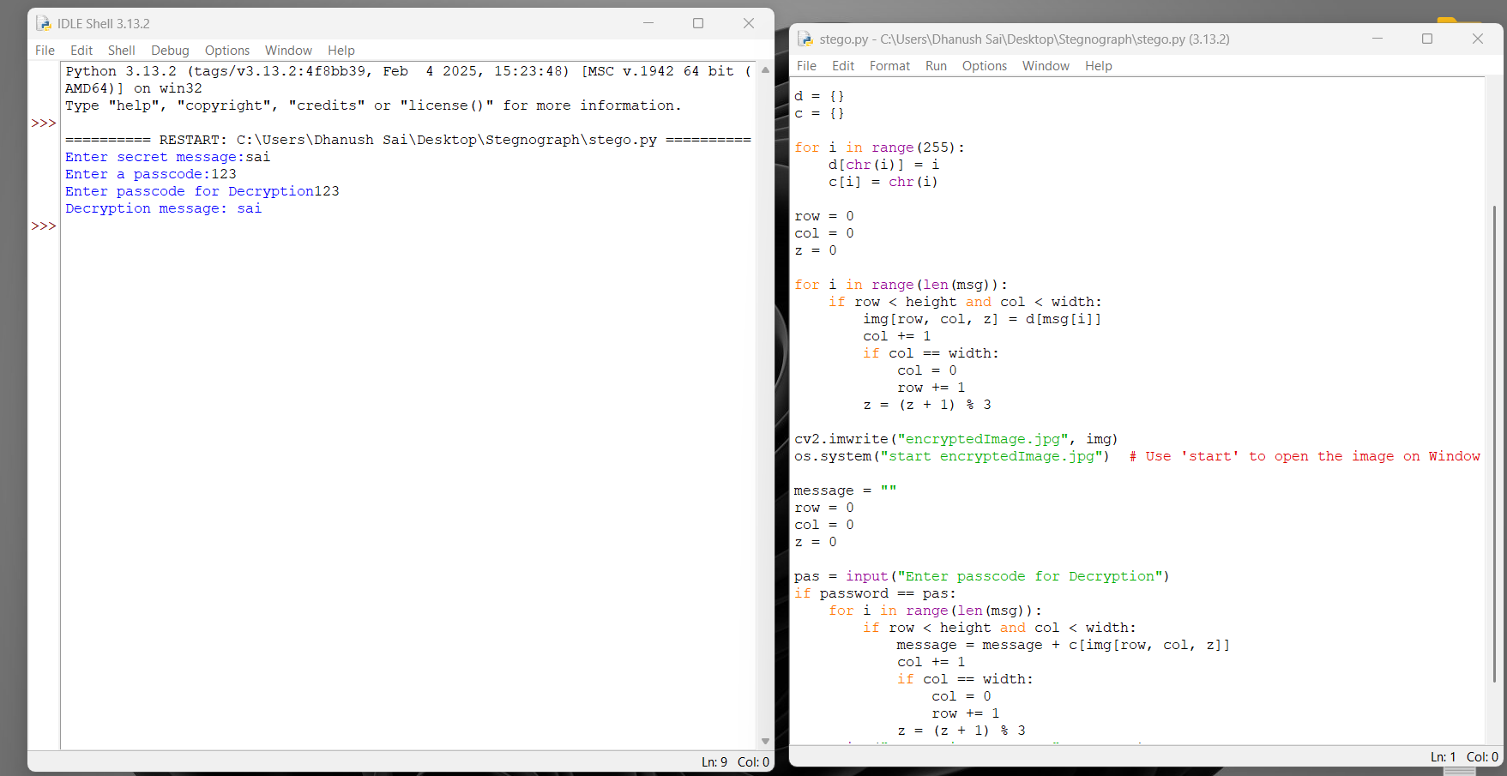
Results

Slide 8
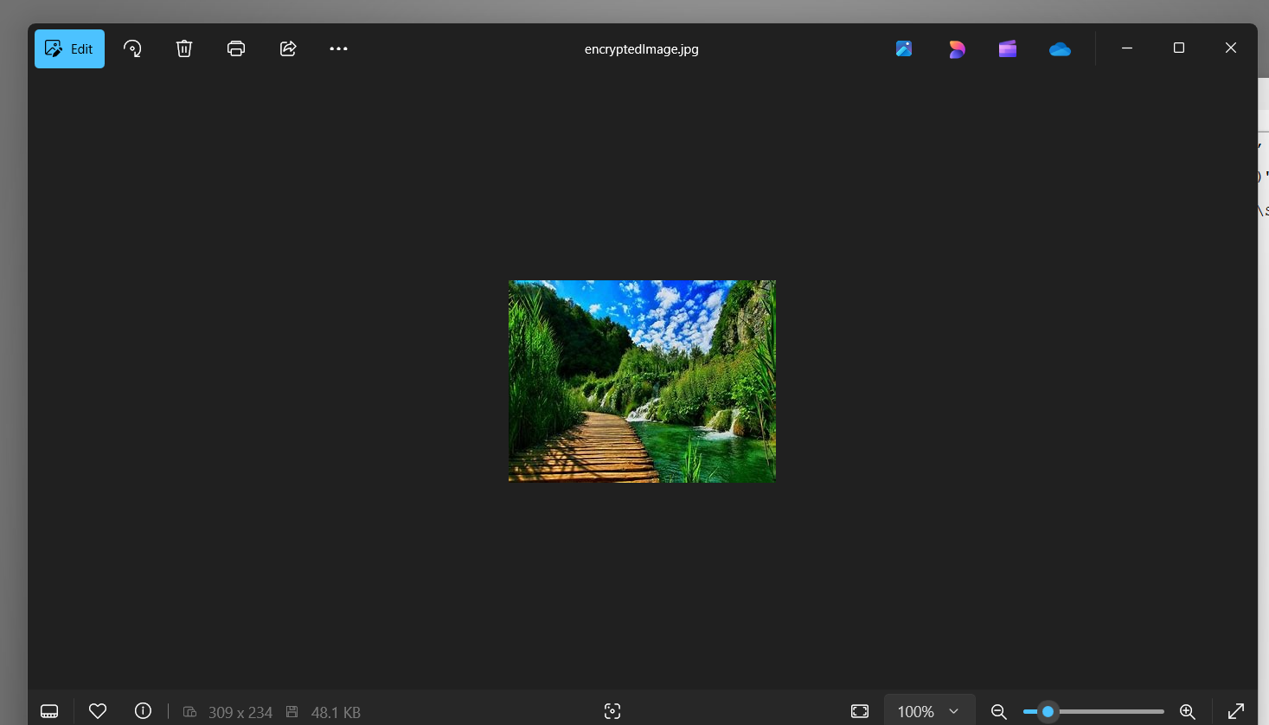

Slide 9
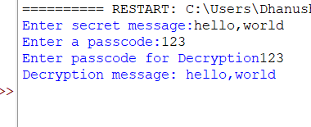

Slide 10
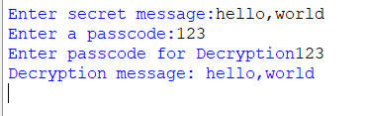

Slide 11
Conclusion
Conclude your project concerning your problem statement

Slide 12
GitHub Link
Make sure that there should be readme file

Slide 13
Future scope(optional)

Slide 14
THANK YOU

