Slide 1

Machine Learning-Powered Smart Agriculture System
CSCE 5612 Embedded Hardware/Software Design (Spring 2025)
Attur Prudhvilok (11817543), Patan Khaja Mukhit Ali Khan (11773782)
March 25, 2025

Slide 2
Project Overview
This Project aims to automate irrigation using sensors along with Machine learning and IoT technologies
Key Features:
Machine Learning decision making in irrigation
Remote monitoring and controlling through IoT
Prediction of power consumption, yield time and contamination possibilities

Slide 3
Simple Block Diagram Representation
Cloud/Edge Storage
Data collection through sensors (Moisture, Humidity, temperature and Camara)
Data Processing Unit/Decision making
(Raspberry pi 4)
5V Battery
12V Battery
Actuators
(Water pump, Humidifier, Air conditioner)

Slide 4
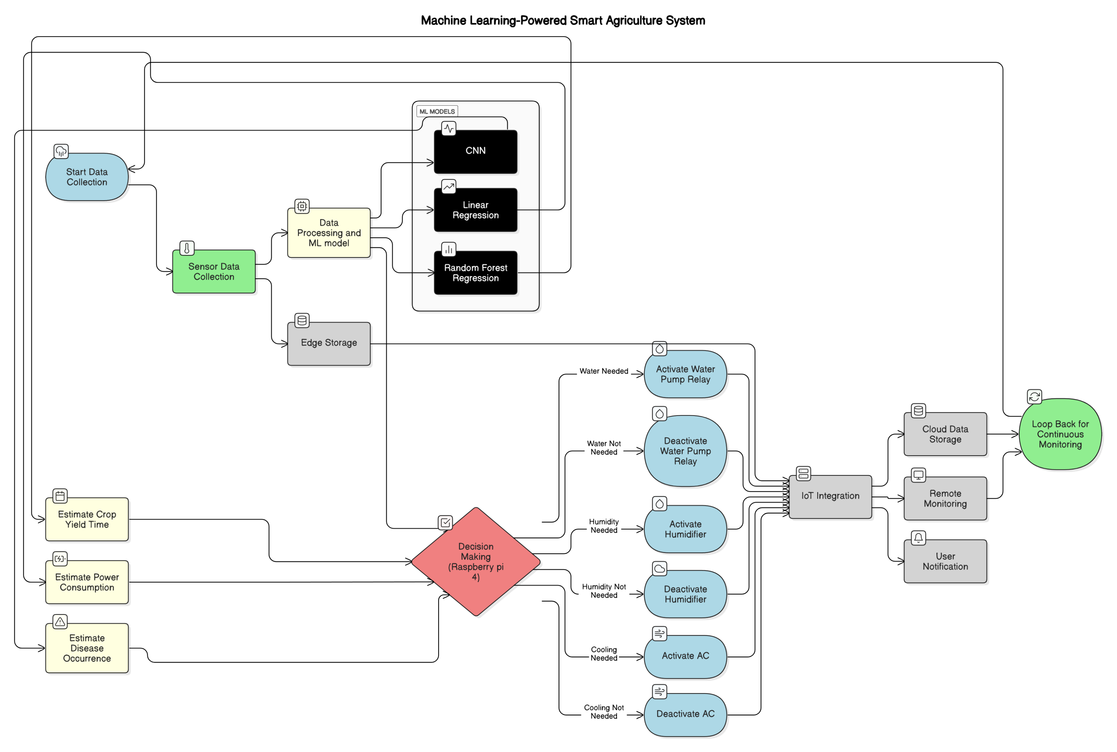

Slide 5
Hardware Component Selection
Components | Specifications & Justification
Raspberry Pi 4 | Quad-core 1.5 GHz, 4GB RAM, used for running ML algorithms and handling IoT communication.
Soil Moisture Sensor | Operating Voltage: 3.3-5V, Detects soil moisture level for irrigation decisions.
Temperature Sensor | DHT22, Accuracy: ±0.5°C, Measures ambient temperature to regulate AC.
Humidity Sensor | DHT22, Accuracy: ±2-5% RH, Controls humidifier operation.
Water Pump | 12V DC, Supplies water based on soil moisture readings.
Humidifier | 5V USB-powered, Increases humidity when needed.
Wi-Fi Module | ESP8266, Handles IoT connectivity for cloud data storage.

Slide 6
Power Consumption Analysis
Power Source:
5V USB power adapter
12V supply for the pump
Estimated Power Usage:
Raspberry Pi 4: ~3W
Sensors: ~1.2W total
Water Pump: ~5W (active only when needed)
Humidifier & AC: ~2.5W
Power Consumption Management Strategies:
Deep Sleep mode for sensors
Duty cycle optimization
Selected low power components
Load balancing in power supply

Slide 7
Communication & Data Flow
Sensor Data → Raspberry Pi (via I2C/GPIO)
ML Model Processing → Actuators (GPIO Control)
IoT Communication (MQTT over Wi-Fi) → Cloud Storage
Data Logging & Mobile Alerts → Real-time Monitoring

Slide 8

Integration Challenges & Solutions
Hardware Compatibility: Standard I2C/GPIO interfaces for easy integration.
Power Management: Low-power operation for sensors and actuators.
IoT Connectivity: Optimized MQTT messages to reduce bandwidth use.
Solution Implementation: Careful component selection and system tuning.

Slide 9

Conclusion & Next Steps
Finalizing the simulation model before hardware implementation.
Next milestone: Initial hardware testing and prototype refinement.
Future Work: Expand ML model for disease (contamination) detection and crop health monitoring.

