Slide 1
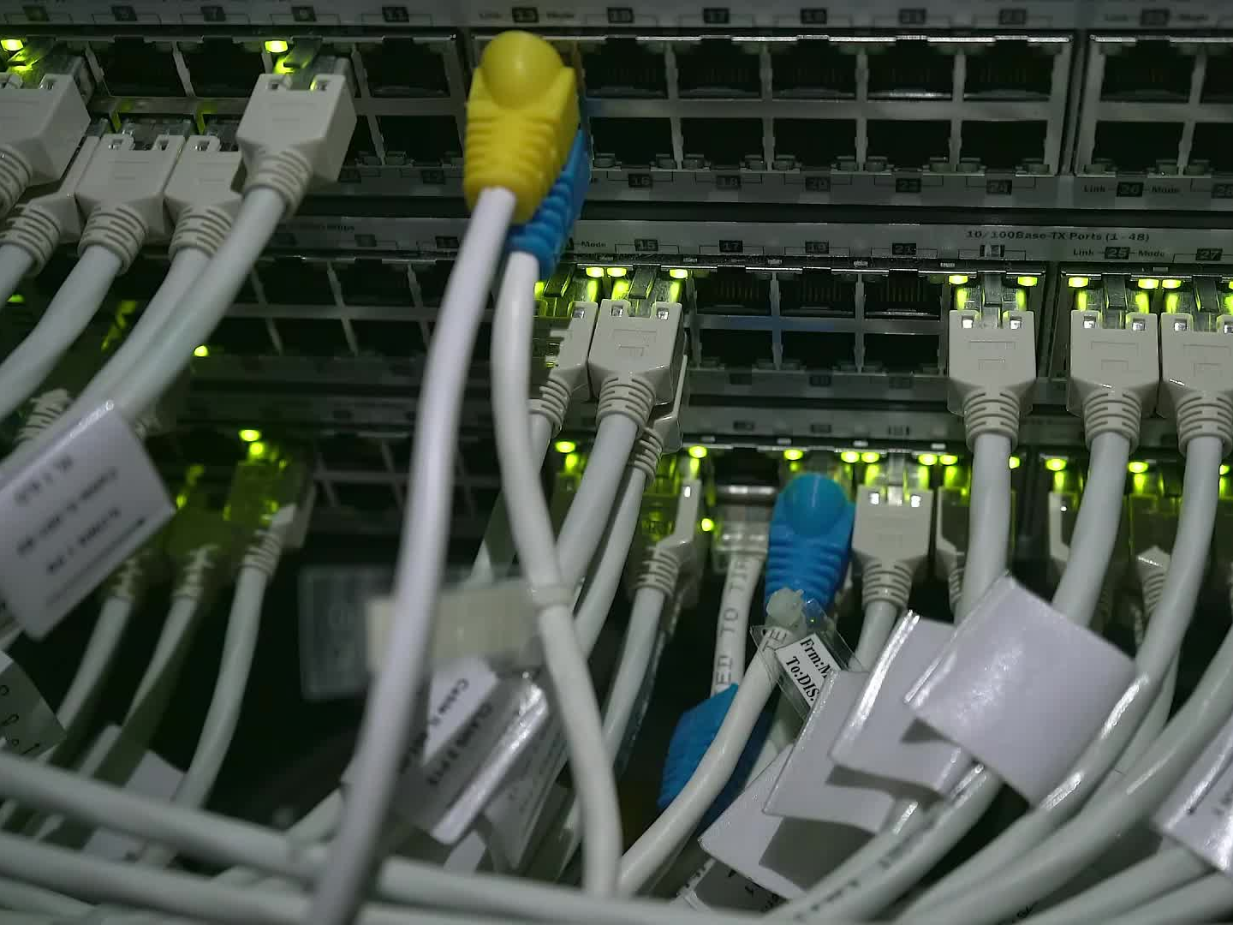
Network Port Monitoring Tool
Capstone Project

Slide 2
Project Overview
• Comprehensive network management tool
• Built with Python, PyQt5, and Matplotlib
• Real-time monitoring, data analysis, and reporting
• Visual and intuitive user interface

Slide 3
Project Design
• Frontend: PyQt5 for GUI
- Pages: Home, Data Analysis, Reports, Network Scanner, etc.
• Backend: Psutil for real-time network data
• Visualization: Matplotlib for graphical data analysis
• Modular and scalable architecture

Slide 4
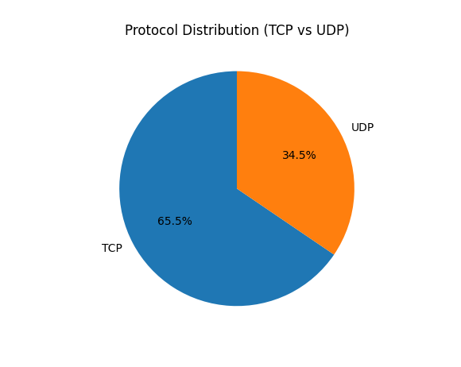
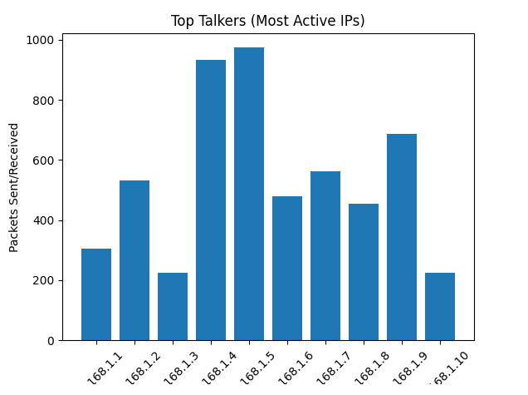
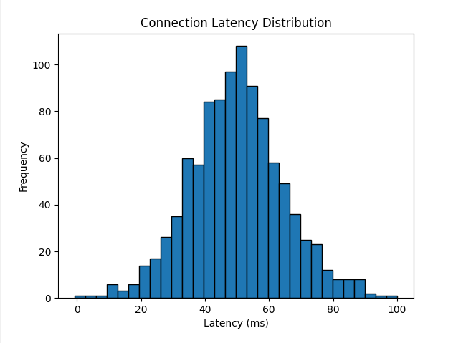
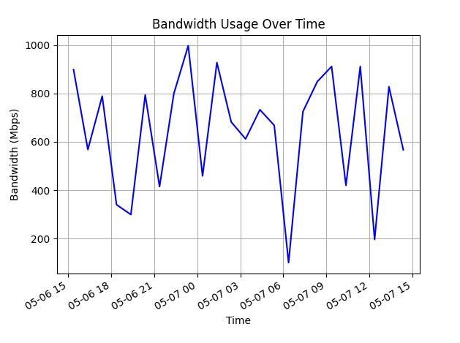
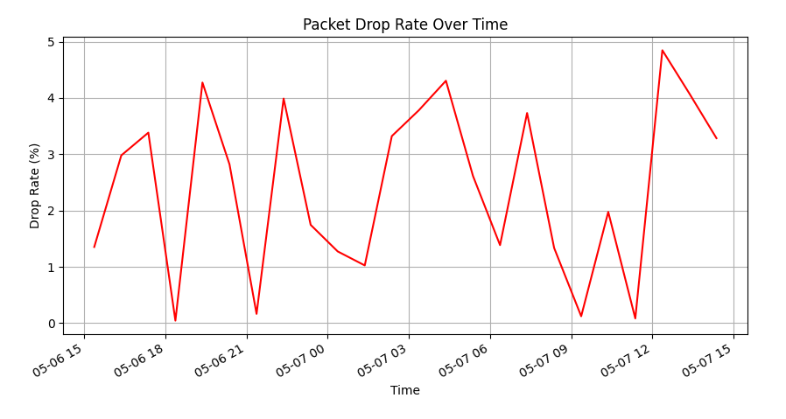
Data Analysis

Slide 5
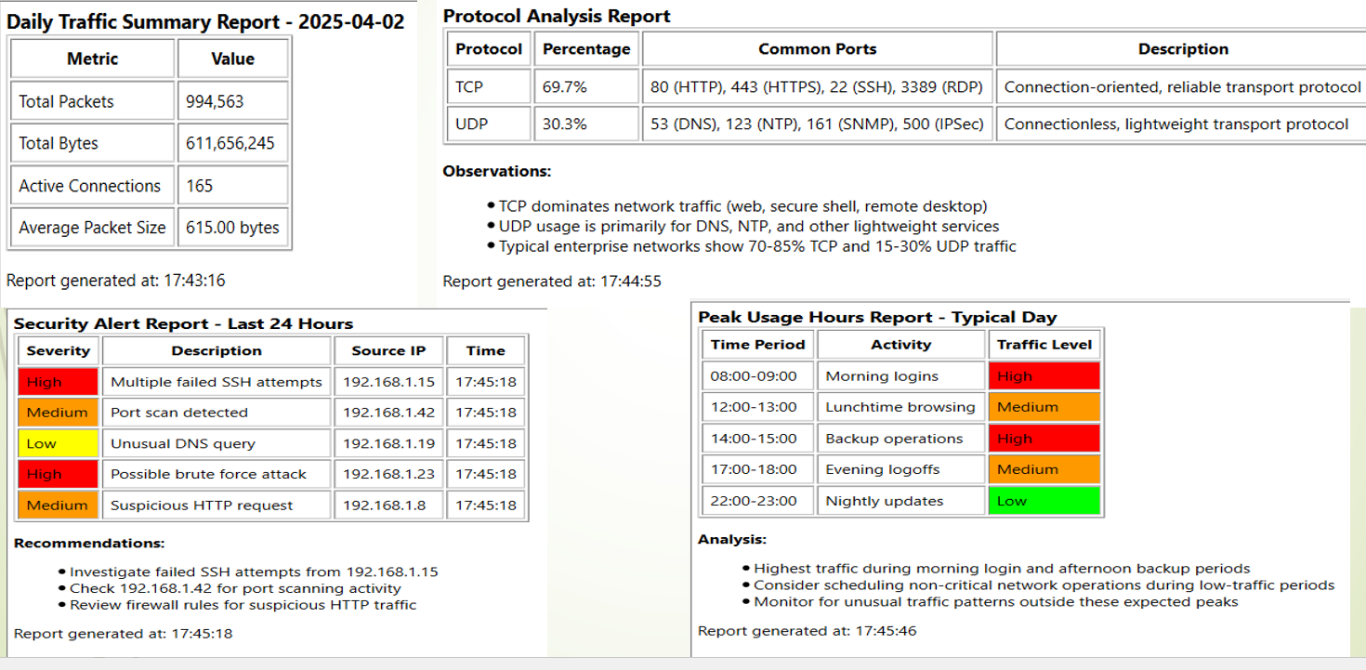
Reports

Slide 6
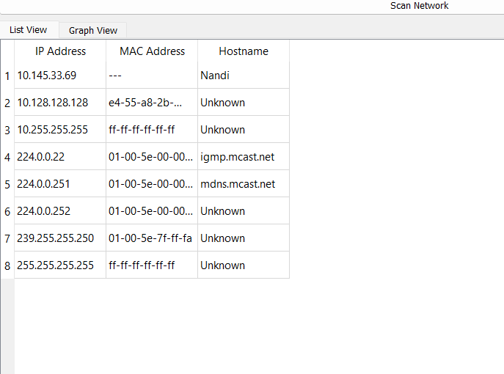
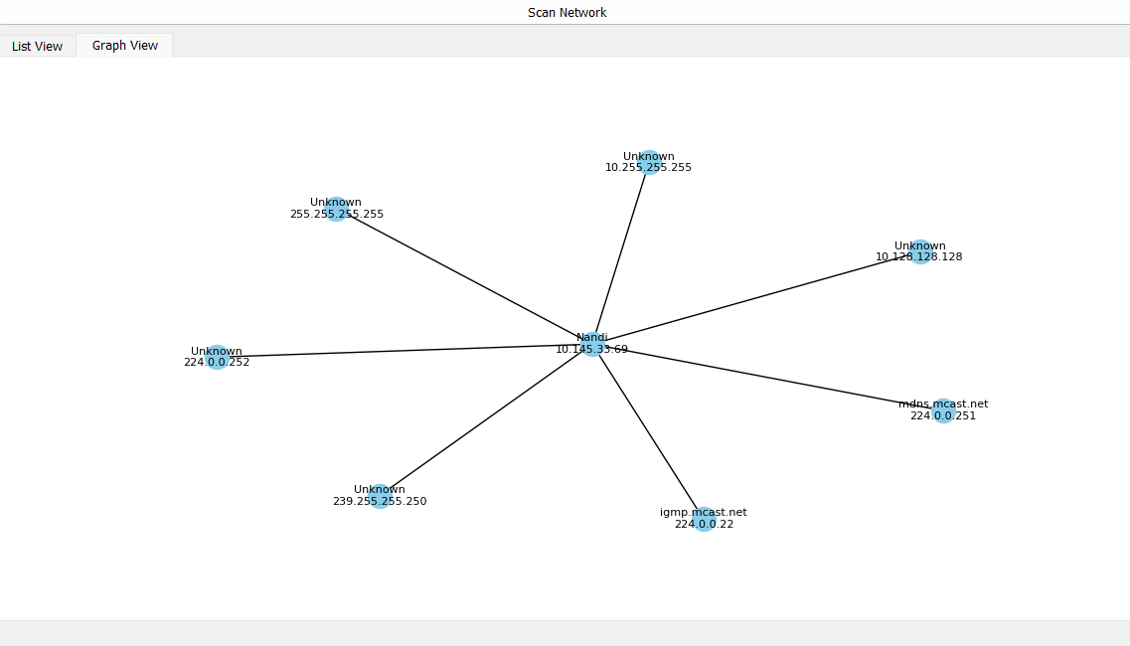
Network Scanner

Slide 7
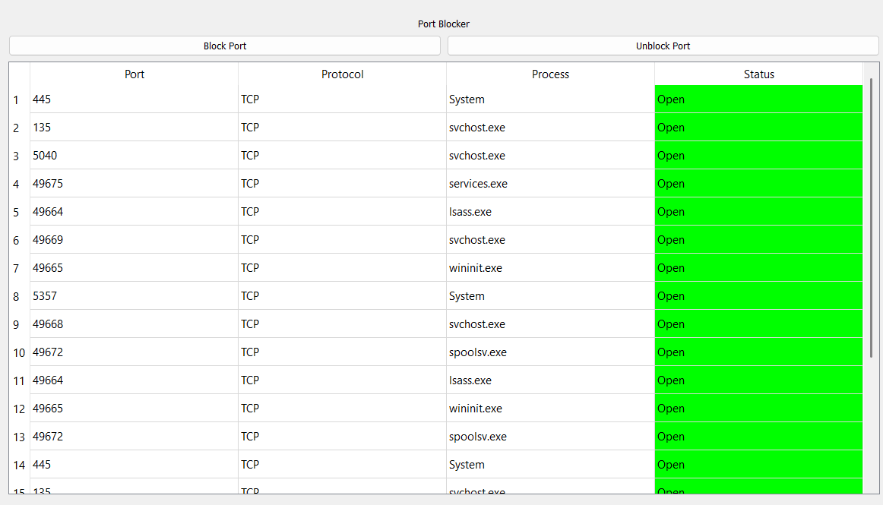
Port Blocker

Slide 8
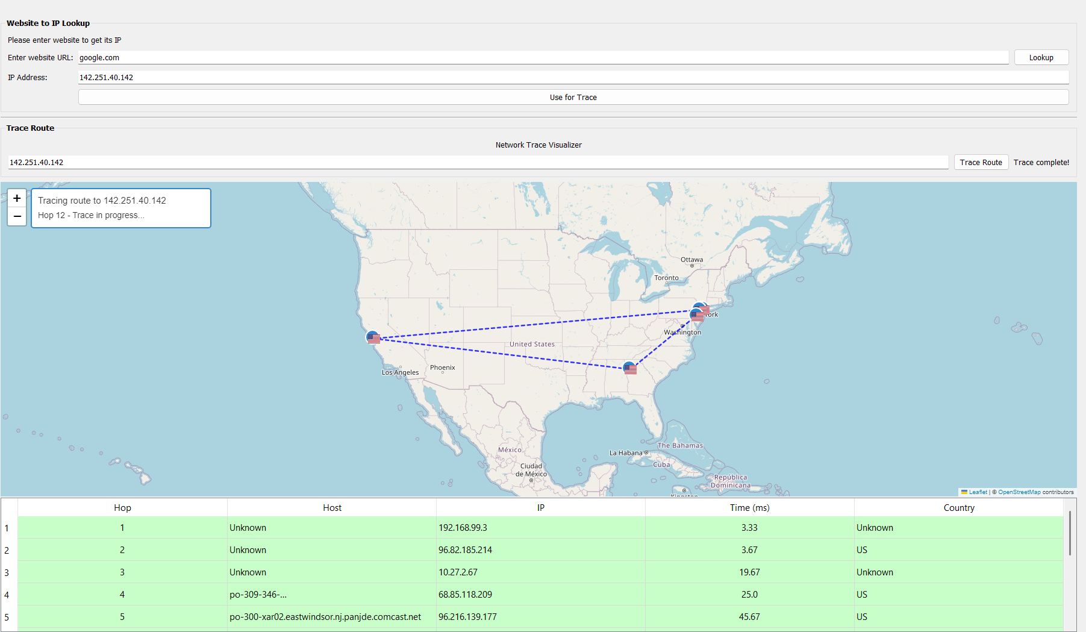
Network Trace Visualizer

Slide 9
Team Contributions
• Jashraj: Backend development and data collection
• Jay Patel: Data visualization and analysis
• Prudhvi: Frontend UI and Fixing Bugs
• Madhu: Reporting module implementation

Slide 10
Results and Feedback
• Enhanced real-time network visibility
• Effective detection on real-time network traffic analysis
• Simplified administrative tasks
• Positive user feedback on usability and functionality

Slide 11
Future Improvements
• Scalability for larger networks
• Cloud-based service integration
• Advanced analytics with machine learning
• Mobile platform support

Slide 12
Conclusion
• Integrated, user-friendly network monitoring tool
• Improved administrative efficiency
• Robust visualization and reporting capabilities
• Significant enhancement of network security

Slide 13

Thank You

