Slide 1
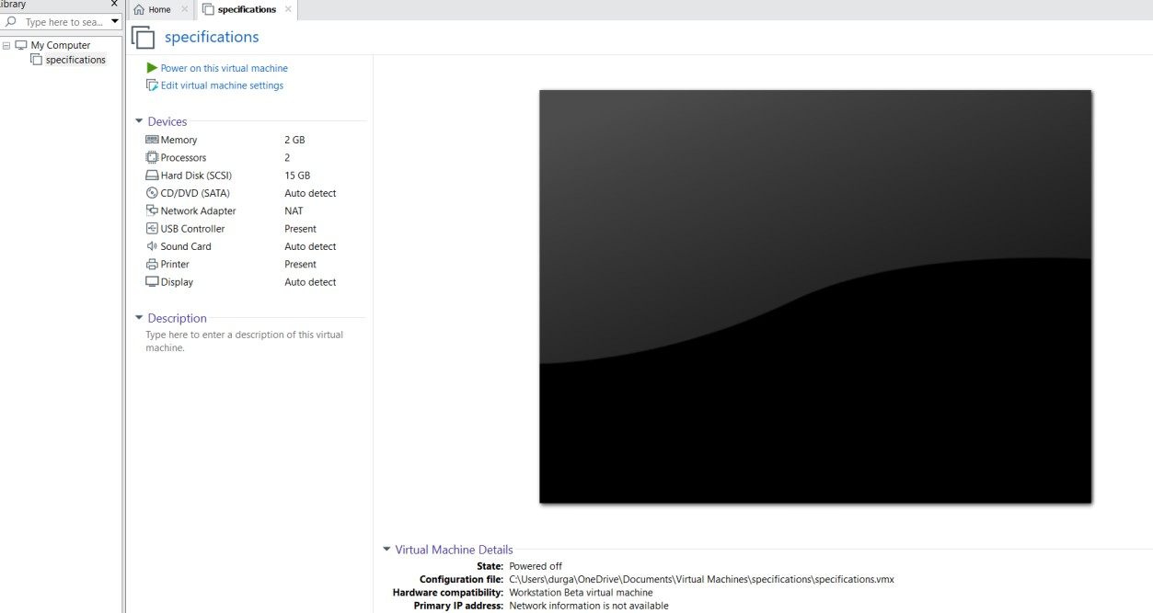
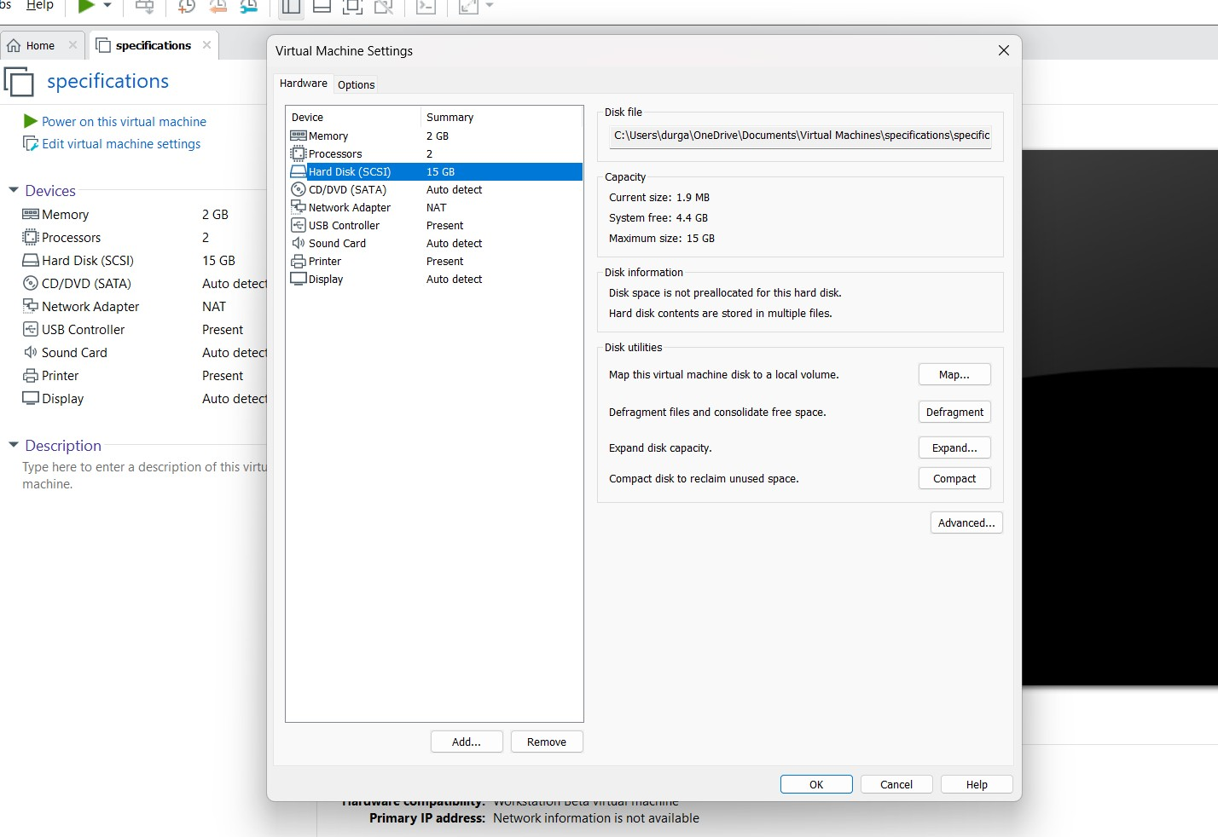
Experiment-8
Create a Virtual Hard Disk and allocate the storage using VM ware Workstation

Slide 2
