Slide 1
HOTEL MENU WITH AVAILABILITY ON LCD
GROUP-3
SHARAN-AM.EN.U4CSE12140
PRUDHVI-AM.EN.U4CSE12150
RAKESH-AM.EN.U4CSE11137
NANDINI-AM.EN.U4CSE12145

Slide 2
AIM
TO INTERFACE LCD WITH PIC MICRO-CONTROLLER.
TO STORE AND DISPLAY STRING USING PIC MICRO-CONTROLLER.
PIC 16F877A
LCD 16/2
SWITCHES
COMPONENTS USED

Slide 3
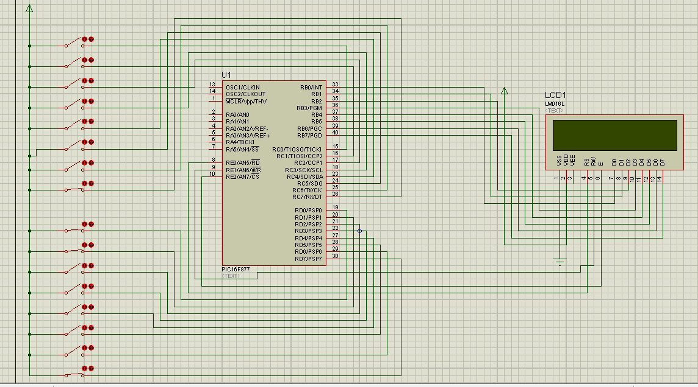
CIRCUIT DIAGRAM

Slide 4
ASM
CODE

Slide 5
Working States

Slide 6
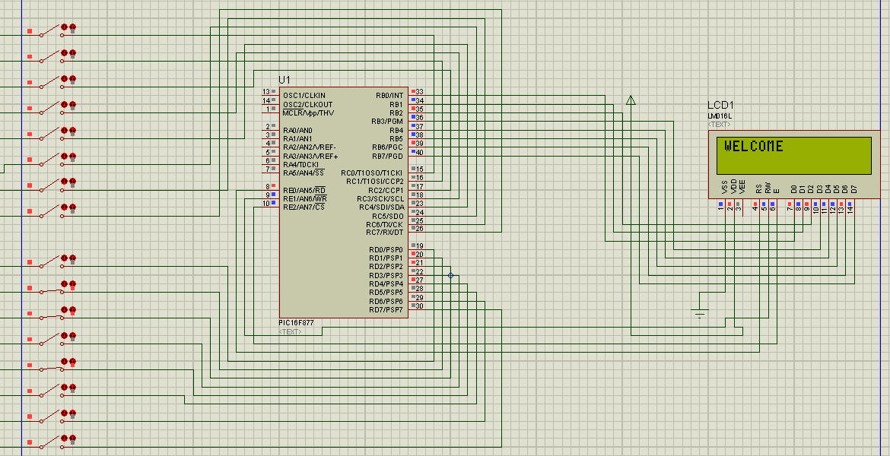
OUTPUT

Slide 7
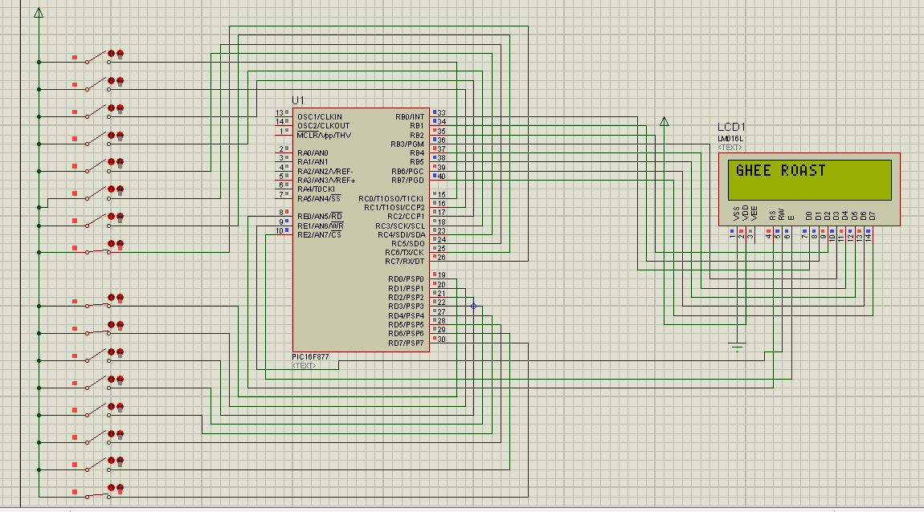

Slide 8
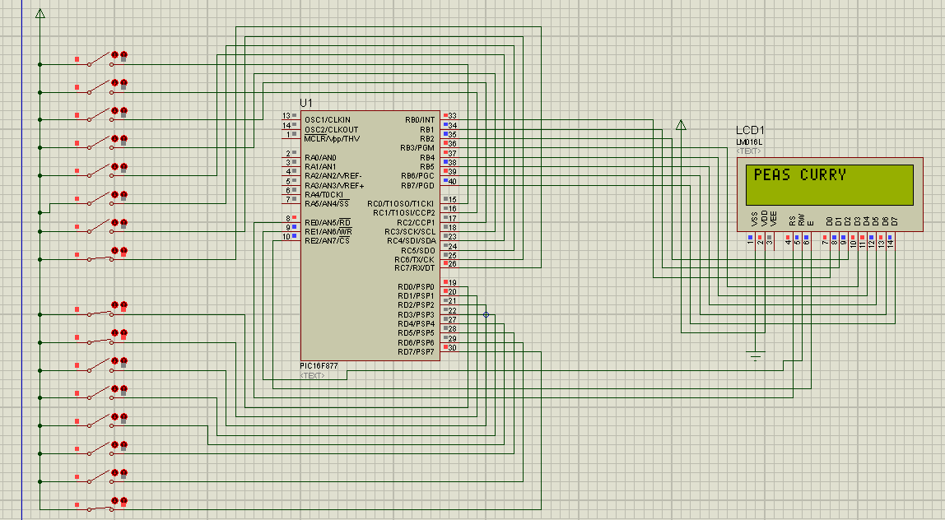

Slide 9
Pros and Cons
Advantages
Disadvantages
Easily changeable hotel menu board.
Cheap implementation .
Cannot add new items in the list.
Lengthy Program Code.

Slide 10
Further Scopes of improvement
Matrix keyboard to input new items.
Counter for each items.
Using interrupts to delete item.
Editable items stored in memory.

Slide 11
References
NPTEL (IIT-K)
Ramesh Gaonkar Introduction to Microcontroller

Slide 12
THANK YOU

